Slide 1

Quizz #5
Mardi 15 Janvier 2019

Slide 2
Question #1
What is the minimum thread depth of the wet tires ?
1,6mm
2,0mm
2,4mm
3,0mm
Notes:
68.6

Slide 3
Question #2
Steel springs calculations
Wire radius : 1,5mm
Mean spring radius : 15mm
50 loops
What is the stifness of such spring ?
38N/m
60N/m
600N/m
4860N/m

Slide 4
Question #3
Runner system between restrictor and throttle body is made up of rectangular cross-section with height 55mm. What is the possible width of the runner system?
60mm
50mm
55mm
65mm
Notes:
50mm

Slide 5
Question #4
What is the first natural frequency of the steel coil spring with spring rate (stiffness) 19500N/m, wire diameter 5mm, nominal spring diameter 30mm and 12 coils ?
158 Hz
168 Hz
178 Hz
198 Hz
Notes:
168Hz

Slide 6
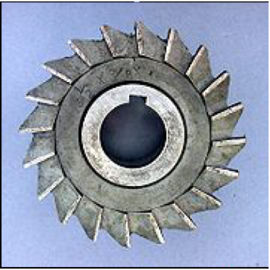
Question #5
Identify the type of milling cutter shown in the figure above
Slot drill
End mill
Side and face cutter
Shell end mill cutter
Notes:
50mm

Slide 7
Question #6
What is the minimum load that the monocoque attachments points for shoulder and lap belts must support before failure?
13kN
6.5kN
19.5kN
17kN
Notes:
168Hz

Slide 8
Question #7
The impact attenuator must be attached to provide load paths in case of off-centre and off-axis impacts for:
Shear and transverse
Vertical and shear
Transverse and axial
Transverse and vertical loads
Notes:
10.5

Slide 9
Question #8
STATEMENT 1-Aluminium wheel nuts may be used, but they must not be hard anodized. STATEMENT 2-A single brake acting on a limited –Slip diffential is not acceptable. STATEMENT 3-Transponders will be provided by FSG.
Only statement 1 is correct
Only statement 2 is correct
Only statement 3 is correct
All are correct
All of them are wrong
Notes:
31%

Slide 10
Question #9
A team completes a skid pad run in 4 sec. What is their lateral acceleration ?
1.65
1.7
1.58
NONE of the above
Notes:
31%

Slide 11
Question #10
The average piston speed for a given motorcycle engine undergoing speed test is 914.4m/min and the corresponding speed at the crankshaft was found to be 5000rpm.The approximate stroke length of the piston is?
8cm
9cm
10cm
11cm
Notes:
31%

