Slide 1

Quizz #4
Mardi 18 Décembre 2018

Slide 2
Question #1
What is the minimum thread depth of the wet tires ?
1,6mm
2,0mm
2,4mm
3,0mm
Notes:
68.6

Slide 3
Question #2
Which of those assertions is true ?
The upper member must connect the main hoop and the front hoop. It must be at a height between 250mm and 320mm above the lowest inside chassis point between the front and main hoop.
The upper member must connect the main hoop and the front hoop. It must be at a height between 240mm and 320mm above the lowest inside chassis point between the front and main hoop.
The upper member must connect the main hoop and the front hoop. It must be at a height between 320mm and 240mm above the lowest inside chassis point between the front and main hoop.
The upper member must connect the main hoop and the front hoop. It must be at a height between 240mm and 320mm above the lowest inside chassis point between the front bulkhead and main hoop.
Notes:
Suspension

Slide 4
Question #3
How many degrees of freedom has one isoparametric quadratic tetrahedron finite element ?
30
20
25
10
Notes:
50mm

Slide 5
Question #4
Which of the followings are important for Business Plan Presentation judging ?
None of the following statement are correct
Plan must relate to specific prototype, actual quality of prototype itself does matter
Plan must relate to specific prototype, actual prototype should be presented live to judges
Plan must relate to specific prototype, actual quality of prototype itself does not matter
Notes:
150mm

Slide 6
Question #5
On a three lane motorway there is a speed limit of 80kph in a construction site. Three cars are driving parallel with this speed. One has a 2.0L naturally aspired gasoline engine with 200 Nm torque @ 4000rpm. The second has a 2.0 turbodiesel with 400Nm torque @2000rpm. The third has a 1.6L naturally aspired gasoline engine with 90kW @ 7000rpm. As the speed limit ends all drivers have selected a gear ratio so that the engines are revving at the above mentioned speed, and push the accelerator fully. Which car has the best initial acceleration ? (transient behavior is not regarded)
Car 1
Car 2
Car 3

Slide 7
Question #6
What kind of post processing is not allowed to remove acceleration spikes from the IAD data ?
10ms FIR Filter (ISO-19575)
3rd Order 100Hz lowpass Butterworth
Class 60 filter (SAE-J211)
Any of the previous ones
None of those can be used
Notes:
A

Slide 8
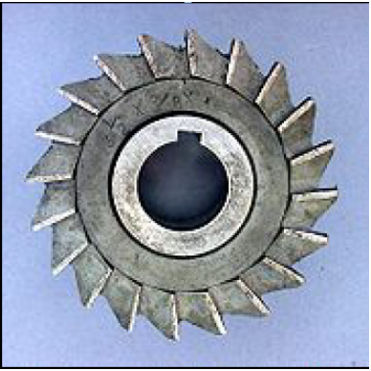
Question #7
Identify the type of milling cutter shown in the figure above
Slot drill
End mill
Side and face cutter
Shell end mill cutter
Notes:
50mm

Slide 9
Question #8
The firewall must cover any line of sight between the parts mentioned in T 4.8.1 and any part of the tallest driver :
below a plane 50 mm above the bottom of the helmet.
below a plane 100 mm above the bottom of the helmet.
below a plane 100 mm above the top of the helmet.
below a plane 100 mm above the bottom of the headrest.
Notes:
168Hz

Slide 10
Question #9
With an “upright driving position”, in side view the lap belt must be at an angle of between :
40° and 60 to the horizontal
35° and 45° to the vertical
45° and 65° to the vertical
50° and 70° to the horizontal
Notes:
10.5

Slide 11
Question #10
With "Pro-Ackermann" Steering the steering angle is bigger on the outer wheel.
True
False
Not related with the steering handle
Notes:
31%

