Slide 1
Customer Churn Prediction Project
Phase 3 – Machine Learning
Objective: Identify customers at risk of leaving before they churn
Team: Customer Success & Retention Analytics

Slide 2
Business Problem & GOAL
Business Problem:
Losing customers reduces revenue and increases acquisition costs
Retaining customers is more cost-effective than acquiring new ones
Goal:
Use data to proactively identify at-risk customers
Enable retention teams to take targeted actions

Slide 3
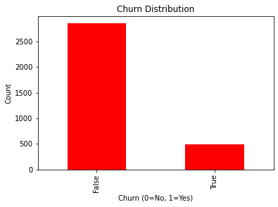
Graphical presentation of customer churning vs not churning

Slide 4
Models TO BE Tested
Model | Type | Notes
Logistic Regression | Linear | Baseline, interpretable
Decision Tree | Rule-based | Easy to explain
Random Forest | Ensemble | High precision
Gradient Boosting | Ensemble | Best balance of recall & precision

Slide 5
KEY METRICS TO BE USED TO MEASURE SUCCESS
Accuracy: Overall correctness of the model
Precision: When we flag a customer as at risk, how often are we correct?
Recall: Out of all customers who actually churn, how many did we correctly identify? (Most important for business)
F1-Score: Balance between precision and recall
AUC: Overall ability to separate churners from non-churners

Slide 6
ACCURACY_SCORE COMPARISON
Model | Accuracy
Logistic Regression | 85.5%
Decision Tree | 88.8%
Random Forest | 93.2%
Gradient Boosting | 93.2%

Slide 7
RECALL_SCORE COMPARISON
Model | Recall
Logistic Regression | 17.8%
Decision Tree | 59.5%
Random Forest | 57.9%
Gradient Boosting | 61.6%
Business Insight:
Catching more at-risk customers prevents revenue loss
Gradient Boosting identifies the largest share of churners

Slide 8
Precision (Reliability of Alerts)
Model | Precision
Logistic Regression | 50.6%
Decision Tree | 61.8%
Random Forest | 92.7%
Gradient Boosting | 86.1%
Business Insight:
Random Forest is highly reliable when it flags churners
Fewer unnecessary retention actions

Slide 9
F1-Score (Balanced Performance)
Model | F1-Score
Logistic Regression | 0.263
Decision Tree | 0.606
Random Forest | 0.712
Gradient Boosting | 0.718
Business Insight:
Gradient Boosting provides the best overall balance between detecting churners and minimizing false alarms

Slide 10
AUC (Overall Model Strength)
Model | AUC
Logistic Regression | 0.830
Decision Tree | 0.766
Random Forest | 0.906
Gradient Boosting | 0.913
Business Insight:
Gradient Boosting is the strongest at distinguishing churners from non-churners

Slide 11
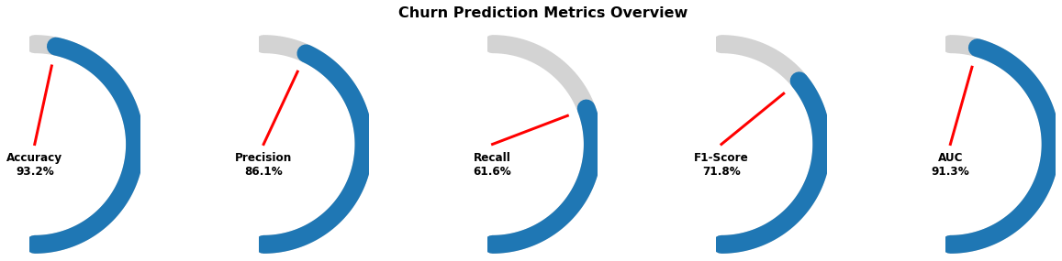
Churn Prediction Metrics Overview

Slide 12
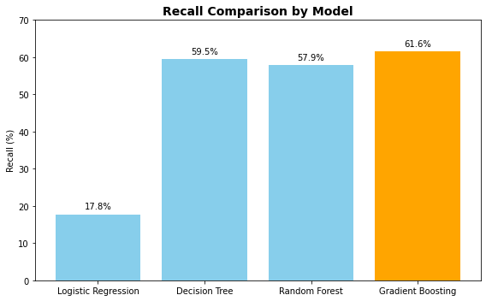
RECALL COMPARISON BY MODEL

Slide 13
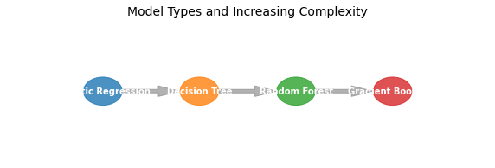
Model type and increasing complexity

Slide 14
Limitations
Class Imbalance: Some churners may still be missed
Threshold Dependence: Results vary depending on the probability cut-off
Feature Limitations: Missing external factors like competitor offers or customer sentiment
Complexity: Ensemble models are less interpretable than simple Decision Trees
Overfitting Risk: High-performance models may need careful monitoring for generalization

Slide 15
Recommendations
Deploy Gradient Boosting for proactive churn identification
Rank high-risk customers by predicted probability for targeted retention
Integrate predictions into CRM for real-time alerts
Adjust thresholds as business priorities shift
Explore future enhancements: additional features, resampling, or alternative ensembles

Slide 16
Business Impact
Identify ~62% of churners before they leave
Prioritize high-risk customers for retention campaigns
Reduce revenue loss and increase customer lifetime value
Enable data-driven, proactive decision-making

