Slide 1
Online Shoppers Purchasing Intention

Slide 2
Objective
Find out consumption patterns
Finds out variables that related to sales
1
2
Find out consumers patterns
Identify factors that can improve to help sales growth
4
3
The goal is to improve company’s performance and increase sales

Slide 3
Exploratory Data Analysis
Data Convert
For example, convert the month from string to integer. Then we identify how many rows and columns in the data set
ROWS
12330 rows
COLUMNS
18 columns

Slide 4
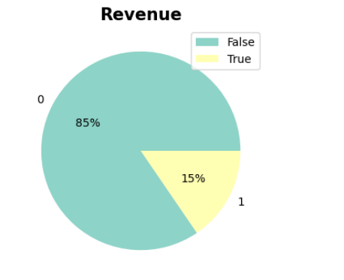
Identify key variables contribute to sales
1
2
“Revenue” is the key variable that we want to study
Use pie chart to describe how many rows are related to sale counts
3
4
False means other variable and
True means the rows related to sales count
Result: 15% of the variables are useful for us to analyze the sales performance

Slide 5
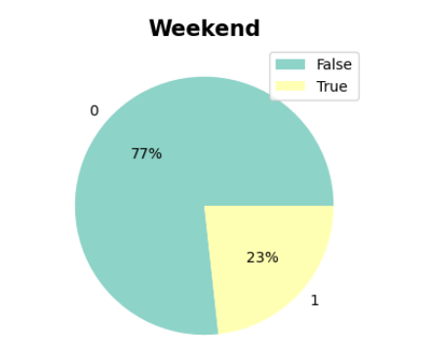
Identify key variables contribute to sales
1
2
To find out the purchase patterns by date
Use pie chart to describe how many visit numbers in weekend
3
4
Results: Weekdays have a higher visit record
Only 23% of visit counts in weekend
False means the visit numbers during weekdays
True means the visit number during weekend

Slide 6
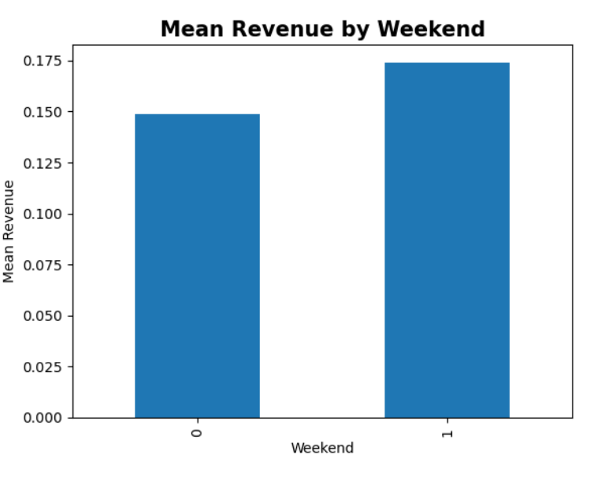
Identify key variables contribute to sales
Hence, it is reasonable to predict weekdays can make more sales by the previous slide
0 is the mean revenue made in weekend, 1 is the weekdays revenue
The mean of weekday are slightly stronger than the mean of revenue generated in weekend
Echoed to the prediction, but no dramatic gap even weekdays visit are 77%

Slide 7
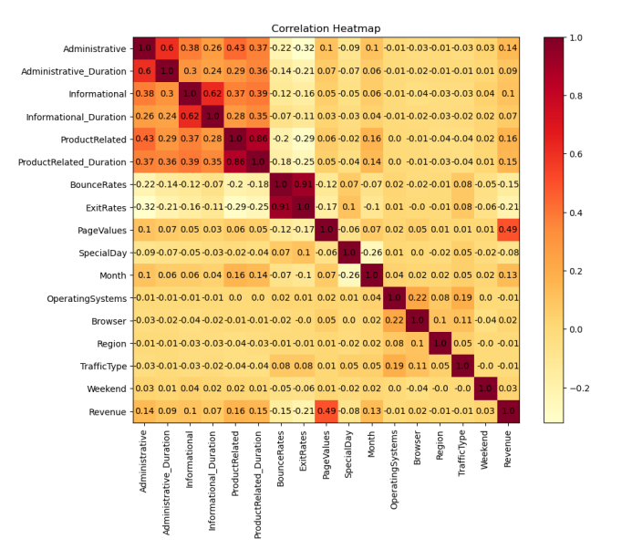
Identify key variables contribute to sales
Heatmap
To test the correlation between Revenue and other variables
Findings
Most variables are not correlated
Revenue and page values are positively correlated
: page value means the average value for a web page that a user visited before completing an e-commerce transaction

Slide 8
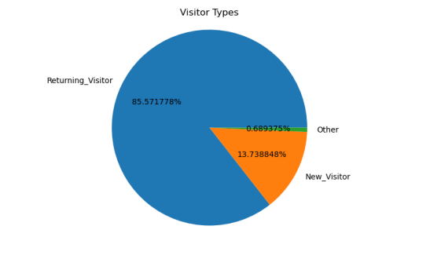
2. Find Consumers pattern
Customer loyalty
Customer loyalty is also important for a company sales and marketing purpose
Pattern
There are three types of website visitors:
New
Return
Other
Result
85% are returning visitors, so we may say that we have a good customer loyalty that majority of they will return to us

Slide 9
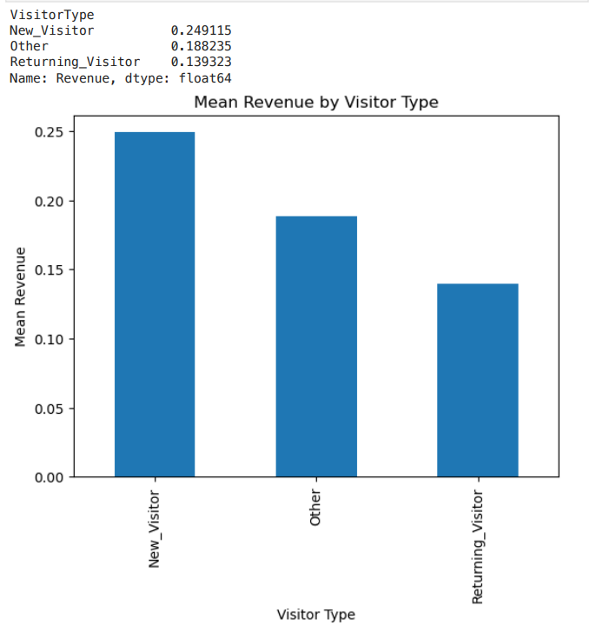
3. Find purchase Pattern
Yet, another interesting finding is that the new visitors contribute a higher sales volume than the returning visitors
New visitors 13% of our total customers but contribute nearly one-third of our business
While we have a quite good result in customer relationship that 85% of our customers are returning customers

Slide 10
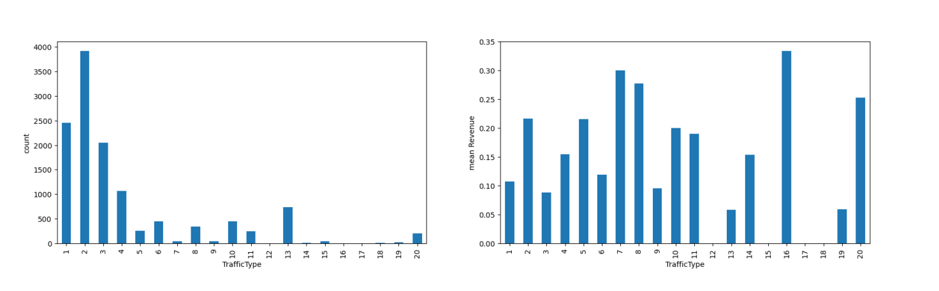
3. Find Purchase Pattern
We see at the traffic type that see how many sources they had been through and made purchase decision. The graphs do not have any obvious patterns and meaningful insight bring to us.

Slide 11
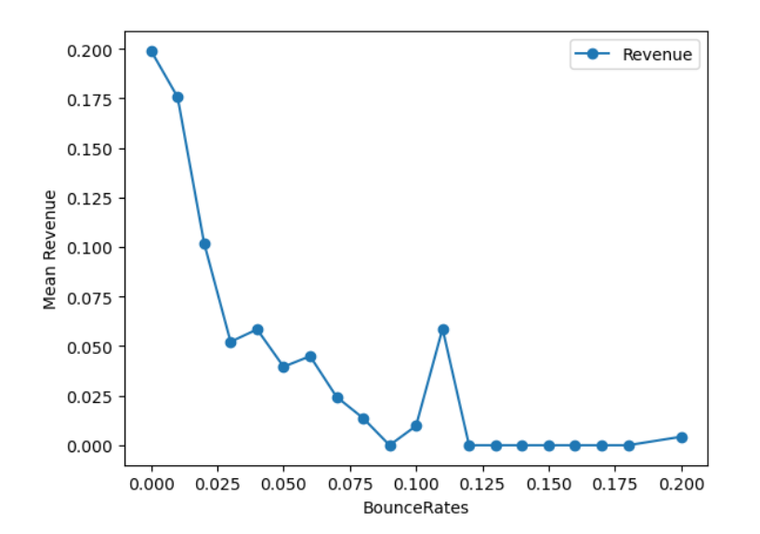
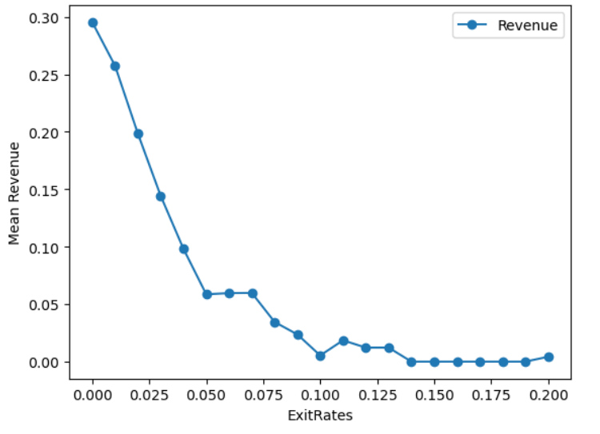
3. Find Purchase Pattern
Exit rates and bounce rates are similar. They are sort of negatively correlate to revenue, the higher the rate, the fewer revenue will be generated

Slide 12
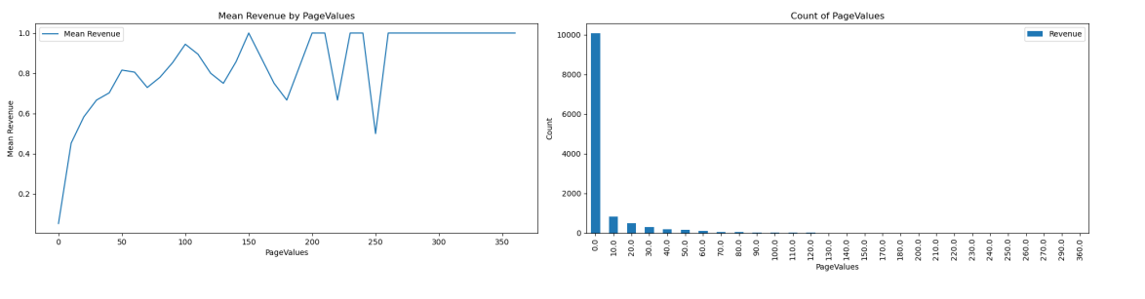
4. Factor that benefits to sales
From previous heatmap, we see there is correlation between page values and revenue.
We can see the more page values, the more revenue generated until 50 page values.
It implies that we need to accurately suggest the products that consumer needs, if they need to filter too many pages, it drops their intention to purchase.

Slide 13
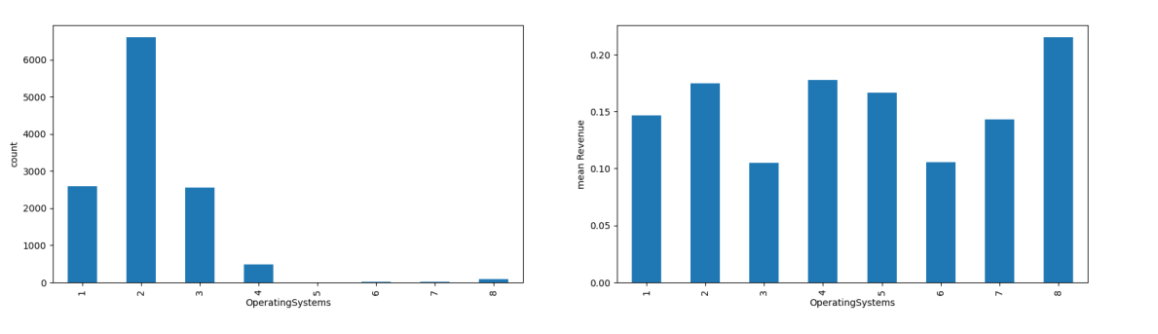
4. Factor that benefits to sales
“operating system” refers to the software that manages the hardware and software resources of a computer or mobile device.
Mainly operating system 1,2 ,3 have high frequency of usage.
It is suggested the company can input more resource in maintenance and improvement for these three operating system.

Slide 14
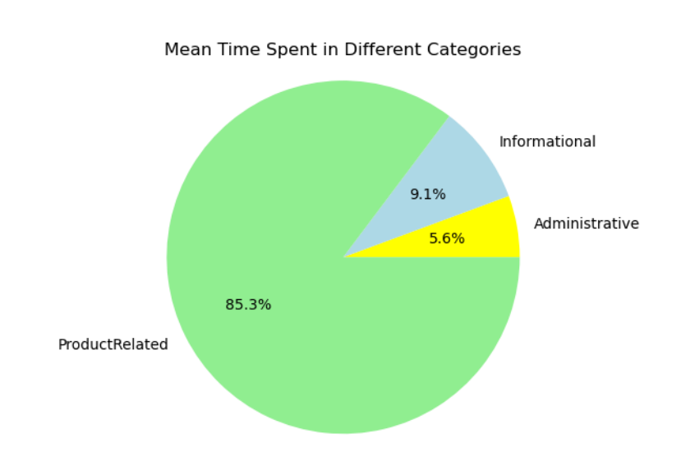
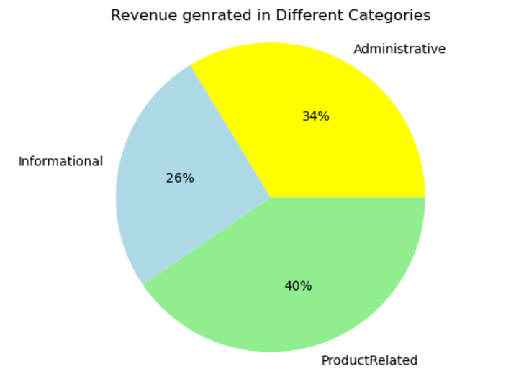
4. Factor that benefits to sales
Product Related
Mean time spent in different categories
Informational
85.3%
9.1%
Implications:
Although the time spent on informative and administrative categories are very short
They contribute 26% and 34% of revenue accordingly even with just a small proportion in time spent
So we also need to keep an eye on these two categories when we are improving our website
Administrative
5.6%
Revenue generated in different categories
Informative
Administrative
26%
34%
Product Related
40%

Slide 15
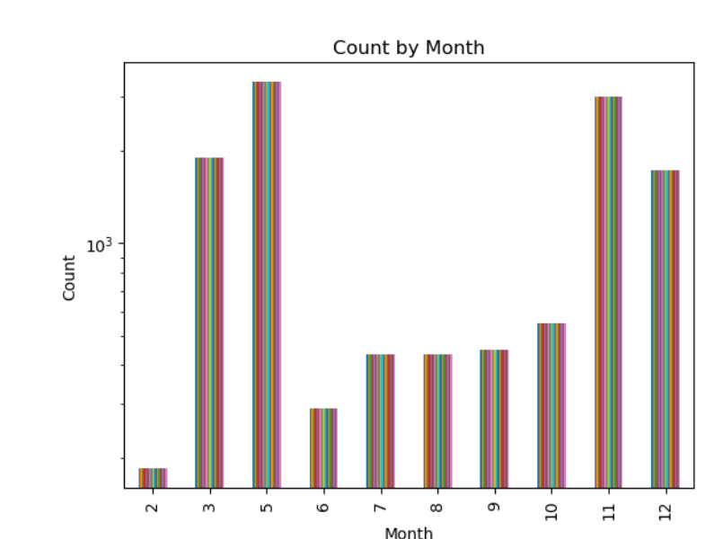
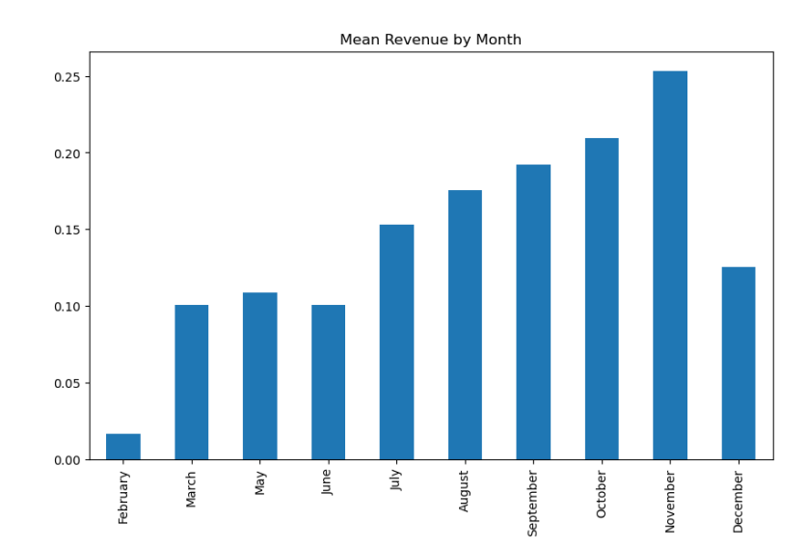
4. Factor that benefits the sales
March, May, October, November, December have high counts of purchases and the highest mean of revenue was come from November
It may due to the Black Friday Sales, so month and festivals are important factors, our consumer may to assume as price sensitive

Slide 16
Data Mining
Pre-processing
Model Training
Post-processing

Slide 17
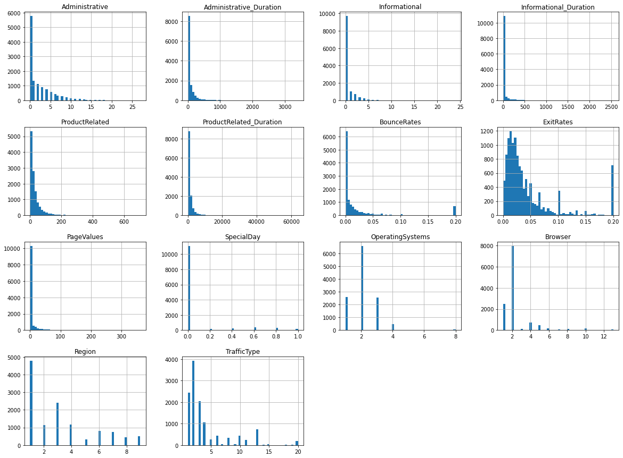
Data Pre-processing
Data is not evenly distributed.

Slide 18
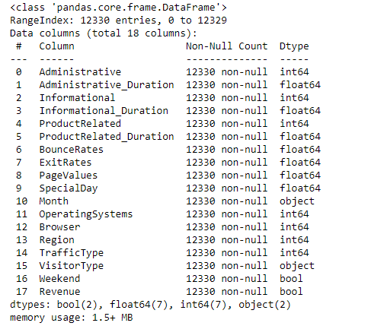
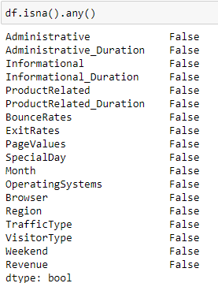
Data Pre-processing

Slide 19
Data Pre-processing
Dummy Encoding
1
LabelEncoder()
LabelEncoder places numeric values from categorical variables so that Scikit Learn can process the data.
Feature Scaling
2
StandardScaler()
Used StandardScaler() to scale the data. Standardise the features by subtracting the mean and dividing by the standard deviation, making it less sensitive to outliers.

Slide 20
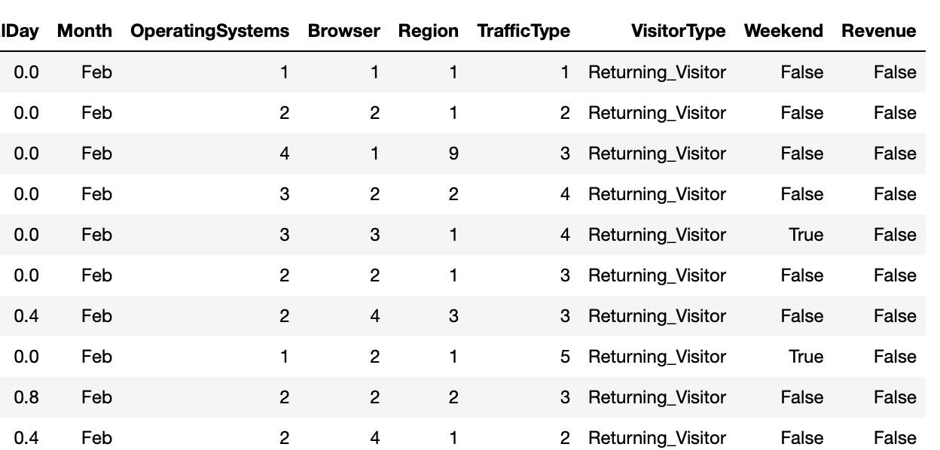
Data Pre-processing: LabelEncoder()
categorical variables
↓
value between 0 and n_classes-1

Slide 21
Data Pre-processing
StandardScaler() -> To standardize data set
Decision Tree -> no
Logistic & KNN -> yes

Slide 22
Data Pre-processing
Set Revenue: 0 (Not sold), 1 (Sold)
Find NAs
No columns dropped - all potentially relevant
Provide dummies to categorical variables
Transformed skewed columns
Split data into train/test sets

Slide 23
Modeling Training
Decision Tree
No standard scaler
Logistic Regression
Standard scaler
KNN Regression
Standard scaler

Slide 24
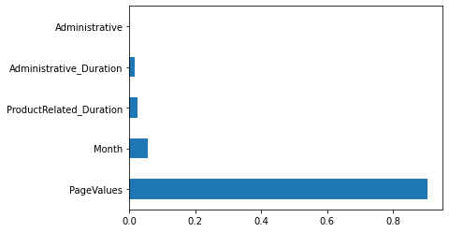
Use GridSearchCV on Decision Tree Model
Best Parameters: {'criterion': 'entropy', 'max_features': 9, 'min_samples_leaf': 700, 'random_state': 5}
Best CV score: 0.892

Slide 25
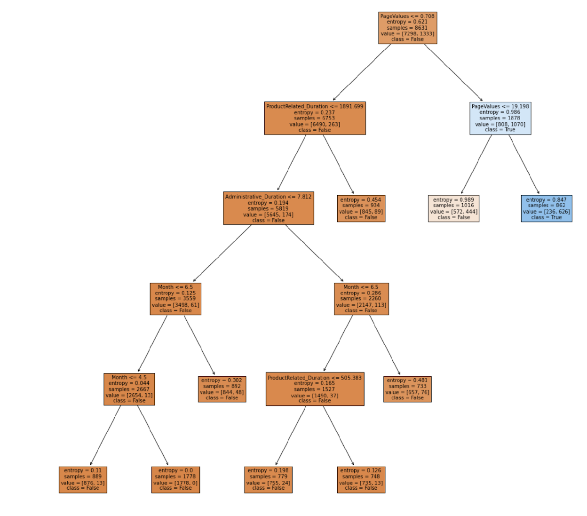
Use GridSearchCV on Decision Tree Model
DecisionTreeClassifier(criterion='entropy', max_features=9, min_samples_leaf=700, random_state=5)
Training performance: 0.891
Generalisation performance: 0.885

Slide 26
Use GridSearchCV on Logistic Regression Model
Best Parameters: {'C': 0.001, 'penalty': None, 'random_state': 5}
Best CV score: 0.886
Intersect: array([-2.25343107])
Coefficients: array([[-4.86534444e-02, -1.04054000e-02, 7.13478850e-02,
-4.52704203e-04, 8.74404543e-02, 1.63608773e-01,
-1.30492005e-01, -7.89645677e-01, 1.49080564e+00,
-2.34221139e-01, 2.64153526e-01, -1.38749430e-01,
5.09311305e-02, -4.95787374e-02, 3.53132004e-02,
-1.06261583e-01, 3.29204882e-02]])
Independent Variables: array(['Administrative', 'Administrative_Duration', 'Informational',
'Informational_Duration', 'ProductRelated',
'ProductRelated_Duration', 'BounceRates', 'ExitRates',
'PageValues', 'SpecialDay', 'Month', 'OperatingSystems', 'Browser',
'Region', 'TrafficType', 'VisitorType', 'Weekend'], dtype=object)
Training performance: 0.887
Generalisation performance: 0.881

Slide 27
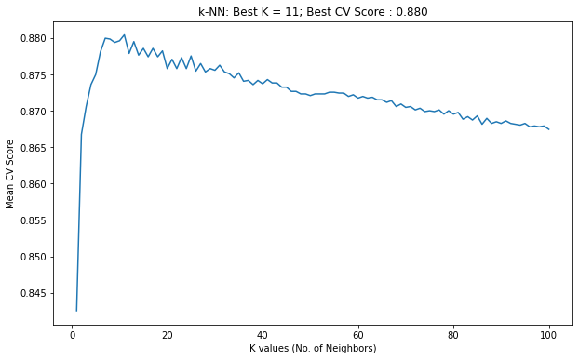
Use GridSearchCV on K-Number Neighbors Model
Best Params: {'n_neighbors': 11}
Mean cv score of the best k: 0.880
Training data performance: 0.888
Generalisation performance:0.880

Slide 28
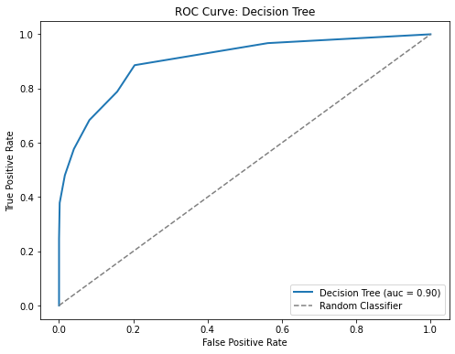
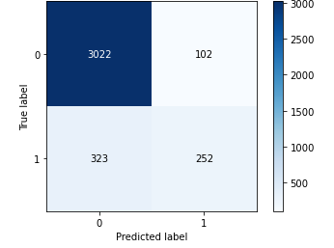
Evaluation: Decision Tree
Confusion Matrix
ROC Curve
'criterion':'entropy’,
'max_features’:9,
'min_samples_leaf':700,
'random_state':5,encoded

Slide 29
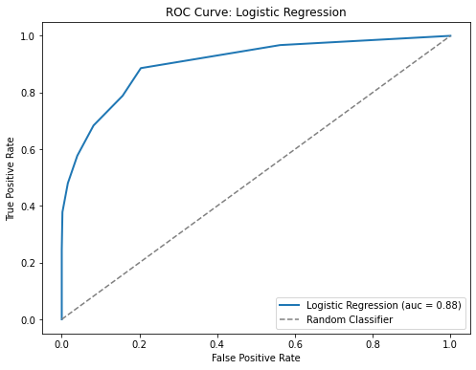

Evaluation: Logistic Regression
Confusion Matrix
ROC Curve
Logistic Regression with parameters:
{C = 0.01, penalty = None}.
(MinMaxScaler, No dropping columns, encoded)

Slide 30
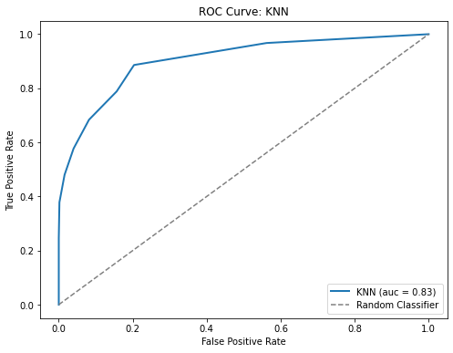
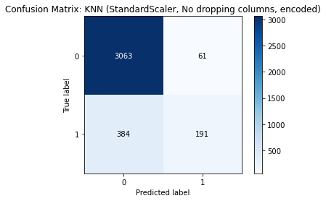
Evaluation: KNN Regression
Confusion Matrix
ROC Curve
KNN(StandardScaler, No dropping columns, encoded)

Slide 31
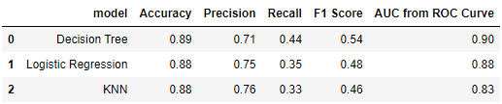
Comparing Three Models
Little difference in accuracy
KNN has higher precision rate
Decision Tree has higher recall rate and F1 score

Slide 32
Model selection
From the previous observation, we find that 85% are returning visitors.
Although new visitors are 13%, they contribute nearly one-third of our business.
Two purposes：
Find new potential buyers —————— Recall is more important
Find returning buyers —————— Precision is more important
We choose both decision tree and logistic regression

Slide 33
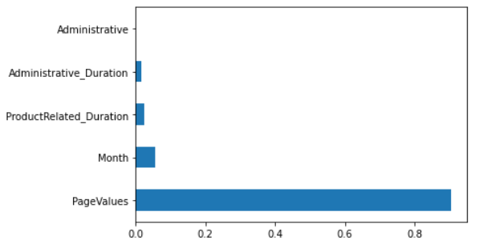
Model selection
Decision Tree:
Find what a visitor cares about
df['Revenue'].value_counts()
False 10422
True 1908

Slide 34
PageValues
ProductRelated_Duration
Administrative_Duration
Month

Slide 35
Model selection
Choose Decision Tree:
The dataset nature is imbalance / skewed.
Faster amongst the tree
Have the highest F1 score as both precision and recall metrics are important.
Highest Area Under Curve value from ROC Curve.
Shows that PageValue, Month, ProductRelated_Duration and Administrative_Duration factors have feature importance on the classification. (Recommendations)

Slide 36
Model selection
Choose Logistic Regression:
To forecast whether a visitor will buy or not.
In predicting the intention of online shoppers to spend, we can just classify shoppers into two categories: buyers and non-buyers. Logistic regression model can predict the probability of buyers by fitting a logical function, so as to judge their consumption intention.
· Have higher precision and ROC curve value.

Slide 37
Logistic Regression
Intersect: array([-2.25343107])
Coefficients: array([[-4.86534444e-02, -1.04054000e-02, 7.13478850e-02,
-4.52704203e-04, 8.74404543e-02, 1.63608773e-01,
-1.30492005e-01, -7.89645677e-01, 1.49080564e+00,
-2.34221139e-01, 2.64153526e-01, -1.38749430e-01,
5.09311305e-02, -4.95787374e-02, 3.53132004e-02,
-1.06261583e-01, 3.29204882e-02]])
Independent Variables: array(['Administrative', 'Administrative_Duration', 'Informational',
'Informational_Duration', 'ProductRelated','ProductRelated_Duration',
'BounceRates', 'ExitRates', 'PageValues',
'SpecialDay', 'Month', 'OperatingSystems',
'Browser', 'Region', 'TrafficType',
'VisitorType', 'Weekend'], dtype=object)

Slide 38
Logistic Regression
Three main factors:
‘Informational’ ‘ProductRelated’ ‘ExitRates’
Conclusion:
If they want to buy the product, customers pay more attention to the ‘Informational’ and ‘ProductRelated’ categories.
If the product is the last in the session, visitors are very likely not to buy it.

Slide 39
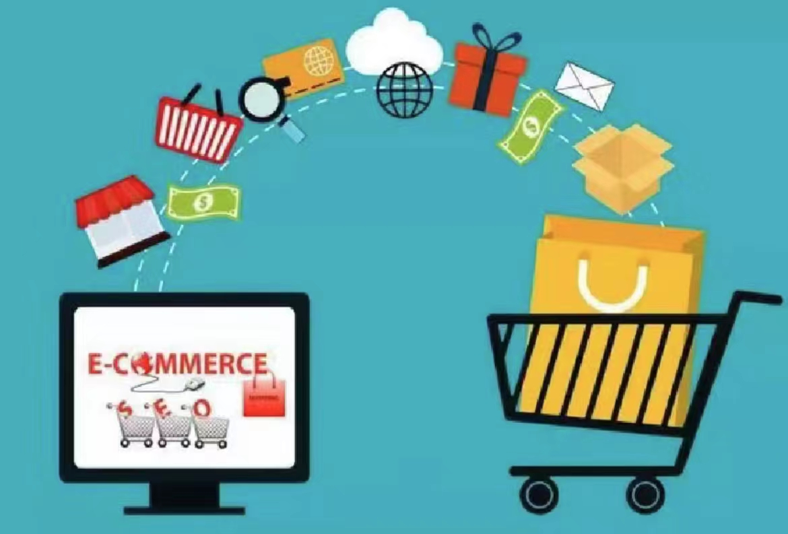
Recommendations
Returning customers (Loyalty →85%) & Attracting new visitors (the new visitors contribute a higher sales volume): Programs & Discount —> enhance brand trust & appeal through positive word-of-mouth marketing
Low sales periods (Like only 23% of visit counts in weekend) & Festival: Launch promotion & Targeted products (improve the page value)
Page values: Concise page, accurate recommendation → enhance the purchase intention
Improve operation system: Input more resource and improvement for 1,2,3 operating system

