Slide 1
Hardware Efficiency
Green software use on HPC

Slide 2
Questions
What is embodied carbon on HPC systems?
How can embodied carbon efficiency be improved on HPC systems?
What can I do to improve the embodied carbon efficiency during my use of HPC systems?

Slide 3
Objectives
Understand what is meant by “embodied carbon” in the context of HPC systems.
Learn how embodied carbon efficiency can be bettered by extending the lifespan of HPC systems and improving performance of applications on HPC systems.

Slide 4
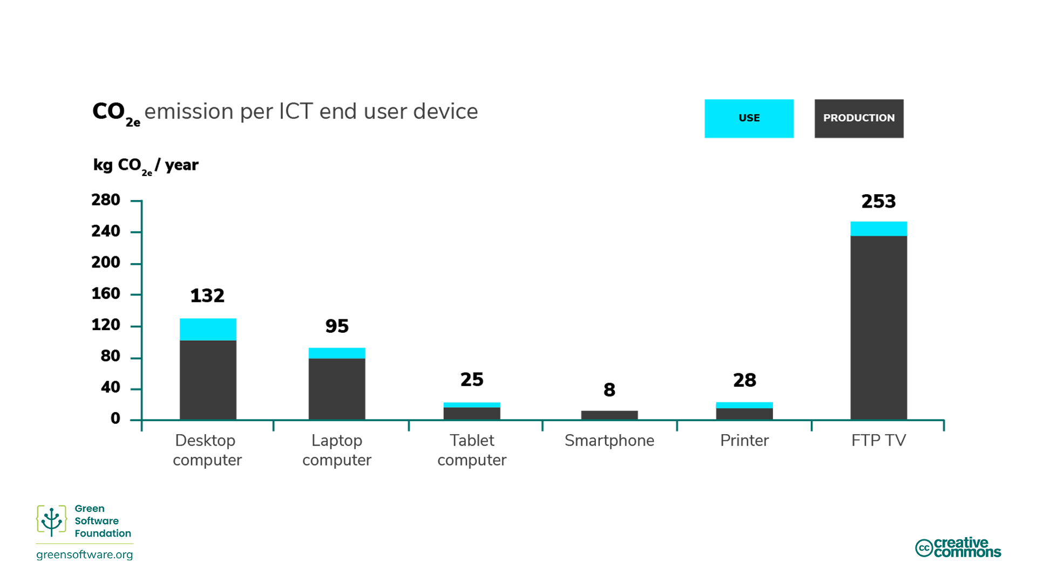
Embodied carbon
Embodied (or embedded) carbon is the amount of carbon emissions from the creation and disposal of a device
When calculating the total carbon emissions for HPC services, both the emissions from running the system as well as the embodied carbon of the hardware must be accounted for
Embodied carbon varies significantly between different hardware
By thinking in terms of embodied carbon, any device is responsible for the release of carbon over its lifetime, even if it isn’t consuming electricity.

Slide 5
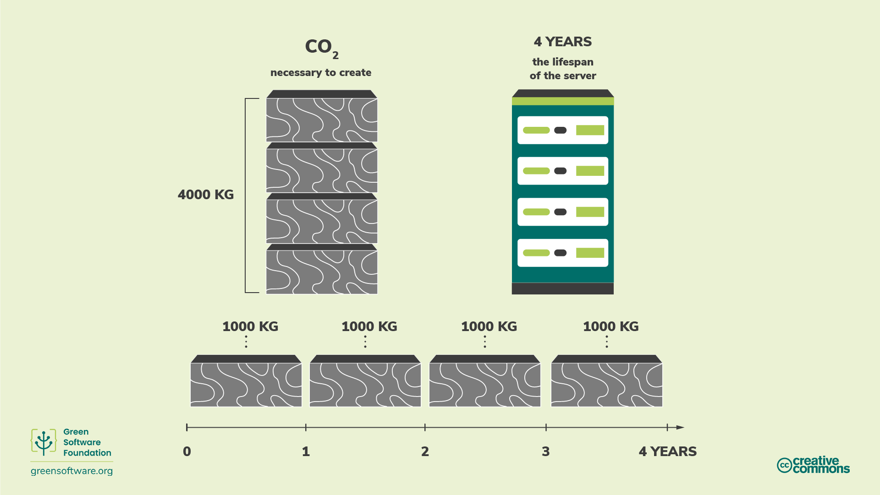
Amortisation
Suppose it took 4000 kgCO2e to build an HPC system, and we expect it to last 4 years. We can amortise this to say the HPC system emits 1000 kgCO2e/year
Typically, we amortise the embodied emissions over the total amount of resource available on the HPC system over its lifetime
(e.g. GPUh)

Slide 6
Improve hardware efficiency
There are two main approaches to improving hardware carbon efficiency:
Extending the lifespan – reduces the carbon emission rate per unit of resource due to amortisation
Increasing the utilisation and performance – getting more useful work out of the hardware per unit of resource
Both rely on getting the most out of the hardware while you have it

Slide 7
Increasing utilisation
Getting the most out of the hardware while it exists corresponds to maximising utilisation
It’s better to have 100% utilisation than 20% utilisation because of the cost of embodied carbon
(also, even idle compute resources consume electricity)
Improved utilisation leads to improved embodied emissions efficiency

Slide 8
Improving performance
Increasing performance (more output per unit of time) can also improve embodied emissions efficiency.
This may lead to higher power draw and higher electricity use which increases the emissions from the use of electricity…
The balance between embodied emissions and emissions from electricity use leads to different approaches to improving emissions efficiency
There are three potential scenarios:
Embodied carbon dominates – run as high performance as possible irrespective of electricity use
Embodied carbon and carbon from electricity use are evenly balanced – you need to find a balance of performance and energy efficiency
Carbon from electricity use dominates – run in as energy efficient a manner as possible

Slide 9
Flexibility is key
Understanding the most carbon efficient way to make use of HPC systems is complex, can depend on
Embodied carbon of the system
Hardware lifetime
Carbon intensity of electricity supply and how it changes over time
Efficiency and performance of the workload
Important that workloads are as flexible as possible
Use different HPC systems and hardware
Run at different times and locations
Vary the power draw of the workload

Slide 10
Key Points
Embodied carbon of an HPC system is the amount of carbon pollution emitted during the creation and disposal of the HPC system.
When calculating your total carbon pollution, you must consider both that which is emitted when running on the HPC system as well as the embodied carbon associated with its creation and disposal.
Extending the lifetime of an HPC system has the effect of amortising the carbon emitted so that its embodied CO₂e/year is reduced.
Increasing utilisation and performance also improve the embodied carbon efficiency from HPC system use.

