Slide 1
Reducing Emissions
Green software use on HPC

Slide 2
Questions
What methodologies are available to reduce carbon emissions and how do they differ?
What is the difference between Net Zero and carbon neutral climate commitments?
How can I reduce the emissions from my use of HPC systems?

Slide 3
Objectives
Understand different carbon reduction methodologies and their role in meeting climate commitments
Appreciate the difference between Net Zero and carbon neutral climate commitments
Understand matching strategies for energy from renewable sources
Introduce potential strategies for reducing emissions from HPC system use

Slide 4
Carbon reduction methodologies

Slide 5
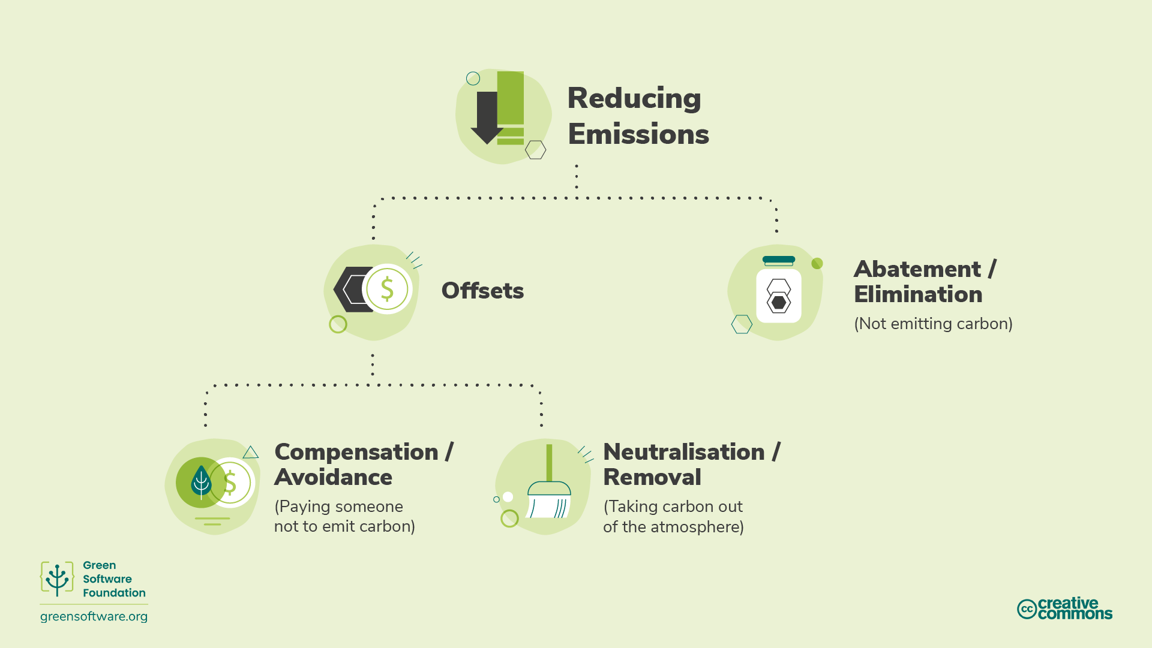
Methodologies

Slide 6
Abatement – not emitting carbon
The Science Based Targets Initiative refers to a mechanism called abatement
This means eliminating sources of CO₂ emissions associated with an organisation’s operations and value chain
The value chain describes the full range of activities needed to create a product or service, from conception to distribution
Abatement on its own is not enough as there will always be residual emissions…
…but abatement must form the core of every viable emissions reduction strategy

Slide 7
Exercise: Strategies for abatement
Abatement is the critical component of carbon emissions reduction strategies. Pick one of the questions below (the one that is most relevant for your role) and write down some answers:
Can you think of actions that individual users/researchers could take to implement abatement in their use of HPC systems?
Can you think of actions that a service operator could take to implement abatement in the operation of HPC systems?
Can you think of actions that a organisation procuring HPC systems could take to implement abatement when buying HPC systems?

Slide 8
Solution

Slide 9
Offsets
Direct investments in emission reduction projects
Organised through the Voluntary Carbon Market (VCM)
1 carbon credit == 1,000 kgCO₂e absorbed or reduced
Many different types of offset available – e.g. ecosystem improvement, empowering local communities
Offsets regulated through frameworks such as the Verified Carbon Standard (VCS) or the Gold Standard (GS)

Slide 10
Why do offsets not improve HPC-CI
Imagine this scenario
Two projects running on an HPC system that is 100% offset and 100% powered by renewable energy
Project A: invested significant time and resources into making sure it is using resources efficiently
Project B: uses resources very inefficiently
For HPC-CI to be useful, Project A needs to have a better score than Project B
If HPC-CI included offsets, then both projects would score 0
HPC-CI is focussed on measuring elimination of emissions to help reach Net Zero

Slide 11
Offsets: Compensations
Actions taken to avoid or reduce emissions
By organisations or communities
Investing in others’ abatement activities
Examples:
Conservation - Based on carbon not released through protecting old trees
Community projects - Help communities worldwide, mainly developing ones, by introducing sustainable living methods
Waste to energy - Capture methane/landfill gas from smaller villages, or human/agriculture waste, and convert it into electricity

Slide 12
Offsets: Neutralisations
The removal and permanent storage of atmospheric carbon
To counterbalance carbon emissions
Examples:
Enhancing natural carbon sinks that remove CO₂ from the atmosphere. For example, forest restoration.
Direct air capture is the process of capturing CO₂ from the air and storing it permanently, either underground or in long-lived products like concrete
Effectiveness measured by ability to remove carbon at the scale and speed needed

Slide 13
Offsets: Neutralisations (cont.)
A key aspect of neutralisations is their durability
This is the length of time that captured carbon will be removed from the atmosphere
Short-term durability is up to 100 years, medium-term is 100 to 1,000 years, and long-term is more than 1,000 years.
Solutions that rely on Earth’s natural carbon cycle have short-term durability measured in decades, for example forestry projects have a durability of 40 to 100 years
Engineered solutions such as direct air capture often have long-term durability measured in millennia, for example direct air capture has a durability of 10,000 years
Long-term projects are typically orders of magnitude more expensive than short-term projects
Emitted CO2 stays in the atmosphere for 5,000 years – any durability shorter than this is of limited use

Slide 14
Climate commitments

Slide 15
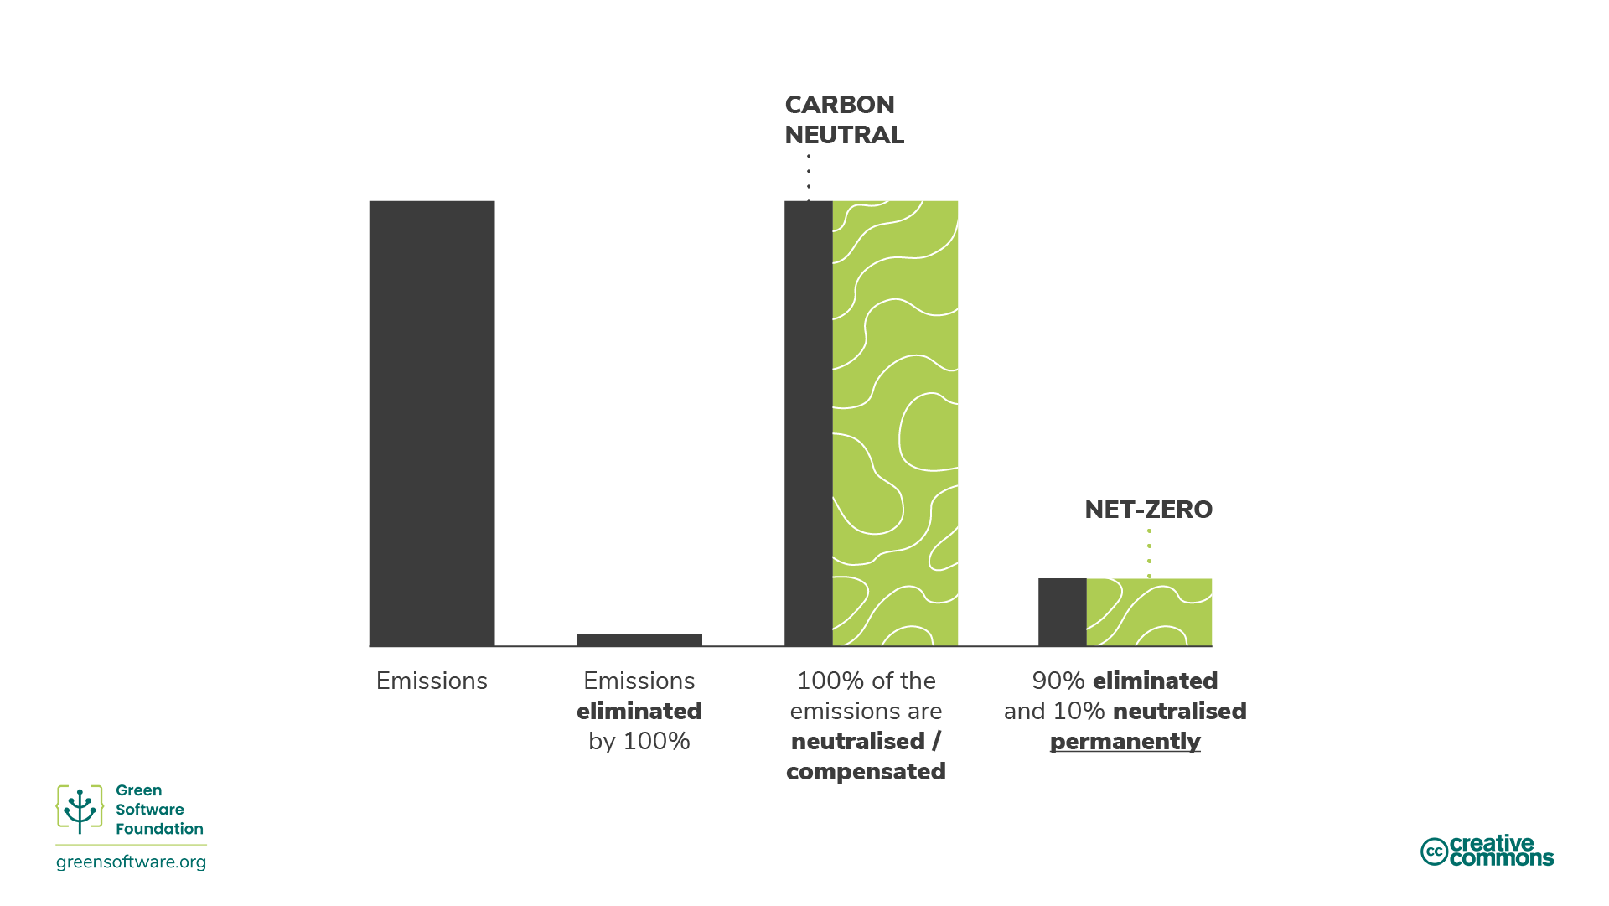
Different commitments
Carbon Neutral and Net Zero are often used (and thought of) interchangeably, but they mean different things

Slide 16
Carbon Neutral
Measure emissions and match with offsets
There are no requirements around abatement
An organisation can simply measure their emissions and offset them without any reduction in emissions
Must cover Scope 1 and 2
Expectation to cover business travel from Scope 3 but n requirement
Carbon Neutrality can be a useful starting point
Not enough offsets available in the world to offset all emissions
…this approach will not scale or achieve the 1.5°C target

Slide 17
Net Zero
Reduce emissions according to the latest climate science and balancing remaining residual emissions through neutralisations
Net zero, by definition, requires emissions reductions in line with a 1.5°C pathway by at latest 2050
Crucial difference from carbon neutral is focus on abatement
Means that the amount of carbon in the atmosphere remains constant
Net Zero must cover Scope 1, Scope 2 and Scope 3 emissions
For HPC facilities, part of these strategies incudes ducating and putting policies and approaches in place to support users in eliminating emissions and improving their emissions efficiency

Slide 18
Reducing Emissions

Slide 19
Reduction of consumption
We will discuss strategies for reducing emissions from a roughly constant level of HPC system use, however…
Fundamentally, we need to reduce the amount of compute we are using, and the amount of compute hardware we are buying.
“We seem to need reminding that computing is not exempt from having to drastically reduce emissions. Instead of assuming computing can innovate the path to a greater future, the bravest and most heroic action the computing sector could take is to show restraint and leadership, …” Bran Knowles et al. Our House Is On Fire: The climate emergency and computing’s responsibility.

Slide 20
Minimising consumption
Before looking at more specific approaches we must make sure any use of HPC systems is actually producing useful output
Ensure any use of HPC systems is useful:
Jobs should produce useful/significant output even if they run correctly
Test input files and job scripts
Can you achieve the same research goals with fewer jobs/calculations?
High quality documentation and training to minimise wastage
Expert support available to users
Aim to use the minimum resource possible to achieve the project aims

Slide 21
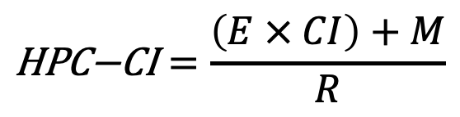
Improving HPC-CI: Users
$$\text{HPC}\text{−}\text{CI}=\frac{\left(E × CI\right)+M}{R}$$
Operational emissions dominate
Improve hardware efficiency
Reduce M
Less hardware needed for same output
Improve performance
Increase R
More output per unit of emissions
Extend hardware lifetime
Reduce M
Due to amortisation of embodied emissions
Use demand shifting
Reduce M
Run on hardware with lower embodied emissions
Embodied emissions dominate
Improve energy efficiency
Reduce E
Less energy needed for same output
Improve performance
Increase R
More output per unit of emissions
Use demand shifting/shaping
Reduce E or CI
Use hardware that uses less energy
Run when carbon intensity is lower

Slide 22
Improving HPC-CI: Operators
$$\text{HPC}\text{−}\text{CI}=\frac{\left(E × CI\right)+M}{R}$$
Operational emissions dominate
Improve the energy efficiency of your HPC systems
Improves the ratio of E to R
This may involve power capping of the, or purchasing hardware that is more energy efficient
Ensure that the power and cooling plant are as efficient as possible
Reduces E
Minimise overheads
Enable temporal shifting
Reduces CI
Run workloads with higher power intensities at times when carbon intensity is lower
Spatial shifting
Reduces CI
site HPC systems in locations that have the lowest carbon intensities
Embodied emissions dominate
Work with users to improve the performance of jobs on the service
Increase R
Even at the expense of energy efficiency through removing any power
Extend the lifetime of the service as long as possible
Reduce Improves ratio of M to R
Purchase HPC systems that have the best ratio of embodied emissions to performance for the workloads that will be run
Improves ratio of M to R

Slide 23
Key Points
There are a number of methodologies commonly applied to help in the overall fight against climate change. These fall into the general categories of carbon elimination (also known as “abatement”), carbon avoidance (a.k.a. “compensating”), or carbon removal (a.k.a. “neutralising”).
Abatement is the most effective way to fight climate change although complete carbon elimination is not possible.
Compensating includes the adoption of renewable energy sources, sustainable living practices, recycling, planting trees, etc.
Neutralisations refer to the removal and permanent storage of atmospheric carbon to counterbalance the effect of releasing CO₂ into the atmosphere. Neutralisations tend to remove the carbon from the atmosphere in the short- and medium-term.
Net zero aims to eliminate emissions and only offset the residual emissions that cannot be eliminated to reach the 1.5°C target set by the Paris Climate Agreement.
Which strategies users or HPC system operators prioritise to reduce emissions depends on if the operational or embodied emissions dominate.
A key part of reducing emissions from HPC use is reducing our consumption of HPC resources.

