Slide 1
Responsible Computing Plans
Green software use on HPC

Slide 2
What is a Responsible Computing Plan?
Ensure that positive environmental impacts are captured and plan the project lifecycle is so that it can achieve project goals with minimal emissions.
High level RCP sections
  Describing the positive environmental impacts from the project
  Planning and starting the project
  Running the project
  Finishing the project
A living document that reacts to changes in the project rather than being prescriptive

Slide 3
Why are RCPs useful/needed?
Disconnect between use and awareness of resources used
Default position is often to use more resources to achieve progress rather than think carefully about the best way to achieve the results
  “Reach for the bigger hammer rather than the right tool.”

Slide 4
Who are RCPs for and when should they be used?
Initial framing is aimed at research projects
  Can be developed by the project team for the whole project
  Can be developed by individual researchers for their part of a larger project
Ideally, developed as part of the project planning
  If a project has already started, can still be useful
With some thought, they could potentially be tailored for non-research activities

Slide 5
1. Positive environmental impacts

Slide 6
Positive environmental impact statement
Statement that describes the positive environmental impacts of the project – ideally quantitative but may need to be qualitative.
Direct impacts
New approaches/technologies, efficiency improvements
Understanding/quantifying polycrisis impacts
Indirect impacts
Fundamental research to enable new approaches/technologies
Model improvements
Community/activism impacts
Adding awareness/skills in environmental issues
Demonstrating leadership in environmental sustainability
Normalising action

Slide 7
Exercise #1: 10 minutes
Choose a project you are (or have been) involved in
…or, make up a plausible project scenario
Write up the project overview in 2-3 sentences
Produce a proposed environmental impact statement
Direct impacts
New approaches/technologies, efficiency improvements
Understanding/quantifying polycrisis impacts
Indirect impacts
Fundamental research to enable new approaches/technologies
Model improvements
Community/activism impacts
Adding awareness/skills in environmental issues
Demonstrating leadership in environmental sustainability
Normalising action

Slide 8
2. Planning projects

Slide 9
Planning: points to consider
Planning the project with environmental sustainability in mind is typically the time when you can have the largest impact. Planning to run the project in a responsible way almost always makes the project more impactful and robust from a non-environmental standpoint too.
a. Plan to minimise resource use
b. Build testing into the project approach
c. Select an appropriate method and scale
d. Plan to use data resources responsibly
e. Select the right resource for the project

Slide 10
a. Plan to minimise resource use
Reduction of consumption is central tenet of reducing environmental impact
Points to consider:
Look for existing datasets that you can use rather than repeating calculations
  This is not all or nothing, existing data may help you minimise your use to the most impactful use of resources
Ensure that all planned use will contribute meaningful data points
If the project involves sampling, select a sampling distribution that maximises information per point
  e.g. regular sampling grid at finest resolution is unlikely to be most efficient use – minimise data points in regions of little change
When running parallel calculations – using the smallest number of cores/nodes that take a reasonable time is usually the most emissions efficient
1. Planning projects → Responsible compute resource use

Slide 11
b. Build testing into the project approach
Testing that the proposed methodologies will likely give viable results before embarking on large amounts of resource use
Review literature carefully
Discuss planned approach with experienced researchers
Undertake pilot studies before committing to large resource use
You often do not need to run at full scale to test if the selected method is viable – shorter runs, reduced datasets or other reductions can give confidence in the proposed resource consumption estimates
1. Planning projects → Responsible compute resource use

Slide 12
c. Select an appropriate method and scale
Use methods proportionate to the project objectives rather than automatically choosing the most complex/advanced/higher resolution option
When planning a project, think carefully about the tools and methods you will use. Some newer tools are more efficient than older ones, but not always.
Some computationally intensive approaches, including some machine learning methods, may not improve enough on simpler methods to justify their extra cost.
Think about redundancy – are you planning to compute too many datapoints or look at too many similar problems which will not provide substantial new information?
Build smaller scale benchmarking and testing into the project plan to ensure the correct scale setup is chosen for each step (or when plans change)
1. Planning projects → Responsible compute resource use

Slide 13
Exercise #2: 10 minutes
For the same project you worked on in exercise #1:
Write brief bullet points covering how you could, from an environmental sustainability viewpoint, plan the project to:
Minimise resource use
Build testing into the project approach
Select appropriate methods and scales

Slide 14
d. Plan to use data resources responsibly
Many projects already produce data management plans, and these typically align well with responsible resource use. The questions that would be asked are similar to those for a data management plan, e.g.:
Do we really need to keep all intermediate files?
Does each collaborator need their own copy of the dataset?
Can rarely used data be compressed or moved to archival storage?
Have we planned time to review and tidy data during the project?
Additionally, build plans to publish data using a FAIR approach throughout the project, more on this later..
1. Planning projects → Responsible data resource use

Slide 15
e. Select the right resource for the project
Projects often have choices of DRI to use for different parts of the project. With environmental sustainability in mind the choice is often a balance of hardware efficiency, energy efficiency and carbon awareness.
Some high level notes:
Use existing resources where possible – making use of existing resources is usually the most sustainable approach
Shared resources are often a more sustainable choice as they usually achieve higher utilisation over their lifetimes
1. Planning projects → Selecting resources

Slide 16
e. Select the right resource for the project: HPC
Select a facility to minimise operational emissions
  Use HPC facilities in locations that have the lowest emissions from electricity generation – this usually corresponds to them being sited in locations with lowest national grid carbon intensities but can also be that they have direct connections to renewable energy sources
  In the UK, this means HPC resources located as far North as possible
Select a facility to maximise performance if embodied emissions are a significant fraction of the facility lifetime emissions
Select a facility to maximise energy efficiency if operational emissions are the dominant factor in lifetime emissions
1. Planning projects → Selecting resources

Slide 17
Exercise #3: 10 minutes
For the same project you worked on in previous exercises:
Write brief bullet points covering how you could, from an environmental sustainability viewpoint, plan the project to:
Use data resources responsibly
(during the project, we will discuss finalising the project later)
Select the right (HPC) resource for the project

Slide 18
3. Running the project

Slide 19
Run projects well
Re-planning is often needed during research projects as objectives might change, new methods may need to be employed, new data may become available. Principles for responsible computing can be built into a research project.
Points to consider:
a. Run software carefully
b. Optimise where it matters
2. Running projects → Overview

Slide 20
a. Run software carefully
Reducing waste of resources is key to using DRI in a sustainable way. The disconnect between using resources and visible consumption makes it easier to waste resources.
Plan testing of software and scripts on a smaller scale before running in ways that can consume large amounts of resource
Plan to run appropriate benchmarking before committing to large usage to ensure you are using resources efficiently (cores, memory, IO, etc.)
  Smallest number of cores/nodes is almost always the most emissions efficient – how fast do you really need results?
  Plan to revisit this if the project plan changes in terms of software, method, problem size, etc.
Consider using carbon intensity forecasts to schedule work at a lower-carbon time
Before running work, ensure you are recording enough information to avoid rerunning this work unnecessarily
2. Running projects → Run software carefully

Slide 21
b. Optimise where it matters
Many projects waste time optimising workflows in areas that will make a negligible impact on reducing environmental impact (or even performance) or optimise inefficiently due to lack of specialist support.
Find the locations where optimisation will likely have the largest impact
  Remember, you may get a larger impact from running carefully without ever needed to get involved with programming
  Make sure you have some plan to measure the impact of any changes (e.g. HPC-CI, covered later)
Enlist the support of specialists to analyse and optimise your workflow
  Many institutions have a local Research Software Engineering team who are well placed to help
2. Running projects → Optimise where it matters

Slide 22
4. Finishing the project

Slide 23
Finish projects well
In environmental sustainability terms, planning how a project will be finalised means ensuring that calculations do not need to be needlessly re-run for outcomes related to the project, ensuring that the right data is kept in a useful form, deleting data that is no longer needed and ensuring work can be re-used effectively in future work.
For example, the following points could be considered:
Which data genuinely need to be retained and what can be deleted?
Could publishing this data or code reduce duplicated work elsewhere?
Have I left enough documentation for others to reuse what has been done?
Finishing a project well typically corresponds to applying FAIR principles

Slide 24
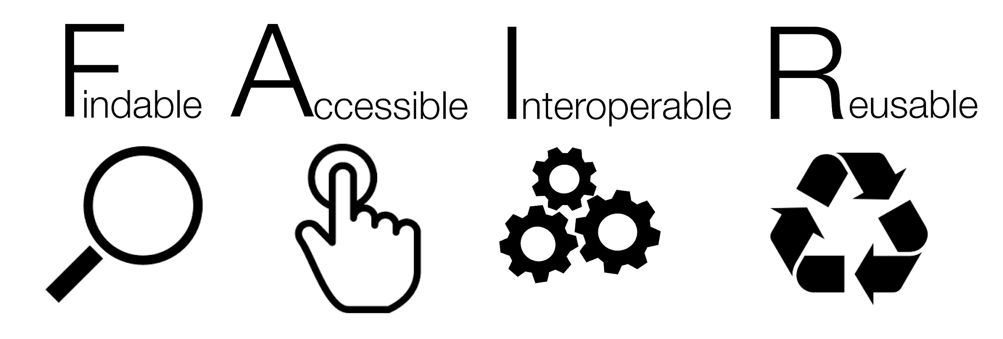
Source: https://en.wikipedia.org/wiki/FAIR_data#/media/File:FAIR_data_principles.jpg
1.Findable – Easy to find by both humans and computer systems and based on mandatory description of the metadata that allow the discovery of interesting datasets;
2.Accessible – Stored for long term such that they can be easily accessed and/or downloaded with well-defined license and access conditions (Open Access when possible), whether at the level of metadata, or at the level of the actual data content;
3.Interoperable – Ready to be combined with other datasets by humans as well as computer systems;
4.Re-usable – Ready to be used for future research and to be processed further using computational methods.
https://www.go-fair.org/how-to-go-fair/

Slide 25
Exercise #4: 5 minutes
For the same project you worked on in previous exercises:
Write brief bullet points covering how you could, from an environmental sustainability viewpoint, plan to end the project in as good a way as possible.

Slide 26
Responsible Computing Plan: HPC Focus
Plan to minimise resource use
Plan data storage
Choose resources carefully
Run software carefully
Aim for largest impact
What is the minimum resource needed?
Finish projects well
Would a simpler method be sufficient?
Do I need to test at smaller scale first?
Am I planning duplicate runs that are not really needed?
Do we really need to keep all intermediate files?
Does each collaborator need their own copy of the dataset?
Can rarely used data be compressed or moved to archival storage?
Have we planned time to review and tidy data during the project?
How have I assessed that this is the correct resource for this workload?
Do I have access to locations or services with lower-carbon electricity?
Have I tested this on a smaller job first?
Which files genuinely need to be retained?
What can be deleted now?
Could publishing this data or code reduce duplicated work elsewhere?
Have I left enough documentation for others to reuse what has been done?
Is this code run often enough for optimisation to matter?
Would specialist support help me make a bigger improvement more quickly?
Am I requesting more compute or memory than I really need?
Could this run at a lower-carbon time or in a lower-carbon location?
Am I recording enough information to avoid rerunning this work unnecessarily?

