Slide 1




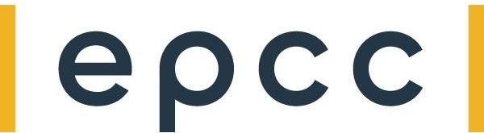
Hands-on 3: GEMV on a Multiple PEs with Collective Communications

Slide 2
Objective
Perform Matrix-Vector Multiplication on multiple adjacent PEs
Perform final reduction step using the collective communications library
Matrix A of size (MxN – M rows, N columns)
N columns will be split across the multiple PEs
Vector x of size N
x will be split across multiple PEs
Vectors b and y of size M
y = b + A@x
Notes:
When programming the CS-2 device, you’ll leverage our new CSL programming language
CSL contains common constructs familiar to most programmers and CSL-specific constructs
We’ll cover what some of these look like,
But most users who have written C or C++ should be very comfortable using CSL

Slide 3
What you must do here
Hints
In pe_program.csl:
TO DO 1: Fill in mpi_x details for reduction
Once you have this running, let’s scale it
TO DO 2: What needs to be changed to run on more than 2 PEs, initially let’s say 4 PEs and then increasing this number
Example of using the collective communications library from walk-through 7
Notes:
When programming the CS-2 device, you’ll leverage our new CSL programming language
CSL contains common constructs familiar to most programmers and CSL-specific constructs
We’ll cover what some of these look like,
But most users who have written C or C++ should be very comfortable using CSL

Slide 4
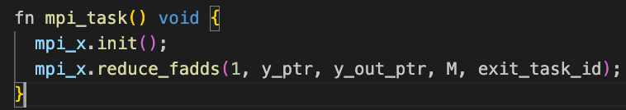
Wash-up for hands on exercise three:
You need to initialize the communications library (it is fairly standard to instantiate this as mpi as we have done in the exercise)
Then issue the mpi_x.init function call
To undertake the reduction we use the reduce_fadds function from the library
Remember, you need to activate the exit_task_id as callback to run this task and clean up the stream
Notes:
When programming the CS-2 device, you’ll leverage our new CSL programming language
CSL contains common constructs familiar to most programmers and CSL-specific constructs
We’ll cover what some of these look like,
But most users who have written C or C++ should be very comfortable using CSL

