Slide 1
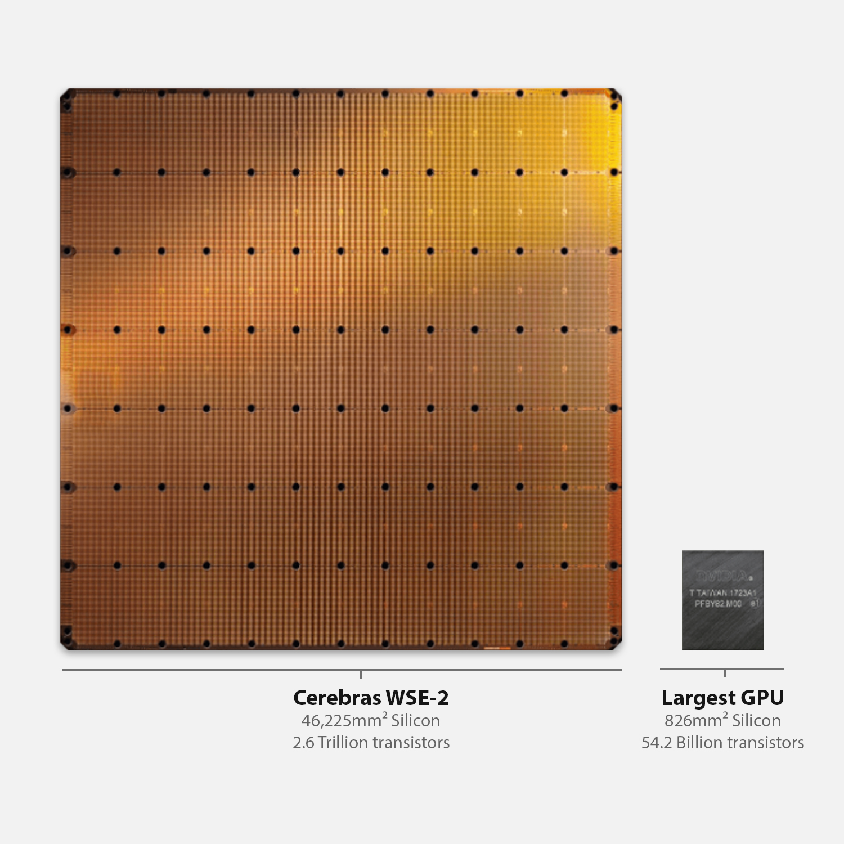



Hands-on 2: GEMV on a Multiple PEs

Slide 2
Objective
Perform Matrix-Vector Multiplication on a Two adjacent PEs
Matrix A of size (MxN – M rows, N columns)
N columns will be split across the two PEs
Vector x of size N
x will be split across two PEs
Vectors b and y of size M
y = b + A@x
Notes:
When programming the CS-2 device, you’ll leverage our new CSL programming language
CSL contains common constructs familiar to most programmers and CSL-specific constructs
We’ll cover what some of these look like,
But most users who have written C or C++ should be very comfortable using CSL

Slide 3
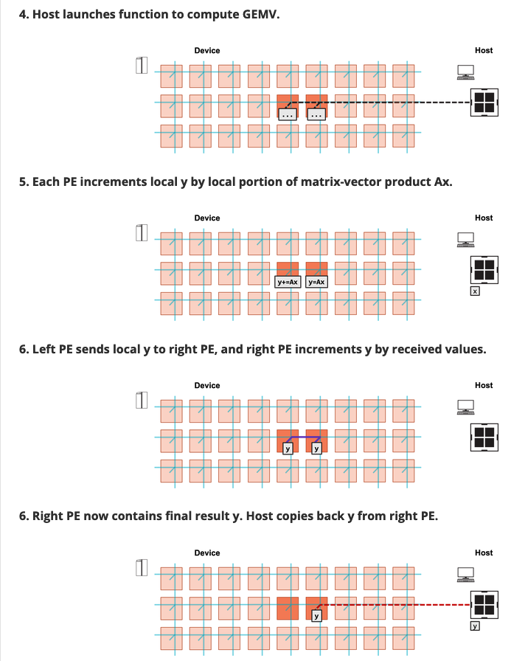
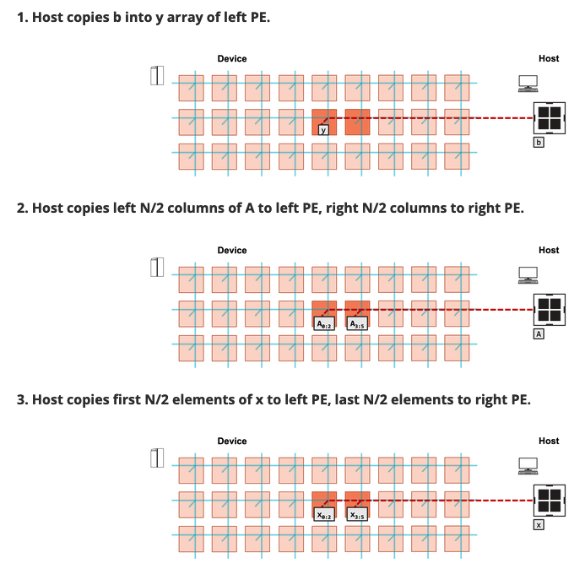
Steps
Notes:
When programming the CS-2 device, you’ll leverage our new CSL programming language
CSL contains common constructs familiar to most programmers and CSL-specific constructs
We’ll cover what some of these look like,
But most users who have written C or C++ should be very comfortable using CSL

Slide 4
To do:
In layout.csl:
TO DO 1: set tile code for Left and Right PEs
TO DO 2: set color config for Left and Right PEs
In pe_program.csl:
TO DO 1: Define send_right()
TO DO 2: Define recv_left()
TO DO 3: Define compute() function
Notes:
When programming the CS-2 device, you’ll leverage our new CSL programming language
CSL contains common constructs familiar to most programmers and CSL-specific constructs
We’ll cover what some of these look like,
But most users who have written C or C++ should be very comfortable using CSL

Slide 5
Hints:
Example of setting tile code for multiple PE from walk-through 5
Example of setting color config & communication functions from walk-through 6
Notes:
When programming the CS-2 device, you’ll leverage our new CSL programming language
CSL contains common constructs familiar to most programmers and CSL-specific constructs
We’ll cover what some of these look like,
But most users who have written C or C++ should be very comfortable using CSL

Slide 6
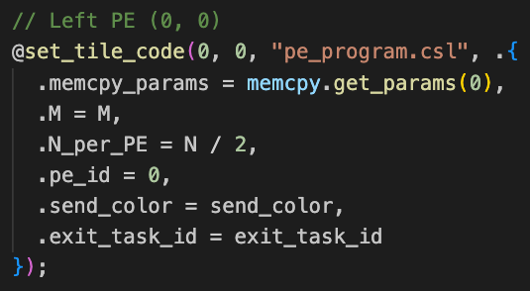
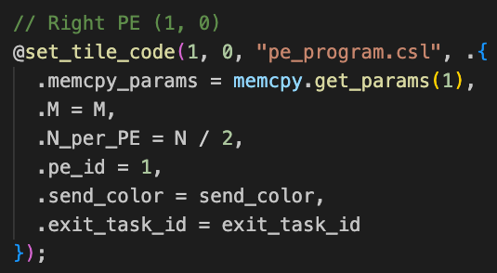
Wash-up for ex2:
Key points:
Setting tile code:
Notes:
When programming the CS-2 device, you’ll leverage our new CSL programming language
CSL contains common constructs familiar to most programmers and CSL-specific constructs
We’ll cover what some of these look like,
But most users who have written C or C++ should be very comfortable using CSL

Slide 7
Wash-up for ex2:
Setting color config:
Notes:
When programming the CS-2 device, you’ll leverage our new CSL programming language
CSL contains common constructs familiar to most programmers and CSL-specific constructs
We’ll cover what some of these look like,
But most users who have written C or C++ should be very comfortable using CSL

Slide 8
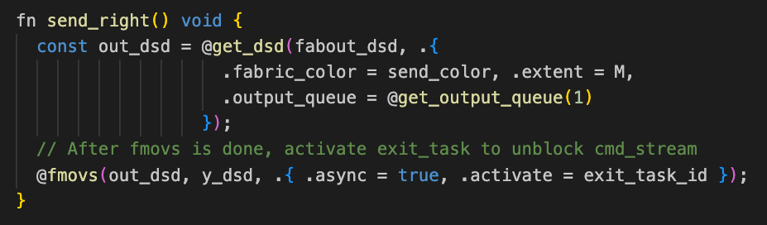
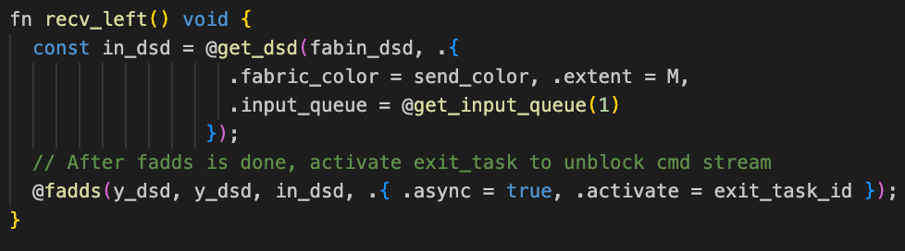
Wash-up for ex2:
send_right()
recv_left()
Notes:
When programming the CS-2 device, you’ll leverage our new CSL programming language
CSL contains common constructs familiar to most programmers and CSL-specific constructs
We’ll cover what some of these look like,
But most users who have written C or C++ should be very comfortable using CSL

Slide 9
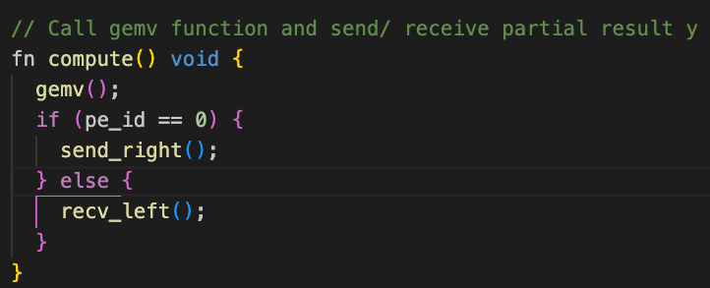
Wash-up for ex2:
compute():
Notes:
When programming the CS-2 device, you’ll leverage our new CSL programming language
CSL contains common constructs familiar to most programmers and CSL-specific constructs
We’ll cover what some of these look like,
But most users who have written C or C++ should be very comfortable using CSL

Slide 10
Wash-up for ex2:
Questions?
Notes:
When programming the CS-2 device, you’ll leverage our new CSL programming language
CSL contains common constructs familiar to most programmers and CSL-specific constructs
We’ll cover what some of these look like,
But most users who have written C or C++ should be very comfortable using CSL

