Slide 1
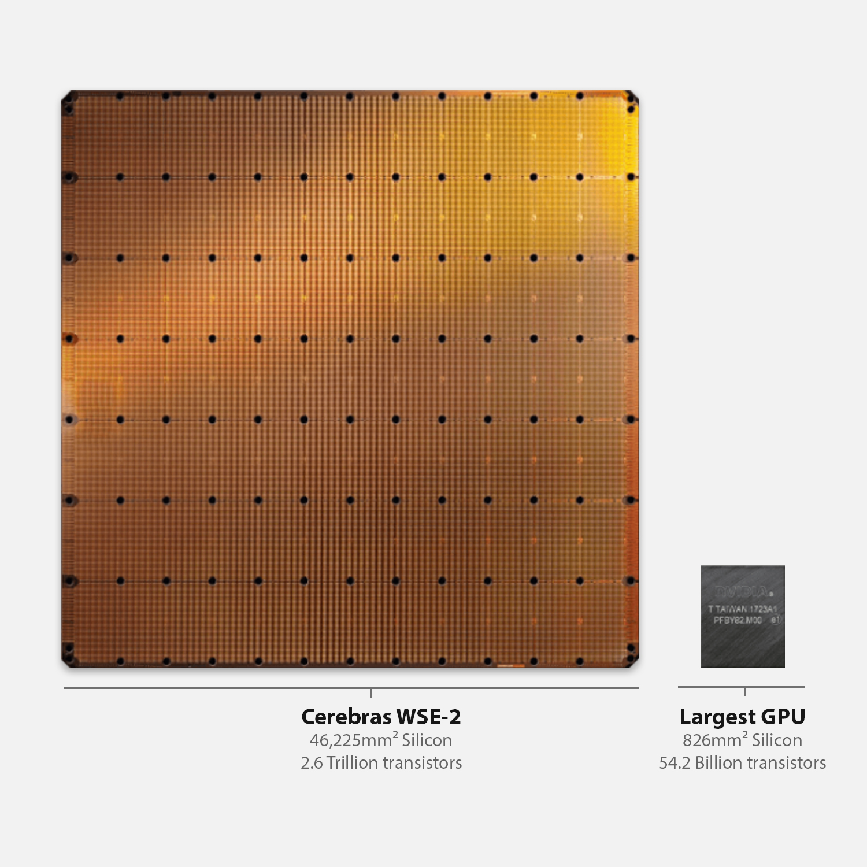



Hands-on 3: GEMV on a Multiple PEs with Collective Communication

Slide 2
Objective
Perform Matrix-Vector Multiplication on multiple adjacent PEs
Perform final reduction step using collective communications library
Matrix A of size (MxN – M rows, N columns)
N columns will be split across the multiple PEs
Vector x of size N
x will be split across multiple PEs
Vectors b and y of size M
y = b + A@x
Notes:
When programming the CS-2 device, you’ll leverage our new CSL programming language
CSL contains common constructs familiar to most programmers and CSL-specific constructs
We’ll cover what some of these look like,
But most users who have written C or C++ should be very comfortable using CSL

Slide 3
To do:
In pe_program.csl:
TO DO 1: Fill in mpi_x details for reduction
TO DO 2: What needs to be changed to run on more than 2, say 4 PEs?
Notes:
When programming the CS-2 device, you’ll leverage our new CSL programming language
CSL contains common constructs familiar to most programmers and CSL-specific constructs
We’ll cover what some of these look like,
But most users who have written C or C++ should be very comfortable using CSL

Slide 4
Hints:
Example of collective communications from walk-through 7
Notes:
When programming the CS-2 device, you’ll leverage our new CSL programming language
CSL contains common constructs familiar to most programmers and CSL-specific constructs
We’ll cover what some of these look like,
But most users who have written C or C++ should be very comfortable using CSL

Slide 5
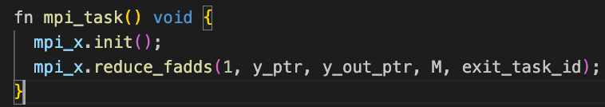
Wash-up for ex3:
Key points:
mpi_x.init() + reduce_fadds
Need to activate exit_task_id as callback!
Notes:
When programming the CS-2 device, you’ll leverage our new CSL programming language
CSL contains common constructs familiar to most programmers and CSL-specific constructs
We’ll cover what some of these look like,
But most users who have written C or C++ should be very comfortable using CSL

Slide 6
Wash-up for ex3:
Questions?
Notes:
When programming the CS-2 device, you’ll leverage our new CSL programming language
CSL contains common constructs familiar to most programmers and CSL-specific constructs
We’ll cover what some of these look like,
But most users who have written C or C++ should be very comfortable using CSL

