Slide 1
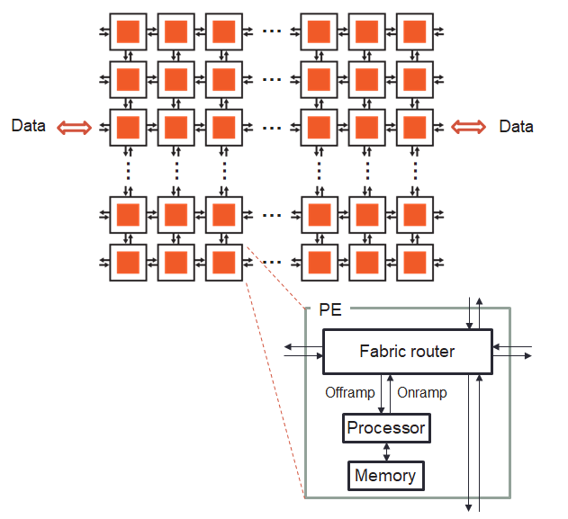




Cerebras SDK walk-through part two

Slide 2
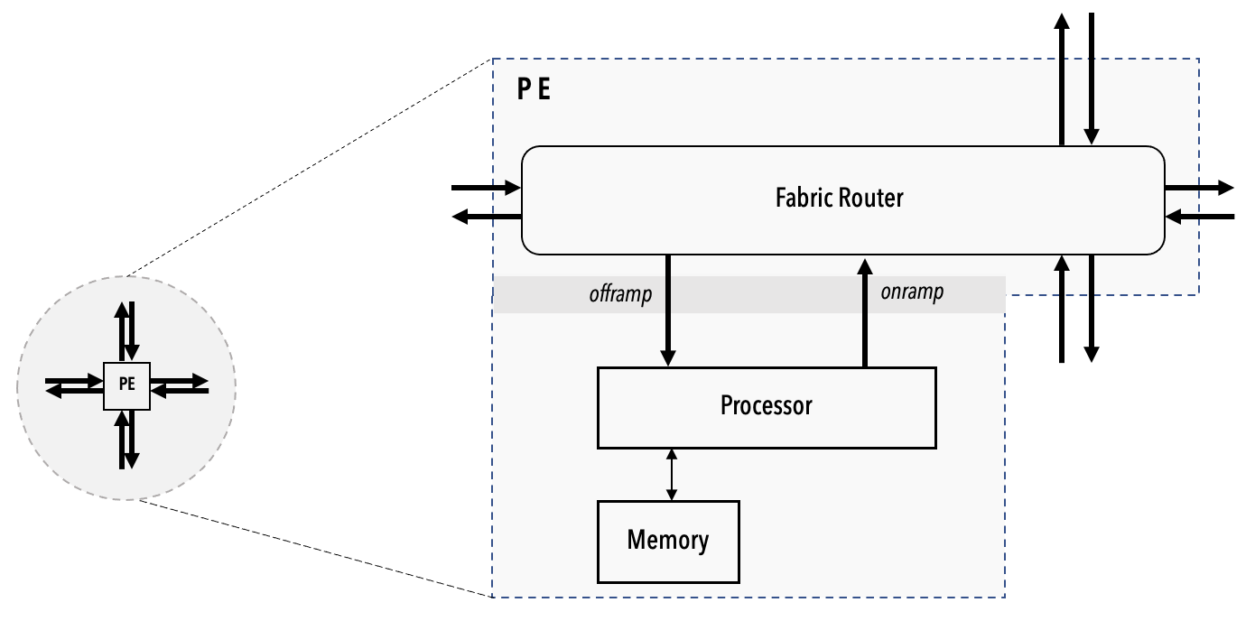
Until this point…
We have focussed on running over a single Processing Element
You should have been able to undertake the first hands on exercise fairly easily using the concepts that we discussed
However, we have over 850,000 PEs so it’s a bit wasteful only running on one of these!
In this second walk through we are going to explore running on multiple PEs and communicating between them

Slide 3
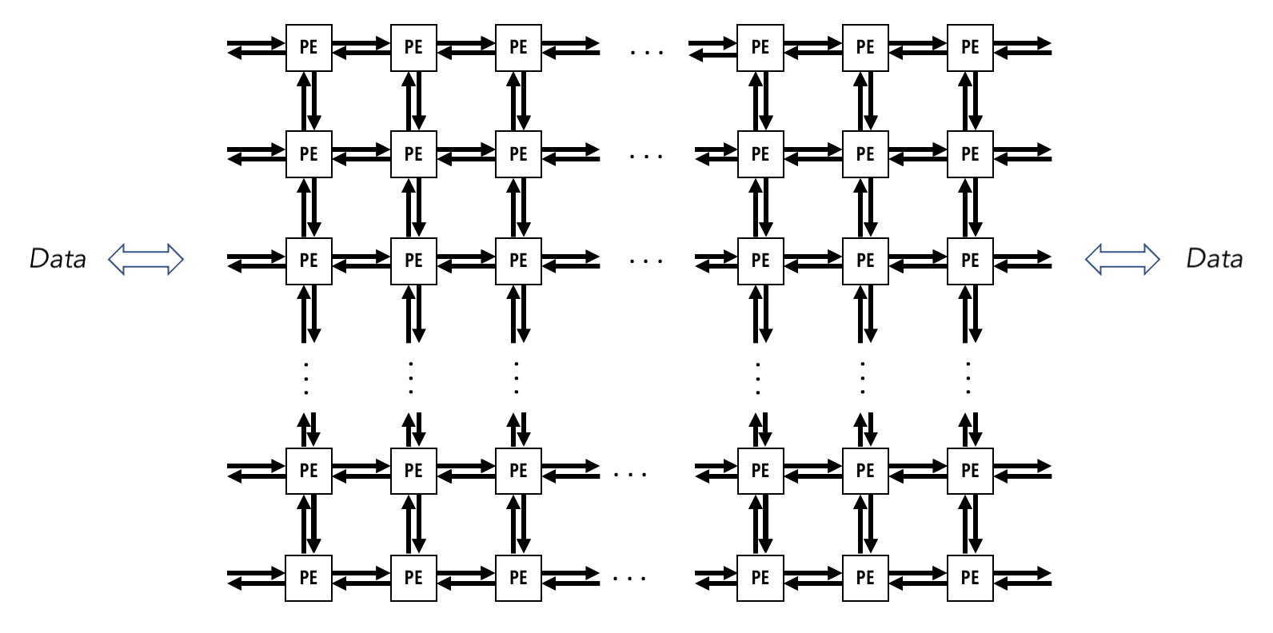
Reminder
Very many individual Processing Elements (PEs)
These run independent of each other (e.g. their own program counter)
PEs are connected by 2D rectangular mesh across the chip
32-bit messages (called wavelets) can be communicated with neighbours in a single cycle
Each physical channel has 24 virtual communication channels known as colors that can be used for passing wavelets
Each wavelet has associated with it a 5-bit identifier which defines which channel it is communicated on
Determines the wavelet’s routing through the fabric and its consumption
This is a bit like a tag in MPI point-to-point communications, and similarly many messages on one color does not block messages with a different color using the same physical link

Slide 4
Multiple Processing Elements (PEs)
Scaling up to multiple PEs for embarrassingly parallel codes is simple
This will be our initial focus in the second part of the walk through
Change into the wt5-multiple-PEs directory
The number of PEs must be known at compile time, this is an example of a constant that is useful to provide as a parameter at compile time (and hence easy to modify)
We can do this using parameters (actually we have already been using parameters to specify the size of the data array!)
[vistor01@sdf-cs1 wt4-memoryDSDs]$ cd ../wt5-multiple-PEs
[vistor01@sdf-cs1 wt5-multiple-PEs]$ cslc layout.csl --fabric-dims=9,3 --fabric-offsets=4,1 --params=N:3,width:2 --memcpy --channels=1 -o out
N and width are compile time parameters that we provide as part of the compilation command

Slide 5
Multiple Processing Elements (PEs)
The modifier param in the CSL code denotes that the value will be provided as a parameter
The change here is in the layout.csl file
Although we have also tweaked pe_program.csl to use the N parameter for the array size, instead of this being hard coded to 3 in previous examples
Using the commands.sh script, build and run this example
Now rebuild to run over a different number of PEs
Hint – look in the commands.sh file to find the width parameter
// N: array size
// width: Number of PE columns
param N: i16;
param width: i16;
// Color used by memcpy for RPC mechanism
const LAUNCH: color = @get_color(8);
// Import memcpy layout module for (width=2) x 1 grid of PEs
// This module defines parameters passed to program on the 2 PEs
const memcpy = @import_module("<memcpy/get_params>", .{
.width = width,
.height = 1,
.LAUNCH = LAUNCH
});
layout {
// set rectangle for 2x1 PEs
@set_rectangle(width, 1);
for (@range(i16, width)) |x| {
@set_tile_code(x, 0, "pe_program.csl", .{
.memcpy_params = memcpy.get_params(x),
.N = N
});
}
// Export device symbol for array "x", "y"
@export_name("x", [*]f32, true);
@export_name("y", [*]f32, true);
// Export host-callable device function
@export_name("compute", fn()void);
}
Imports the memcpy module onto the cores, now across width by 1 PEs (previously it was across 1x1)
Set the rectangle of PEs in use to be width by 1 (previously it was 1x1)
Use a for loop to assign the code to each PE and set appropriate parameters. We need to do this explicit assign for each PE (as in some cases different PEs have different code)

Slide 6
Running on multiple PEs
[vistor01@sdf-cs1 wt5-multiple-PEs]$ ./commands.sh
INFO: Using SIF: /home/y26/shared/cs_sdk-1.0.0/cbcore_sdk-202311111408-10-4a54bce5.sif
compile successful
INFO: Using SIF: /home/y26/shared/cs_sdk-1.0.0/cbcore_sdk-202311111408-10-4a54bce5.sif
Reading file out/out.json
Reading file out/bin/out_rpc.json
Reading file out/west/out.json
Reading file out/east/out.json
fab w,h = 9,3
Kernel x,y w,h = 4,1 2,1
memcpy x,y w,h = 1,1 7,1
SUCCESS!
Ensure you are in the w5-multiple-PEs directory and run the commands.sh script
Now rebuild to run on four PEs and then rerun
Hint – you can edit the width parameter passed in via the commands.sh script
You must also increase the first fabric dimension by three

Slide 7
Solution: Running on multiple PEs
Using the compile and run commands separately (rather than driving via the commands.sh file) to show the difference here
[vistor01@sdf-cs1 wt5-multiple-PEs]$ cslc layout.csl --fabric-dims=11,3 --fabric-offsets=4,1 --params=N:3,width:4 --memcpy --channels=1 -o out
INFO: Using SIF: /home/y26/shared/cs_sdk-1.0.0/cbcore_sdk-202311111408-10-4a54bce5.sif
compile successful
[vistor01@sdf-cs1 wt5-multiple-PEs]$ cs_python run.py --name out
INFO: Using SIF: /home/y26/shared/cs_sdk-1.0.0/cbcore_sdk-202311111408-10-4a54bce5.sif
Reading file out/out.json
Reading file out/bin/out_rpc.json
Reading file out/west/out.json
Reading file out/east/out.json
fab w,h = 9,3
Kernel x,y w,h = 4,1 4,1
memcpy x,y w,h = 1,1 9,1
SUCCESS!
There are some small differences in the output
The kernel width and height have changed from 2,1 to 4,1
The memcpy width and height have changed from 7,1 to 9,1

Slide 8
Communicating between PEs
Fabric router
Fabric router
offramp
onramp
offramp
onramp
Processor
Processor
Memory
Memory
We will have two PEs, left and right, with the left PE sending data to the right PE
The left PE’s sending route will be onramp and EAST, the right PE will use the receive route of WEST and offramp
Remember, there are 24 virtual communication channels (colors) each capable of communicating a 32-bit wavelet per cycle (router to router)

Slide 9
Communicating between PEs: layout.csl
// Colors
const send_color: color = @get_color(0); // Color used to send/recv data
// Task IDs
const exit_task_id: local_task_id = @get_local_task_id(9); // Task ID used by local task
In layout.csl we have introduced a color to send/receive data between the PEs, and a task_id used to trigger the exit task
These are passed as parameters to the pe_program.csl code that runs on each PE
// Left PE (0, 0)
@set_tile_code(0, 0, "pe_program.csl", .{
.memcpy_params = memcpy.get_params(0),
.N = N,
.pe_id = 0,
.send_color = send_color,
.exit_task_id = exit_task_id
});
// Left PE sends its result to the right
@set_color_config(0, 0, send_color, .{.routes = .{ .rx = .{RAMP}, .tx = .{EAST} }});
// Right PE (1, 0)
@set_tile_code(1, 0, "pe_program.csl", .{
.memcpy_params = memcpy.get_params(1),
.N = N,
.pe_id = 1,
.send_color = send_color,
.exit_task_id = exit_task_id
});
// Right PE receives result of left PE
@set_color_config(1, 0, send_color, .{.routes = .{ .rx = .{WEST}, .tx = .{RAMP} }});
The router receives a wavelet from the ramp and then sends EAST
We are setting up each PE separately now, setting the pe_id parameter explicitly
We set up the communication route for each PE
The route
The PE rank that this applies so
The color to use
The router receives a wavelet from the WEST and then sends down the ramp

Slide 10
Communicating between PEs: pe_program.csl
fn compute() void {
if (pe_id == 0) {
const a: f32 = 2.0;
@fmuls(x_dsd, a, x_dsd);
send_right();
} else {
y[0] = 1.0;
y[1] = 1.0;
y[2] = 1.0;
recv_left();
}
}
In pe_program.csl we branch based upon the pe_id value which has been provided as a parameter by layout.csl
The compute function on the left PE first computes the multiplication a*x, and calls send_right to transfer the result to the left. On the right PE, it initializes y, then receives the results from the left
Define a fabout DSD to send wavelets to the fabric along the color send_color
fn send_right() void {
const out_dsd = @get_dsd(fabout_dsd, .{.fabric_color = send_color, .extent = N, .output_queue = @get_output_queue(1)});
@fmovs(out_dsd, x_dsd, .{ .async = true, .activate = exit_task_id });
}
Extent is N as we intend to send N elements
Copies the N elements accessed by x_dsd into out_dsd
The operation is asynchronous, with the exit_task_id activated once it completes

Slide 11
Communicating between PEs: pe_program.csl
Define a fabin DSD to receive wavelets from the fabric along the color send_color
fn recv_left() void{
const in_dsd = @get_dsd(fabin_dsd, .{fabric_color = send_color, .extent = N, .input_queue = @get_input_queue(1)});
@fadds(y_dsd, y_dsd, in_dsd, .{ .async = true, .activate = exit_task_id});
}
Extent is N as we intend to receive N elements
Undertake an add operation on the y_dsd DSD using the values received in in_dsd
The operation is asynchronous, with the exit_task_id activated once it completes
Thus, after this operation y_dsd contains the AXPY result
Advice is to always make communication operations asynchronous for performance
This is the task executed when communication operations complete, which unblocks the memcpy stream. This must be executed on both PEs for completion to complete from the host perspective.
task exit_task() void {
sys_mod.unblock_cmd_stream();
}
comptime {
@bind_local_task(exit_task, exit_task_id);
}
Binds this function as a task with the specific task id

Slide 12
Communicating between PEs
[vistor01@sdf-cs1 wt5-multiple-PEs]$ cd ../wt6-routes-fabricDSDs
[vistor01@sdf-cs1 wt6-routes-fabricDSDs]$ ./commands.sh
INFO: Using SIF: /home/y26/shared/cs_sdk-1.0.0/cbcore_sdk-202311111408-10-4a54bce5.sif
pe_program.csl:37:59: error: use of undeclared identifier
const out_dsd = @get_dsd(fabout_dsd, .{ .fabric_color = TODO, .extent = TODO, .output_queue = @get_output_queue(1)});
^
layout.csl:29:3: error: semantic error in module imported here
@set_tile_code(0, 0, "pe_program.csl", .{
^
The code isn’t quite finished, look in pe_program.csl at lines 37 and 43
Based on the previous two slides, can you complete the four TODOs (two in the send_right and two in the recv_left) functions?
fn send_right() void {
const out_dsd = @get_dsd(fabout_dsd, .{ .fabric_color = TODO, .extent = TODO, .output_queue = @get_output_queue(1)});
// After fmovs is done, activate exit_task to unblock cmd_stream
@fmovs(out_dsd, x_dsd, .{ .async = true, .activate = exit_task_id });
}
fn recv_left() void{
const in_dsd = @get_dsd(fabin_dsd, .{ .fabric_color = TODO, .extent = TODO, .input_queue = @get_input_queue(1)});
// After fadds is done, activate exit_task to unblock cmd stream
@fadds(y_dsd, y_dsd, in_dsd, .{ .async = true, .activate = exit_task_id});
}

Slide 13
Communicating between PEs
Once we have completed the TODOs in the code…
Then it all works, this illustrates point to point communications on the CS-2
The next question is how we could do collectives – these can of course be built out of P2P calls, but that would require a lot of work from the programmer…
[vistor01@sdf-cs1 wt6-routes-fabricDSDs]$ ./commands.sh
INFO: Using SIF: /home/y26/shared/cs_sdk-1.0.0/cbcore_sdk-202311111408-10-4a54bce5.sif
compile successful
INFO: Using SIF: /home/y26/shared/cs_sdk-1.0.0/cbcore_sdk-202311111408-10-4a54bce5.sif
Reading file out/out.json
Reading file out/bin/out_rpc.json
Reading file out/west/out.json
Reading file out/east/out.json
fab w,h = 11,3
Kernel x,y w,h = 4,1 2,1
memcpy x,y w,h = 1,1 7,1
SUCCESS!

Slide 14
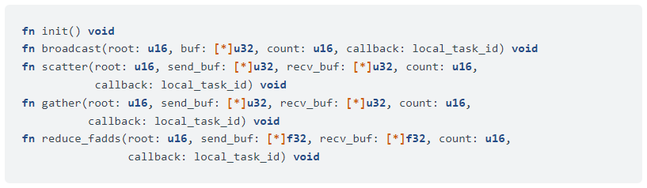
Collective communications library
We can perform collective communications directly using fabric DSDs and setting up the routes like we did with point-to-point communications
But this is time consuming and error prone
Cerebras provides the collectives_2d library with the following functionality
Communications are non-blocking, and activate a task when they complete

Slide 15
Collective communications library: layout.csl
// Colors
const c2d_x_color_0: color = @get_color(0);
const c2d_x_color_1: color = @get_color(1);
const c2d_y_color_0: color = @get_color(4);
const c2d_y_color_1: color = @get_color(5);
// Task IDs
const c2d_x_entrypt_0: local_task_id = @get_local_task_id(10);
const c2d_x_entrypt_1: local_task_id = @get_local_task_id(11);
const c2d_y_entrypt_0: local_task_id = @get_local_task_id(12);
const c2d_y_entrypt_1: local_task_id = @get_local_task_id(13);
const c2d = @import_module("<collectives_2d/params>");
layout {
@set_rectangle(Pw, Ph);
var Px: u16 = 0;
while (Px < Pw) : (Px += 1) {
var Py: u16 = 0;
while (Py < Ph) : (Py += 1) {
const params = c2d.get_params(Px, Py, .{
.x_colors = .{ c2d_x_color_0, c2d_x_color_1 },
.x_entrypoints = .{ c2d_x_entrypt_0, c2d_x_entrypt_1 },
.y_colors = .{ c2d_y_color_0, c2d_y_color_1 },
.y_entrypoints = .{ c2d_y_entrypt_0, c2d_y_entrypt_1 },
});
...
}
}
...
}
The collective communications library contains the get_params helper to set up the context required for collective communications
This involves specifying colors and task ids for communicating in dimensions X and Y
If you look in this file then you will see there are other aspects too, but these should already be familiar

Slide 16
Collective communications library: pe_program.csl
In the pe_program.csl we then initialise the communications library and broadcast data to other PEs (the first argument is the root rank)
Allocate data of size Nx for both the send and recv arrays that are passed to the call
var broadcast_data = @zeros([Nx]u32);
var broadcast_recv = @zeros([Nx]u32);
var ptr_broadcast_data: [*]u32 = &broadcast_data;
var ptr_broadcast_recv: [*]u32 = &broadcast_recv;
task task_x() void {
mpi_x.init();
var send_buf = @ptrcast([*]u32, &broadcast_data);
var recv_buf = @ptrcast([*]u32, &broadcast_recv);
if (mpi_x.pe_id == 0) {
mpi_x.broadcast(0, send_buf, Nx, task_x_id);
} else {
mpi_x.broadcast(0, recv_buf, Nx, task_x_id);
}
}
fn f_run_x() void {
@activate(task_x_id);
}
Get pointers of these arrays which can be provided to the communications library
Initialise the communications library
Cast pointers so they are type compatible with communications library function signature
pe_id member retrieves the ID of the current PE
Issue the broadcast of Nx elements of data with 0 as the root
Called from the host and activates the task_x task with our collectives communication in it

Slide 17
Collective communications library
Our walkthrough example also illustrates a reduction, scatter and gather
[vistor01@sdf-cs1 wt6-routes-fabricDSDs]$ cd ../wt7-collective-communications
[vistor01@sdf-cs1 wt7-collective-communications]$ ./commands.sh
INFO: Using SIF: /home/y26/shared/cs_sdk-1.0.0/cbcore_sdk-202311111408-10-4a54bce5.sif
compile successful
INFO: Using SIF: /home/y26/shared/cs_sdk-1.0.0/cbcore_sdk-202311111408-10-4a54bce5.sif
Pw = width of the core = 15
Ph = height of the core = 15
chunk_size = 3
Nx = 45, Ny = 45
Reading file out/out.json
Reading file out/bin/out_rpc.json
Reading file out/west/out.json
Reading file out/east/out.json
fab w,h = 22,17
Kernel x,y w,h = 4,1 15,15
memcpy x,y w,h = 1,1 20,15
step 1: copy mode H2D(broadcast_data) to 1st column PEs
step 2: copy mode H2D(scatter_data) to 1st row PEs
step 3: call f_run_x to test broadcast and reduction
step 4: call f_run_y to test scatter and gather
step 5: copy mode D2H(broadcast_recv)
step 6: copy mode D2H(faddh_result) from 1st column PEs
step 7: copy mode D2H(gather_recv) from 1st row PEs
SUCCESS
Have a look at the different collective calls in pe_program.csl

Slide 18
Conclusions
The layout.csl file drives the number of PEs and placement of code onto each of them
It’s common to provide the PE id as a parameter (e.g. the loop index variable)
The WSE supports both point-to-point and collective communications
We use colors to specify which virtual channel our 32-bit wavelets will be communicated on between PEs
With in-built intrinsic functions to send and receive the data
The collective communications library provides a convenient way in which we can leverage common collective communication calls between the cores
Detailed documentation is available at https://sdk.cerebras.net/csl/language/libraries#collectives-2d

