Slide 1


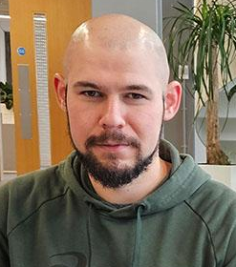



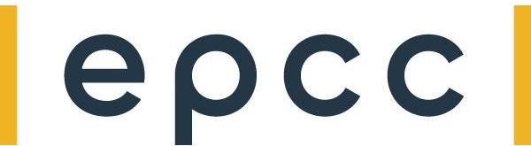
Conclusions and next steps
Nick Brown
EPCC University of Edinburgh
Leighton Wilson
Cerebras Systems
Justs Zarins
EPCC University of Edinburgh
David Kacs
EPCC University of Edinburgh

Slide 2
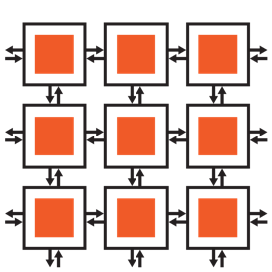
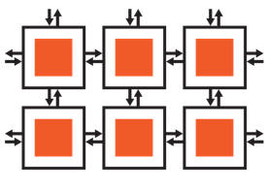
We hope you have enjoyed the tutorial….
…
The Cerebras CS-2 is a powerful system with significant potential for HPC workloads
We have seen that it is programmed using CSL, which is generally fairly similar to other languages but with some specifics for the architecture
We have explored three hands-on activities and run these on a real CS-2 machine
And leveraged the simulator during development, which is standard practice on the CS-2
…
Data
…
Data
…
…
…
…
…
…
…
…
PE
Fabric router
Offramp
Onramp
Processor
Memory

Slide 3
Taking things further
We have covered the basics here which should be enough for you to understand programming of the machine for multi-PE codes
But by necessity we couldn't fit everything in, and there are other aspects you can now explore
More advanced topics
Sentinels
Associates a task ID with routable colors for more routing flexibility
Switches
Runtime control of routes
Filters
Selectively consume wavelets
FIFOs
Hardware queues for buffering
Connecting FIFOs to host-device communication for streaming
More advanced task handling
For scheduling and managing tasks
Storage classes
Making variables visible outside the PE
Modules
For improved structuring of CSL codes
Map builtin
For performing custom operations on DSDs

Slide 4
Cerebras SDK libraries
Complex
For working with complex numbers
Debug
A tracing library for debugging CSL codes
Layout
Access to information about where the PE is located on the WSE
Malloc
Allocation for memory on the WSE
Math
Standard math functions on the WSE
Random
Random number generation
Tile_config
Hardware configuration of the WSE
Time
Timestamping on the WSE
We explored the communications library, but there are others which you might find helpful
Similarly to the communications library, these provide standard API function calls that you can leverage from your code

Slide 5
Example CSL programs are also available
Repository: https://github.com/Cerebras/csl-examples
Introductory Tutorials
GEMV
GEMM
Cholesky Decomposition
1D and 2D FFT
7-Point Stencil SpMV
Power Method
Conjugate Gradient
Preconditioned Conjugate Gradient
Finite Difference Stencil Computations
Mandelbrot Set Generator
Shift-Add Multiplication
Hypersparse SpMV
Histogram Computation

Slide 6
Materials and the CS-2 community
All materials for this tutorial are open source and can be found at
https://github.com/EPCCed/cs2-sdk-training
There is lots of documentation on the Cerebras website on CSL and the SDK
https://sdk.cerebras.net/csl
https://github.com/Cerebras/csl-examples
There is a CS-2 developer community that you can join
Roughly monthly meetings: https://www.cerebras.net/developers/community/
Forums: discourse.cerebras.net
The SDK is free to download, meaning you can have a copy of the compiler and simulator on your own local machine
https://www.cerebras.net/developers/sdk-request/

Slide 7
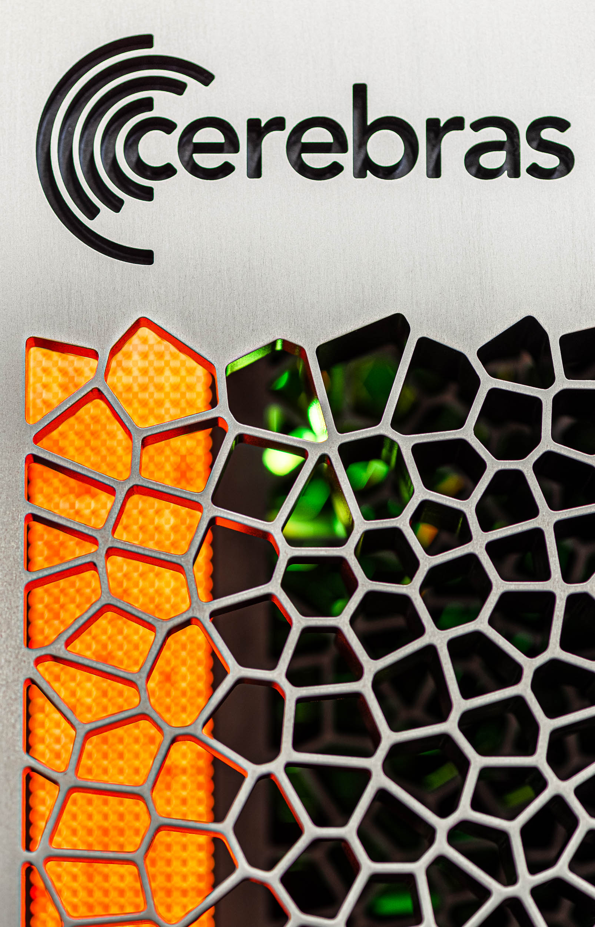
Going forwards…
We are very happy to chat with you about your own codes on the CS-2 and offer any advice that we can here
The visitor accounts will stay open on the EPCC CS-2, so you can continue to experiment with the codes and run on the machine
And remember you can install the SDK locally too
There are also cloud CS-2s hosted by Cerebras

