Slide 1





Hands-on 2: GEMV on a Multiple PEs

Slide 2
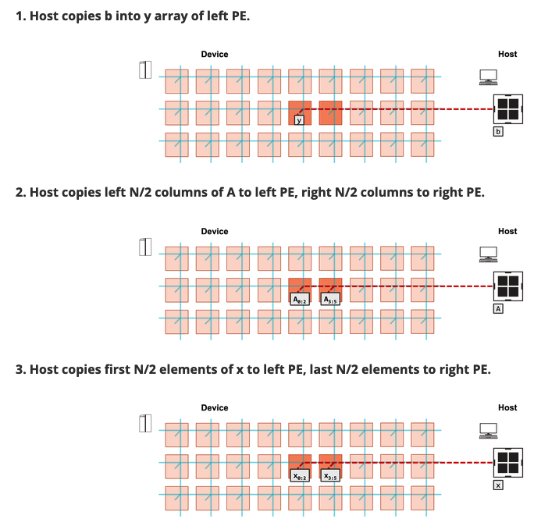
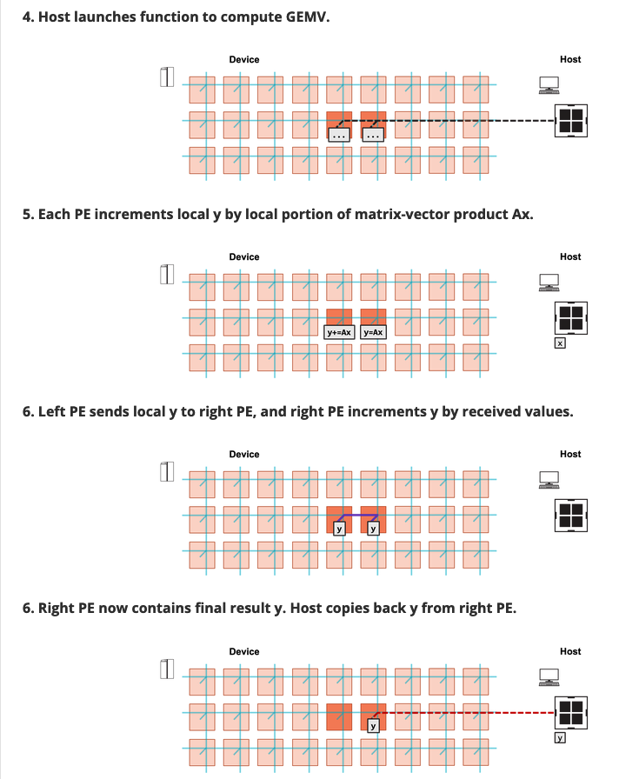
Objective
Perform Matrix-Vector Multiplication on two adjacent PEs
Matrix A of size (MxN with M rows, N columns)
N columns will be split across the two PEs
Vector x of size N
x will be split across two PEs
Vectors b and y of size M
y = b + A*x
Notes:
When programming the CS-2 device, you’ll leverage our new CSL programming language
CSL contains common constructs familiar to most programmers and CSL-specific constructs
We’ll cover what some of these look like,
But most users who have written C or C++ should be very comfortable using CSL

Slide 3
What you need to do here
Hints
In layout.csl:
TO DO 1: set tile code for Left and Right PEs
TO DO 2: set color config for Left and Right PEs
In pe_program.csl:
TO DO 1: Define send_right()
TO DO 2: Define recv_left()
TO DO 3: Define compute() function
Example of setting tile code for multiple PE from walk-through 5
Example of setting color configuration and communication functions from walk-through 6
Notes:
When programming the CS-2 device, you’ll leverage our new CSL programming language
CSL contains common constructs familiar to most programmers and CSL-specific constructs
We’ll cover what some of these look like,
But most users who have written C or C++ should be very comfortable using CSL

Slide 4
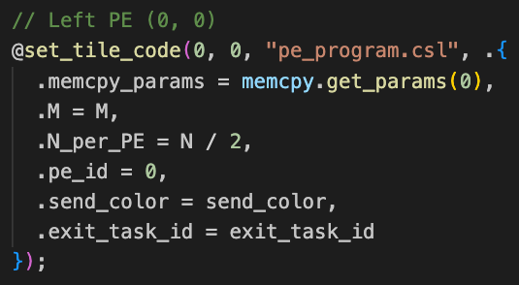
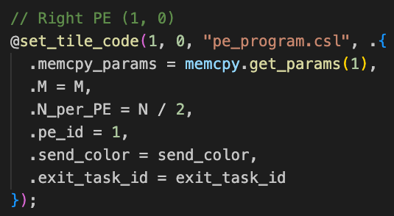
Wash-up for hands on exercise two:
Placing the program on each individual PE by tiling:
As with the walk-through, you can see how we explicitly set the pe_id parameter depending upon whether it’s the left or right neighbour
Notes:
When programming the CS-2 device, you’ll leverage our new CSL programming language
CSL contains common constructs familiar to most programmers and CSL-specific constructs
We’ll cover what some of these look like,
But most users who have written C or C++ should be very comfortable using CSL

Slide 5
Wash-up for hands on exercise two:
Setting the color configuration:
Similarly to the walk-through example, the left PE’s router will receive the wavelet from the ramp and then send it east.
The right PE will receive a wavelet from the west and then send it down the ramp to it’s processor
The send_color variable defines which, of 24, virtual channels the wavelet will travel on
Notes:
When programming the CS-2 device, you’ll leverage our new CSL programming language
CSL contains common constructs familiar to most programmers and CSL-specific constructs
We’ll cover what some of these look like,
But most users who have written C or C++ should be very comfortable using CSL

Slide 6
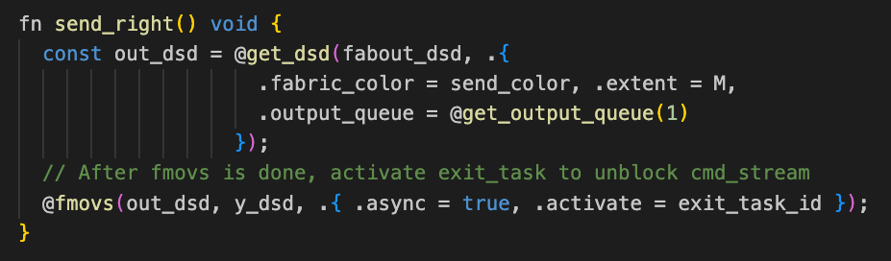
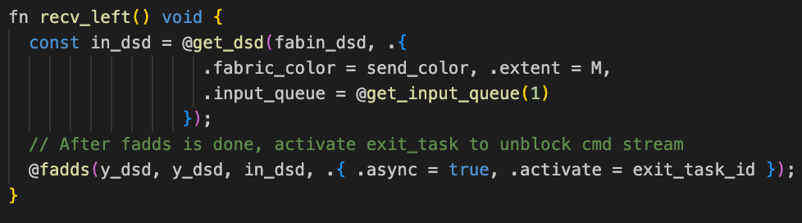
Wash-up for hands on exercise two:
The send_right and recv_left functions will send and receive data respectively
With the recv_left function also undertaking the required operation on the data when it arrives
Notes:
When programming the CS-2 device, you’ll leverage our new CSL programming language
CSL contains common constructs familiar to most programmers and CSL-specific constructs
We’ll cover what some of these look like,
But most users who have written C or C++ should be very comfortable using CSL

Slide 7
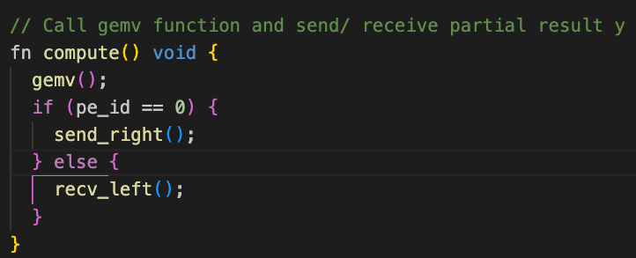
Wash-up for hands on exercise two:
The compute function calls into the gemv function on both PEs, and then branches depending upon the pe_id parameter (the rank of the PE).
Notes:
When programming the CS-2 device, you’ll leverage our new CSL programming language
CSL contains common constructs familiar to most programmers and CSL-specific constructs
We’ll cover what some of these look like,
But most users who have written C or C++ should be very comfortable using CSL

