Slide 1





Cerebras SDK walk-through part one

Slide 2
CSL: Language Basics
Types
Functions
Control structures
Structs/Enums
Comptime
Builtins
Module system
Params
Tasks
Data Structure Descriptors
Layout specification
Straight from C
(via Zig)
Used for writing device kernel code
Familiar to C/C++/HPC programmers
CSL specific
Notes:
When programming the CS-2 device, you’ll leverage our new CSL programming language
CSL contains common constructs familiar to most programmers and CSL-specific constructs
We’ll cover what some of these look like,
But most users who have written C or C++ should be very comfortable using CSL

Slide 3
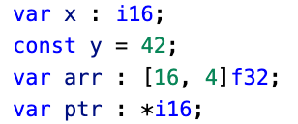
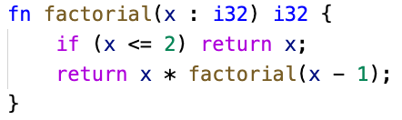
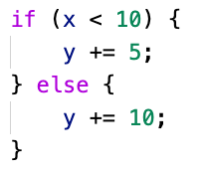
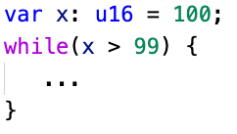
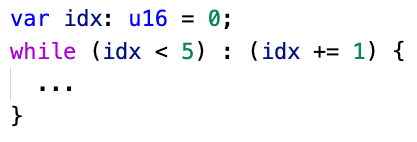
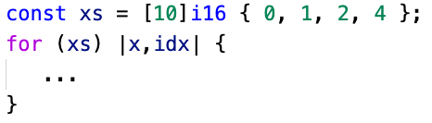
Familiar Features
Types
Syntax similar to other modern languages – Go, Swift, Scala, Rust
Float (f16, f32), signed (i16, i32), unsigned (u16, u32), boolean (bool)
Functions
Zig-style syntax
Pass by value or reference and inlining automatically handled
Control Structures
Traditional control flow: if, for, while, with zig and C style syntax
while loop
while loop with iterator
range for loop
(also provides C-style for)
conditionals

Slide 4
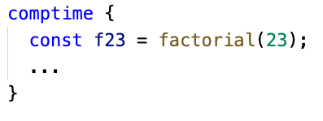
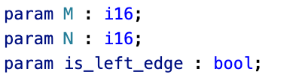
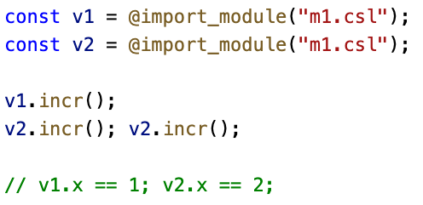
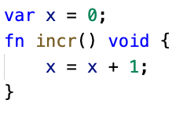
Quality of Life Features
Comptime
From Zig, block of code where all evaluation occurs at compile time
Useful for frontloading computation to avoid runtime overhead
Params
Like #define, but strongly typed
Have to be “bound” completely during compilation
Modules
Any CSL source code file is a “Module,” importable into other modules
Imported modules acts as an instance of a unique struct type
Multiple imports of the same module allowed
p1.csl
m1.csl

Slide 5
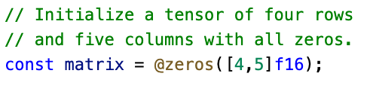
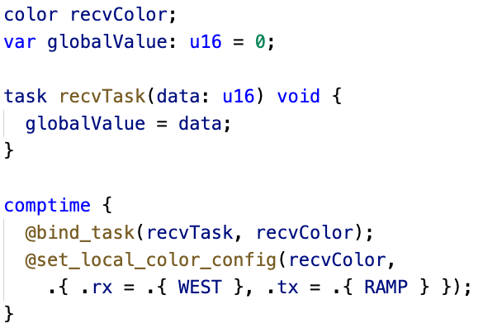
Performance Features
Builtins
Similar to function calls with @ in front of function name
Language extensions without special syntax
Used for invoking special compiler functionality
Tasks
Core building blocks of CSL
Special functions used to implement dataflow programs
Triggered by incoming wavelets on a specific color
var
More details about these can be found in the Cerebras SDK documentation at https://sdk.cerebras.net/

Slide 6
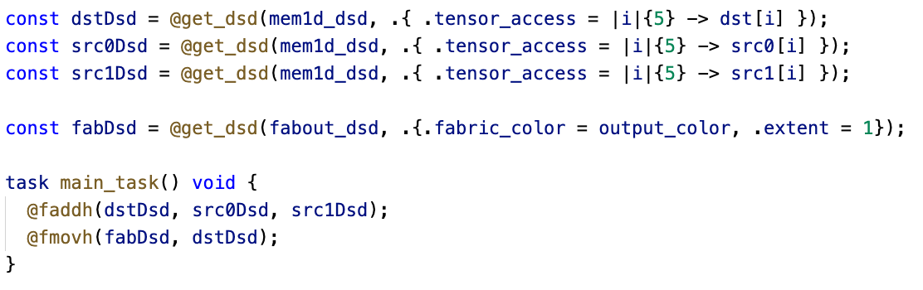
Performance Features
Data Structure Descriptors (DSDs)
Provide a mechanism to consider an array, and an access pattern, as a complete unit
Operations using DSDs run for multiple cycles to complete an instruction on all data referenced by the DSD
Performance and ease of use: lifts level of program to talking about whole structures, while lowering cost of computing indexing into hardware
DSDs are a unifying concept that provides for complex memory reads and writes and fabric reads and writes

Slide 7
Let’s get to accessing the machine
You should have done this already when accessing the CS-2 host a few minutes ago, but in-case not!
Step one – using the visitor account assigned to you, login to our CS-2 host machine
ssh vistor01@sdf-cs1.epcc.ed.ac.uk
We are now logged into the host machine that connects to the CS-2
Step two – clone the tutorial repository
git clone https://github.com/EPCCed/cs2-sdk-training.git
Step three – cd into the cs2-sdk-training/practicals/walk-through which we will be working in for the next part of the tutorial
[vistor01@sdf-cs1 ~]$ cd cs2-sdk-training/practicals/walk-through
[vistor01@sdf-cs1 walk-through]$ ls
wt1-getting-started wt2-basic-syntax wt3-memcpy wt4-memoryDSDs
wt5-multiple-PEs wt6-routes-fabricDSDs wt7-collective-communications
Let one of the tutors know if you are struggling with this

Slide 8
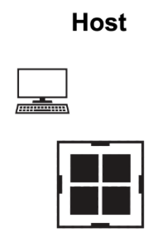
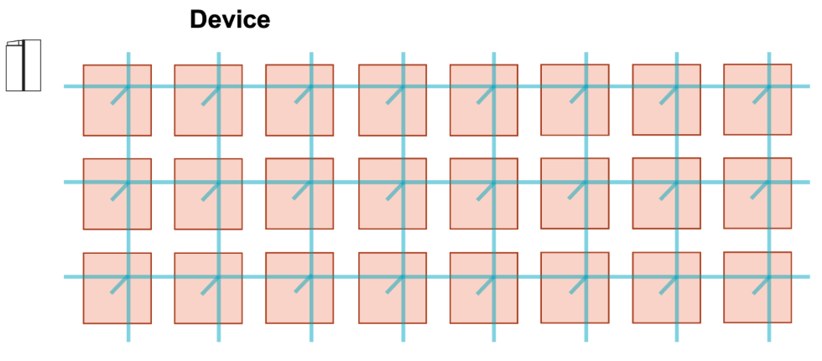
High level view
[vistor01@sdf-cs1 wt1-getting-started]$ ls
run.py layout.csl pe_program.csl commands.sh README.md Makefile
layout.csl
run.py
pe_prog1.csl
pe_prog1.csl
pe_prog...csl
pe_prog2.csl

Slide 9
Running my first CSL program
Change into the wt1-getting-started directory
Compile the code using the cslc command
[vistor01@sdf-cs1 walk-through]$ cd wt1-getting-started
[vistor01@sdf-cs1 wt1-getting-started]$ cslc layout.csl --fabric-dims=8,3 --fabric-offsets=4,1 --memcpy --channels=1 -o out
INFO: Using SIF: /home/y26/shared/cs_sdk-1.0.0/cbcore_sdk-202311111408-10-4a54bce5.sif
compile successful
[nebcs1@sdf-cs1 wt1-getting-started]$ ls out/
bin east out.json west
[nebcs1@sdf-cs1 wt1-getting-started]$ ls out/bin/
out_0_0.elf out_rpc.json
You don’t need to type in or remember the compile and run commands, as we have a helper script that will compile and simulate the code (more on that in a moment)

Slide 10
Running my first CSL program
Run (via the simulator)
[vistor01@sdf-cs1 walk-through]$ cd wt1-getting-started
[vistor01@sdf-cs1 wt1-getting-started]$ cs_python run.py --name out
INFO: Using SIF: /home/y26/shared/cs_sdk-1.0.0/cbcore_sdk-202311111408-10-4a54bce5.sif
Reading file out/out.json
Reading file out/bin/out_rpc.json
Reading file out/west/out.json
Reading file out/east/out.json
fab w,h = 8,3
Kernel x,y w,h = 4,1 1,1
memcpy x,y w,h = 1,1 6,1
SUCCESS!
Congratulations! You have run your first CSL program (although it doesn’t do very much yet!)
You don’t need to type in or remember the compile and run commands, as we have a helper script that will compile and simulate the code (more on that in a moment)

Slide 11
What are these arguments to the CSL compiler?
[vistor01@sdf-cs1 wt1-getting-started]$ cslc layout.csl --fabric-dims=8,3 --fabric-offsets=4,1 --memcpy --channels=1 -o out
--fabric-dims=8,3 defines the size of the simulated fabric, which is 8 x 3
--fabric-offsets=4,1 defines where the program is placed on the fabric.
--memcpy this flag is required to enable memcpy within the host program (we discussed this in the architecture slides)
--channels=1 determines the number of ethernet links that can be used to transfer data to/from the CS-2 (maximum of 12)
-o out is the directory where the executables will be saved

Slide 12
For convenience…..
To avoid you typing the compile and run command each time, we provide these in the commands.sh script that is in each walk through directory
[vistor01@sdf-cs1 wt1-getting-started]$ ./commands.sh
INFO: Using SIF: /home/y26/shared/cs_sdk-1.0.0/cbcore_sdk-202311111408-10-4a54bce5.sif
compile successful
INFO: Using SIF: /home/y26/shared/cs_sdk-1.0.0/cbcore_sdk-202311111408-10-4a54bce5.sif
Reading file out/out.json
Reading file out/bin/out_rpc.json
Reading file out/west/out.json
Reading file out/east/out.json
fab w,h = 8,3
Kernel x,y w,h = 4,1 1,1
memcpy x,y w,h = 1,1 6,1
SUCCESS!

Slide 13
What’s this layout.csl?
Defines the layout of the program on the CS-2
[vistor01@sdf-cs1 wt1-getting-started]$ cslc layout.csl --fabric-dims=8,3 --fabric-offsets=4,1 --memcpy --channels=1 -o out
const LAUNCH: color = @get_color(8);
const memcpy = @import_module("<memcpy/get_params>", .{
.width = 1,
.height = 1,
.LAUNCH = LAUNCH
});
layout {
@set_rectangle(1, 1);
@set_tile_code(0, 0, "pe_program.csl", .{ .memcpy_params = memcpy.get_params(0) });
@export_name("init_and_compute", fn()void);
}
Color (virtual channel) used for Remote Procedure Call (RPC) mechanism
Imports the memcpy module (WSE side of memcpy support) needed to launch kernel
We are using just one PE (columns=1, rows=1)
The lone PE should execute “pe_program.csl” and we pass the memcpy parameters as a parameter
Expose this function “init_and_compute” to the host
In the layout.csl file you will see comments to explain these lines (omitted here for space)

Slide 14
Driving from the host
import argparse
from cerebras.sdk.runtime.sdkruntimepybind import SdkRuntime
# Read arguments
parser = argparse.ArgumentParser()
parser.add_argument('--name', help="the test compile output dir")
parser.add_argument('--cmaddr', help="IP:port for CS system")
args = parser.parse_args()
# Construct a runner using SdkRuntime
runner = SdkRuntime(args.name, cmaddr=args.cmaddr)
# Load and run the program
runner.load()
runner.run()
# Launch the init_and_compute function on device
runner.launch('init_and_compute', nonblock=False)
# Stop the program
runner.stop()
We create an instance of the Cerebras SdkRuntime (the host side library that interacts with the CS-2).
Load our compiled program onto the WSE
Start running the program on the WSE. This won’t do anything yet, it activates and is ready for a Remote Procedure Call (RPC) from the host.
Launch the “init_and_compute” function on the WSE and wait until it has completed
Stop the program on the WSE and clean up

Slide 15
Running on the actual CS-2 (appliance mode)
All our development will be run via the simulator, but we then want to run on the actual machine for production runs
Two changes are required:
How we compile the code and then using the SdkLauncher
https://sdk.cerebras.net/appliance-mode.html
Setup the Python virtual environment:
https://epcced.github.io/eidf-docs/services/cs2/run/
Submit the job via Slurm
We will point you to an example of this in a few minutes

Slide 16
Exploring (and fixing!) the code
Change into the wt2-basic-syntax directory
[vistor01@sdf-cs1 wt1-getting-started]$ cd ../wt2-basic-syntax
We are going to use this as a basis for a (very simple) code update to fix the code

Slide 17
Exploring the pe_program.csl code
// Struct containing parameters for memcpy layout
param memcpy_params: comptime_struct;
const sys_mod = @import_module("<memcpy/memcpy>", memcpy_params);
// Constants defining dimensions of our data
const N: i16 = 3;
// 48 kB of local PE memory contains x and y
var x: [N] f32;
var y: [N] f32;
fn scaled_sum(x_ptr : *[N] i16, y_ptr : *[N], value : i16) void
{
…
}
fn initialize() void {
…
}
fn init_and_compute() void {
…
}
comptime {
// Export function so it is host-callable by RPC mechanism
@export_symbol(init_and_compute);
// Create RPC server using color LAUNCH
@rpc(@get_data_task_id(sys_mod.LAUNCH));
}
Infrastructure we need for the memcpy library support
Defines a constant integer of 16 bits
Declares arrays x and y to be of size N and type single-precision floating point. These are allocated in the PE’s local memory
We will look at these functions in detail in a minute
Sets up the program by exporting the “init_and_compute” function
Create an RPC server (so it can be called from the host) using the color defined in layout.csl

Slide 18
Exploring the pe_program.csl code
This initialise function accepts no arguments and returns no value
fn initialize() void {
for (@range(i16, N)) |idx| {
x[idx] = 1.0;
y[idx] = @as(f32, idx);
}
}
fn init_and_compute() void {
initialize();
scaled_sum(&x, &y, 2);
// After this function finishes, memcpy's cmd_stream must
// be unblocked on all PEs for further memcpy commands
// to execute
sys_mod.unblock_cmd_stream();
}
For loop, looping up to N with the idx variable containing the loop value at each iteration
Accesses the global variables x and y, setting x to be the value 1.0 and y to be the current loop value (cast to a 32-bit floating point)
Entry point called by the host
Calls the initialise function followed by sum , with x and y global variables as arguments and the scalar value 2
After the work completes need to do some cleanup on the command stream to ensure can execute further commands

Slide 19
Exploring the pe_program.csl code
Defines scaled_sum to be a function with a void return type. It accepts three arguments
The value argument is a scalar of type f32 (32-bit float). CSL uses a colon to provide type information
fn scaled_sum(x_ptr : *[N] f32, y_ptr : *[N] f32, value : f32) void
{
for (@range(i16, N)) |idx| {
// TO DO: EDIT following line to multiply value to Right Hand Side
y_ptr.*[idx] += x_ptr.*[idx];
}
}
x_ptr and y_ptr are defined as pointers of over memory of size N. Like C, the asterisk, *, represents a pointer
This is a for loop, which loops over some array and at each iteration the variable idx contains the loop’s current value
This is very similar to a loop in Python but just with a different syntax.
The in-built range function is used here to provide an array containing 0 to N-1 with each element of type i16. Again this is similar to Python’s range function
The .* operator is used to dereference a pointer, so here we are accessing the idx element of y

Slide 20
Fixing the pe_program.csl code
For the algorithm to be correct we need to also multiply by the value scalar on the RHS
Then recompile and run
fn scaled_sum(x_ptr : *[N] f32, y_ptr : *[N] f32, value : f32) void
{
for (@range(i16, N)) |idx| {
// TO DO: EDIT following line to multiply value to Right Hand Side
y_ptr.*[idx] += x_ptr.*[idx];
}
}
This will look something like value * x_ptr.*[idx];
[vistor01@sdf-cs1 wt2-basic-syntax]$ ./commands.sh

Slide 21
Exposing data in layout.csl
What we have done so far isn’t terribly useful as we are not transferring any data to or from the host (so at the very least we can’t even view the results!)
Change into the wt3-memcpy directory
Very similar to our previous layout.csl, with two additional lines that export symbols x and y
const LAUNCH: color = @get_color(8);
const memcpy = @import_module("<memcpy/get_params>", .{
.width = 1,
.height = 1,
.LAUNCH = LAUNCH
});
layout {
@set_rectangle(1, 1);
@set_tile_code(0, 0, "pe_program.csl", .{ .memcpy_params = memcpy.get_params(0) });
@export_name("x", [*]f32, true);
@export_name("y", [*]f32, true);
@export_name("init_and_compute", fn()void);
}
These two new lines of code export symbols x and y so that we can view them from the host

Slide 22
Binding variables to exported symbols x and y
In pe_program.csl we then bind program variables to the symbols x and y that have been exposed to the host
Again very similar to the previous code, with two new lines added here
(plus definitions of x_ptr and y_ptr)
comptime {
// Export symbol pointing to x, y so it is host-read/writeable
@export_symbol(x_ptr, "x");
@export_symbol(y_ptr, "y");
// Export function so it is host-callable by RPC mechanism
@export_symbol(compute);
// Create RPC server using color LAUNCH
@rpc(@get_data_task_id(sys_mod.LAUNCH));
}
These two new lines of code bind our global variables x_ptr and y_ptr to x and y respectively that have been exposed to the host in the layout.csl file

Slide 23
Interfacing from the host
In run.py we then allocate data using Numpy, and can then copy input data it and/or copy results out
# Construct a runner using SdkRuntime
runner = SdkRuntime(args.name, cmaddr=args.cmaddr)
# Get symbol for copying x, y onto and off device
x_symbol = runner.get_id('x')
y_symbol = runner.get_id('y’)
……
y = np.full(shape=N, fill_value=1.0, dtype=np.float32)
x = np.full(shape=N, fill_value=1.0, dtype=np.float32)
runner.memcpy_h2d(x_symbol, x, 0, 0, 1, 1, N, streaming=False,
order=MemcpyOrder.ROW_MAJOR, data_type=MemcpyDataType.MEMCPY_32BIT, nonblock=False)
runner.memcpy_h2d(y_symbol, y, 0, 0, 1, 1, N, streaming=False,
order=MemcpyOrder.ROW_MAJOR, data_type=MemcpyDataType.MEMCPY_32BIT, nonblock=False)
# Launch the compute function on device
runner.launch('compute', nonblock=False)
# Copy y back from device
y_result = np.zeros([N], dtype=np.float32)
runner.memcpy_d2h(y_result, y_symbol, 0, 0, 1, 1, N, streaming=False,
order=MemcpyOrder.ROW_MAJOR, data_type=MemcpyDataType.MEMCPY_32BIT, nonblock=False)
Retrieve references to the x and y symbols on the device
Using numpy to allocate (and initialise) input data on the host
Copy both fields on the host to the CS-2 device
Run the compute function on the device and wait for completion
Allocate result data on the host and copy back data held referenced by the y symbol

Slide 24
Let’s see if this works….
[vistor01@sdf-cs1 wt2-basic-syntax]$ cd ../wt3-memcpy
[vistor01@sdf-cs1 wt3-memcpy]$ ./compile.sh
INFO: Using SIF: /home/y26/shared/cs_sdk-1.0.0/cbcore_sdk-202311111408-10-4a54bce5.sif
compile successful
INFO: Using SIF: /home/y26/shared/cs_sdk-1.0.0/cbcore_sdk-202311111408-10-4a54bce5.sif
Reading file out/out.json
Reading file out/bin/out_rpc.json
Reading file out/west/out.json
Reading file out/east/out.json
fab w,h = 8,3
Kernel x,y w,h = 4,1 1,1
memcpy x,y w,h = 1,1 6,1
Traceback (most recent call last):
File "run.py", line 66, in <module>
np.testing.assert_allclose(y_result, expected_y, atol=0.01, rtol=0)
AssertionError:
Not equal to tolerance rtol=0, atol=0.01
Mismatched elements: 3 / 3 (100%)
Max absolute difference: 1.
Max relative difference: 0.33333334
x: array([2., 2., 2.], dtype=float32)
y: array([3., 3., 3.], dtype=float32)
The assertion at the end of run.py fails, can you change the value in pe_program.csl to fix this?
Hint: Look at the value in program.csl passed to the sum function. Ask one of the tutors if you get stuck here

Slide 25
How to run on the actual CS-2 hardware
We have provided wafer-version-wt3-memcpy in the repository
This is a version of wt3-memcpy, but runs on the CS-2 instead of via the simulator
We have included an example Slurm script, and the required modifications to the run.py file
Executed via submit sbatch.sh
This submission script will first compile, and then run on the CS-2
Still need to set up your virtual environment as per https://epcced.github.io/eidf-docs/services/cs2/run/
Later on in the hands-on, if you want to run on the actual CS-2 you can use this

Slide 26
Memory Data Structure Descriptors (DSDs)
Provides a mechanism for efficiently performing operations on arrays of data (known as tensors)
By describing operation at this more abstract level, the CSL compiler has more information upon which it can then determine the best way to drive the actual code
There are two steps to using DSDs:
Define the DSD(s)
Use builtin operations to operate upon your defined DSDs
N is the loop bound (i.e. loop all the way to N)
Array access expression evaluated at each iteration
Handle to the newly created DSD
Tell CSL that we work with a 1D array
i is the induction variable
var x_dsd = @get_dsd(mem1d_dsd, .{ .tensor_access = |i|{N} -> x[i] });
var A_dsd = @get_dsd(mem1d_dsd, .{ .tensor_access = |i|{M} -> A[i*N] });
This DSD is slightly more complicated, accessing the i*N element at each iteration, i.e. it loops until M, but at each iteration the loop access is strided by N

Slide 27
Memory Data Structure Descriptors (DSDs)
// DSDs for accessing x, y
// .tensor_access field defines the access pattern of these DSD
// |i| specifies the induction variable
// {N} specifies the loop bound
var x_dsd = @get_dsd(mem1d_dsd, .{ .tensor_access = |i|{N} -> x[i] });
var y_dsd = @get_dsd(mem1d_dsd, .{ .tensor_access = |i|{N} -> y[i] });
Creates DSDs for both x and y
We use the fmacs builtin that executes a multiply accumulate
The line of code will be @fmacs(y_dsd, y_dsd, x_dsd, a);
cd into wt4-memoryDSDs and replace the loop in the scaled_sum function of program.csl with this DSD operation
The answer is on the next slide!
[vistor01@sdf-cs1 wt3-memcpy]$ cd ../wt4-memoryDSDs

Slide 28
Memory Data Structure Descriptors (DSDs)
// DSDs for accessing x, y
// .tensor_access field defines the access pattern of these DSD
// |i| specifies the induction variable
// {N} specifies the loop bound
var x_dsd = @get_dsd(mem1d_dsd, .{ .tensor_access = |i|{N} -> x[i] });
var y_dsd = @get_dsd(mem1d_dsd, .{ .tensor_access = |i|{N} -> y[i] });
fn compute() void {
const a: f32 = 2.0;
// @fmacs is a builtin for multiply-add that operates on DSDs
@fmacs(y_dsd, y_dsd, x_dsd, a);
// After this function finishes, memcpy's cmd_stream must
// be unblocked on all PEs for further memcpy commands
// to execute
sys_mod.unblock_cmd_stream();
}
We have replaced the loop (in fact, the whole scaled_sum function call) with the fused multiple add DSD intrinsic
[vistor01@sdf-cs1 wt4-memoryDSDs]$ ./commands.sh

Slide 29
Conclusions
We have explored the key concepts required for getting started in writing code for the Cerebras CS-2
This is enough for our first hands-on activity
Which we will introduce you to in a moment!
Our focus so far has been on a single Processing Element (PE)
For now we will limit our focus to this
In the second part of the walk through (after the break) we will explore running on multiple PEs and communicating data between them

