Slide 1
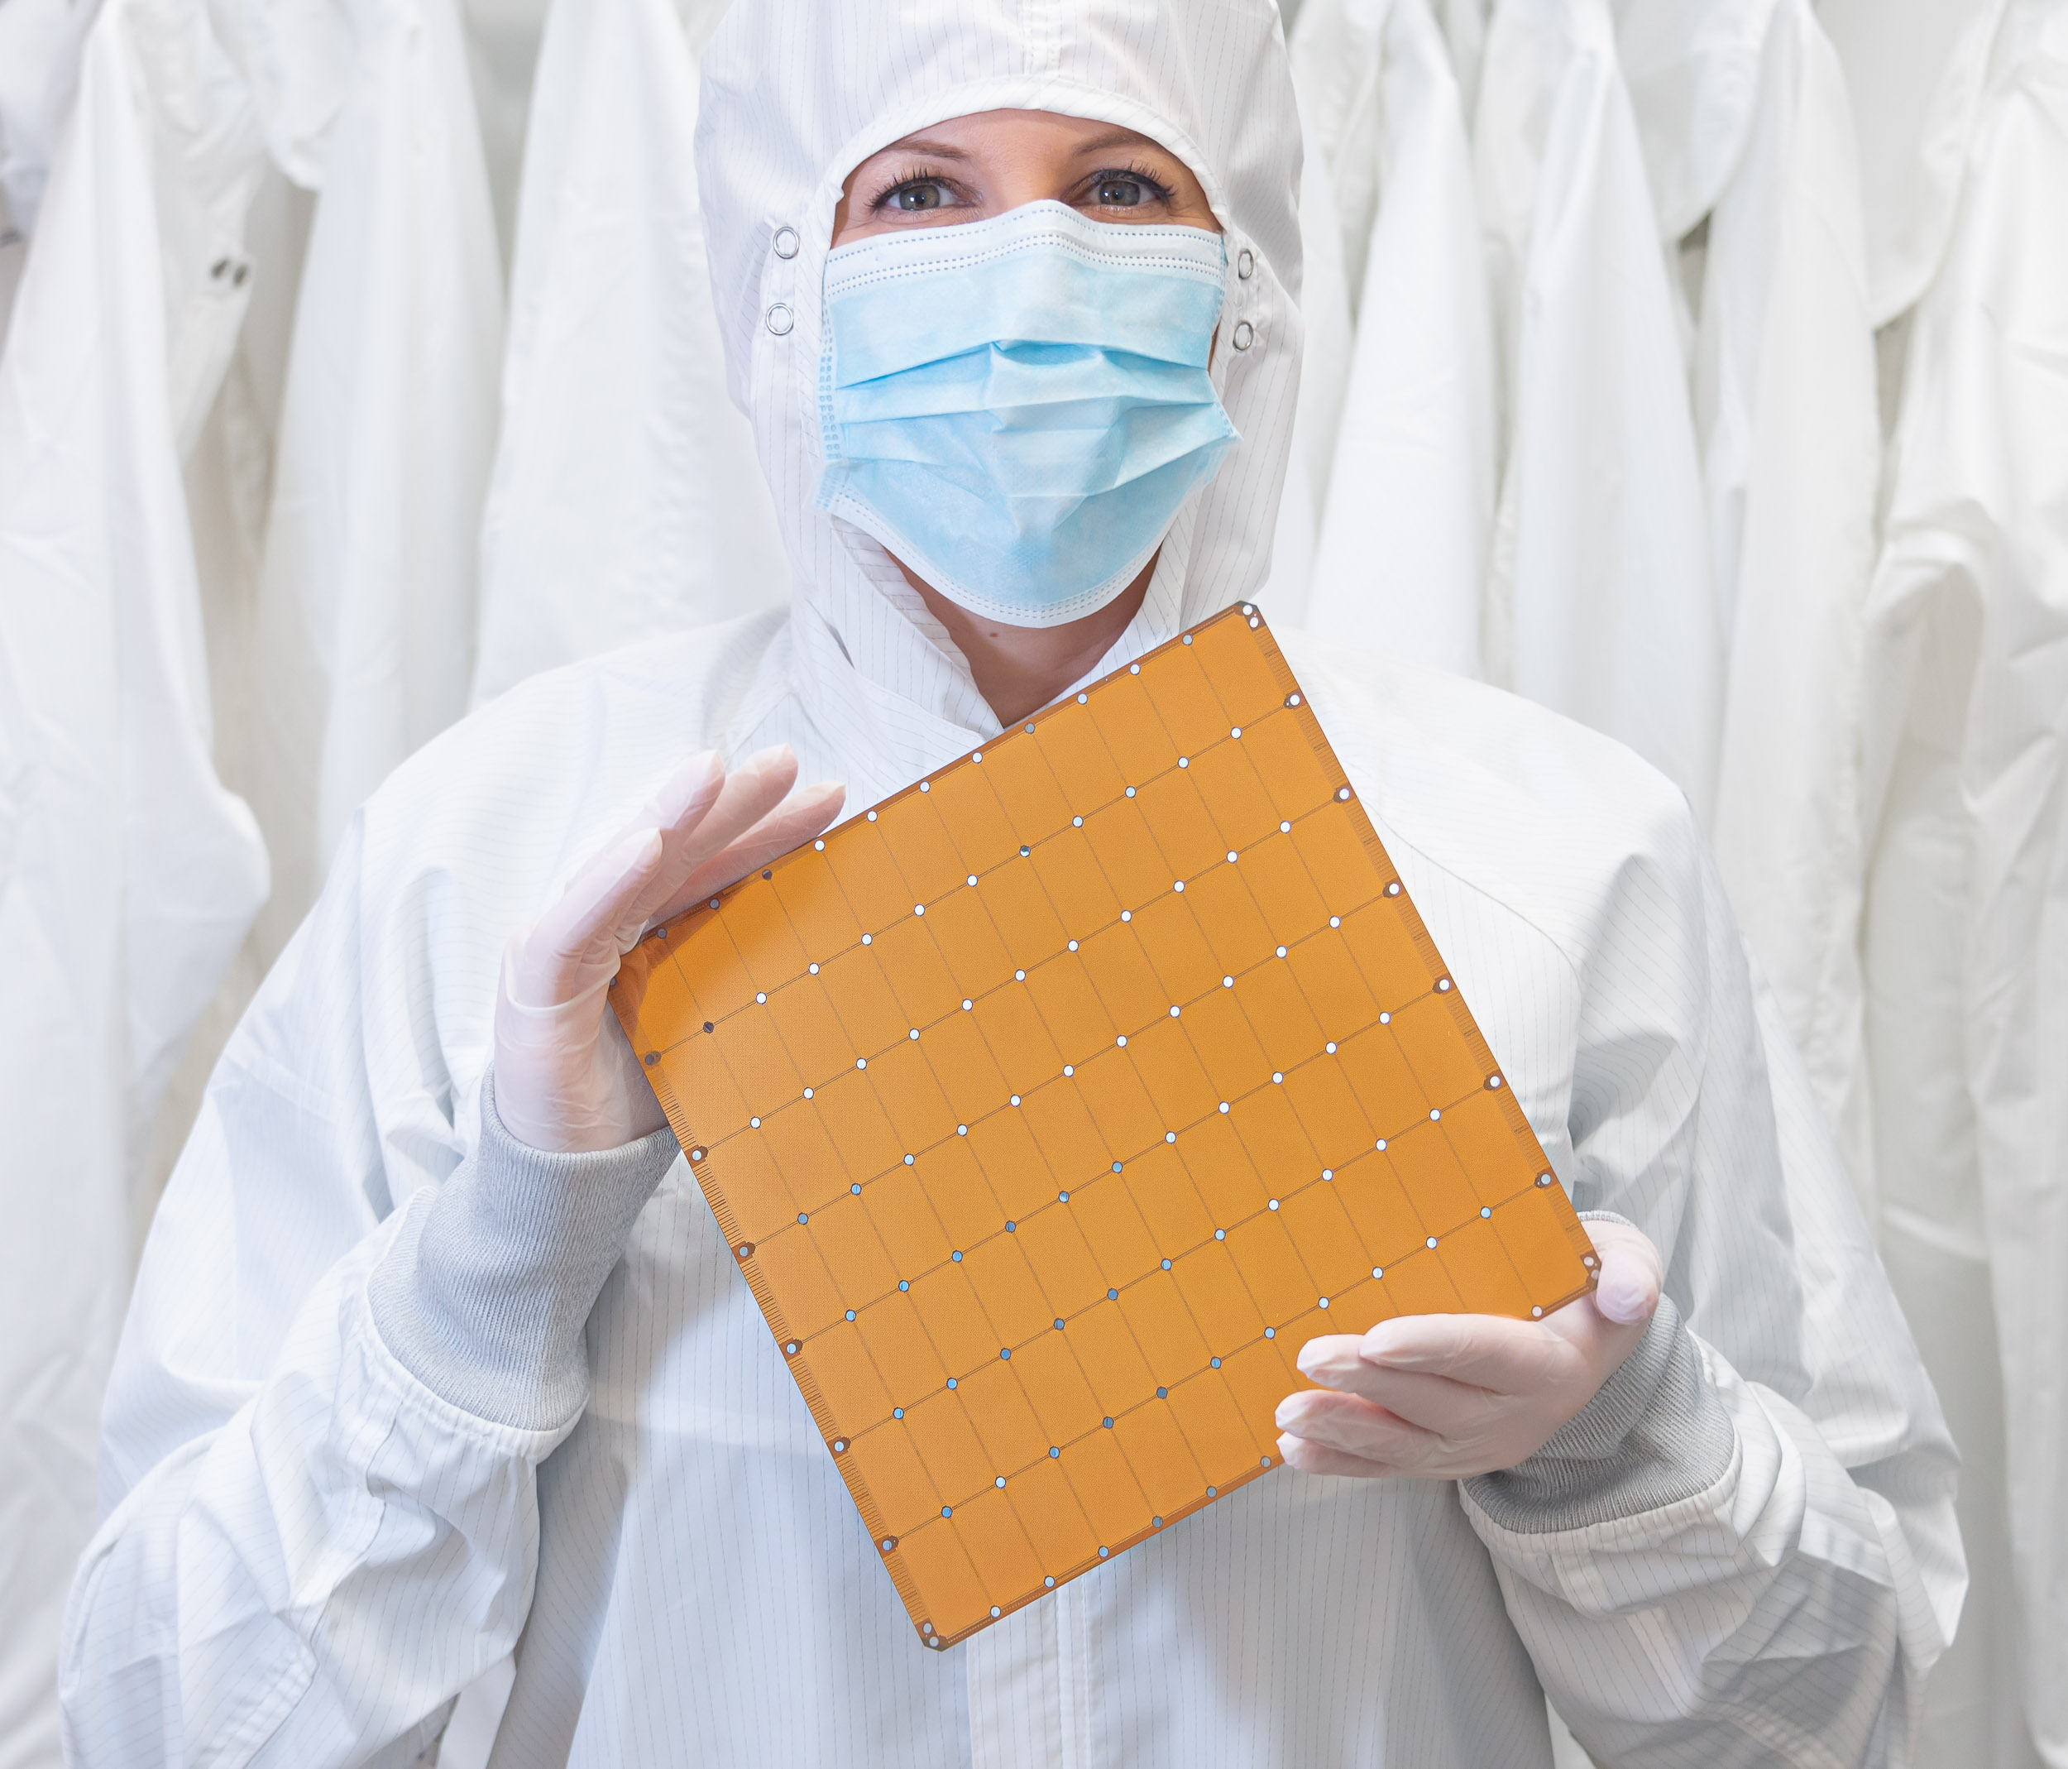



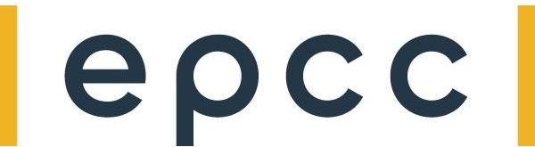
Hands-on 1: GEMV on a Single PE

Slide 2
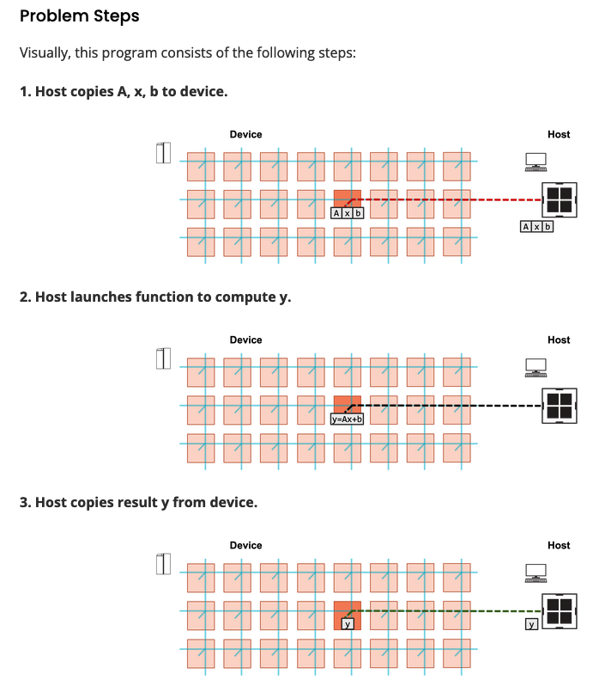
Objective and steps
Perform Matrix-Vector Multiplication on a Single PE
Matrix A of size (MxN – M rows, N columns)
Vector x of size N
Vectors b and y of size M
y = b + A*x
for i from 0 to M-1:
tmp = 0.0
for j from 0 to N-1:
tmp += A[i*N + j] *x [j]
y[i] = tmp + b[i]
Notes:
When programming the CS-2 device, you’ll leverage our new CSL programming language
CSL contains common constructs familiar to most programmers and CSL-specific constructs
We’ll cover what some of these look like,
But most users who have written C or C++ should be very comfortable using CSL

Slide 3
What you need to do here
In pe_program.csl:
TO DO 2: Construct gemv() function
Option 1 (simpler) – use a for-loop
Option 2 (more advanced) – use memory DSDs
In layout.csl:
TO DO 1: Define parameters for matrix dimensions
In run.py:
TO DO 1: Copy A, x, b to device via memcpy
TO DO 2: Copy y back from device via memcpy
Hints
Example of param from walk-through 2
Example of memcpy from walk-through 3
Example of memory DSD from walkthrough 4
for i from 0 to M-1:
tmp = 0.0
for j from 0 to N-1:
tmp += A[i*N + j] *x [j]
y[i] = tmp + b[i]
Notes:
When programming the CS-2 device, you’ll leverage our new CSL programming language
CSL contains common constructs familiar to most programmers and CSL-specific constructs
We’ll cover what some of these look like,
But most users who have written C or C++ should be very comfortable using CSL

Slide 4
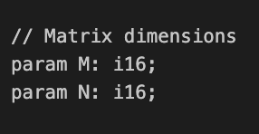
Wash-up for hands on exercise one:
Key points:
Parameters: (in pe_program.csl and layout.csl):
Notes:
When programming the CS-2 device, you’ll leverage our new CSL programming language
CSL contains common constructs familiar to most programmers and CSL-specific constructs
We’ll cover what some of these look like,
But most users who have written C or C++ should be very comfortable using CSL

Slide 5
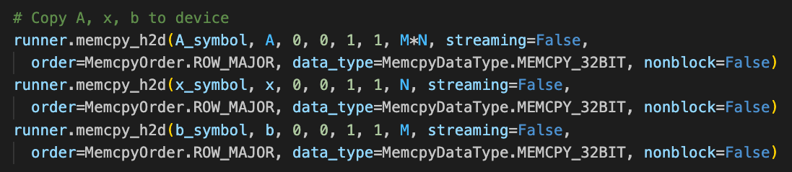
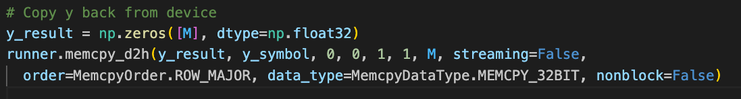
Wash-up for hands on exercise one:
Memcpy in the host code run.py
Notes:
When programming the CS-2 device, you’ll leverage our new CSL programming language
CSL contains common constructs familiar to most programmers and CSL-specific constructs
We’ll cover what some of these look like,
But most users who have written C or C++ should be very comfortable using CSL

Slide 6
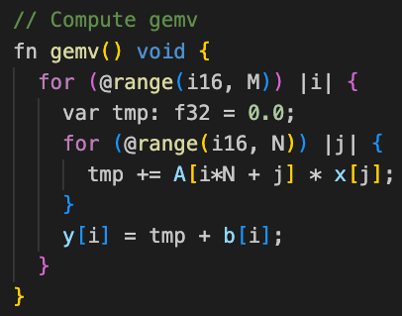
Wash-up for hands on exercise one: gemv() solution A
This is the approach that will be more familiar to people
We use two for loops, looping over the column and row
Notes:
When programming the CS-2 device, you’ll leverage our new CSL programming language
CSL contains common constructs familiar to most programmers and CSL-specific constructs
We’ll cover what some of these look like,
But most users who have written C or C++ should be very comfortable using CSL

Slide 7
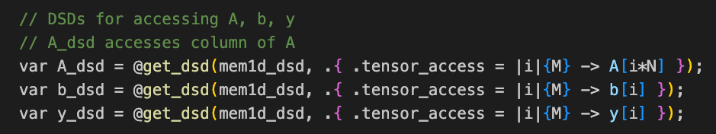
Wash-up for hands on exercise one : gemv() solution B
However, we can potentially obtain more performance by using DSDs, as this provides the compiler with our intentions, and it is then free to implement this as it sees best
The plan
Have a single for loop over the columns, in this we issue @fmacs
The @fmacs operation performs multiply-add in single precision
DSDs: b_dsd and y_dsd are straightforward as these access all elements
The A_dsd accesses each column (A is stored in row major format)
Notes:
When programming the CS-2 device, you’ll leverage our new CSL programming language
CSL contains common constructs familiar to most programmers and CSL-specific constructs
We’ll cover what some of these look like,
But most users who have written C or C++ should be very comfortable using CSL

Slide 8
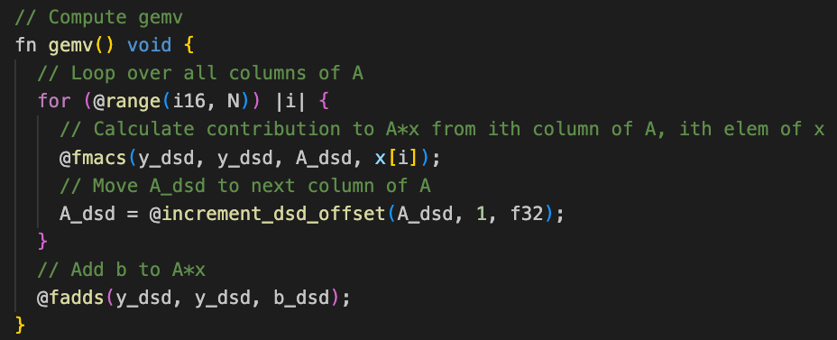
Wash-up for hands on exercise one : gemv() solution B
The single for loop iterates over columns, performs the @fmacs operation and then increments the A_dsd offset
This increment is done so we can access the next column in the next iteration
@fadds is used for the final addition of b_dsd
Notes:
When programming the CS-2 device, you’ll leverage our new CSL programming language
CSL contains common constructs familiar to most programmers and CSL-specific constructs
We’ll cover what some of these look like,
But most users who have written C or C++ should be very comfortable using CSL

