Slide 1
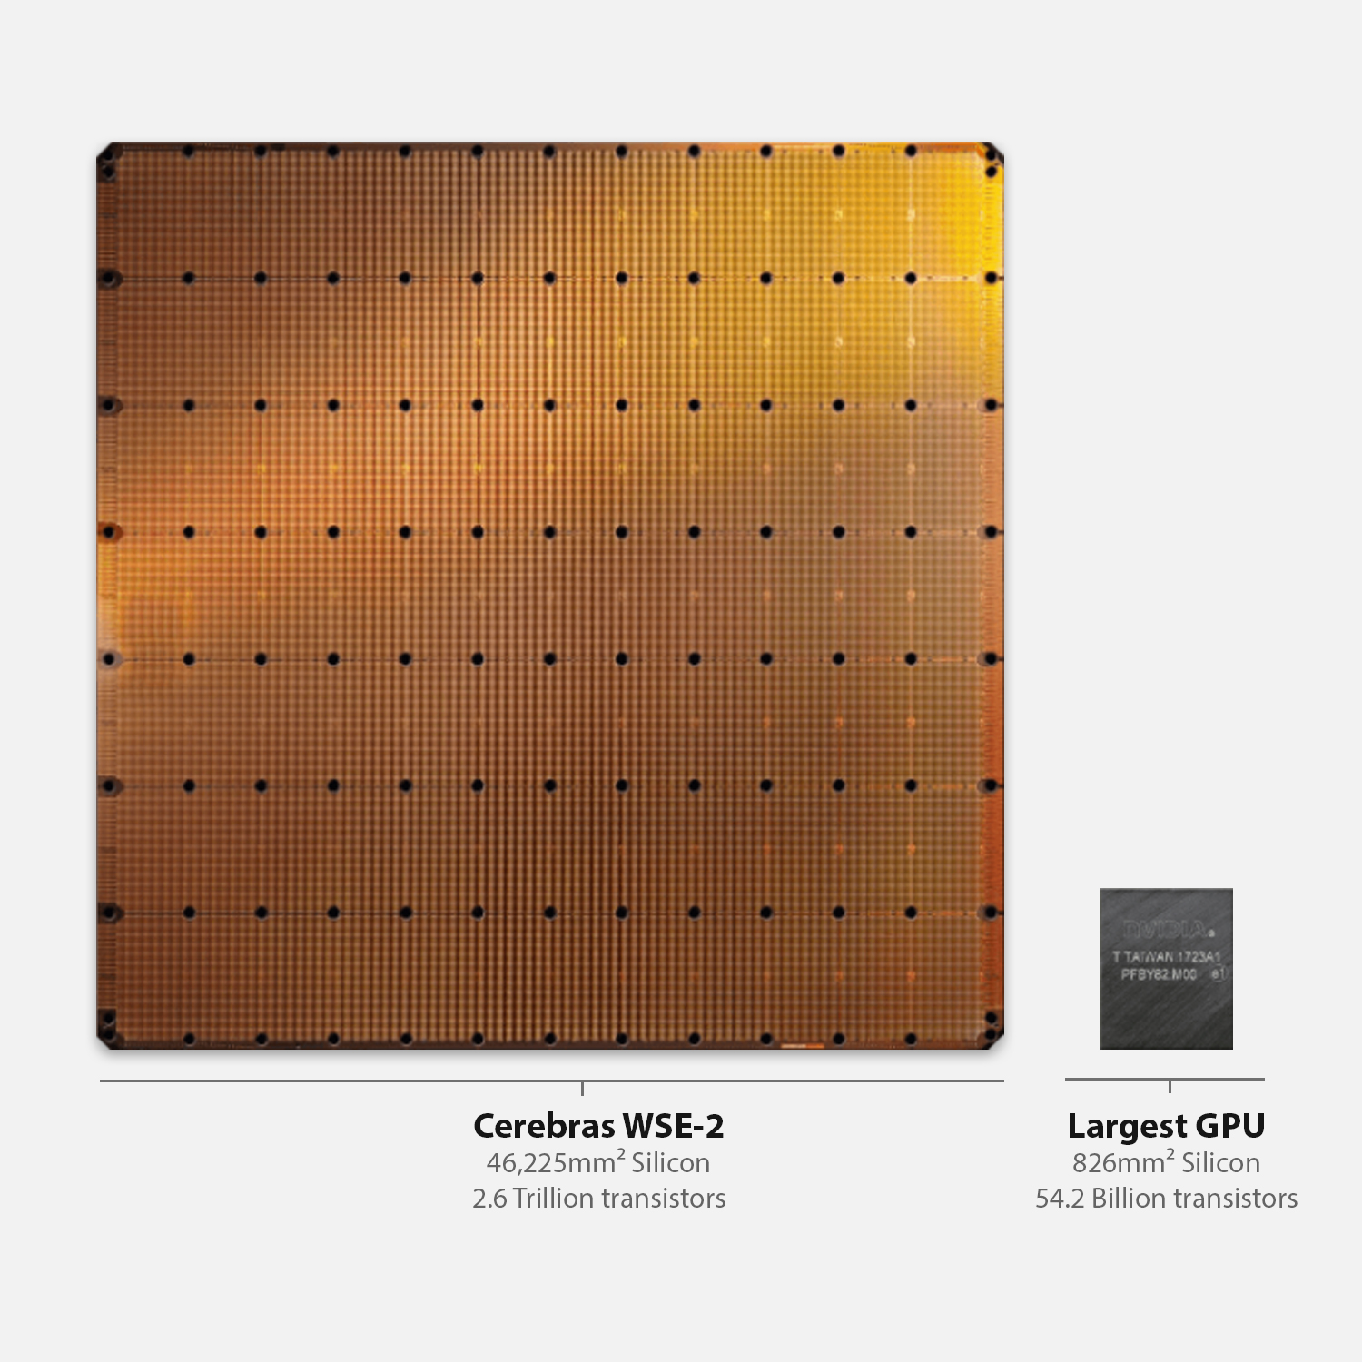
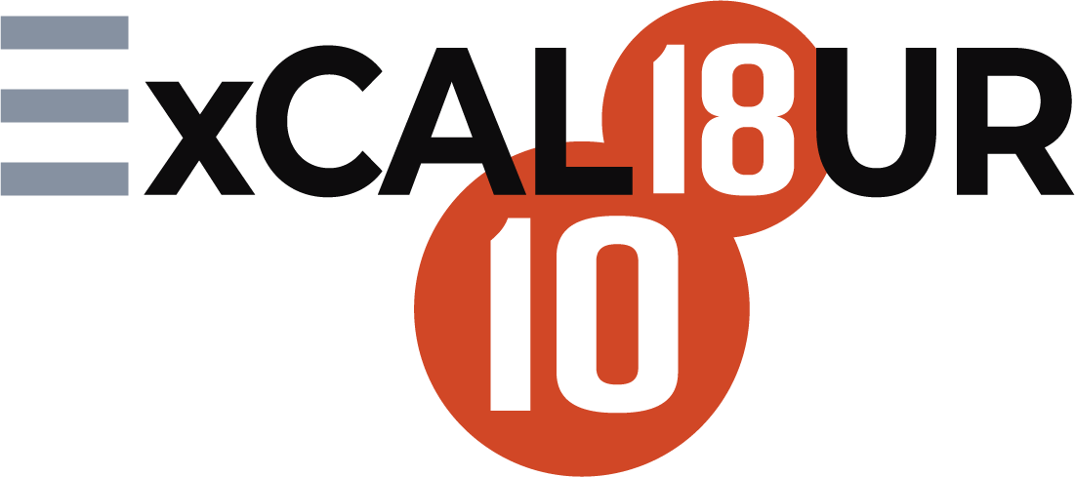

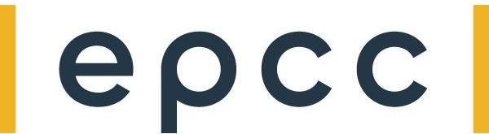
Hands-on 1: GEMV on a Single PE

Slide 2
Objective
Perform Matrix-Vector Multiplication on a Single PE
Matrix A of size (MxN – M rows, N columns)
Vector x of size N
Vectors b and y of size M
y = b + A@x
Notes:
When programming the CS-2 device, you’ll leverage our new CSL programming language
CSL contains common constructs familiar to most programmers and CSL-specific constructs
We’ll cover what some of these look like,
But most users who have written C or C++ should be very comfortable using CSL

Slide 3
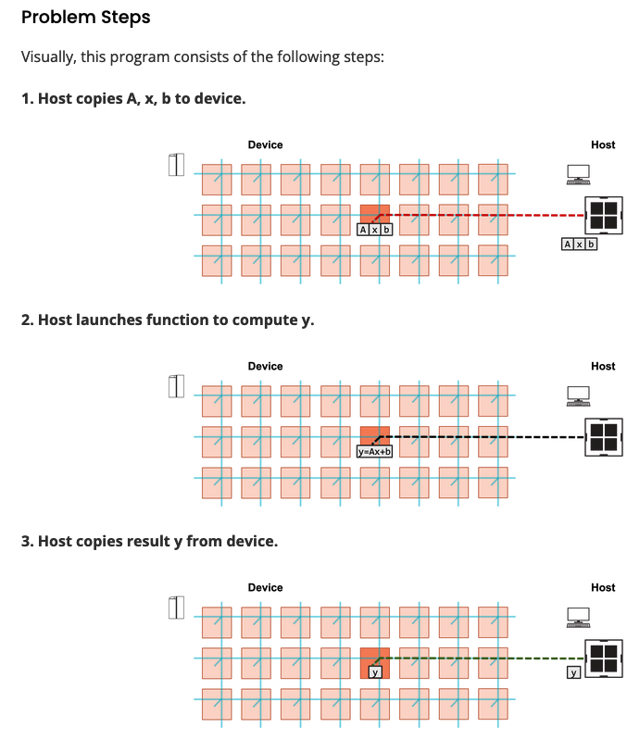
Steps
Notes:
When programming the CS-2 device, you’ll leverage our new CSL programming language
CSL contains common constructs familiar to most programmers and CSL-specific constructs
We’ll cover what some of these look like,
But most users who have written C or C++ should be very comfortable using CSL

Slide 4
To do:
In pe_program.csl:
TO DO 2: Construct gemv() function
Option 1 (simpler) – use a for-loop
Option 2 (harder) – use memory DSDs
In layout.csl:
TO DO 1: Define parameters for matrix dimensions
In run.py:
TO DO 1: Copy A, x, b to device via memcpy
TO DO 2: Copy y back from device via memcpy
Notes:
When programming the CS-2 device, you’ll leverage our new CSL programming language
CSL contains common constructs familiar to most programmers and CSL-specific constructs
We’ll cover what some of these look like,
But most users who have written C or C++ should be very comfortable using CSL

Slide 5
Hints:
Example of param from walk-through 2
Example of memcpy from walk-through 3
Example of memory DSD from walkthrough 4
Notes:
When programming the CS-2 device, you’ll leverage our new CSL programming language
CSL contains common constructs familiar to most programmers and CSL-specific constructs
We’ll cover what some of these look like,
But most users who have written C or C++ should be very comfortable using CSL

Slide 6
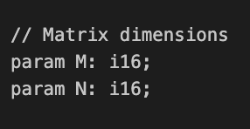
Wash-up for ex1:
Key points:
Parameters: (in pe_program.csl + layout.csl):
Notes:
When programming the CS-2 device, you’ll leverage our new CSL programming language
CSL contains common constructs familiar to most programmers and CSL-specific constructs
We’ll cover what some of these look like,
But most users who have written C or C++ should be very comfortable using CSL

Slide 7
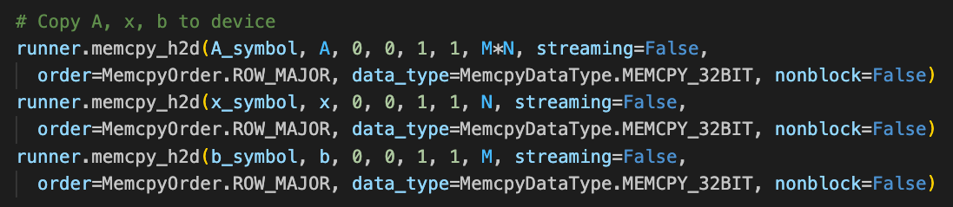
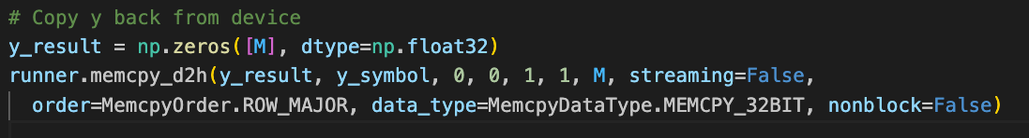
Wash-up for ex1:
Memcpy in host code run.py
Notes:
When programming the CS-2 device, you’ll leverage our new CSL programming language
CSL contains common constructs familiar to most programmers and CSL-specific constructs
We’ll cover what some of these look like,
But most users who have written C or C++ should be very comfortable using CSL

Slide 8
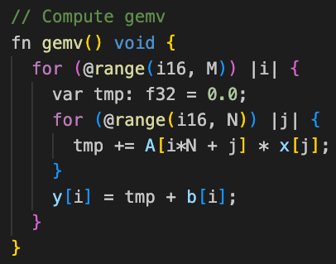
Wash-up for ex1: gemv() solution A:
Two for loops: column and row
Notes:
When programming the CS-2 device, you’ll leverage our new CSL programming language
CSL contains common constructs familiar to most programmers and CSL-specific constructs
We’ll cover what some of these look like,
But most users who have written C or C++ should be very comfortable using CSL

Slide 9
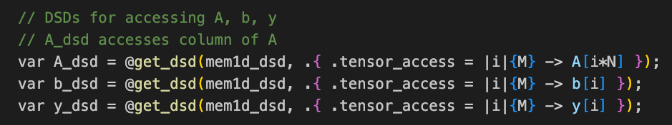
Wash-up for ex1: gemv() solution B:
Single for loop + @fmacs (multiply-add – single precision)
DSDs: b_dsd and y_dsd straightforward, access all elements
A_dsd access each column (A is stored in row major)
Notes:
When programming the CS-2 device, you’ll leverage our new CSL programming language
CSL contains common constructs familiar to most programmers and CSL-specific constructs
We’ll cover what some of these look like,
But most users who have written C or C++ should be very comfortable using CSL

Slide 10
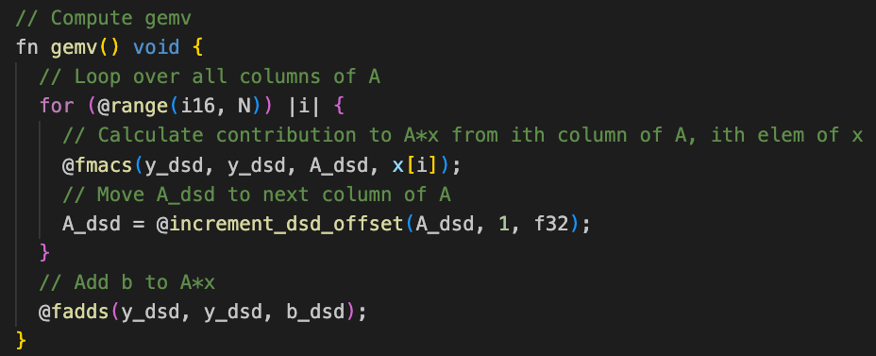
Wash-up for ex1: gemv() solution B:
Single for loop + @fmacs (multiply-add – single precision)
Each for-loop step incremenets dsd offset, i.e. access next column
fadds for final addition of b
Notes:
When programming the CS-2 device, you’ll leverage our new CSL programming language
CSL contains common constructs familiar to most programmers and CSL-specific constructs
We’ll cover what some of these look like,
But most users who have written C or C++ should be very comfortable using CSL

Slide 11
Wash-up for ex1:
Questions?
Notes:
When programming the CS-2 device, you’ll leverage our new CSL programming language
CSL contains common constructs familiar to most programmers and CSL-specific constructs
We’ll cover what some of these look like,
But most users who have written C or C++ should be very comfortable using CSL

