Slide 1
ISORROPIA-ΙΙ
ISORROPIA-II calculates:
the composition and phase state of an NH₄⁺-SO₄²⁻-NO₃⁻-Cl⁻-Na⁺-Ca²⁺-K⁺-Mg²⁺-water inorganic aerosol in equilibrium with gases
Liquid phase
Non-volatile: Na⁺, Ca²⁺, K⁺, Mg²⁺, H⁺, OH⁻, HSO₄⁻, SO₄²⁻
Semi-volatile:
NH₄⁺, NO₃⁻, Cl⁻, H₂O
Gas phase
HNO₃, HCl, NH₃, H₂O
http://isorropia.epfl.ch

Slide 2
ISORROPIA-ΙΙΙ, ISORROPIA-Lite
ISORROPIA-3 calculates:
the composition and phase state of an NH₄⁺-SO₄²⁻-NO₃⁻-Cl⁻-Na⁺-Ca²⁺-K⁺-Mg²⁺-Org-water inorganic aerosol in equilibrium with gases
Assumptions:
One phase where organics are mixed with inorganics
Effect of organics is to include water in the partitioning of inorganics
Water uptake is parameterized in terms of organic mass, and hygroscopicity parameter
Lite version: metastable aerosol only
Full version: stable/metastable option also
Liquid phase
Non-volatile: Na⁺, Ca²⁺, K⁺, Mg²⁺, H⁺, OH⁻, HSO₄⁻, SO₄²⁻
Organics
Semi-volatile:
NH₄⁺, NO₃⁻, Cl⁻, H₂O
Gas phase
HNO₃, HCl, NH₃, H₂O
http://isorropia.epfl.ch

Slide 3
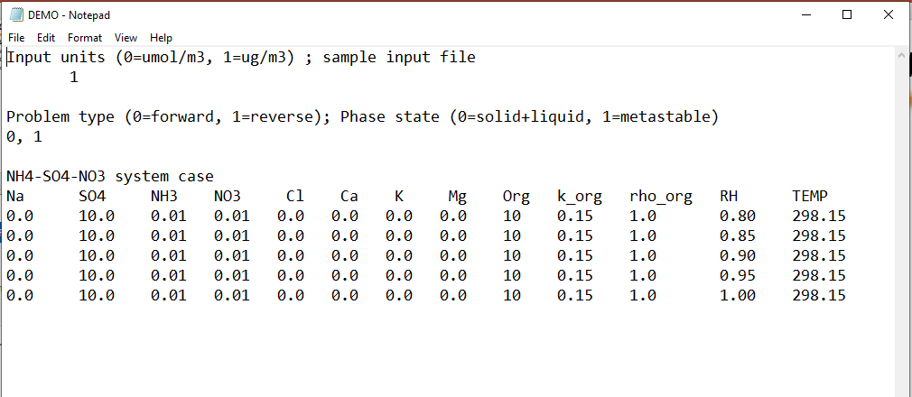
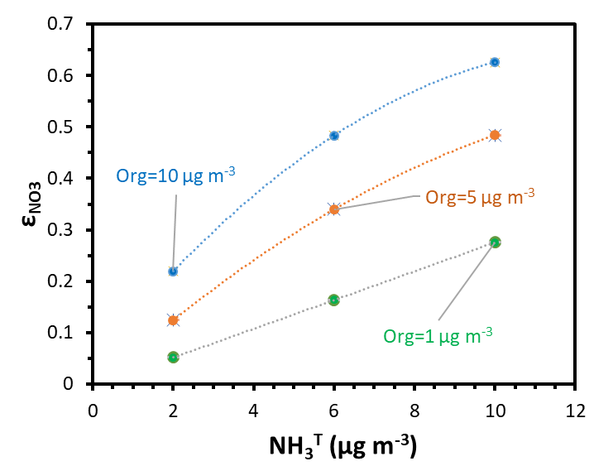
ISORROPIA-3 (some results)
Modified Input file (shaded column is the only change)

