Slide 1
Weight Erosion: A novel personalized FL method
Felix Grimberg, CSE master student
Supervisors: Mary-Anne Hartley, Martin Jaggi, Sai Karimireddy, Andres Colubri
---
June 19th, 2020
Notes:
Hi everyone, thank you for coming to the presentation of my semester project on the UKF
I came to EPFL to study CSE. Looked for semester project here because I am concerned with global warming and I hope to contribute to the future of energy to combat it.
-> next slide
30s

Slide 2




Federated Learning & personalization
Data can’t be shared (private)
IID?
Individual data sets too small
Local fine-tuning, MAML
Featurization
Multi-task learning
Notes:
Most are familiar, still 2-minute introduction to FL:
Federated Learning: ML on data that's collected by many individual agents (i.e., smartphones or hospitals) without first aggregating (privacy)
Data is often not IID across agents.
For instance, you could imagine that data collected on patients at two hospitals that are half a continent apart would not be identically distributed, due to the presence of some confounding variables.
This gives rise to the task of model personalization, where the agents collaborate to train a plurality of models ( one per agent, or per cluster, ...).
You could train one global model -> wouldn't transfer well to the local distribution due to non-IID-ness.
You could train a local model, but if you don't have enough samples it won't generalize well.
Use some amount of data from other agents to find a balance between specializing well and generalizing well.
Some methods in the literature:
Local fine-tuning of the globally trained model by doing a few SGD steps on the local set,
with some variants called MAML (model-agnostic meta-learning) where you train the global model specifically to be good for fine-tuning.
Featurize certain context information
Multi-task learning where you learn a clustering of the agents at the same time as you're learning the models for each cluster

Slide 3
My contribution
Theory
Adapted Ndoye factor
Rank agents before training
Weight Erosion
Application
Medical data set
Titanic data set
Notes:
What I did:
Introduced two novel model personalization methods with a theoretical discussion
implemented one of them and tested it on a medical data set and on the Titanic data set.

Slide 4
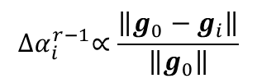

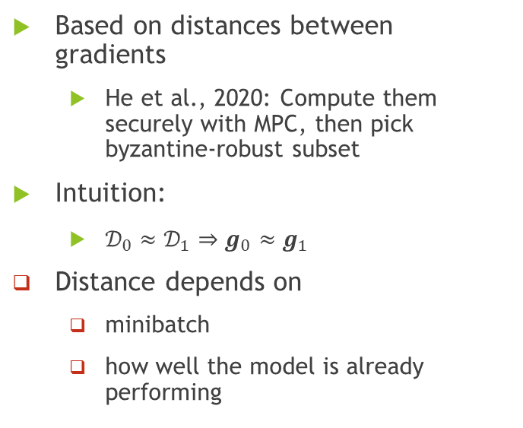











Weight Erosion aggregation scheme
$ℒ_{2}\left(f\right)$ level sets
$ℒ_{1}\left(f\right)$ level sets
Based on distances between gradients
He et al., 2020: Compute them securely with MPC, then pick byzantine-robust subset
Intuition:
$𝒟_{0}≈𝒟_{1}⇒g_{0}≈g_{1}$
Distance depends on
minibatch
how well the model is already performing
$$g_{1}$$
$$f^{∞}$$
$$g_{0}$$
$$g_{1}$$
$$g_{2}$$
$$g_{0}$$
$$f^{0}$$
Parameter space
$ℒ_{0}\left(f\right)$ level sets
$$α_{i}^{0}=1$$
$${∆α}_{i}^{r−1}∝\frac{\left\|g_{0}−g_{i}\right\|}{\left\|g_{0}\right\|}$$
$$α_{i}^{r}=α_{i}^{r−1}−{∆α}_{i}^{r−1}$$
Notes:
Instead of using the distances to pick a byzantine-robust subset, you use them to pick agents whose gradients are somewhat aligned with your own.
At first glance: if two data sets are similar, you'll get a similar gradient back
However, you can see that this distance depends on many things:
Random chance from sampling that minibatch
How well the model is performing. Imagine two small data sets drawn from the same distribution and assume your loss function for each of them is convex.
then, as your model is smack in between the two local minimizers, which is probably where you want to be, the gradients will point in opposed directions.
Solution: give each agent a weight, initially one, and aggregate all agents' gradients by a weighted average.
at each round, that weight decreases by an amount that's proportional to the distance between the two gradients.
Over time, random sampling effects smooth out and you give more importance to those agents whose data is more useful.

Slide 5
Application to medical data set
Ebola data set, 577 patients in 2014 – 2015 (Hartley et al., 2017)
Classification: predict diagnosis EVD(+) vs. EVD(-)
Using features identified in Hartley et al., 2017
1 layer, Log-softmax activation, cross-entropy loss
Splitting the data set by age:
AGE_STRICT: agent 0: 0 – 20 yo / agent 1: 21 – 40 yo / agent 2: 41+ yo
AGE_SOME: agents 0 & 1: 0 – 40 yo / agent 2: 41+ yo
Notes:
I'll talk only about the medical data set
Based on data set collected by Annie in Sierra Leone during the West African Ebola outbreak of 2014
Train a classification model to predict whether patients are infected with the Ebola virus, based on the features identified in a paper published by Annie in 2017. (linear model with 2 outputs, then log-softmax, with cross-entropy loss)
Data set is split across 3 agents by patient age groups, once strictly and once where two agents share the same age group

Slide 6
Figure 1: Predicting Ebola infection with AGE_STRICT split.
Full lines: model’s accuracy on the user's test set. Red (dashed): baseline test accuracy (always EVD(+) or always EVD(-)). Pointed lines: weight of each agent in the Weight Erosion scheme.
The learning rates are displayed in the legend. Each agent's data set contains two batches of 125 samples each.
Notes:
Despite the initially high weights of other agents, the Weight Erosion scheme quickly outperforms the (fairly poor) global model
In some cases, it also outperforms the local model.
Is it just some weighted average of the local and the global model?

Slide 7
Figure 3: Parameters of the models in Figure 1 (left).
Weight for the 1st output of the linear regression layer.
Weight for the 2nd output of the linear regression layer.
Strong correlation with EVD(-)
Strong correlation with EVD(+)
Notes:
By looking at the model weights, we see it isn’t somewhere between the global and the local model's weights (exacerbating some model weights even beyond what the local model does)

Slide 8
References
Hartley et al., 2017:
Mary-Anne Hartley et al. “Predicting Ebola infection: A malaria-sensitive triage score for Ebola virus disease”. In: PLoS neglected tropical diseases 11.2 (2017).
Ndoye factor:
Mohamed Ndoye et al. “Collaborative privacy”. Semester project (2020). url: https://www.mndoye.com/collaborativeprivacy.pdf.
He et al., 2020:
Lie He, Sai Praneeth Karimireddy, and Martin Jaggi. \Secure Byzantine-Robust Machine Learning". In: arXiv:2006.04747 [cs, stat] (June 8, 2020). url: http://arxiv.org/abs/2006.04747 (visited on 06/16/2020).

