Slide 1
STA303 Artificial Intelligence Course Project

Slide 2

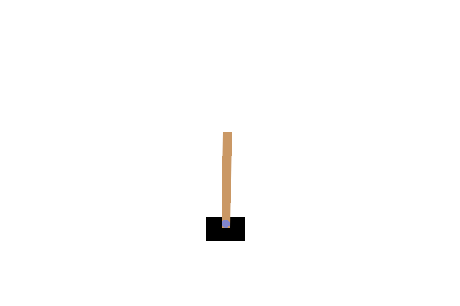
1. Introduction
CartPole Problem:
The CartPole environment is a classic control
problem where the goal is to balance a pole
on a moving cart by applying forces to the left
or right.
Project Goal:
To design and train an intelligent agent that can
successfully balance the pole in the CartPole
environment using RL techniques.

Slide 3
2. Environment
Environment: OpenAI Gymnasium – CartPole-v1
State Space: 4-dimensional
(cart position, cart velocity, pole angle, pole angular velocity)
Action Space: Discrete — {Move Left, Move Right}
Reward: +1 for every time step the pole remains balanced
Termination: Episode ends when the pole falls or the cart moves out of bounds

Slide 4
3. Tasks
Baseline: A DQN implementation is provided as a starting point.
Basic requirement:
  Implement and train at least two different types of RL algorithms.
    Value-based: DQN (provided as a baseline), double DQN, …
    Policy-based: REINFORCE, PPO, TRPO, etc.
    Actor–Critic: A2C, DDPG, etc.
  Performance: If the average score exceeds a specified threshold, you will receive full marks for this part.

Slide 5
3. Tasks (cont’d)
Advanced
Go beyond traditional online RL algorithms:
  Offline RL: train from a fixed dataset without new environment interaction (e.g., using BCQ, TD3+BC, or IQL).
  Imitation Learning: mimic an expert’s policy using Behavioral Cloning (BC) or GAIL.
  Hybrid or Novel Approaches: combine methods creatively and analyze the result.

Slide 6
4. Encouraged Directions
You are strongly encouraged to think critically and explore creatively.
Beyond implementation, we expect you to discuss questions such as:
How do important hyperparameters influence learning stability and convergence?
Which module of the algorithm is most critical for performance and why?
Can you propose a simple modification that improves the original version?

Slide 7
5. Team project
This is a team project — each team should consist of three students.
Team registration information will be announced next week.

