Slide 1
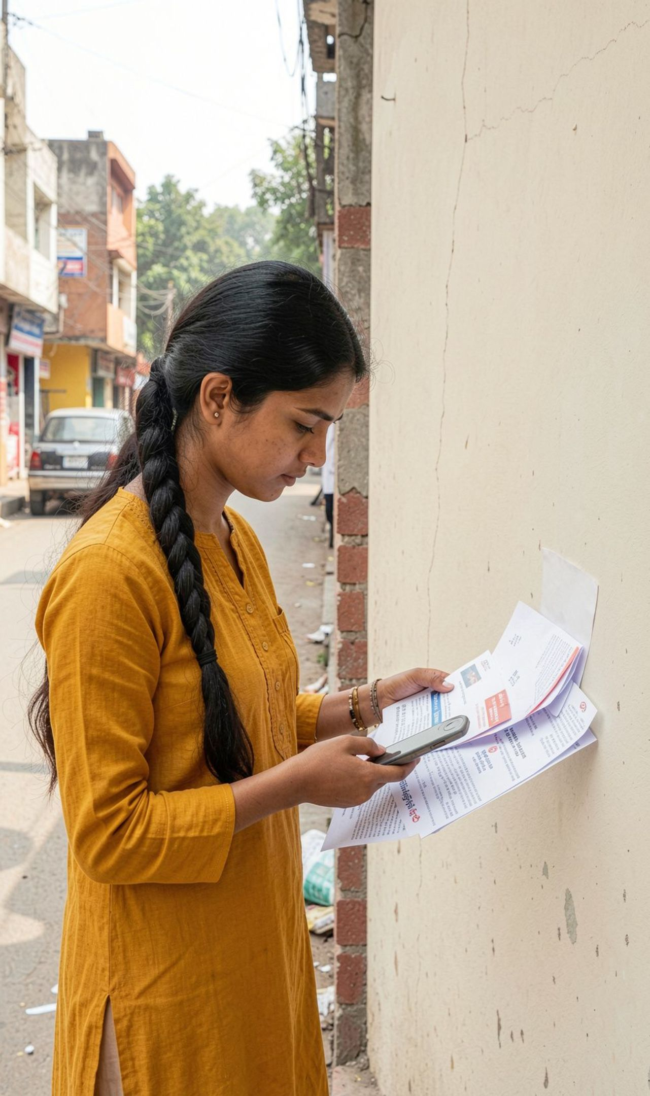
Civic complaints are fragmented before they are even solved
One problem, many points of failure
Citizens often do not know which authority or portal to use.
Multi-department problems become separate complaints with no shared context.
People struggle to prepare evidence, avoid duplicate reports, and track progress.
Pan-India pilot: multiple cities and states

Slide 2





CaseLink turns a confusing complaint into a guided case
The citizen starts with what they know. CaseLink makes the next steps visible.
Unified Timeline
Separated citizen, community, AI, official updates
Recommend Actions
Suggested authority and related reports
AI Review
Classification and missing-information prompts
Create Report
Plain-language report with photo or location

Slide 3
From street-level report to trackable action
01
02
03
04
05
Report
Review
Check
CaseLink ID
Track
Text, evidence, and location.
Correct the AI summary and category.
Review potential related reports without automatic merging.
Prepare, submit, confirm, and track through the supported official channel.
Create one case and coordinate department tasks.
CaseLink ID

Slide 4






AI does the busywork — citizens stay in control
See
Understand
Identify visible signals in photos, with uncertainty when evidence is weak.
Classify the issue and extract relevant details.
Ask
Guide
Identify missing information before a complaint is drafted.
Recommend an authority using configured, trusted reference data.
Connect
Rank related reports and explain why they may match.

Slide 5





One case can coordinate many departments
One internal history. Separate tasks. Clear boundaries around official status.
Central CaseLink
Department A Task
Department C Task
Department B Task

Slide 6
Trust is a product feature, not a disclaimer
01
Private by default
02
Traceable changes
Private complaints and sensitive evidence are private by default.
Every consequential status change has a timestamp and source.
03
Recoverable failure
04
Verified urgency
Failed submissions remain unconfirmed; drafts are preserved for retry.
Emergency guidance is shown only with verified instructions and clear action status.
05
No invented facts
AI never invents policies, contacts, ticket IDs, outcomes, or government partnerships.

Slide 7
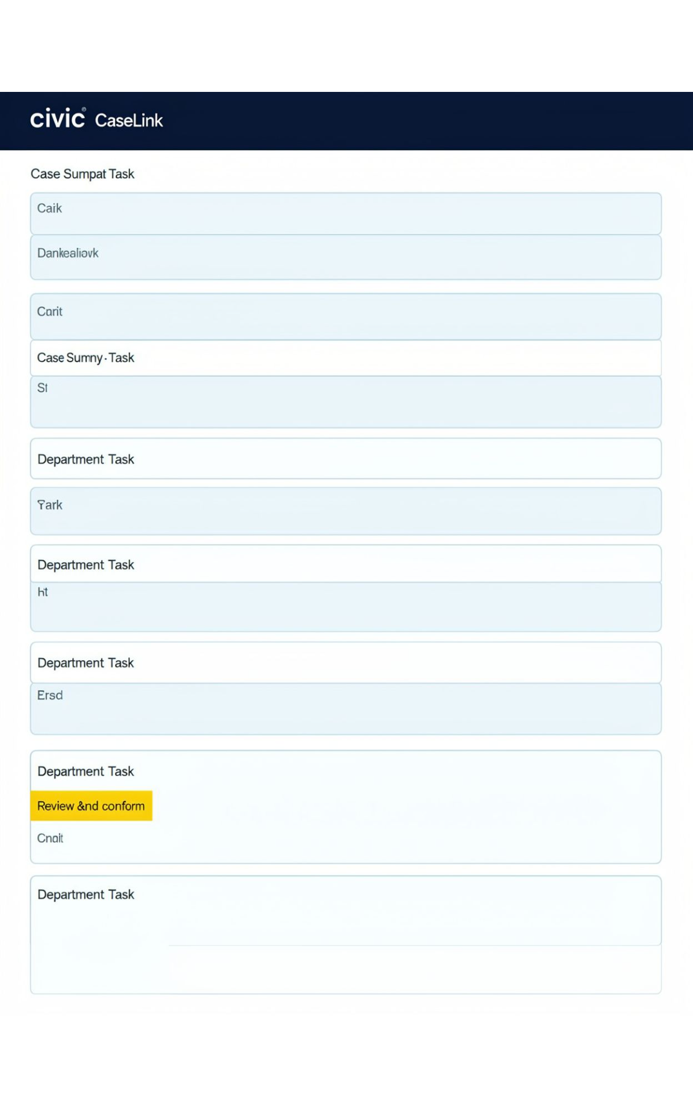
The hackathon MVP is focused and demoable
Must-have
Demo path
Secure accounts, text/photo reporting, AI assistance, authority guidance, internal case timeline, linked department tasks, related-report review, and failure recovery.
Submit a civic issue in any pilot city, review AI suggestions, confirm a related report, split tasks, and track the case.
Integration boundary
Use guided filing unless an official portal integration is genuinely authorized and tested.
The product is the demo path.

Slide 8
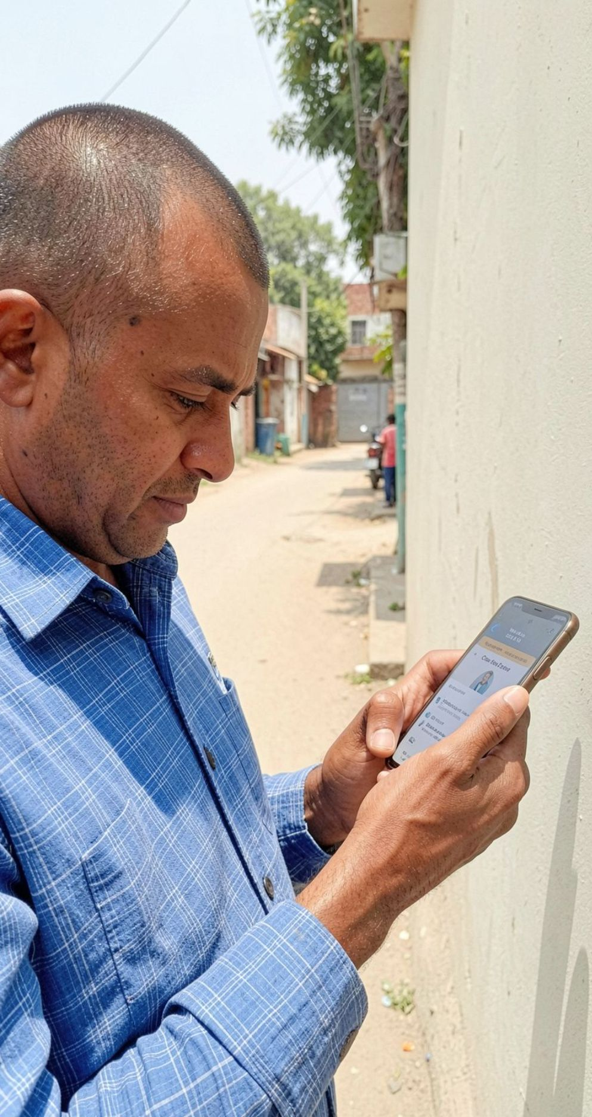
Success means a citizen can see what happens next
Persistent case
Visible next step
1
2
A report becomes a persistent CaseLink case instead of disappearing into a form.
Citizens understand the recommended channel, missing details, and current status.
Safe review
Complete journey
3
4
Moderators can review matches and harmful content without exposing private cases.
The prototype proves the complete internal reporting-to-tracking journey end to end.

Slide 9
THE ACCOUNTABILITY LAYER
Build civic action people can follow.
Start with a focused pilot across several Indian cities, earn trust through transparent status, and expand state by state only where the data and integrations are real.
CivicSaathi CaseLink

