Slide 1
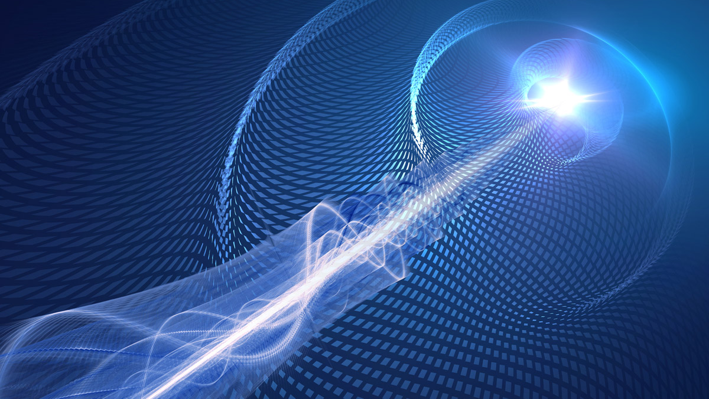
Quantum Computing
Emerging frontiers and future perspectives

Slide 2
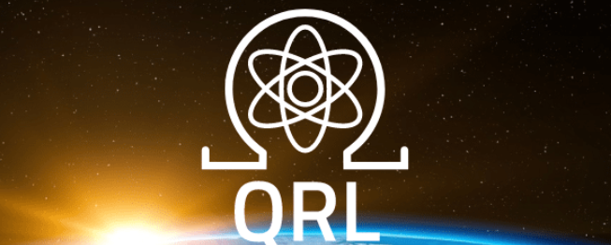
Quantum Resistant Ledger

Slide 3
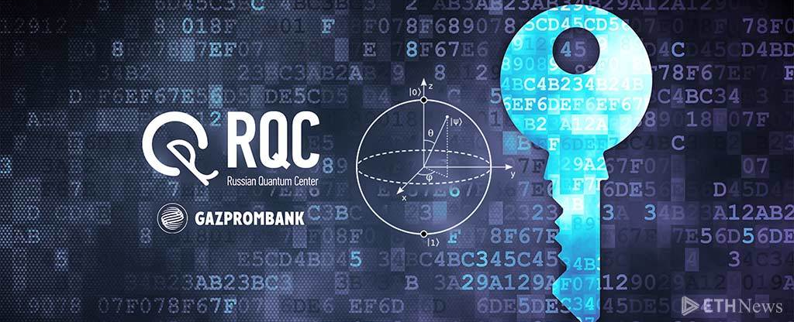
Quantum blockchain by RQC
QUIDIT COMPUTING MODEL

Slide 4
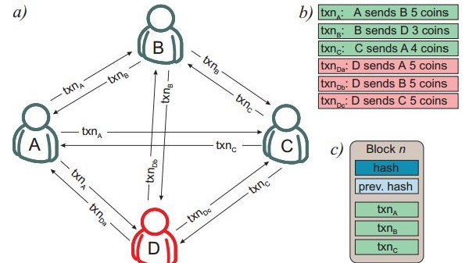
Quantum Blockchain Architecture

Slide 5
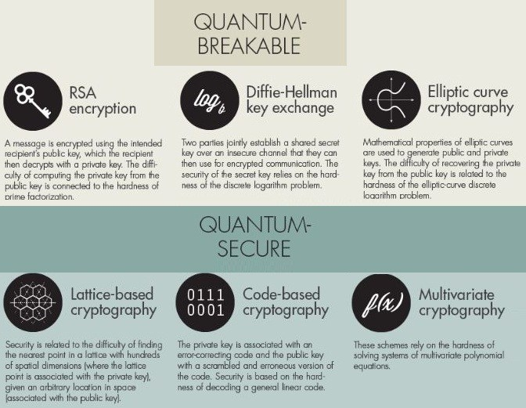

Slide 6
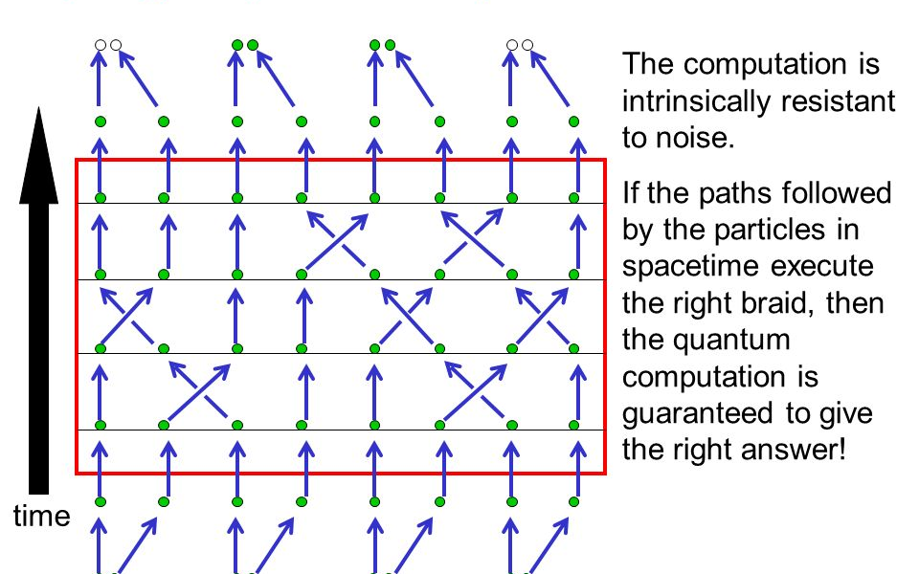
Topological quantum computing

Slide 7
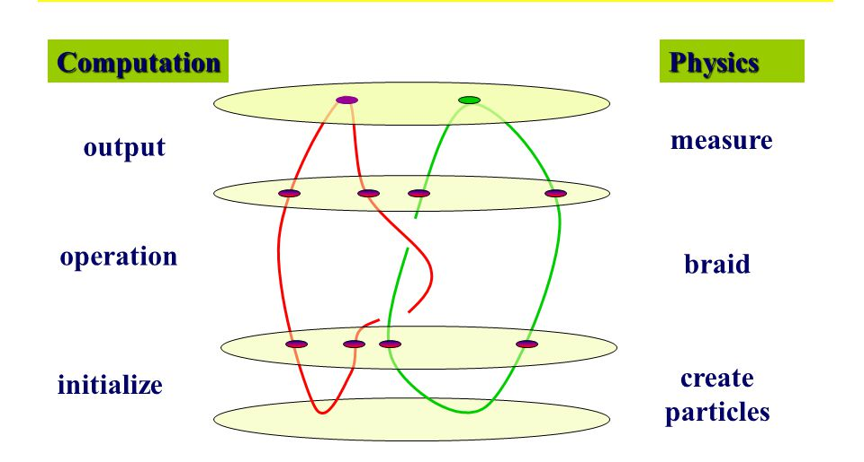
Topological Computation

Slide 8
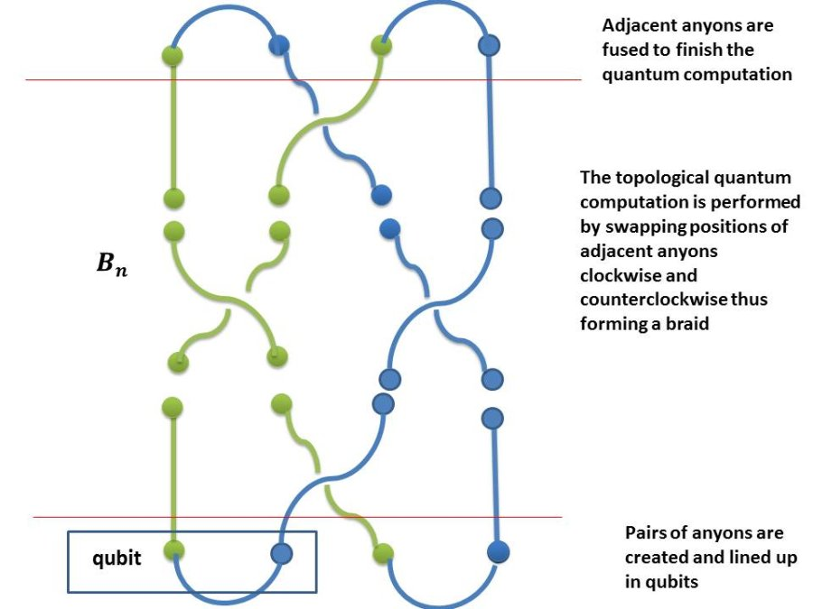
Topological Dynamics

Slide 9
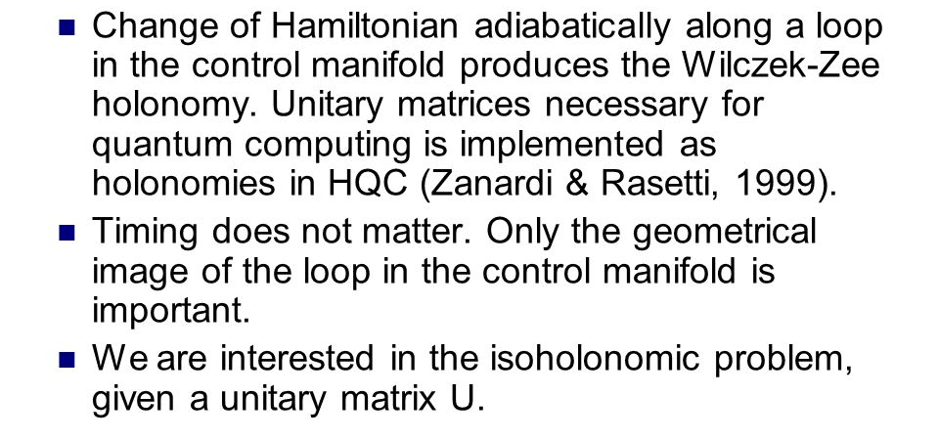
Holonomic Computing

Slide 10
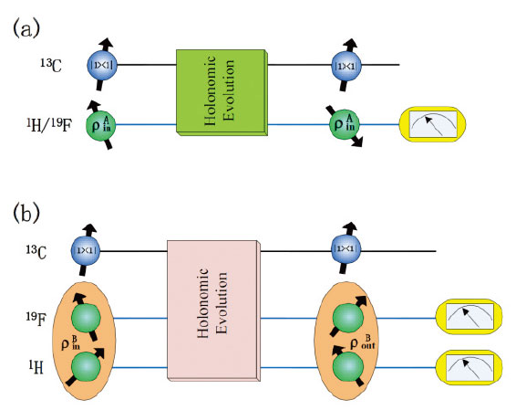
Holonomic evolution

Slide 11
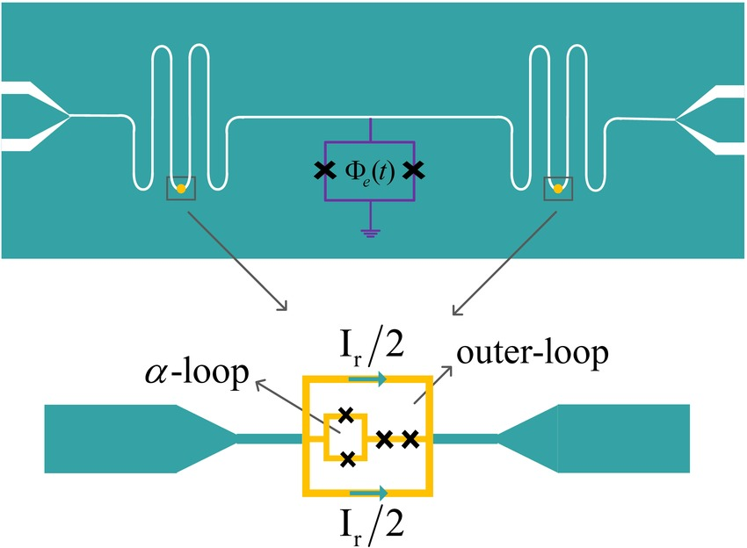
Holonomic loops

Slide 12
Computation is a combination of an algorithm ( a Mathematical object ) and a computing device ( physical object ).
What is the basic premise of computation

Slide 13
if an abstract computing device is considered for classical computation ( turing machine abstraction ), a physical system obeying laws of quantum physics is considered as computing device for quantum computing
Classical v/s quantum computation

Slide 14
The central problem in computing sciences is the conjecture that two complexity classes, P ( Polynomial Time ) and NP ( Nondeterministic polynomial time) are distinct in the standard Turing model of computation.
P V/S NP Problem

Slide 15
Laws of quantum computing exhibit the mathematical features necessary to support a model capable of solving all P Problems, a computationally intractable class in polynomial time.

Slide 16
A set of quantum gates G acting on a quBIT circuit model with N quBITS is defined to be a n-quibit universal gate set if for any E > 0 , a sequence of gates from this set G can be used to approximate any unitary evolution on all N-Qubits to accuracy E.
Definition of a universal gate set

Slide 17
the cost can be placed on the bredth of the circuit, the depth of the circuit, the total number of gates used etc.
Cost for implementing a universal gate set

Slide 18
it seeks to understand how the cost for building quantum gates grow for various quantum algorithms
Quantum computational complexity

Slide 19
The depth corresponds to total running time of the circuit.
Depth of quantum computing circuit

Slide 20
Theorem tells us the depth difference between circuits constructed with different universal sets of gates to an accuracy of o(log-c(1/E))
Solovay - Kitaev Theorem

Slide 21
Quantum computing is performed with the aid of a quantum system whose evolution is described by the unitary operator U(T) = exp-iHT where h is the hamiltonian of the system.
system Requirements for the Quantum Computing

Slide 22
The state of a composite system that can’t be written as the product of states of its component system is called entangled state.
Entangled state of a quantum computer

Slide 23
Bell basis is a orthonormal basis for the two quBit state space
Bell states

Slide 24
A two qubit gate A is a universal for the quantum computation if a together with local unitary transformations generates all unitary transformations of the complex vector space of dimension 2-exp-N to itself.
Universal quantum gate

Slide 25
A gate A is said to be entangling if there is a vector |ab>=|A> X |b> such that A|aB> is not decomposable as a tensor product of two qubits.
Proof of entanglement

Slide 26
Two qubit gate A is universal if and only if it is entangling.
Universality and entanglement

Slide 27
A phase is not a state of matter but a complex number of unit modules. The phases is obtained with the cyclic evolution of a physical system.
Geometric character of quantum Computing

Slide 28
Cyclic variation of external parameters often lead to a net evolution involving a phase depending only on the geometry of the path traversed in the parameter space.
Evolution of phase property

Slide 29
Presence of geometric phase is quantum systems and its properties has been used to construct a new model for quantum computing. Holonomy is a phase that depends on the geometry of a loop and is independent of any coordinate choice.
Holonomic quantum computing

Slide 30
Classical games cannot be quantized in a unique way because they are only asymptotical shadows of a wide spectra of quantum models. Following two stages are important :
1. Pre-quantization
2. Quantization
Quantum game theory

Slide 31
QFT does not explicitly produce any of the Fourier coefficients. QFT can be regarded as computing all the probabilities of a probability distribution or sampling a distribution
Quantum Fourier Transform

