Slide 1

Patient Risk Profiling and Care Management Tool An Engineering Project in Community Service
Phase – II Report
Supervisor- Dr. Hariharan R
Designation- Associate Professor
Submitted by​
Siddharth Dayal 21BCY10019​
Rishikesh M 21BCG10072
Ankit Sankar 21BCG10075​
Chetan Khoche 21BCG10100​
Yashsh Sujithkumar Randive 21BCE11334
Devansh Trived 21BCE11407 ​
Rishabh Pradhaan 21BCE11342​
GPV Mruthunjai 21BCE11559
Ashutosh Kr. Srivastava 21BAC10005
Notes:
d. Project Modules (Explaining the project components, associations, Purpose) – May include diagrams if required.
f. Responsibility of each team member – the contributions made module wise & Work integration.
g. Reference – if any.

Slide 2
Problem Introduction-
Healthcare management is crucial for effective healthcare service delivery in India, especially given its large population of over 1.3 billion.
India faces a shortage of hospitals, doctors, nurses, and essential medical resources.
Rural areas particularly suffer from inadequate medical facilities and limited healthcare access.
During COVID-19, many people visited medical facilities unnecessarily, leading to increased risk of infection and overburdening the healthcare system.
Non-critical visits escalated the chances of virus transmission and strained resources, impacting those in dire need of medical attention.
The surge in patient numbers also heightened local traffic and chaos in medical facilities.
Health care expenditure in India is rising, fueled by both public and private investments.
However, there is a significant disparity in healthcare financing, leading to unequal access to quality care across different regions and communities.
Ensuring the quality and safety of healthcare services is a major challenge.
Healthcare managers are responsible for maintaining medical standards and reducing errors.
They need to implement effective protocols and regulations to prioritize patient safety and enhance care quality.

Slide 3
Our Proposal Introduction-
To make a tool that identifies the health status of a participant
To provide stratification of a person’s health status.
To allow a local multidisciplinary approach to identify those who are seriously ill, or at immediate risk of a hospital admission.
To provide a platform for professionals to coordinate the care of the participant
To provide remote active care management and diagnosis
At least a quarterly risk profiling of the participant to identify those who are predicted to become or at significant risk of emergency hospital admission.
Actively and passively measure the participants’ health status via various factors such as weight, hydration, activity stress, etc...
Keep a holistic record of the participant's health records, previous conditions, known hereditary conditions, etc...
Keep a record of the participants’ current trends such as activity or recovery.
Shared and Integrated approach to care management to improve quality of care and reduce individual risk of emergency hospital admission

Slide 4
Literature review-
Analytical Determination of Conditions Using Symptoms: Advanced algorithms capable of analyzing a range of symptoms have proven critical in early disease detection and risk assessment in mHealth platforms.
Health Status Identification : Neural networks demonstrate notable effectiveness in interpreting complex patterns in blood and urine reports, thereby improving the accuracy of health status predictions in patient risk profiling.
Gamification of Health: The incorporation of gamification strategies in mHealth applications has shown to significantly boost user engagement and adherence to health and wellness programs.
Biomedical Image Segmentation Using UNET CNN: UNET CNNs have revolutionized biomedical image processing, significantly enhancing the precision and efficiency of image-based diagnostics in mHealth applications.
Active Trackers for Health Monitoring: Wearable devices like smartwatches have become integral in real-time health monitoring, providing continuous data on vital signs and physical activity for advanced mHealth solutions.

Slide 5
Findings-
UNET Convolutional Neural Networks (CNNs) significantly enhance the precision of biomedical image segmentation in MRI and CT scans, vital for accurate diagnoses in mHealth applications.
Long Short-Term Memory Neural networks effectively predict health conditions from blood and urine reports, improving the predictive accuracy and monitoring capabilities of mHealth applications.
Wearable health trackers, including smartwatches, provide valuable real-time data on vital signs and physical activities, enabling continuous health monitoring and personalized insights in mHealth solutions.
Analytical tools using symptom data are effective in early disease detection and patient triaging, guiding mHealth users towards appropriate medical attention.
Incorporating gamification elements in health applications increases user engagement and adherence to health regimens, making health management more interactive and effective in mHealth platforms.

Slide 6
Objective-
To make a tool that identifies the health status of a participant
To provide stratification of a person’s health status.
To allow a local multidisciplinary approach to identify those who are seriously ill, or at immediate risk of a hospital admission
To provide a platform for professionals to coordinate the care of the participant
To provide remote active care management and diagnosis

Slide 7
Motivation-
During the COVID period the people and government realised the lack of management in the health infrastucture of india. The lack of access to healthcare professionals, limited diagnostic resources, and insufficient data on local health trends contributed to the deaths of many. The fact that government was already trying to improve the health infrastucture pre- covid cannot be ignored but the need of better system was realised during covid.

Slide 8
Purpose-
In prevention and health promotion interventions, screening methods, and risk profile assessments, are often used as methods
At least a quarterly risk profiling of the participant to identify those who are predicted to become or at significant risk of emergency hospital admission.
Actively and passively measure the participants’ health status via various factors such as weight, hydration, activity stress, etc...
Keep a holistic record of the participant's health records, previous conditions, known hereditary conditions, etc...
Keep a record of the participants’ current trends such as activity or recovery.
Shared and Integrated approach to care management to improve quality of care and reduce individual risk of emergency hospital admission

Slide 9
System Design / Architecture-
1. Components:
Mobile and Desktop App:
Developed using Godot game engine.
Responsible for:
User interface and interaction.
Symptom and health data collection.
Self-assessment tools and risk analysis based on user data and pre-trained models.
Visualization of health trends and risk profiles.
Secure communication with the backend server.
Website:
Developed using plain HTML, CSS and Javascript
Offers functionality similar to the mobile and desktop app.
Provides access to additional features such as detailed health information, community forums, and educational resources.

Slide 10
Backend Server:
Hosted on Google Cloud Platform (GCP) or Firebase.
Responsible for:
Database management (user data, health records, model files).
Processing and analysing user data.
Running machine learning models for diagnosis and risk assessment.
Securely storing and transmitting data.
Machine Learning Model:
Developed and trained in Google Colab.
Uses computer vision and machine learning algorithms for diagnosis and risk prediction.
Model files are copied to the data branch for integration with the mobile, desktop, and website components.

Slide 11
2. Data Flow:
Users interact with the app (mobile, desktop, or website) to input data (symptoms, health information, etc.) and utilize features.
User data is securely transmitted to the backend server.
The backend server stores user data in the database and performs data analysis.
The server runs the machine learning model on the user data to generate diagnoses and risk assessments.
Results and visualizations are sent back to the user's chosen interface (mobile, desktop, or website).
When the machine learning model is updated in Google Colab, the updated model files are copied to the data branch for integration with other components.
3. Technology Stack:
Mobile and Desktop App: Godot game engine
Website: Web framework (e.g., Django, React)
Backend Server: GCP or Firebase
Database: Google Cloud SQL or Firebase Realtime Database
Machine Learning: Google Colab
Computer Vision: TensorFlow, OpenCV
Programming Languages: Python, JavaScript (for website), GDScript (for Godot)

Slide 12
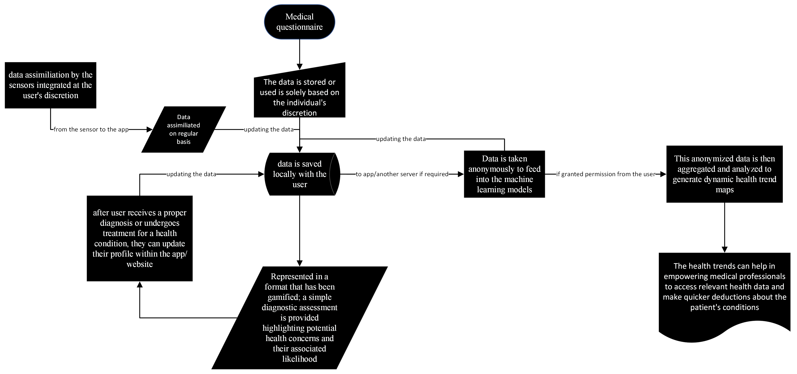
Methodology

Slide 13
Expected outcomes
Increased access to basic healthcare resources, especially in underserved communities.
Improved early detection and prevention of health problems.
Enhanced community awareness of health trends and risk factors.
Empowering individuals to take control of their health and well-being.
Providing valuable data for informed decision-making in local healthcare planning.

Slide 14
Individual Contribution-Rishabh Pradhaan (21BCE11342)
Machine Learning
Backend development(Django,React,Node.js)
Decision Making Models in Applications
Mobile Application Development

Slide 15
Individual Contribution- GPV Mruthunjai (21BCE11559)
Machine Learning
Wrote self-brewed CNN model for biomedical image segmentation
Random Forest Walk

Slide 16
Individual Contribution- Devansh Trivedi(21BCE11407)
Research
Machine Learning Models

Slide 17
Individual Contribution- Yashsh Randive(21BCE11334)
Research

Slide 18
Individual Contribution- Chetan Khoche(21BCG10100)
Full Stack Development
Web Application Development

Slide 19
Individual Contribution- Siddharth Dayal(21BCY10019)
Web Scraping
Web Application Development
Data Collection

Slide 20
Individual Contribution- Rishikesh M(21BCG10072)
System Design
Gamification
Tools and Utility Programming

Slide 21
Individual Contribution- Ankit Sankar(21BCG10075)
Data Visualization
2D Visualization program for MRIs and scans
Development of a VR/AR based Application

Slide 22
Individual Contribution- Ashutosh Kr. Srivastava(21BAC10005)
Hardware, IoT
Documentation

Slide 23
References-
Klasnja, P., Pratt, W., & Paasche-Orlow, M. K. (2017). Mobile health apps for promoting healthy behaviors: A systematic review and meta-analysis. Journal of medical Internet research, 19(3), e83.
Mitesh, A., & Singh, S. K. (2019). Mobile health apps for early detection and prevention of non-communicable diseases: A narrative review. Journal of Clinical and Diagnostic Research, 13(11), FE01-FE05.
Ventola, C. L. (2014). Mobile apps for the healthcare professional: Benefits, risks, and a framework for evaluation. Pharmacy and Therapeutics, 39(4), 280-287.

Slide 24
GitHub Platform-

