Slide 1
Motion Control and EPICS
Torsten Bögershausen
Experiment Control
www.europeanspallationsource.se

Slide 2
Introduction
Welcome everybody
What is not:
- a 4 day training course in EPICS
- a 8 hour training course in motion control
- an introduction to EtherCAT
- a 4 day training course on TwinCAT
- a 2 day training course on ecmc

Slide 3
Introduction
What it is:
- a 90 minutes introduction
- a list of URLs for further reading
- a list of Git repositories to get started
Lots of stuff to go through
Motto: We like to move it

Slide 4
Overview
Overview (this slides)
History, historic stuff
EPICS Motor module, general overview
More presentations
Live demo ?

Slide 5
Motion Control at ESS
Green field site: No legacy
Aim for a high range solution to use as many neutrons as possible
Collect experience from other facilities
Prefer “of the shelf” over “home made”
Prefer proven SW vs ”develop from scratch”

Slide 6

The way forward
Which way forward ?

Slide 7
Motion control platform
Different motion controllers evaluated
Did we found the golden bullet ?
Facility is build while we speak

Slide 8
EtherCAT
EtherCAT based hardware
- Motion Control
- medium range data acquisition
Faster than a slow control PLC (1Hz vacuum)
10Hz..10kHz
Slower than a digitizer card (µTCA card)

Slide 9
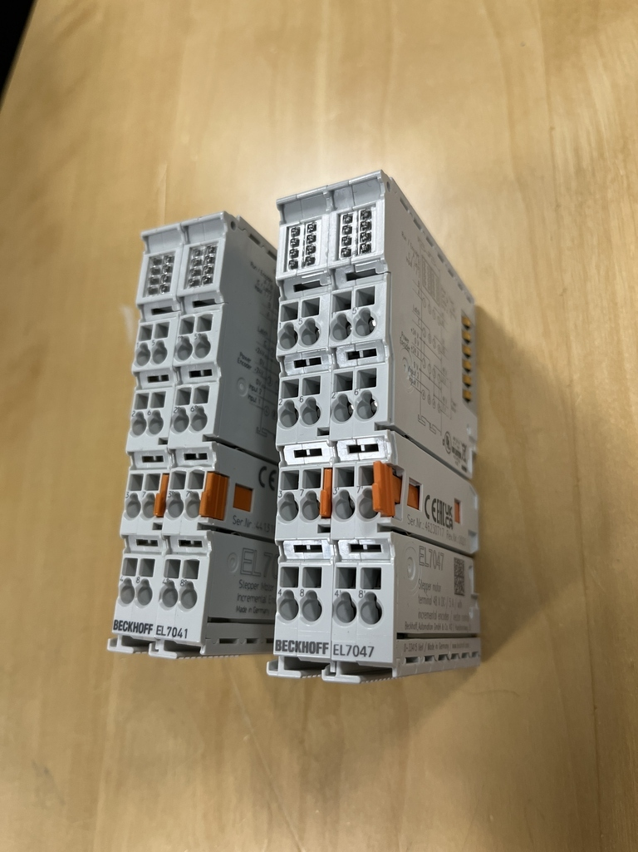
EtherCAT terminals for stepper motors: EL704x

Slide 10
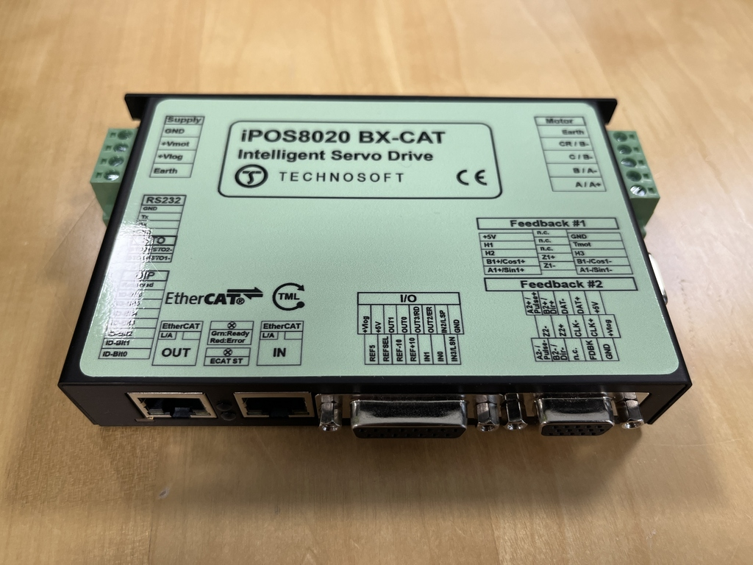
EtherCAT terminal for Servos

Slide 11
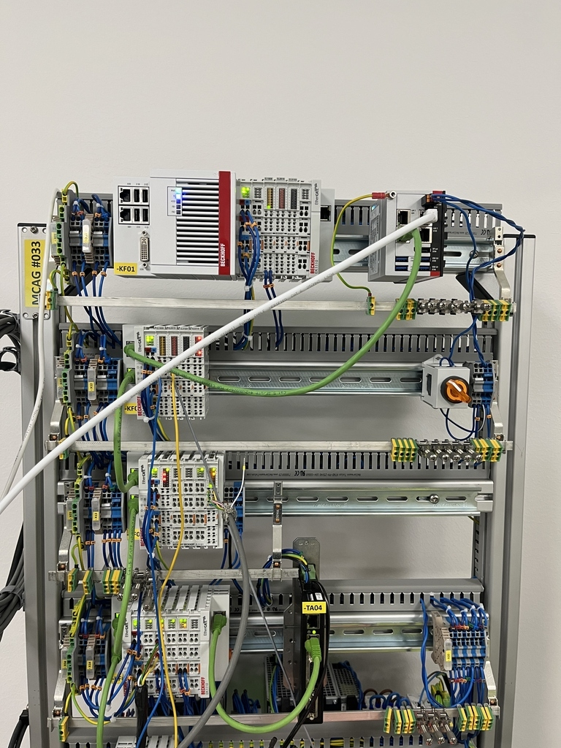
Test stand in the lab

Slide 12
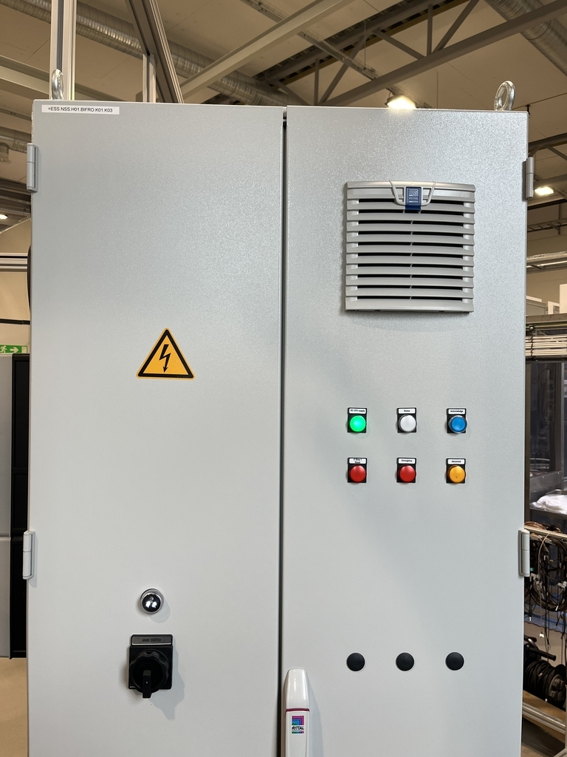
Motion control cabinet

Slide 13
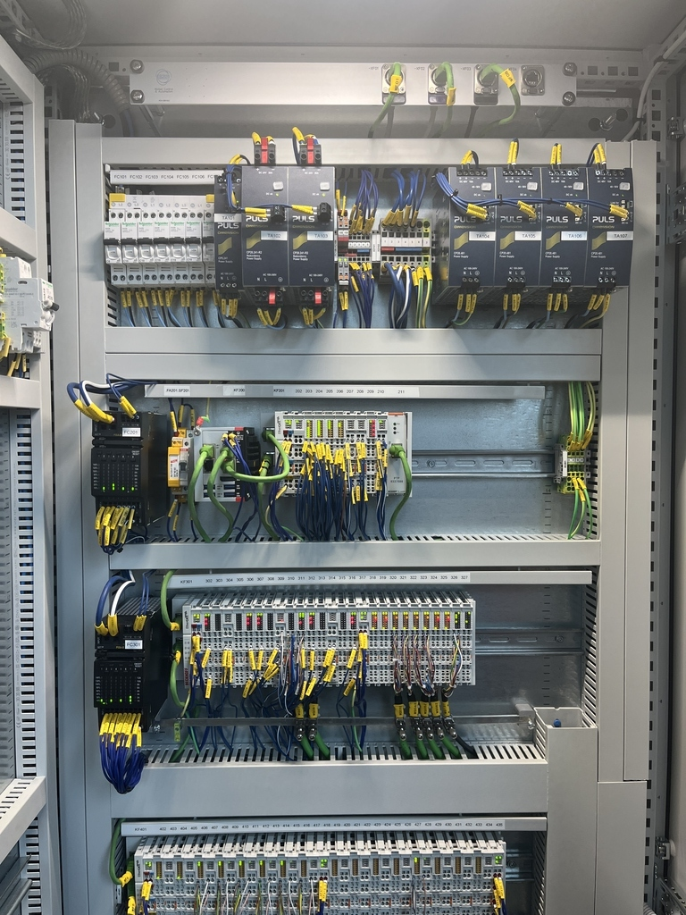
Motion control cabinet

Slide 14
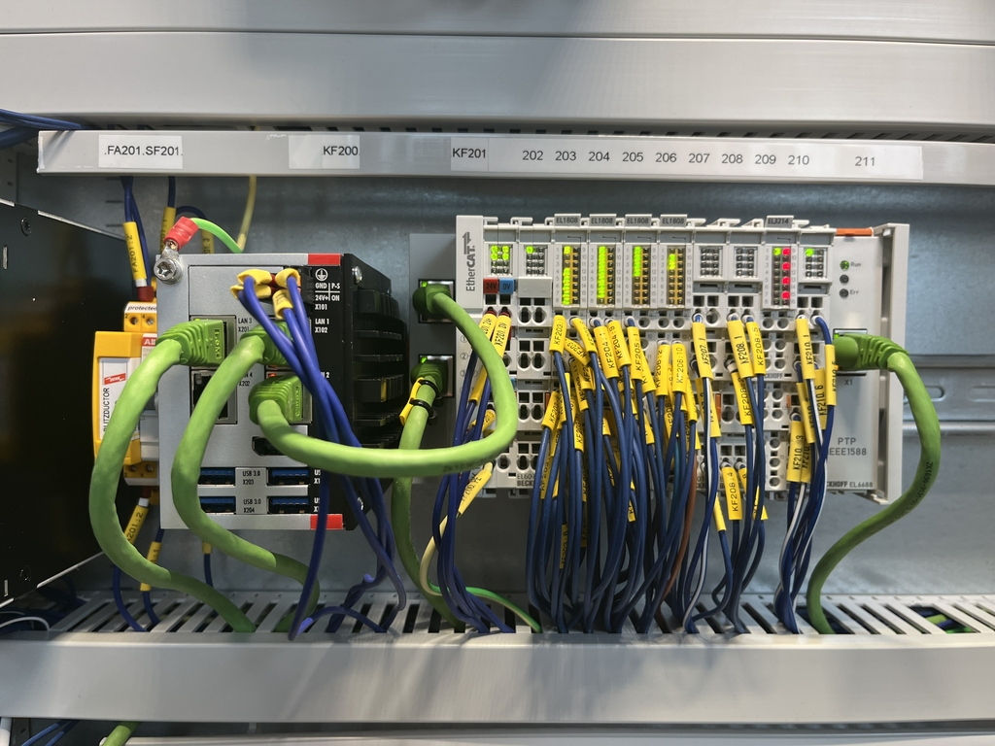
Motion control cabinet

Slide 15
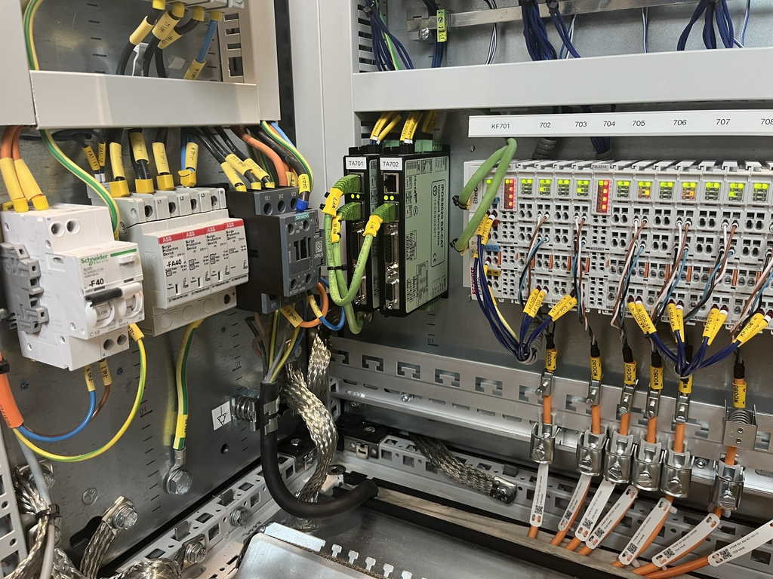
Motion control cabinet

Slide 16
Software
1 hardware platform: EtherCAT
2 Software platforms:
ecmc (open source)
TwinCAT (commercial)

Slide 17
TwinCAT
TwinCAT: commercial from Beckhoff
May (and must) write PLC code yourself
Common code base for ”our” code:
bitbucket.org/europeanspallationsource/tc_mca_std_lib/
International TwinCAT collaboration
Focus on motion control
ESS (Sweden), ISIS (UK), JCNS (Germany)

Slide 18
ecmc
Fully open source package
Linux based (No Windows !)
https://github.com/epics-modules/ecmc
Used in accelerator @ ESS
Used by other facilities (PSI, CLS)

Slide 19
End of intro
Short questions: here and now
Over to motion-control-EPICS

