Slide 1
EPICS module for PMAC
Control
Alan Greer

Slide 2
EPICS module for PMAC
Control
Alan Greer
Gary Yendell

Slide 3
Current Control of PMAC
3 EPICS driver modules required
tpmac – includes asyn type 2 and 3 control code for raw motors
pmacCoord – includes asyn type 2 control code for CS axes
pmacUtil – provides utility records for PMAC status
Stream device required for additional messages
Multiple points of control, messages sent to PMAC from all of the modules
Simple moves supported but many features of PMAC are not utilised

Slide 4
Goals of upgrading PMAC modules
Upgrade the driver to Asyn model 3
Combine all control code into a single module
Simplify communications, cut down traffic
Support changing Coordinate Systems on board the PMAC
Support model 3 trajectory scan interface
Maintain backwards compatibility

Slide 5
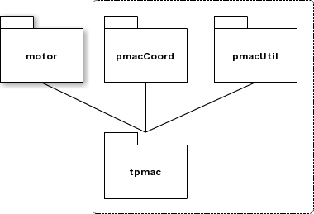
EPICS pmac module
https://github.com/dls-controls/pmac
Replacement for tpmac, pmacCoord and pmacUtil.

Slide 6
Features of pmac module
Message Broker
Coordinate System Support
Coordinate System Configurations
Trajectory Scanning

Slide 7
Features: Message Broker (1/5)
3 Polling loops for variables (slow, medium and fast)
Fast loop polled at 1Hz when no motors are moving and 10Hz otherwise
Fast loop rate can be set
Medium loop polled at 1Hz
Slow loop polled at 0.1Hz
Variables combined into single large messages to cut down message overhead and traffic

Slide 8

Features: Message Broker (2/5)
Variables added to the loops by using special Asyn parameter names in record database
PMAC_VDF_ Variable (V) of double (D) type added to the fast (F) loop
PMAC_VIM_ Variable (V) of integer (I) type added to the medium (M) loop
PMAC_VHS_ Variable (V) of hex (H) type added to the slow (S) loop

Slide 9
Features: Message Broker (3/5)
Interested classes register for callbacks
pmacController
pmacCSController
pmacAxis
pmacCSAxis
Reduces number of threads and provides better control of message sending to the PMAC

Slide 10
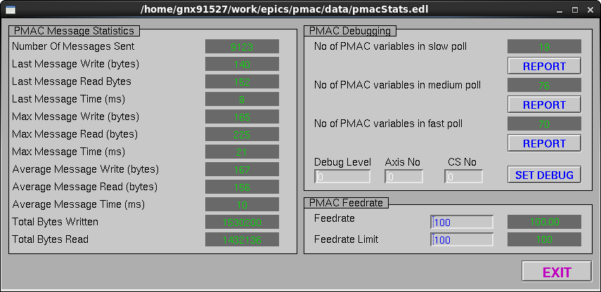
Features: Message Broker (4/5)
Statistics recorded to monitor traffic

Slide 11
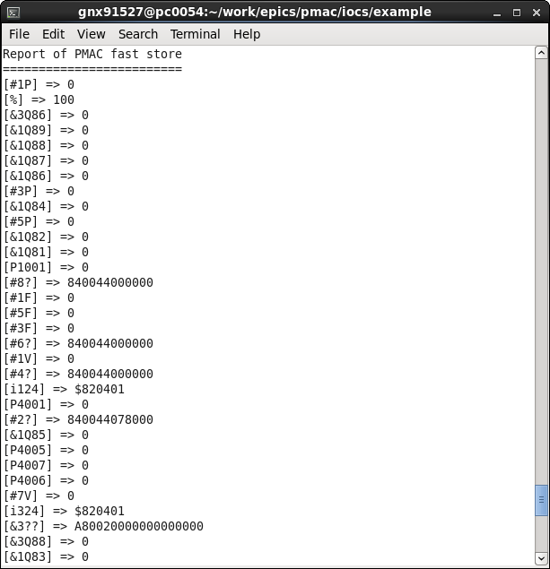
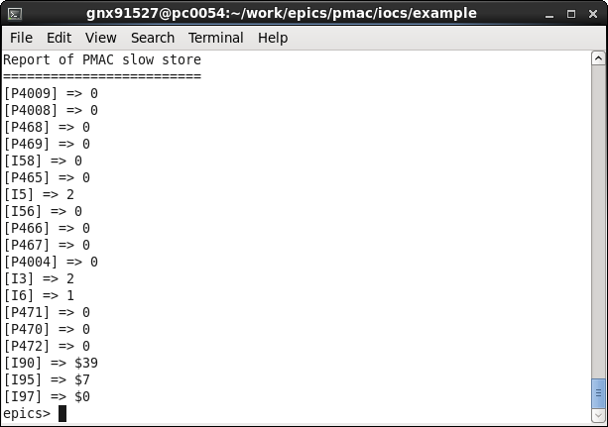
Features: Message Broker (5/5)
Improved debugging
Report contents of all monitored values at any time

Slide 12
Features: Coordinate Systems
Asyn model 3 CS controller and axis classes
Standard CS status provided as Asyn parameters
Debug output available for individual axes
Currently assigned coordinate systems available for each motor (Asyn parameters)
Kinematics available (Asyn parameters)
Communication to PMAC through the broker

Slide 13
Features: Coordinate System Configuration (WIP)
Coordinate systems assignments can be specified during IOC runtime
Coordinate system assignments can be saved as a configuration
Saved coordinate system configurations can be loaded

Slide 14
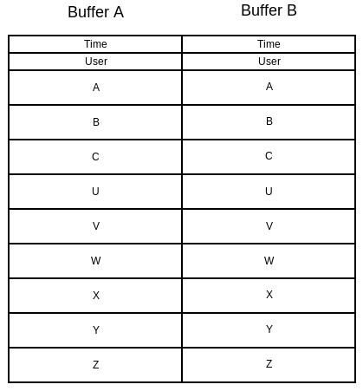
Features: Trajectory Scan (1/10)
Generic trajectory scan implementation provided
Double buffer allocated on board the PMAC

Slide 15
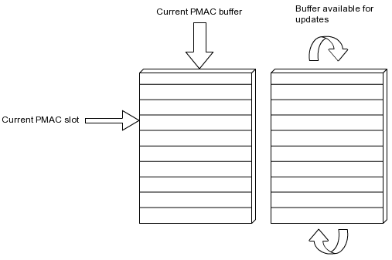
Features: Trajectory Scan (2/10)
As PMAC hardware reads from buffer A, buffer B is free to be filled by the pmac driver
When PMAC hardware reaches the end of buffer A, it switches to buffer B and A becomes free to be filled by the pmac driver

Slide 16
Features: Trajectory Scan (3/10)
Buffers are filled using writes to memory locations – no PMAC message corruption (no open buffers)
Buffer size and location can be customised per PMAC
Driver reads the configuration from the PMAC, no special setup required
Motor record trajectory scan interface supported with additional records for user modes

Slide 17
Features: Trajectory Scan (4/10)
Only 1 coordinate system can be trajectory scanned at any time
Any coordinate system axes can be included (or ignored) for a trajectory scan

Slide 18
Features: Trajectory Scan (5/10)
Scans are executed using PVT mode on the PMAC
User routines can be executed during moves
Driver reads back the current scan status
Positions and delta times are supplied, velocities are calculated in one of three ways
Velocity 1: previous to current
Velocity 2: previous to next
Velocity 3: current to next

Slide 19
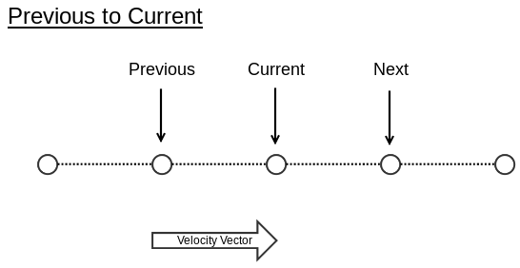
Features: Trajectory Scan (6/10)
Velocity Mode:

Slide 20
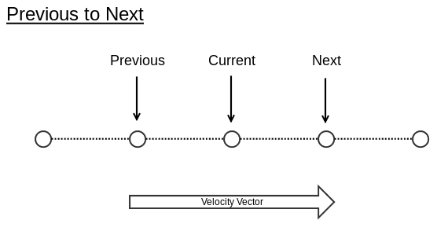
Features: Trajectory Scan (7/10)
Velocity Mode:

Slide 21
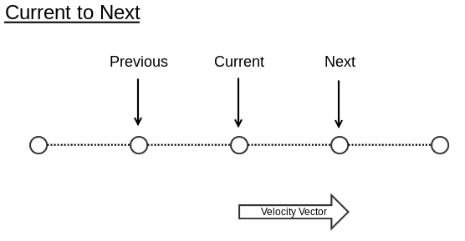
Features: Trajectory Scan (8/10)
Velocity Mode:

Slide 22
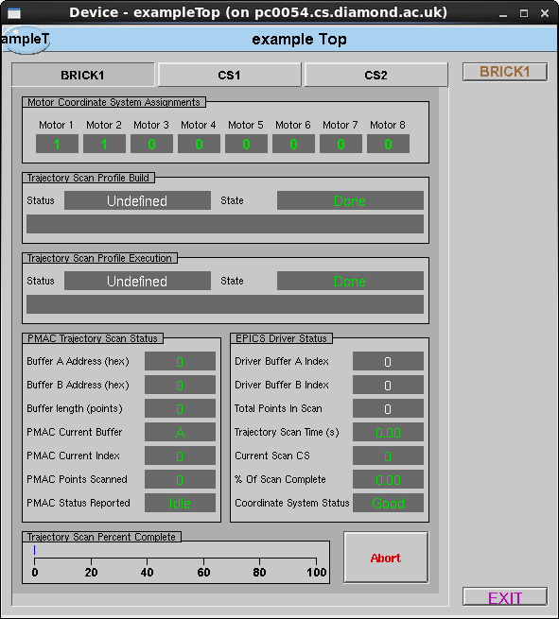
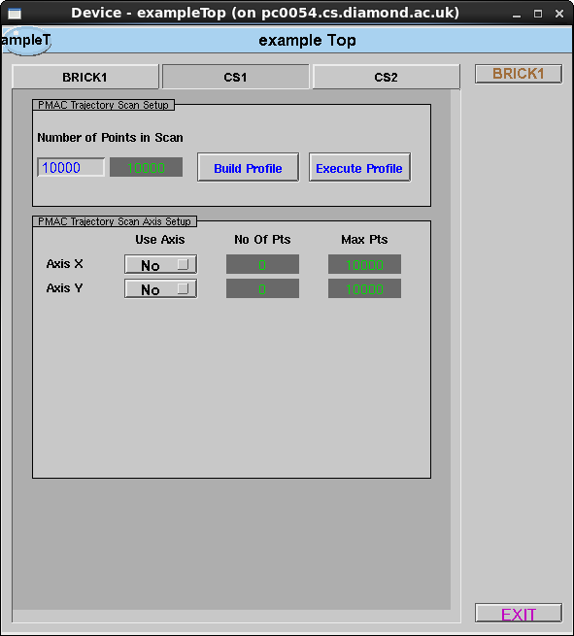
Features: Trajectory Scan (9/10)

Slide 23
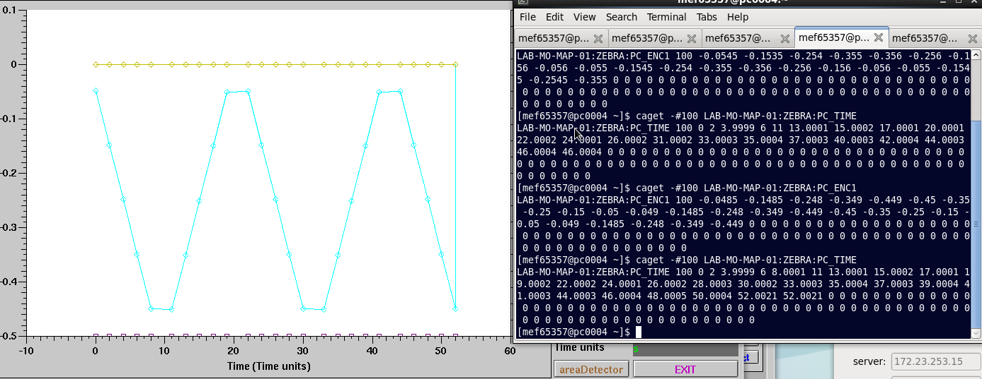
Features: Trajectory Scan (10/10)
Motion program and associated Python test scripts supplied with the module

Slide 24
Thank You
Any Questions?

