Slide 1
Connecting EPICS to TwinCAT
Torsten Bögershausen
SW Engineer
www.europeanspallationsource.se
2024-04-16
Notes:
Some good development done @ ESS, worth to mention

Slide 2
Epics com module
”first generation”
Presented at the EPICS meeting 2015 at FRIB. Dead link:
http://www.frib.msu.edu/misc/epics2015/index.htm
2nd generation much more advanced:
(indexer,timestamping, EPICS alarms from PLC)
New code for TwinCAT and EPICS

Slide 3
Connections to TwinCAT
TwinCAT
real time
kernel
ADS
PLC
Motion
OPC
FB_DriveVirtual
Ethercat master
COM
winsock
EPICS IOC
Motor
Encoder, switches
Control network: EPICS channel access, pvaccess
Notes:
- IOC should be run under defined Linux
Clean separtion between EPICS and non EPICS
- Can cut the wire: simulate the motor + MCU
- 2 different people look from different sides at the same interface:
- 2 brains give better code
- Can upgrade both parts independently

Slide 4
EPICS Com Module
EPICS Com
Module
(realtime under
TwinCAT)
TwinCAT
real time
kernel
ADS Router
PLC
Motion
FB_DriveVirtual
Ethercat master
winsock
EPICS IOC
Motor
Encoder, switches

Slide 5
ASCII data
Low level debugging
$ telnet 192.168.88.48 5000
Main.M1.bBusy?;\r\n
0;\r\n
EPICS TwinCAT
“Main.M1.fPosition=10.0;\n”
IOC
Stream-
Device
TwinCAT
System
“OK;\n”

Slide 6
EPICS – PLC communication
”Move absolute” to position 200
Main.M1.bExecute=0;
Main.M1.nCommand=3;
Main.M1.nCmdData=0;
Main.M1.fPosition=200.0;
Main.M1.bExecute=1
(Not shown: fVelocity,fAcceleration,
fDecelaration)
(Not shown: ADSPORT=851)

Slide 7
EPICS from python
Python: ”Move absolute” to position 200
Import pyepics
m1 = ”IOC:m1”
Position = 200
caput(m1, position)
And when is the motor done ?

Slide 8
Client EPICS MR & wait
m1 = ”LabS-ESSIIP:MC-MCU-01:m1”
Position = 200
caput(m1, position, wait=true)
#And now the movement is done

Slide 9
Client EPICS MR & STAT field
#And now the movement is done
stat = caget(m1 + '.STAT')
if (stat != 0):
# Error handling
# To be discussed
# with ”Users”

Slide 10
Move & monitor a motor
(done on a simulator, Mac or raspi)
caput IOC:m1.VAL 60.1
Old : IOC:m1.VAL 24.9
New : IOC:m1.VAL 60.1
camonitor IOC:m1.RBV IOC:m1.DMOV
IOC:m1.RBV 2016-02-02 10:58:16.157350 24.87
IOC:m1.DMOV 2016-02-02 10:58:16.658745 1
IOC:m1.DMOV 2016-02-02 10:58:16.658745 0
IOC:m1.RBV 2016-02-02 10:58:30.124368 49.86
IOC:m1.RBV 2016-02-02 10:58:31.138087 60.06
IOC:m1.DMOV 2016-02-02 10:58:31.639072 1
#Notes:
#caput: Channel access put
#camonitor: Channel access monitor
#IOC:m1..DMOV: Field “done moving”
#IOC:m1.RBV: Field Read back value

Slide 11
epics-twincat-ads
Now comes the ”1.5 generation”
Used for this demo
In production at ESS, SLAC

Slide 12
ADS
2015:
Code from Beckhoff to ”talk” ADS from
Windows, Linux, MacOS
https://github.com/Beckhoff/ADS.git
Yeah!
https://github.com/europeanspallationsource/epics-twincat-ads

Slide 13
EPICS ads Module
asyn
ads
ethercatmc
motor
TwinCAT
real time
kernel
ADS Router
PLC
Motion
FB_DriveVirtual
Ethercat master
Motor
Encoder, switches

Slide 14
commissioning
Over to commissioning

Slide 15
commissioning
From communication to commissioning
MotorRecord approach:
”dump” controller card:
All configuration i EPICS
Modern controller approach:
All configuration inside the controller
ESS:
commission the controller
read data intoEPICS

Slide 16
commissioning
When we commission a crate these values are
configured:
- Scaling/Resolution (mm/rev, steps/rev)
- Maximum velocity
- Default velocities (positioning, jog, homing)
- Default acceleration, jerk
- Soft limits
- In target position monitor (deadband)
- Many more

Slide 17
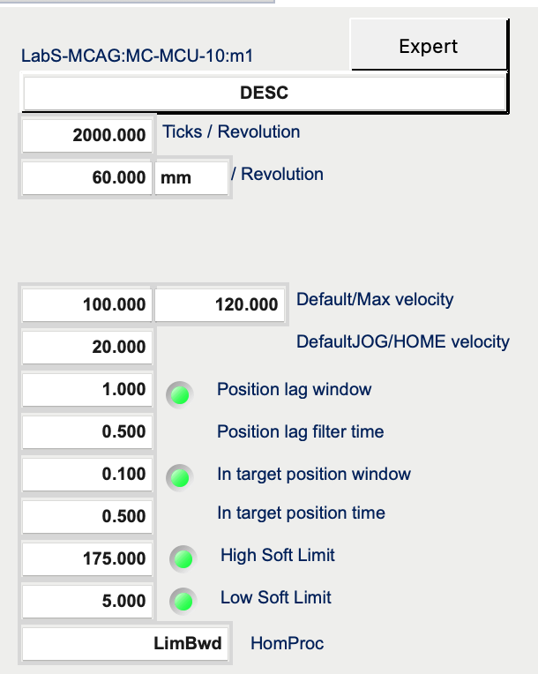
Config parameters from TwinCAT into EPICS

Slide 18
Commission MCU → motorRecord
Read data from MCU into Record:
out=ADSPORT=501/.ADR.16#4001,16#16,8,5?;…
in=1.0e-1;2.0e-2;...
rdbd=0.100000, rdbd_tim=0.020000 rdbd_en=1
IOC:m1 enforceMinRetryDeadband...cfg_rdbd=0.100000
Why important:
- When is a movement ”completet” ?
- Movements with smaller distances are ”ignored”

Slide 19
That’s it
Thanks – for listening
Time for questions

