Slide 1
Motion Control Getting Started
Torsten Bögershausen
Experiment Control
www.europeanspallationsource.se

Slide 2
Introduction
EPICS: use the simulator:
https://github.com/EuropeanSpallationSource/MCAG_setupMotionDemo

Slide 3
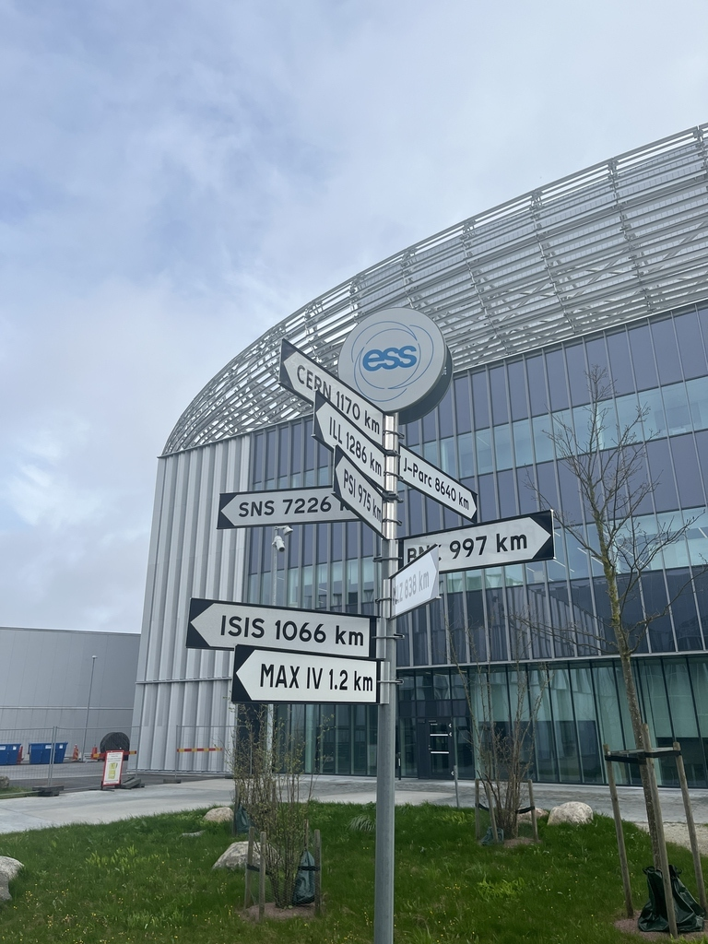
Which way to go ?

Slide 4
ecmc
ecmc (EtherCAT Motion Control)
https://github.com/epics-modules/ecmc
Fully open source: Linux based
Good if:
- you love open source
- need advanced motion trajectories
- you can work without a mouse

Slide 5
TwinCAT ”version 1”
FB_DriveVirtual
https://bitbucket.org/europeanspallationsource/tc_lab_mcu010-fb_drivevirtual/
Good if:
- you need lot of PLC code
- want re-use vacuum and stuff from SLAC
https://github.com/pcdshub/
- you can work with a mouse

Slide 6
TwinCAT ”version 2”
TwinCAT: “Generic structure”
https://bitbucket.org/europeanspallationsource/tc_generic_structure/
EPICS: PILS protocol, “indexer”
https://forge.frm2.tum.de/public/doc/plc/v2.0/singlehtml/
Good if:
- you want the latest and greatest
from ESS, ISIS, JCNS
- Need time-stamped motion (ESS only)
- you want EPICS alarms from TwinCAT code

Slide 7
ECMC
Fully open source package
Linux based (No Windows !)
https://github.com/epics-modules/ecmc
Used in accelerator @ ESS
Used by other facilities (PSI, CLS)

Slide 8
Thats the introduction
Questions: here and now

