Slide 1
Motion control @ ESS
Torsten Bögershausen
Motion Control and Automation Group
www.europeanspallationsource.se

Slide 2
Overview
Hardware
Software
Collaboration
Work to be done

Slide 3
Hardware
All motion today is EtherCAT based
Different motor terminals covering a range of:
Stepper 8..50V 3.5 A (rms)
…..
Servo 100..480V 6A

Slide 4
More hardware
Most work is done outside ESS, ”in kind”:
List with recommendations
Level A: first choice
Level B: second choice
Neither A nor B: ”special”
https://confluence.esss.lu.se/display/MCAG/Motion+control+electronics

Slide 5
Software
3 layers:
- High level (CSS, NICOS with scan engine)
- EPICS with motor
- SW running in the motion controller.

Slide 6
SW platforms Motion Controller
Commercial : Beckhoff TwinCAT
”Industrially proven”
International working group (.de, .uk, .se)
Open Source : ”ECMC” under Linux
Motion controller & EPICS IOC on same CPU
”works very well”

Slide 7
motorRecord
Some patches done @ ESS:
- All configuration is done in TwinCAT:
The IOC reads it into the motorRecord fields
- Allow the record to be configured
NOT to stop the motor on a limit switch
- Better connection handling (”late connect”):
IOC is started before controller
ACCS field for acceleration
Better debug prints (”SPAM” field)

Slide 8
Challanges @ ESS
Common HW list
E-plan drawings, PIN layout
Common code for TwinCAT
Automated testing
TwinCAT – EPICS IOC communication
- ”dig out all configuration from MCU”
- ”Motor position every 10 msec”

Slide 9
Hardware @ ESS
HW has been build outside ESS :-)
Motion control (hardware) standards:
https://confluence.esss.lu.se/display/MCAG/Motion+Control+Hardware+Standards
EtherCAT HW catalogue:
https://confluence.esss.lu.se/display/MCAG/Motion+control+electronics

Slide 10
SW @ ESS
Training material
TwinCAT:
https://confluence.esss.lu.se/display/MCAG/
Commissioning+Workflow+TwinCAT
ECMC:
https://indico.esss.lu.se/event/1156/

Slide 11
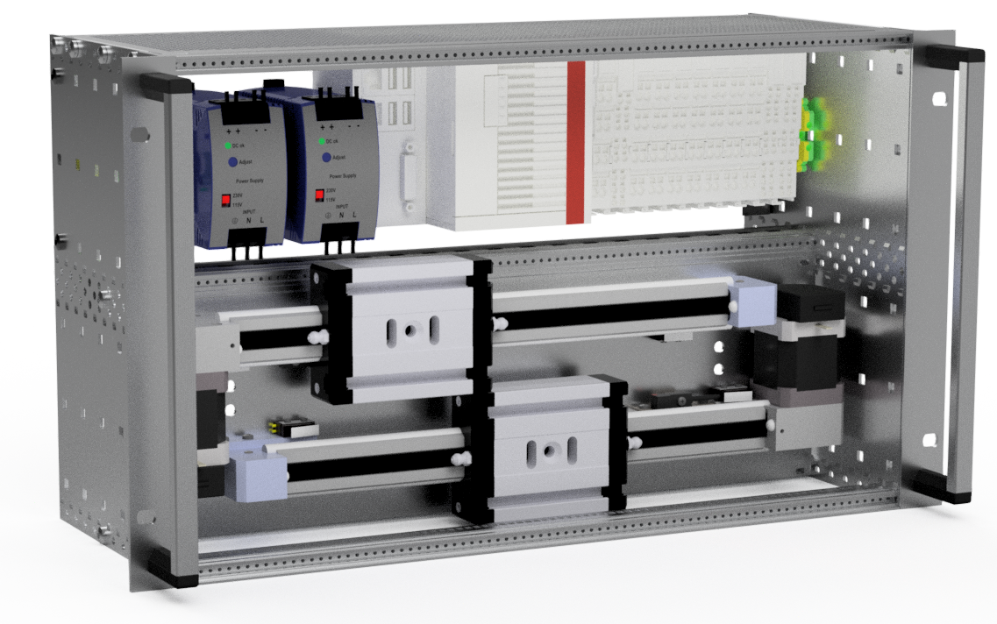
Test crate

Slide 12
Thanks
Merci & Thanks

