Slide 1
NSLS2 Motorcontrollers and motion applications
Oksana Ivashkevych, 3 June 2019

Slide 2
Standards and deviations
NSLS2 standardizes on Geobrick-LV-NSLS-II.
Units in production since 2012, low failure rates
Maintenance performed: changed air filters.
Newer units with hardware changes and possibly new components fails noticeably more.
Several Power Pmacs (custom fly scan, controlling AC motor with custom interface)
few Newport XPS, vendor insisted, and beamline scientist brought from NSLS.
Couple dozen FMB MCS-8, partner beamlines delivered in full by FMB, adopted old NSLS controllers.
Piezo controllers: SmarAct MSC, Smarpod, PI (E621, E625, E712, E517, ECC100, E873), Autocube, Newfocus picomotors Npoint.

Slide 3
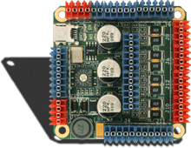
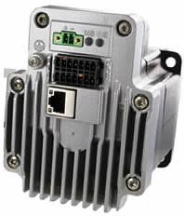
Recent Additions
EZ4 AXIS from All Motion
For the compact size, in a tight space end station.
Schneider Lexium integrated drive
(controller on motor),
mandated by beamline controls review in 2018 to introduce a simple motorcontroller solution.
intend to gather enough operational reliability data before making it an alternate standard.
for small <~ 2 A motors

Slide 4
Software , EPICS IOCs
Most on Debian 7
Built using Debian packages
Base 3.14
Model 3 driver
Older version of pmac from https://github.com/epicsdeb/pmacasyn [pmacutil, pmaccoord]
This version is not in sync with pmac repo
There is a new pmac from Diamond
CSS GUI
Bluesky(https://nsls-ii.github.io/bluesky/) data collection interface.

Slide 5
Scans
Step scan is done via bluesky
Move motor,
wait till the move is done DMOV
Trigger detector
Flyscans also handled from bluesky.
There is no uniform hardware and software impleentaion
No difference from bluesky

Slide 6
Fly scans
No standard
Strong interest from beamlines.
One custom solution with Power Pmac, piezo stack, and customized electronics.
Using Zebra for triggering detectors and encoder capture
Interested to know other sites solutions.

