Slide 1
Motion Control at ESS
Torsten Bögershausen
Experiment Control
www.europeanspallationsource.se

Slide 2
Overview
Motion control at ESS (this slides)
Majority: point-to-point: Beckhoff
Special:
- Piezo
- Hexapod

Slide 3
Motion Control at ESS
Green field site: No legacy
Aim for a high range solution to use as many neutrons as possible
Collect experience from other facilities
Prefer “of the shelf” over “home made”
Prefer proven SW vs ”develop from scratch”

Slide 4
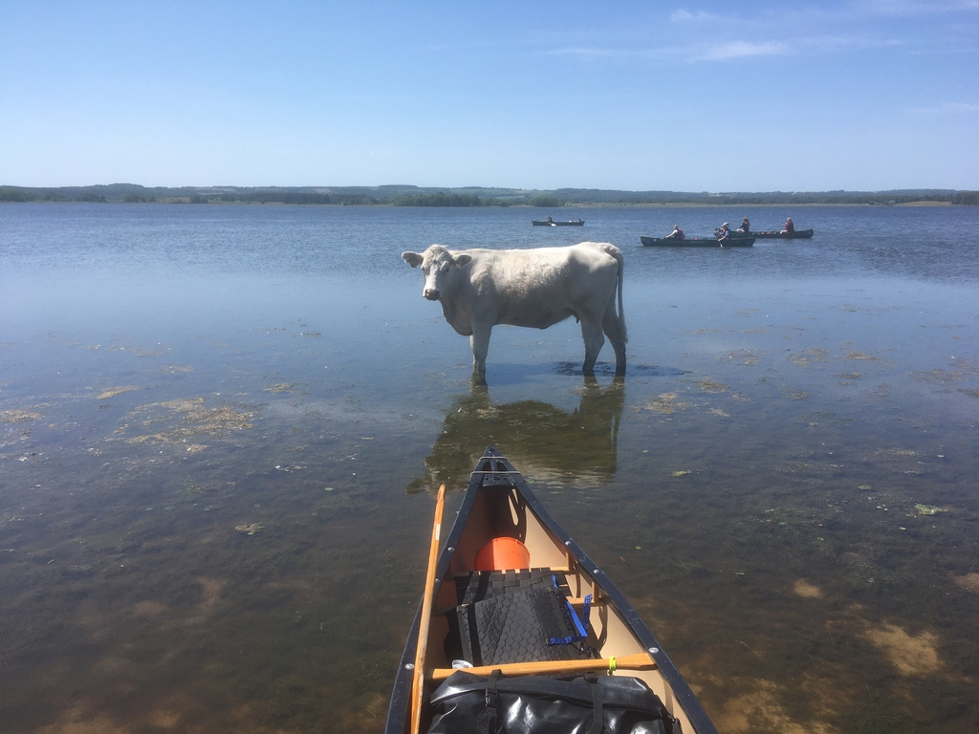
The way forward
Which way forward ?

Slide 5
Motion control platform
Different motion controllers evaluated
Did we found the golden bullet ?
Facility is build – motion installed and commissioned while we speak

Slide 6
EtherCAT
EtherCAT based hardware
- Motion Control
- medium range data acquisition
Faster than a slow control PLC (1Hz vacuum)
10Hz..10kHz
Slower than a digitizer card (µTCA card)

Slide 7
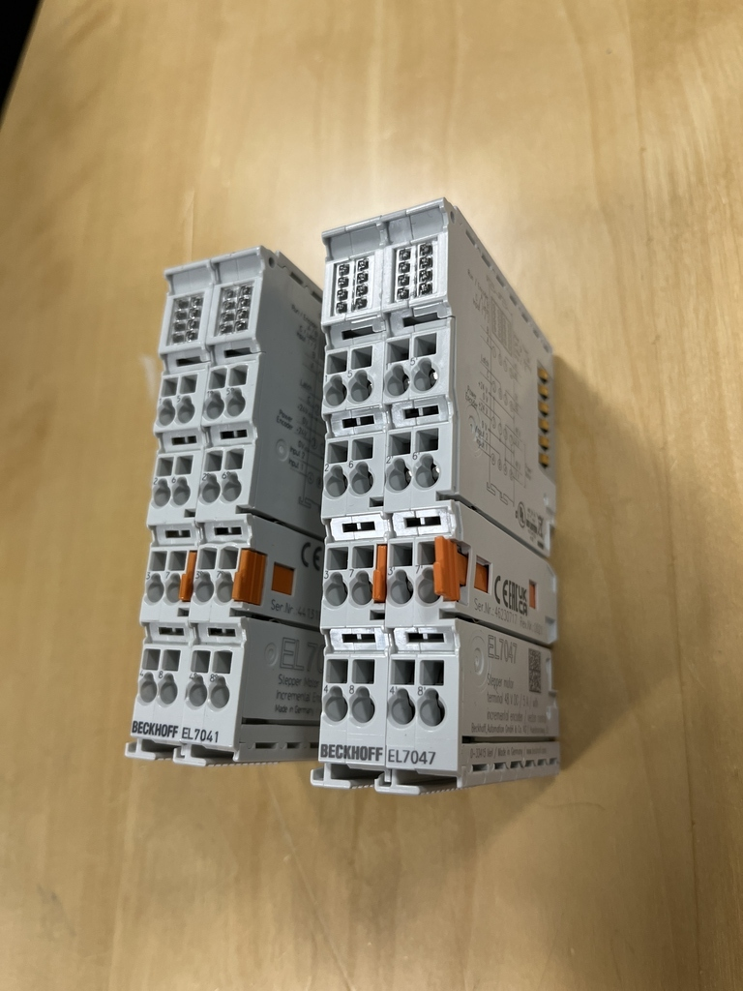
EtherCAT terminals for stepper motors: EL704x

Slide 8
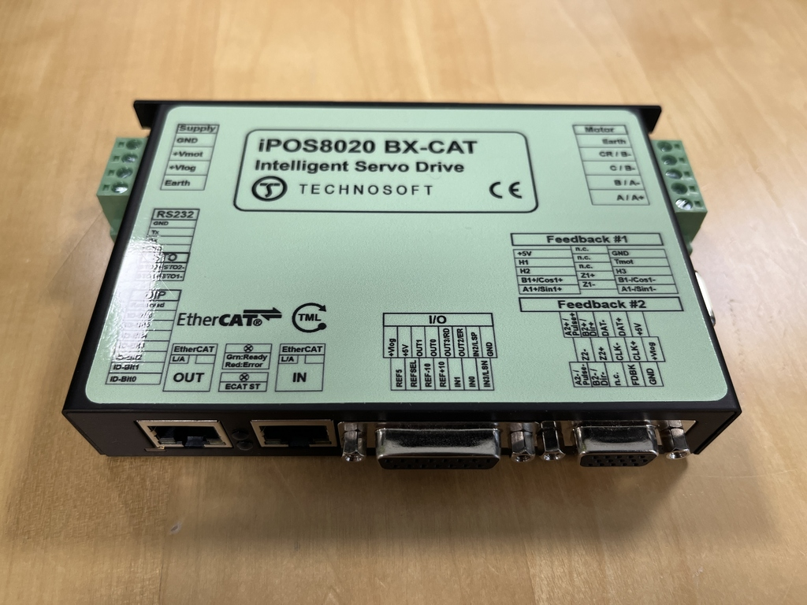
EtherCAT terminal for Servos

Slide 9
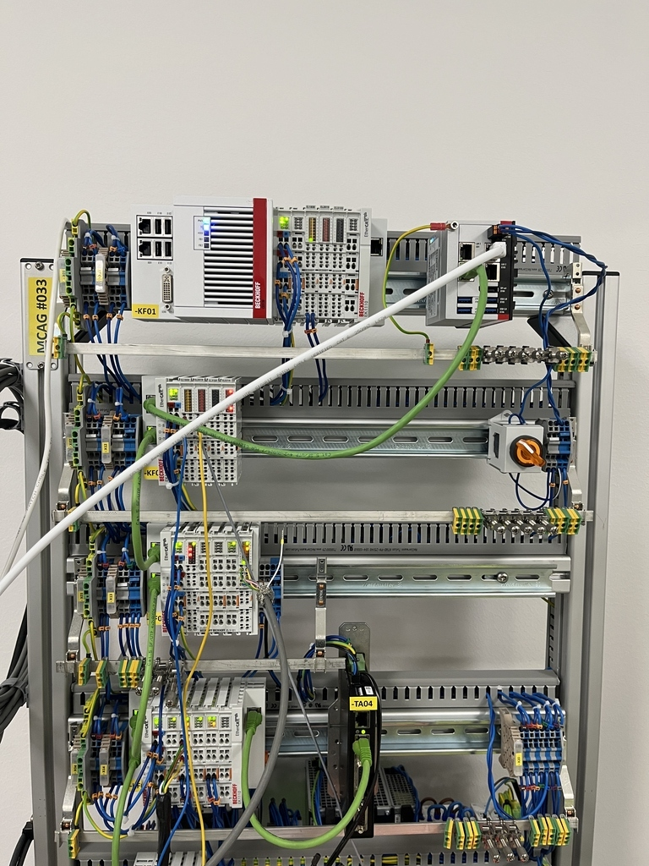
Test stand in the lab

Slide 10
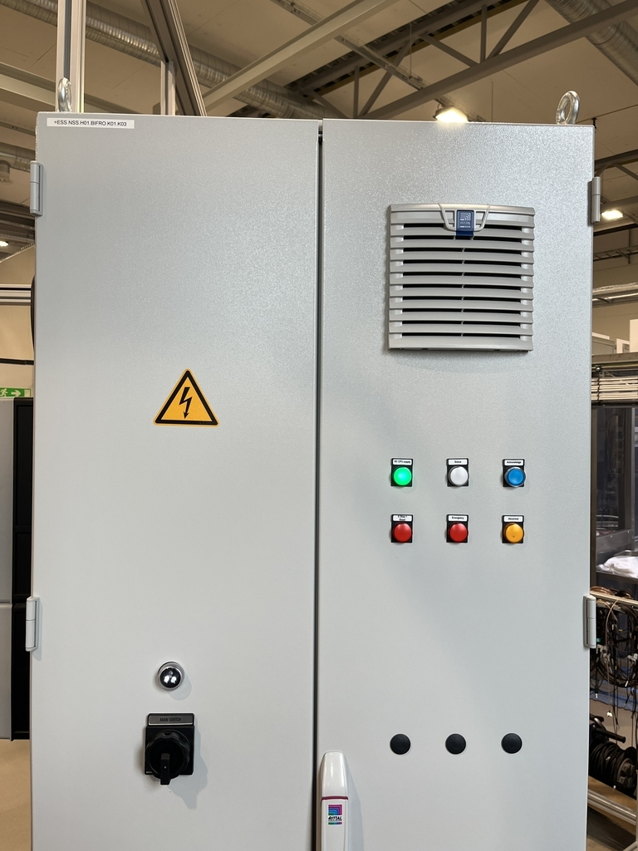
Motion control cabinet

Slide 11
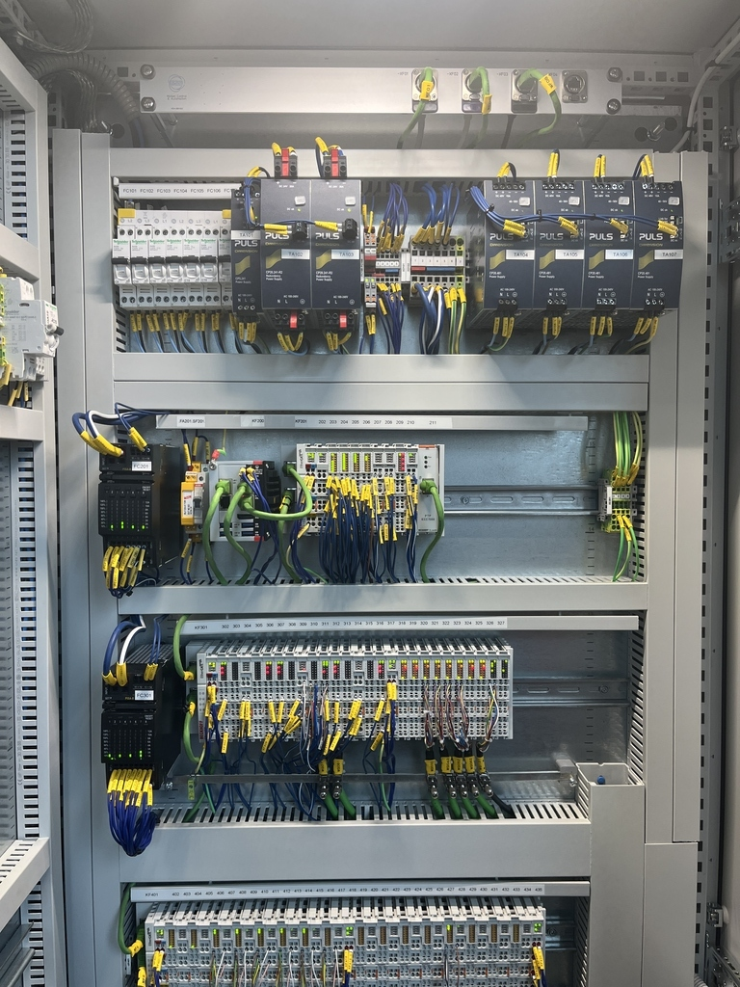
Motion control cabinet

Slide 12
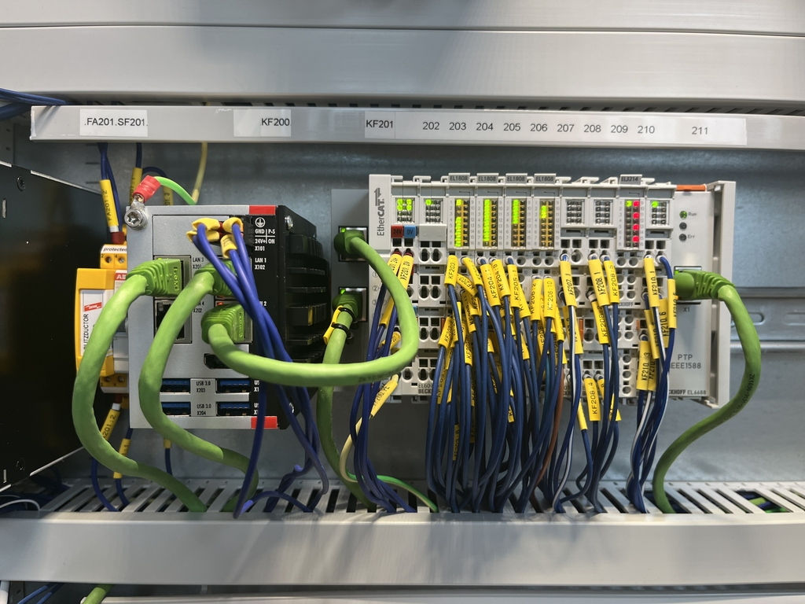
Motion control cabinet

Slide 13
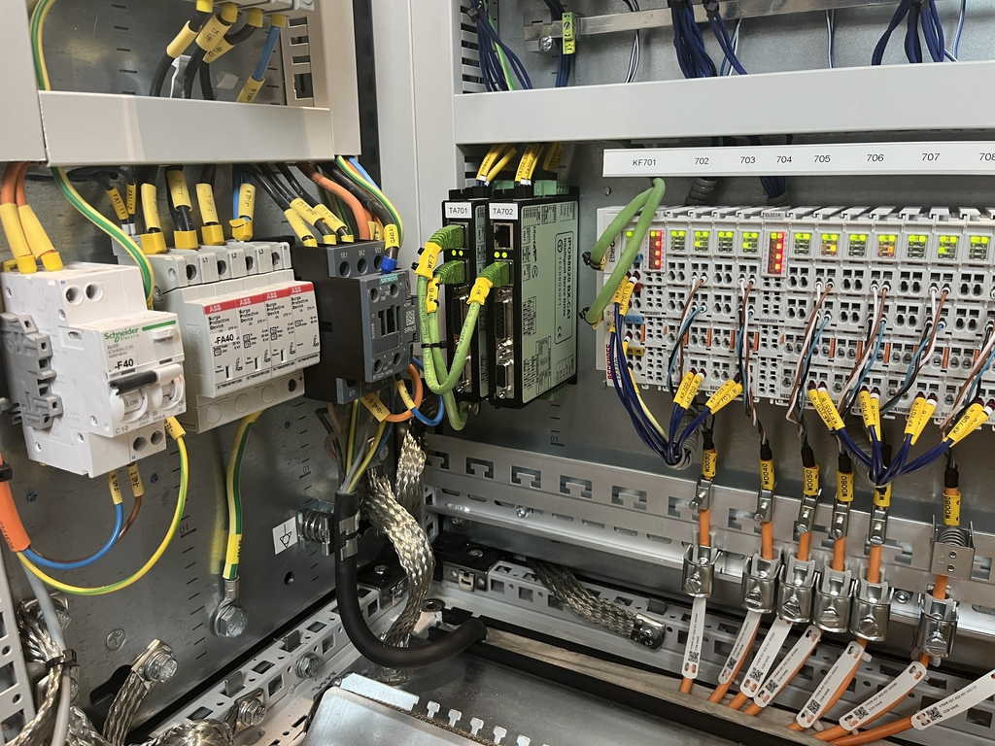
Motion control cabinet

Slide 14
Software
1 hardware platform: EtherCAT
2 Software platforms:
ecmc (open source)
TwinCAT (commercial)
More training/presentations available:
Too much for this very WS

Slide 15
TwinCAT
TwinCAT: commercial from Beckhoff
May (and must) write PLC code yourself
Common code base for ”our” code:
github.com/europeanspallationsource/tc_mca_std_lib/
International TwinCAT collaboration
Focus on motion control
ESS (Sweden), ISIS (UK), JCNS (Germany)

Slide 16
ecmc
Fully open source package
Linux based (No Windows !)
https://github.com/epics-modules/ecmc
Used in accelerator @ ESS
Used by other facilities (PSI, CLS)

Slide 17
Special things
Not really covered here:
- Encoders (absolute, incremental)
- Synchronization to the facility time
- time stamped motion (fly scan)
- Interlocks
- pneumatic shutters
- ESS target wheel

Slide 18
End of intro
Questions: please
Over to motion-control-EPICS

