Slide 1
synApps
Tim Mooney

Slide 2
What is synApps?
A collection of EPICS modules for synchrotron-beamline users
  Web page:
    http://www.aps.anl.gov/bcda/synApps
  Github repositories:
    https://github.com/epics-modules (modules)
    https://github.com/EPICS-synApps (support directories)
EPICS modules:
  alive, autosave, busy, calc, caputRecorder, dac128V, delaygen, dxp, ip, ip330, ipUnidig, mca, measComp, modbus, motor, optics, quadEM, script, softGlue, softGlueZynq, sscan, std, vac, vme, xxx
Support directories:
  documentation, configure, utils

Slide 3
synApps modules
Modules contain the following kinds of support:
  Compiled code; libraries
    E.g., record and device support
    State-Notation-Language (SNL) programs
  EPICS databases and autosave-request files
    A database is a program written in a high-level language.
    One or more copies of a database can be run, each with its own private process variables (PV’s).
    The database designer recommends PV’s to be autosaved by naming them in a .req file.
  Display files for MEDM, caQtDM, and CSS-BOY
    The default user interface
  Documentation
  Some modules contain iocBoot directories, as examples or for testing.

Slide 4
Other EPICS modules included with synApps
areaDetector
asyn
ipac
seq
stream
devIocStats
allenBradley

Slide 5
alive module
Sends operational status of an IOC to a server.
  Environment variables
  vxWorks boot parameters
  Boot time
Collected information is available at http://bcda.xray.aps.anl.gov/cgi-bin/ioc_alive.cgi

Slide 6
autosave module
Records latest values of selected EPICS PVs; restores those values when the ioc restarts.
  Not an archiver; only the latest value is saved
  Don’t confuse this with saveData, which writes scan data
  When a list list of PV’s is saved, the entire list is written, even if only one PV has changed.
Can save/restore any scalar or array-valued PV (synApps 5.1)
  Array-valued PV must be hosted by the ioc that does the restore operation. (Normally, ioc’s save/restore only their own PV’s.)
  DBF_MENU, DBF_ENUM PV’s are handled by number.
Save operation uses channel access for scalars.
Restore operation uses static database access for scalars.
Arrays are saved and restored with database access.

Slide 7
…autosave module
Three restore options for save files:
  before record/device initialization
    Motor positions must be restored at this time.
    Arrays cannot be restored at this time. *
    PV’s that are DBF_NOACCESS before record init (e.g., genSub variable-type fields) cannot be restored at this time. *
  2) after record/device initialization
    to override record-initialization values
    Link fields cannot be restored at this time. *
  3) both before and after record initialization
    The ‘auto_settings.sav’ file is restored at both times.
    It’s not an error to attempt to restore a PV at the wrong time.
    If you restore a motor position at this time, you override the value read from hardware, without writing to hardware.
* Not illegal, just doesn’t work

Slide 8
...autosave module
PV lists can use include files (e.g., <database_name>.req), include path.
  Database developer can supply default include file with database.
  User can override with custom include file.
Save triggers:
  on change of any PV in the list
  periodically
  on change of a trigger PV
  manual
User can reload save sets.
Autosave can recover from file-server reboot.
  Currently, only on vxWorks
User can choose to save redundant files.
Autosave reports status via EPICS PV’s.

Slide 9
...autosave module
Sample request file
xxx:my_PV.VAL
xxx:my_array_PV.VAL
file motor_settings.req P=$(P),M=m1
...
<END><lf>
PV names
Keyword
Macro replacements
Name of include file
Sample save file
# save/restore V4.4 Automatically generated…
xxx:my_PV.VAL 1.0
xxx:my_array_PV.VAL @array@ { “0” “0.1” … “10.2” }
xxx:m1.DIR 0
xxx:m1.DHLM 100
xxx:m1.DLLM –100
...

Slide 10
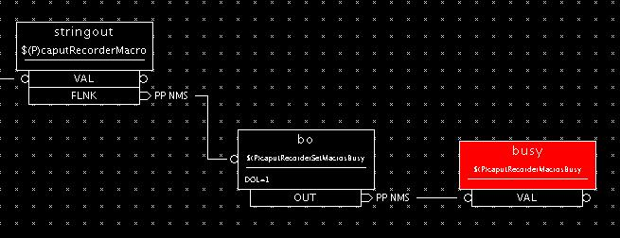
busy module
Allows channel-access clients and asyn drivers to participate in EPICS’ completion reporting
Records
  busy – like bo record, but forward link is executed only if VAL==0.
  Example of use:

Slide 11
calc module
Support for evaluating expressions entered at run time
Records
  acalcout – like calcout, but also supports array expressions; user can specify wait-for-completion.
  scalcout – like calcout, but also supports string expressions; user can specify wait-for-completion.
  swait – like calcout, but uses recDynLink (no “PP MS” link attributes), and waits for completion.
  transform – like 16 calcout records that share a PV data pool
  sseq – like seq, in base, but can get and put strings; user can specify wait-for-completion.
Other code
  interpolation routines for aSub record
  averaging routines for sub record
  sseq-record editor

Slide 12
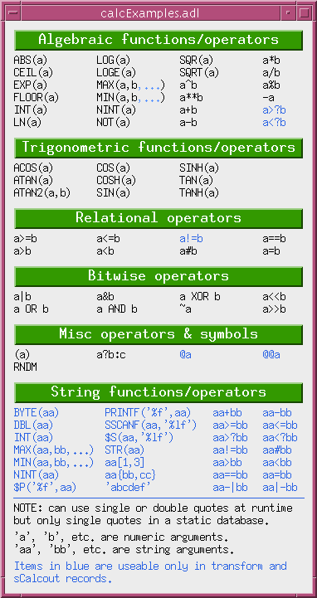
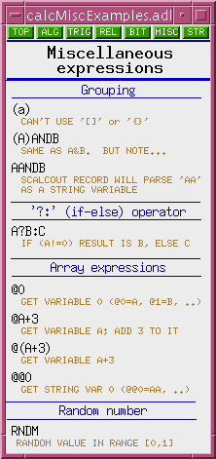
...calc module
Databases, display files for run-time programming
  userCalc, userCalcout
  userStringCalc
  userArrayCalc
  userTransform
  userStringSeq
  userAve
  interpolation
Examples of ALL calc expressions can be found in synApps MEDM help displays

Slide 13
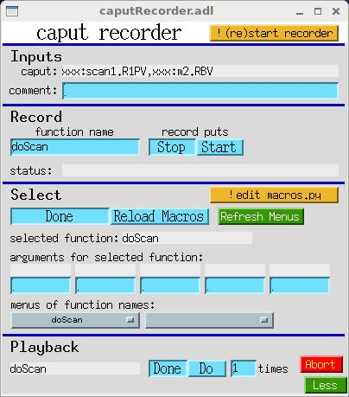
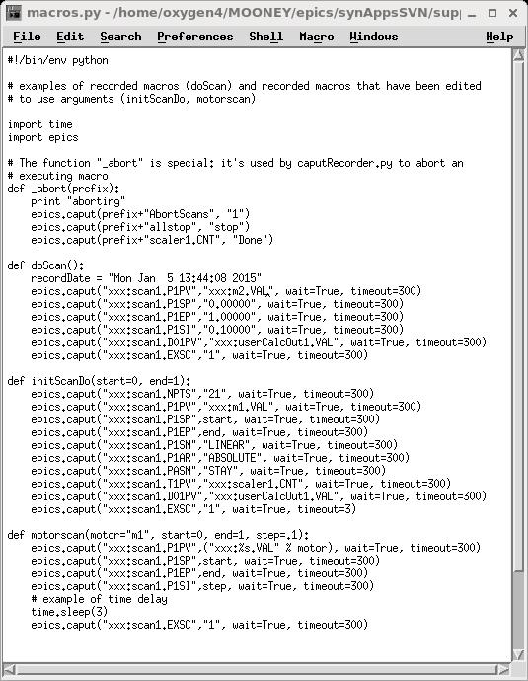
caputRecorder module
Support for recording and playing back sequences of channel-access puts.
User interface for executing python functions

Slide 14
configure directory
Configures all modules in or used by synApps
RELEASE
  specifies version number and file path to EPICS base, and to every module in synApps/support
makeReleaseConsistent.pl
  Edits <module>/configure/RELEASE for every module in synApps/support, to agree with synApps/support/configure/RELEASE
  “make release” in synApps/support causes this to run.

Slide 15
dac128V module
device support, database, and display files for dac128V IndustryPack module
  8-channel, 12-bit DAC
  Support exists to run a DAC channel manually, or according to an algorithm written at run time, or as a scan positioner, or as part of a PID feedback loop at up to ~10 Hz, or as part of a fast PID feedback loop at up to ~10 kHz.

Slide 16
delaygen module
device support, database, and display files for delay generators
  Stanford Research Systems DG535 and DG645 digital delay generators.
  Colby Instruments PDL100A programmable delay line
  Coherent synchronization delay generator
  Berkeley Nucleonics 505 pulse/delay generator

Slide 17
documentation directory
TOP-level synApps documentation
  What synApps is
  How to deploy it
  How to build it
  How to make a user application from the ‘xxx’ sample module
  How to fit the user application to a particular set of hardware

Slide 18
dxp module
record, device support, databases, and display files for X-ray Instrumentation Associates (XIA) Digital X-ray Processors: xMap, Mercury, Saturn, MicroDXP systems
dxp record for setting DXP parameters
device support for the mca record

Slide 19
ip module
device support, SNL code, databases, and display files for many message-based devices
  originally, for devices supported via IndustryPack hardware
  Note some of this support will inevitably be out of date, or pending access to hardware for testing.
deviceCmdReply
  Used to write support at run time for one command/reply message
  scalcout to format output string
  asyn record to write/read device
  scalcout record to parse reply
devXxStrParm device support
  New support should use stream/asyn

Slide 20
ip330 module
device support, databases, and display files for the IP330 ADC IndustryPack module
16/32 channel, 16-bit ADC
  ip330Scan for periodic, averaged reads of ADC channels
  ip330Sweep, with the MCA record, for using ip330 as a waveform-digitizer, or to record analog data during a fly scan
  ip330PID for using the ip330 in a fast-feedback loop

Slide 21
ipUnidig module
device support, databases, and display files for the IPUnidig digital I/O IndustryPack module
IP-UD-I 24-channel input/output/interrupt module
DIO316I 48-bit digital I/O module

Slide 22
mca module
Support for multichannel analyzers, multichannel scalers, and other array-valued detectors
mca record
device support
  Canberra 556 AIM module (MCA and ICB controller)
  DSA-2000 Ethernet MCA
  various Canberra-ICB modules for spectroscopy
  SIS 3801 (Struck STR7201) and 3820 multichannel scalers
  (DXP support in dxp module)
  (IP330 support in ip330 module)
  (quadEM support in quadEM module)

Slide 23
measComp module
Support for Measurement Computing USB and Ethernet devices
  USB-CTR08 8-channel counter/timer module
  USB-1208 analog I/O modules
  USB-231 analog I/O module
  USB-1608 analog I/O modules
  E-1608 analog I/O module
  USB-2408 analog I/O module
  E-TC thermocouple module
  TC-32 thermocouple module
  USB-4303 (obsolete) counter/timer module

Slide 24
modbus module
Support for Modbus Protocol
  Programmable Logic Controllers (PLCs)
  Other modbus devices, such as temperature controllers
Uses asyn to support various communication links
  TCP/IP
  Serial RTU
  Serial ASCII

Slide 25
motor module
Motor record and device support
  stepper and servo motors
  soft-motor support
    Put motor “face” on, e.g., a DAC channel
    Drive a hard motor through a nonlinear transform (see 2slit_soft.db in the optics module)
  user/dial/raw coordinates
  backlash-takeout algorithm
  pre/post move commands
  many more features

Slide 26
…motor module
Supported motor types
  Oregon Micro Systems, Inc. (OMS) models; VME8, VME44, VME58, VS4, VX2, MAXv, PC68 and PC78.
  Newport models MM3000, MM4000/5/6, PM500, ESP300/301/100 and XPSC8.
  Schneider Electric (formally IMS) models IM483, MDrive and MForce.
  Advanced Control Systems, Corp. model MCB-4B.
  Mclennan models PM304 and PM600.
  Physik Instrumente (PI) GmbH & Co. model C-630, C-844, C-848, C-862/863, E-662, E-710 and E-816.
  MicroMo model MVP 2001 B02.
  Micos model MoCo dc controller, SMC hydra controller.
  Delta Tau PMAC2-VME controller.
  Faulhaber MCDC2805 servo controller.
  Parker Hannifin, Compumotor Division, 6K Series controllers.
  New Focus, models; 8750 and 8752.
  ACS Motion Control, SPiiPlus model.
  Spectra-Physics, Encoder Mike Controller, Model 18011.
  Thorlabs, Piezo Controller, Model MDT695.
  Animatics Corporation SmartMotor.
  piezosystem jena GmbH EDS data interface module.
  Kohzu SC-200, SC-400, SC-800 stepper motor controllers.
  attocube systems AG ANC150 Piezo Step Controller.
  Aerotech Soloist single-axis servo controller, Ensemble multi-axis digital servo controller.
  Hytec 8601 Industry Pack based 4-channel Stepper Motor Controller.

Slide 27
optics module
Slits and mirrors
  Four virtual positioners; two real motors
  Automatic sync to motor positions
  Completion reporting
Monochromators
  Nondispersive double-crystal
    Geometries: (Y1, Z2), (Y2, Z2)
    Crystal species: Si, Ge, Diamond, Si (77K)
    Miller indices, allowed reflections
    Operational modes:
      Use/Set
      Manual/Auto
    Managing the vertical beam offset
    Automatic sync to motor positions

Slide 28
…optics module
…Monochromators
  Spherical grating
    Geometrical variables:
      1) Grating line density; radius
      2) Tangent-arm length
      3) Diffraction order
      4) Input/output slit distances
    Operational modes:
      Use/Set
      Manual/Auto
    Grating-stripe list
    Manual sync to motor positions

Slide 29
…optics module
…Monochromators
  Dispersive double-crystal
    Geometries: nested, symmetric
    Crystal species: Si, Ge, Diamond, Si (77K)
    Miller indices, allowed reflections
    Operational modes:
      Use/Set
      Manual/Auto
      Theta1 / Theta1&2 / Rock Theta2
    Accommodate incident-beam angle shift (“world offset”)
    Automatic sync to motor positions

Slide 30
…optics module
Optical table
  Table record supports a six-degree-of-freedom optical table.
  Four geometries: SRI, GEOCARS, NEWPORT, and PNC
  User/client can write either to (x, y, z, θ_{X}, θ_{Y}, θ_{Z}), or to underlying motor records.
  Table rotates about user-specified point.
  Table database includes a list of rotation points, selected by menu.
  Can recover table position from motor positions
  Partial support for fewer than six degrees of freedom

Slide 31
…optics module
…Optical table
  Geometries
    SRI
    GeoCARS
    Newport
    PNC
SRI
GEOCARS
PNC
NEWPORT
- Calibration/sync
    Use/Set – changes to [X, Y, ..]. move table / change calibration
    Zero – redefine current [X, Y, …] as zero
    Sync – update [X, Y, …] from motors, honoring calibration
    Init – clear calibration and sync to motors
  Table record sets motor speeds so that motors start/stop together.

Slide 32
quadEM module
Support for four-input electrometers.
  CAENels AH401B, AH401D, AH501, AH501C, and AH501D picoammeters
  CAENels TetrAMM picoammeter
  NSLS Quad Electrometer
  NSLS2 Quad Electrometer
  APS Quad Electrometer

Slide 33
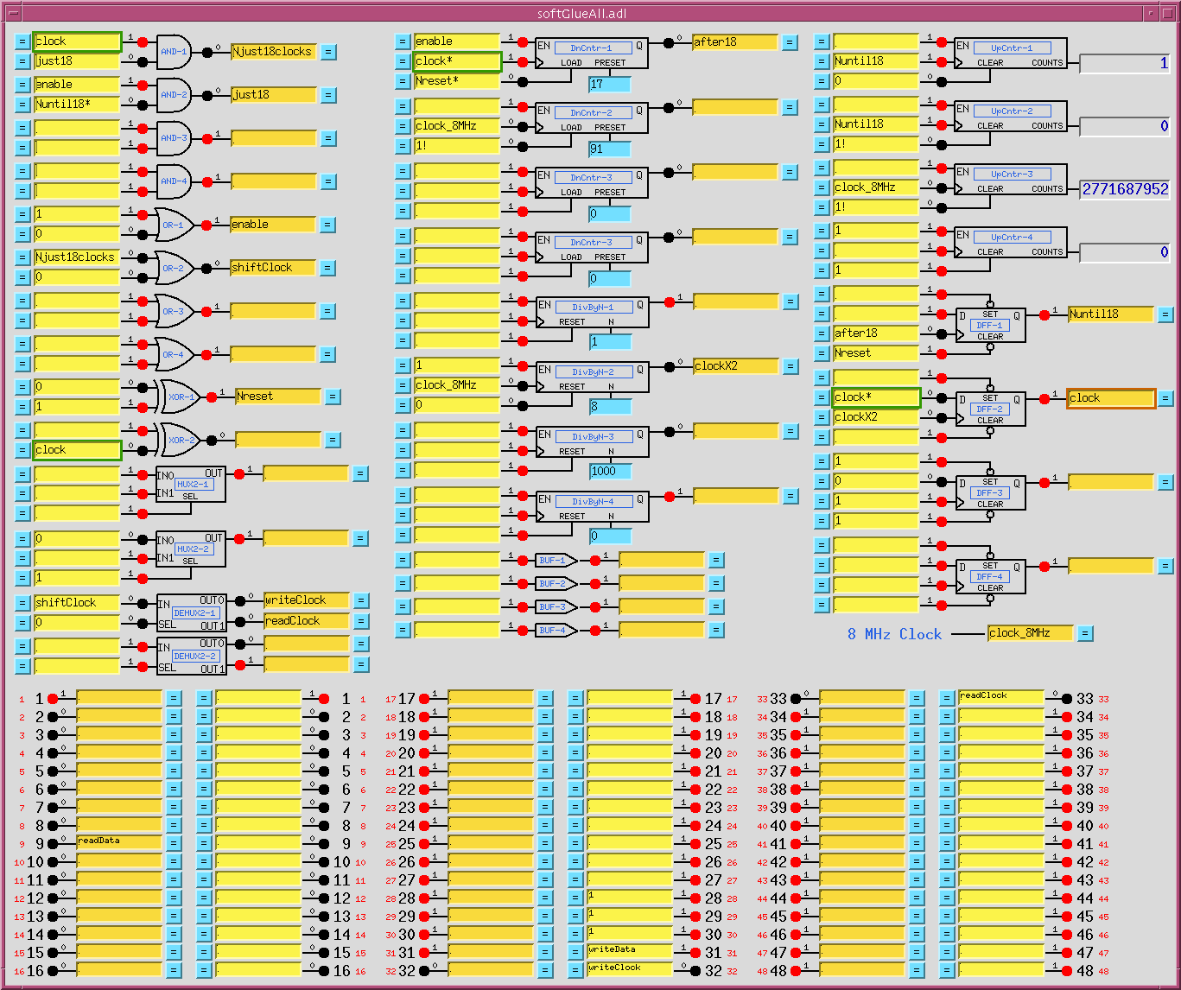
softGlue module
Support for FPGA-based digital electronics.

Slide 34
sscan module
Support for user-programmable data-acquisition
  sscan and busy records
  saveData
  recDynLink
A one-dimensional scan:
  Do NPTS times:
    Set conditions e.g., move motors; wait for completion
    Trigger detectors e.g., start scaler; wait for completion
    Acquire data read detector signals; store in arrays
  Write data to NFS file
Multidimensional scan:
  Same as a 1-D, but detector trigger executes inner-loop scan.
  saveData monitors a set of sscan records, determines scan dimension when scan starts, and writes data as it is acquired.

Slide 35
...sscan module
scan features:
  Three 1-D scan types: constant-step-size, table-driven, fly
  Unlimited number of data points, scan dimensions
  0-4 positioners, 0-4 detector triggers, 0-70 detector signals
  Acquisition from scalar and 1-D-array-valued PV's
  Detector/client wait, data-storage wait
  Pause/resume, abort
  Double buffered: can write 1-D acquired data during next 1-D scan
  saveData writes self-describing XDR-format (“.mda") files to NFS-mounted disk (vxWorks only, at present).
  A positioner can have private scan parameters (scanparm record).
  After-scan actions include move to peak, valley, and edge.
  scanparm record + after-scan action = automated 1-D alignment, so you can easily implement an “Align” button.

Slide 36
…sscan module
The sscan record
  performs 1-D scan
  before-scan link – optional completion callback
  positioner: any writable, numeric, scalar PV (menus, enums are ok)
  detector trigger: any writable, numeric, scalar PV
  detector signal: any readable, numeric, scalar or 1D array PV
  array detectors: exactly <scanRecord>.NPTS elements are acquired
  array trigger: callback indicates array data are ready to read
  after-scan link – optional completion callback
  pause/resume
  abort (<scanRecord>.EXSC -> 0) wait for callbacks, cleanup
  kill (two aborts in a row) abandon callbacks
  handshake with multiple display / data-acquisition clients
  handshake with data-storage client

Slide 37
Other data-acquisition-related software
Data-visualization tools for use with the sscan record
  dview, sview
  utils/mdautils
  utils/mdaExplorer
  utils/mdaPythonUtils

Slide 38
std module
Epid record
  Extended PID record
Scaler record
  Controls a set of counters with a common clock, gate, and trigger
Soft-motor database
  Run-time programmable soft-motor/transform/hard-motor database
  Quick solution for driving a motor through a nonlinear transform
4-step database
  Up to four steps of (set condition; read data) with an end calculation
  Originally developed for dichroism experiments
PID control
Femto current-amplifier support
genTweak, ramp_tweak
selector
pvHistory
Alarm clock, countdown timer

Slide 39
utils directory
changePrefix
  Change EPICS prefix throughout a copy of the xxx module
changePrefixIoc
  Change EPICS prefix for all files in an ioc directory
copyAdl
  Find MEDM-display files; copy to specified directory.
mdaExplorer, mdaPythonUtils, mdautils-src
  Display, manipulate scan-data (MDA) files
snapDb
  “Freeze” a collection of userCalcs into a custom database, display
Subversion utilities:
  logModuleFromTag, releaseNotesFromTag, makeTar

Slide 40
vac module
Support for vacuum measurement and control
  vs, digitel records
  Granville-Phillips GP307, GP350
  Televac MM200, CC10
  Digitel 500/1500
  Gamma MPC, MPCe, LPC, SPC, PI Digitel 500/1500

Slide 41
vme module
VME record
  Provides run-time access to VME bus
  Great for testing hardware
  Run-time programmed control of an unsupported VME board
Device support for VME hardware
  Joerger scaler
  APS bunch-clock generator
  APS machine-status interface
  Heidenhain encoder interpolator
  Generic A32 VME interface
  HP Laser interferometer
  VMI4116 16-bit DAC
  Acromag 9440 16-bit digital input

Slide 42
xxx module
Prototype user directory
  Builds everything in synApps into a load module
  Contains command files to load/configure ~everything in synApps
  Contains sample top-level display files
  Contains sample script to set environment variables and start up the sample user interface
  Contains table of recommended address/interrupt configuration for selected VME and IndustryPack hardware
Two ways to use this module
  Make copies; run changePrefix; build; customize; run a beamline
    this is the recommended use
    detailed instructions in support/documentation
  2) Reference/grab bag

Slide 43
For developers: features of synApps
extended-processing records
  records that are neither synchronous nor asynchronous, as these terms are described in the EPICS Application Developer’s Guide
completion reporting
  All databases behave correctly when written to by ca_put_callback().
recDynLink links
  Similar to standard EPICS links, but no “PP NMS” attributes
GUI standards
  Default colors for menus, PV values, links, etc.
coordinated motions
  Many of the databases in synApps (especially in ‘optics’) involve coordinated motion of several motors.
initialization of complex databases
  Some common EPICS initialization problems are handled in various synApps databases.

Slide 44
Coordinated motions
Simple cases: database (transform records)
  Slits, mirrors, spherical-grating monochromator
More complicated cases: SNL code
  Multiple-crystal monochromators
Very complicated cases: custom record
  Optical table, scan
Criteria a useful coordination should meet:
  Report completion to ca_put_callback()
  Share control of base positioners with CA clients
  Recover state from the states of base positioners

Slide 45
Completion reporting
Simple prescription for databases contained within a single ioc:
  Use only PP links and forward links in execution chain.
Database operations spanning more than one ioc:
  Use records with put_callback links to span iocs:
    calcout with asynchronous device support
    sscan, swait
    sseq or sCalcout (with .WAIT* = “Wait”)
Cases in which a CA client performs part of the operation:
  Database sets a busy record via PP or put_callback link.
  CA client clears the busy record when operation is done.
Cases in which part of the operation is driven by a CP link:
  - Not different from above; a CP link is a CA client

Slide 46
Initialization of complex databases
Initial values: .VAL vs. .DOL
  Most records allow .VAL field to be set in the database.
  Note that .DOL cannot be used for constant strings.
Save-restore and interaction with record/device initialization
  save-restore pass 0
  record/device initialization → device support can use pass-0 value
  save-restore pass 1 → pass-1 overrides record/device-init value
.PINI (Process at INIt) uses and limitations
  This is the normal mechanism for database initialization.
  What if you need a value from some other .PINI-initialized record, and that record hasn’t processed yet?
  Note .PHAS is not considered in .PINI processing.

Slide 47
...Initialization of complex databases
Contending with link alarms
  If you have an input link to a record with .UDF=1, you get a link alarm.
  .UDF=1 until a record processes. (In 3.14.1+, database can specify .UDF)
  The transform record can abort execution on a link alarm (or not).
Initialization problems with CP links
  You have a CP link to a field that is a calculation result.
  If the calc result is the same as the field’s initial value, you’ll have the right value, but you won’t know that you have the right value, and you won’t know for how long to wait to be sure.
  The transform record always posts its initial calculation result.
Programmatically initializing link fields
  Link field must be written with a CA link (because lock-set recalc).
  .PINI processing occurs before CA is running (EPICS 3.13.5+).
  Can’t use .PINI; Drive init from a scan task; set init record to “Passive” when init is done.

Slide 48
synApps in use at APS
Deployed/released on /APSshare, rsync’d to beamline dservs
  New minor releases (e.g., what would be synApps 5.8.x, if minor releases were numbered) are done by adding new versions of modules to the support directory.
  Beamlines select version with their configure/RELEASE files.
  A new major release is done when it becomes impossible or impractical to upgrade the previous release with needed software.
    New version of EPICS base
    New non-backward compatible version of a module on which many other modules depend, for examples, asyn and seq.

