Slide 1
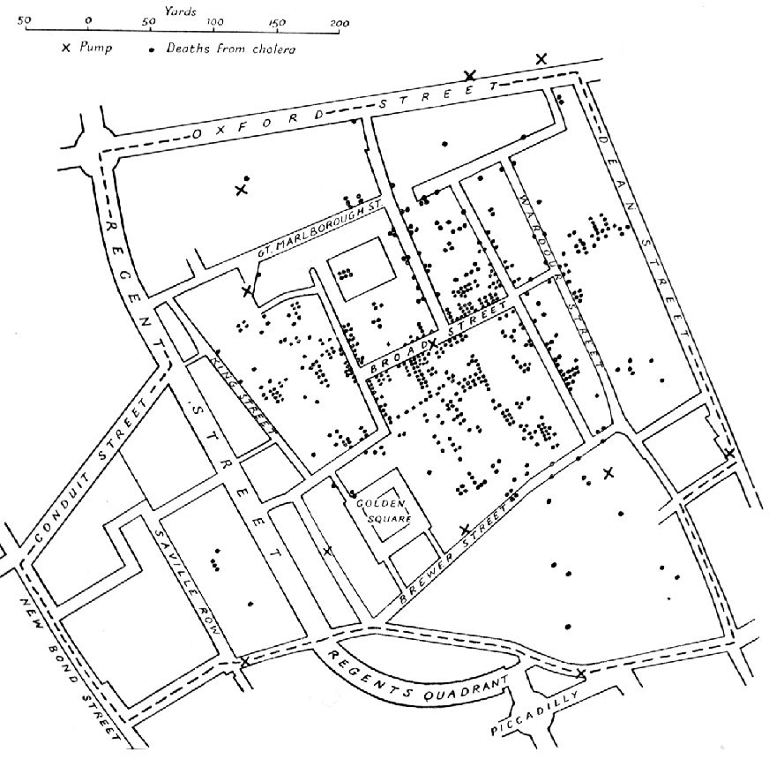
Introducing Broadwick
“A Computational Framework for Mathematical Modeling”

Slide 2

… want model continuity and not always start from scratch
… before [and especially during an outbreak] we want scientists thinking about the science NOT whether their code works.
But we still need talented people to do the research!
THE PROBLEM

Slide 3
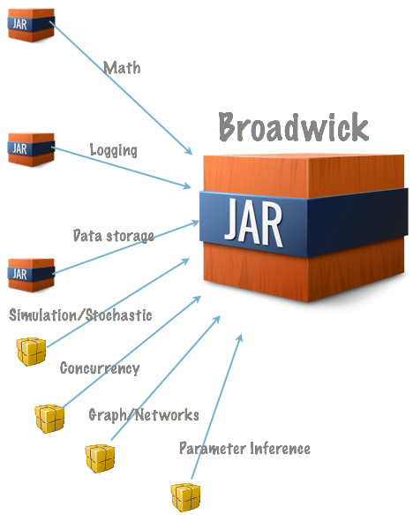
Broadwick is
… is a framework for developing sophisticated epidemiological based mathematical models.
… essentially is a library consisting of several libraries and bespoke packages.
… contains many hooks that allow Broadwick to be used to develop models with the minimum of effort.
… is written in Java 7. Nothing else is imposed on the user (e.g. build system, IDE etc).

Slide 4

Using Broadwick
Java code
+
Config file
Broadwick
Project

Slide 5
xsd file defines the configurable parameters in your model
… and is injected magically into the configuration file.
<?xml version="1.0" encoding="UTF-8" standalone="yes"?>
<project>
<logs>
<console>
<level>info</level>
<pattern>[%thread] %-5level %msg %n</pattern>
</console>
<file>
<name>myModel.log</ name>
<level>trace</level>
<pattern>[%thread] %logger %-5level %msg %n</pattern>
<overwrite>true</ overwrite>
</file>
</logs>
<data>
<datafiles>
<PopulationFile>
<name>data.csv</ name>
<separator>,</ separator>
<dateFormat>yyyy-MM-dd</ dateFormat>
</PopulationFile>
</datafiles>
</data>
<models>
<model id="The name of my model">
<classname>org.mymodel.MyModel</ classname>
<numAgents>100</numAgents>
<numSimulations>50</numSimulations>
</model>
</models>
</ project>
<xsd:schema xmlns:xjc="http://java.sun.com/xml/ns/jaxb/xjc"
xmlns:xsd="http://www.w3.org/2001/XMLSchema">
<xsd:annotation>
<xsd:documentation xml:lang="en"/>
</xsd:annotation>
<xsd:element name="model">
<xsd:complexType>
<xsd:sequence>
<xsd:elementname="numAgents" minOccurs="1"
maxOccurs="1"
type="xsd:int"/>
<xsd:elementname="numSimulations" minOccurs="1"
maxOccurs="1"
type="xsd:int"/>
</ xsd:sequence>
</ xsd:complexType>
</ xsd:element>
</ xsd:schema>
Little work is required from the modeller
- But a lot of functionality is gained

Slide 6
Creating a new model
Creating a new model is easy …
package custom;
public class myModel extends broadwick.model.Model {
@Override
public void init() {
throw new UnsupportedOperationException("Not supported yet.");
}
@Override
public void run() {
throw new UnsupportedOperationException("Not supported yet.");
}
@Override
public void finalise() {
throw new UnsupportedOperationException("Not supported yet.");
}
}
Extend Broadwick's Model class
… and override the abstract methods.
… and much easier than writing ALL the code from scratch [again!]

Slide 7
Each calculation class contains intelligent defaults
For example, the MonteCarlo class uses a Metropolis-Hastings algorithm for accepting proposals
simulation = new McModel () {
@Override
public McResults compute(Step step) {
throw new UnsupportedOperationException("Not supported yet.");
}
};
final MonteCarlo mc = new MonteCarlo(simulation);
mc.setWriter(newFileOutput(“myMcmc.dat”));
mc.run();
But this can easily be customised....
mc.setAcceptor(new Acceptor() {
@Override
public boolean accept(final McResults oldResult,
final McResults newResult) {
return newResult.getScore() > oldResult.getScore();
}
});
… customising these defaults are [and should be] easy to do.
One size does not fit all after all !

Slide 8
Broadwick Contains …
Useful classes/packages you'd expect
math(factorial, sets operations, RNG), file i/o
A concurrency package
Can take advantage of multithreaded/distributed/grid computation with very little work/thought from the modeller.
Calculation packages
Stochastic Simulations, MCMC, Approx. Bayesian Computation
Very sophisticated models can be built relatively simply

Slide 9
What can Broadwick do for Epic?
off the shelf simulations would be readily adaptable for new diseases (e.g. what if Schmallenberg had become a more serious problem?)
implementation of parameter estimation routines directly allows for better prediction
data imputation - given the existing data (e.g. we know about impact on farms in SE England) what does that tell us about risk in Scotland?
Bang >> Buck !

Slide 10

Why Broadwick?
Models can be written quickly
Code reuse
verifiable
Off-the-shelf models can be written in advance of an outbreak.
Plug'n'play
Modified easily if needed

Slide 11
for u in `attendees`
do
echo “Thank ”$u
done

Slide 12
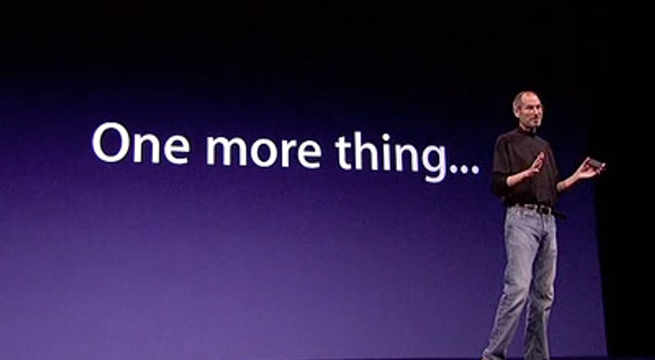
Broadwick 1.0 is available
to developers today

