Slide 1

How to Run Simple Models with the Broadwick Framework
“Broadwick Examples”
S. J. Lycett
24 June 2014

Slide 2
Introduction
Broadwick Framework provides the underlying code for generating and running specific models
To show how this works, we’ve generated some examples
This morning: running pre-written models
This afternoon: how to write your own models

Slide 3
Broadwick Examples
Demonstration models have been written in the Broadwick Framework
They have been compiled (built) together with the Broadwick Framework into one jar file BroadwickExamples-1.0-SNAPSHOT.one-jar.jar
Files are on the USB stick, or
Get the files from GitHub (see) http://epicscotland.github.io/broadwick.html

Slide 4
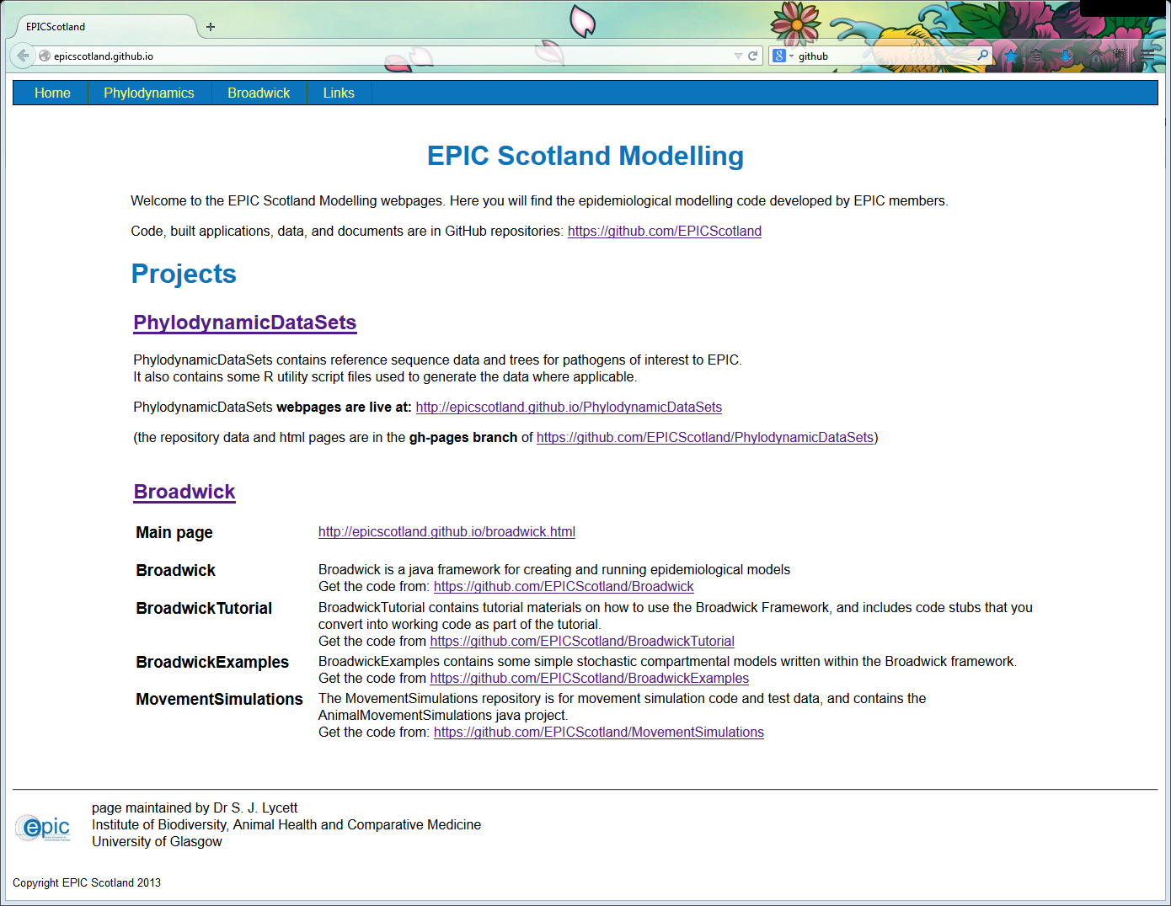
http://epicscotland.github.io/
(Github user facing site)

Slide 5
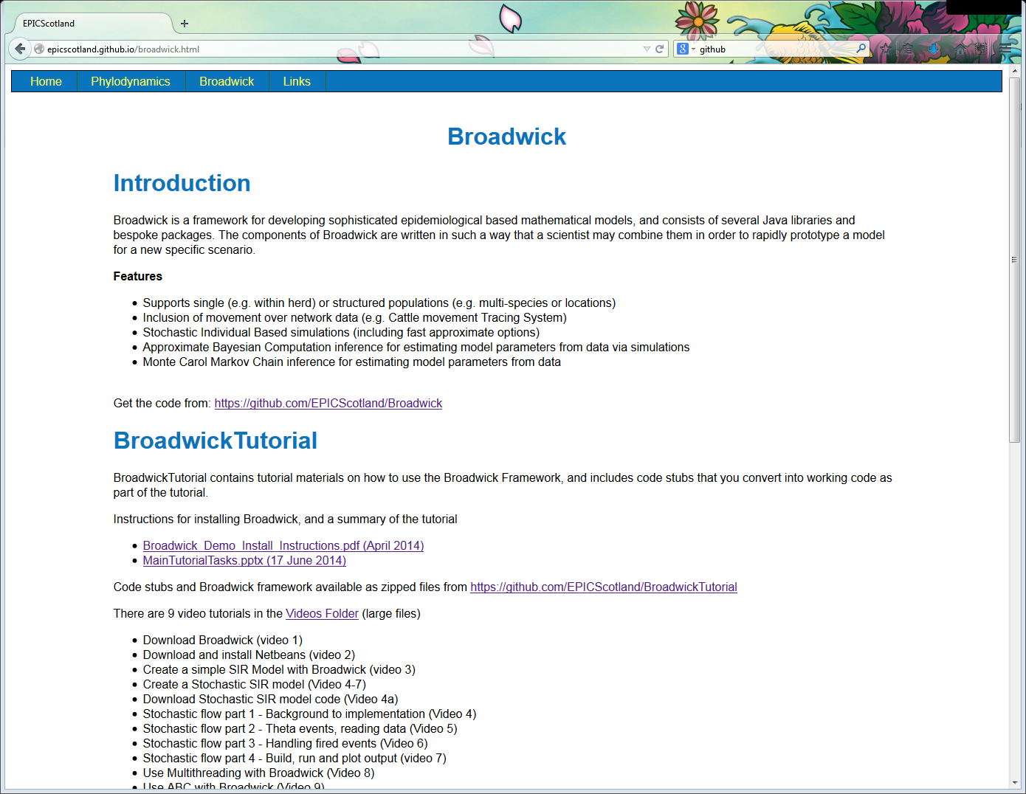
This afternoon

Slide 6
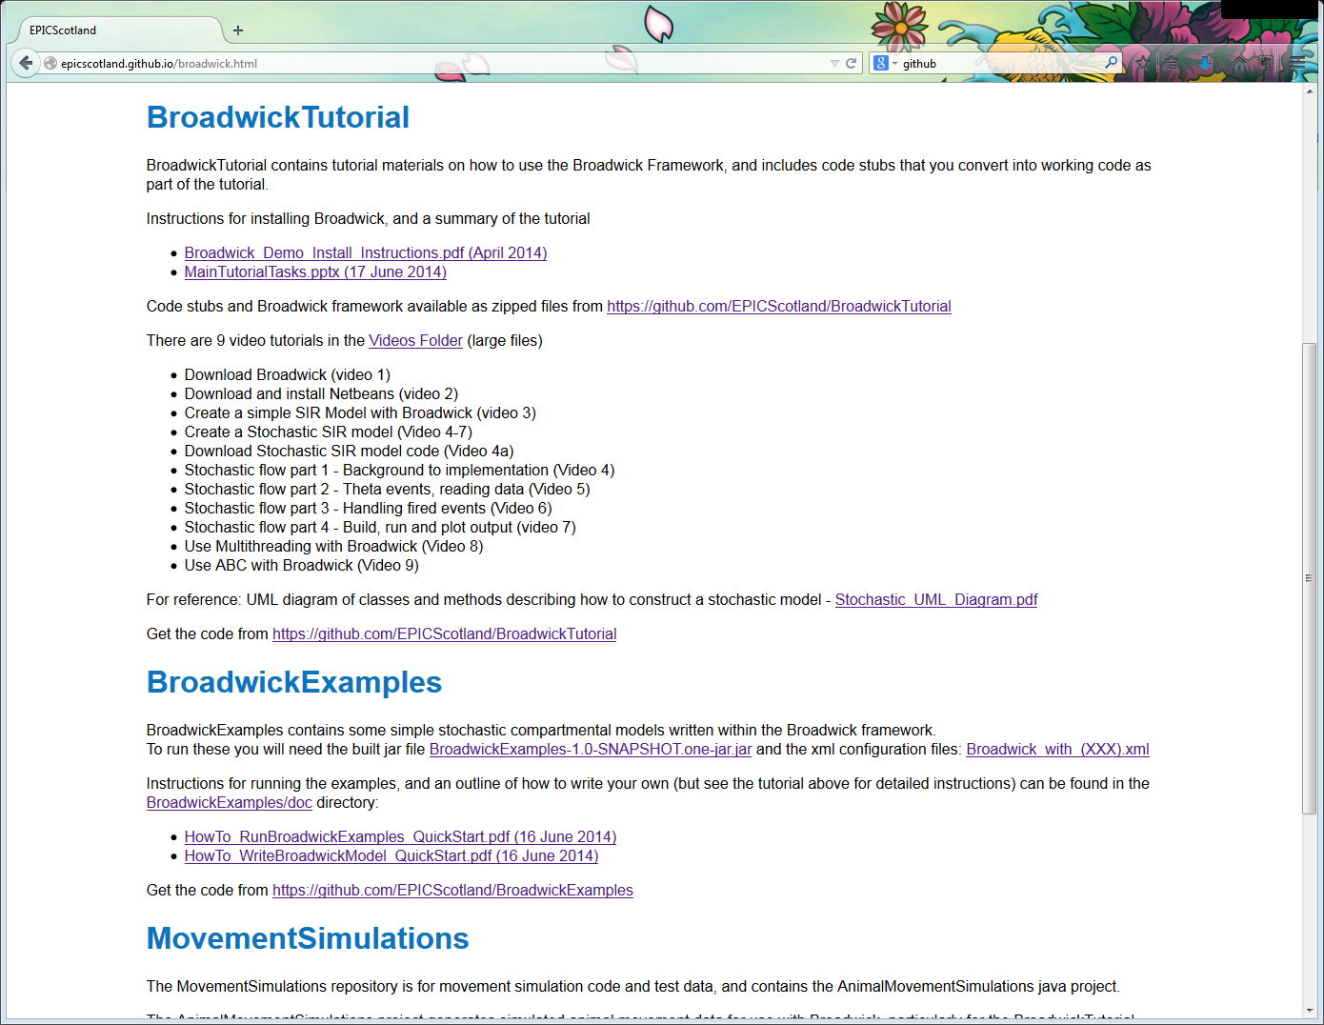
Demonstration files

Slide 7



Simple Compartmental Model
Assume fixed population of N individuals
Model number of Susceptibles (S), Infecteds (I) and Recovereds (R) over time
Assume that anybody can infect anybody else (if Susceptible)
$$\frac{dS}{dt}=−\frac{βSI}{N}$$
S
I
R
$$\frac{dI}{dt}=\frac{βSI}{N}−γI$$
βSI/N
γI
Infection rate
Recovery rate
$$\frac{dR}{dt}=γI$$

Slide 8
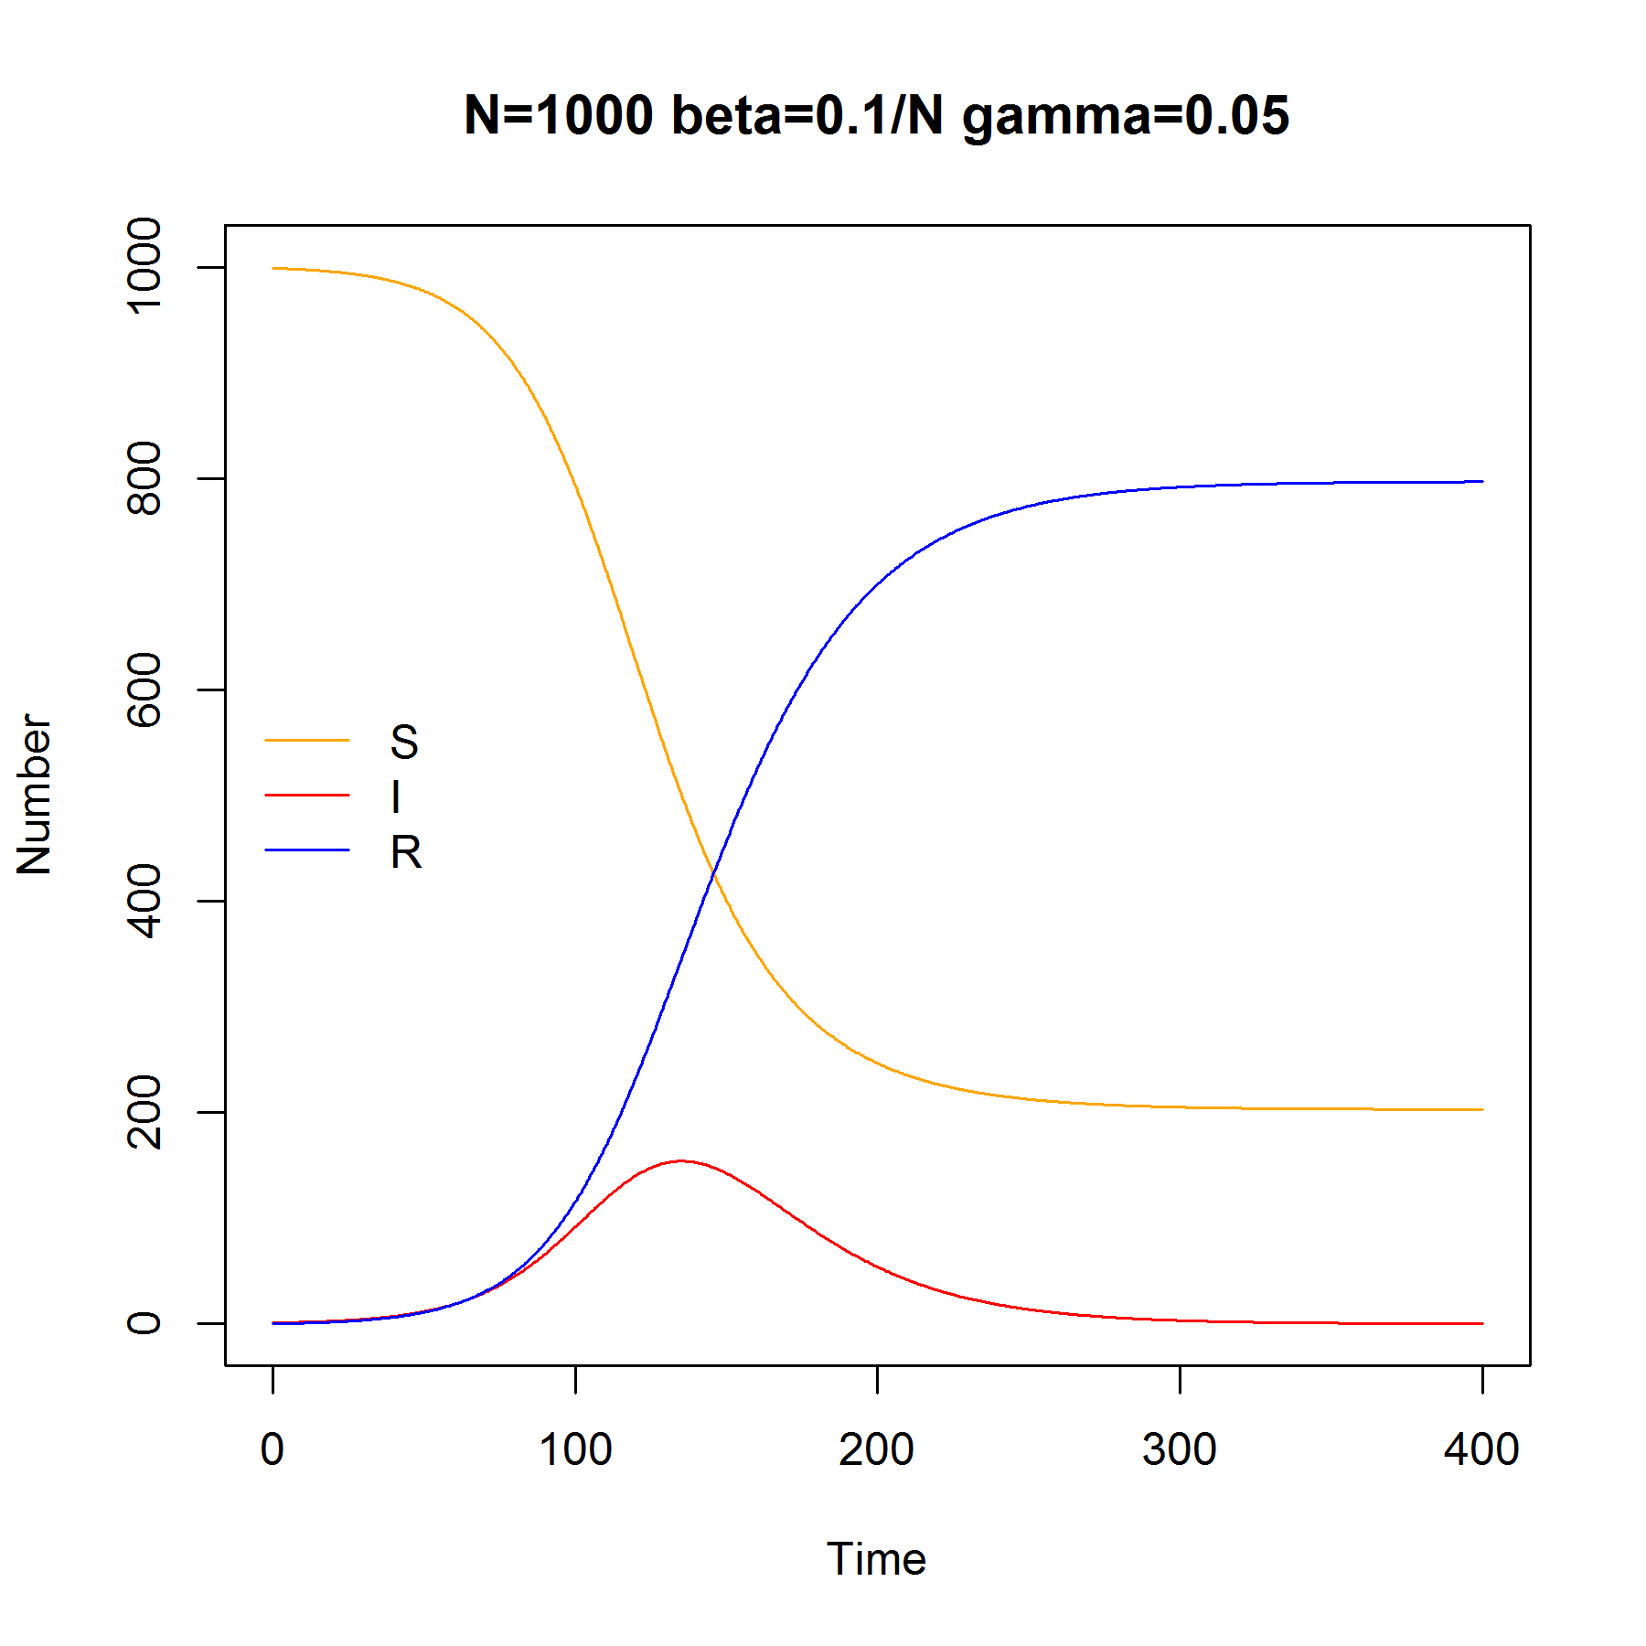
Deterministic Solution to SIR Model

Slide 9
Demonstration models
All use Broadwick Stochastic algorithms
Event driven: calculating the probability of infection and recovery for individuals
Choice of Gillespie Algorithm or Fixed Step Tau-Leap (approximate Gillespie, faster)
BasicSIR: stochastic SIR model
IndividualSIRModel: stochastic SIR model with named individuals and who-infected-whom
NetworkSIRModel: as above, but individuals only infect each other over a network

Slide 10
Configuration Files
Models in the “one-jar” file are run using XML configuration files
Broadwick_with_DummyModel.xml
Broadwick_with_BasicSIRModel.xml
Broadwick_with_IndividualSIRModel.xml
Broadwick_with_IndividualNetworkModel.xml

Slide 11
Broadwick_with_BasicSIRModel.xml
(Page 1 of 2)
General framework part of configuration file:
<?xml version="1.0" encoding="UTF-8" standalone="yes"?>
<project>
<logs>
<console>
<level>info</level>
<pattern>[%thread] %-5level %msg %n</pattern>
</console>
<file>
<name>epic.basic.basicsirmodel.log</name>
<level>info</level>
<pattern>[%thread] %-5level %msg %n</pattern>
<overwrite>true</overwrite>
</file>
</logs>
Broadwick framework log file

Slide 12
Broadwick_with_BasicSIRModel.xml
(Page 2 of 2)
Model specific part of configuration file:
<models>
<model id="Broadwick Project">
<classname>epic.basic.BasicSIRModel</classname>
<parameter id="filename" value="basicsir_test"/>
<parameter id="verbose" value="false"/>
<parameter id="maxTime" value="1000000"/>
<parameter id="tauStep" value="0"/>
<parameter id="N" value="1000"/>
<parameter id="initI" value="1"/>
<parameter id="beta" value="0.1"/>
<parameter id="gamma" value="0.05"/>
</model>
</models>
</project>
The model to run
Specific parameters for the model

Slide 13
Command Line Operation
Broadwick is designed to be run from the command line, and/or in batch scripts
Bring up your command line:
Windows: Start -> (search) “prompt” -> command prompt
Mac: (Launch Pad) -> Terminal
Go to the directory of the jar and xml files
To run a model type this (all one line):
java –jar BroadwickExamples-1.0-SNAPSHOT.one-jar.jar –c Broadwick_with_BasicSIRModel.xml

Slide 14
Expected Results

Slide 15
Broadwick_with_DummyModel.xml
Command:
java -jar BroadwickExamples-1.0-SNAPSHOT.one-jar.jar -c Broadwick_with_DummyModel.xml
Expected results:
lots of:
[JarClassLoader] INFO: findResources..
[main] INFO Running broadwick Version 1.1 Build (SJLDELL - unknown : 2014-06-14 11:49)
[main] INFO Running broadwick for the following models [Broadwick Project]
[pool-1-thread-1] INFO Running Broadwick Project [epic.broadwickexamples.DummyModel]
[pool-1-thread-1] INFO Initialise Dummy Model
[pool-1-thread-1] INFO Run Dummy Model
[pool-1-thread-1] INFO stringParam=ABCDEFG
[pool-1-thread-1] INFO intParam=1
[pool-1-thread-1] INFO doubleParam=2.0
[pool-1-thread-1] INFO Finalise Dummy Model
[pool-1-thread-1] INFO END
[main] INFO Simulation complete. 0:00:00.056
SUCCESS !

Slide 16
Broadwick_with_BasicSIRModel.xml
Command:
java -jar BroadwickExamples-1.0-SNAPSHOT.one-jar.jar -c Broadwick_with_BasicSIRModel.xml
Expected results – also written to log file epic.basic.BasicSIRModel.log
[main] INFO Running broadwick Version 1.1 Build (SJLDELL - unknown : 2014-06-14 11:49)
[main] INFO Running broadwick for the following models [Broadwick Project]
[pool-1-thread-1] INFO Running Broadwick Project [epic.basic.BasicSIRModel]
[pool-1-thread-1] INFO BasicSIRModel - init
[pool-1-thread-1] INFO seed = 12345
[pool-1-thread-1] INFO maxTime = 1000000.0
[pool-1-thread-1] INFO tauStep = 0
[pool-1-thread-1] INFO N = 1000
[pool-1-thread-1] INFO initI = 1
[pool-1-thread-1] INFO beta = 0.1
[pool-1-thread-1] INFO gamma = 0.05
[pool-1-thread-1] INFO BasicSIRModel - run
[pool-1-thread-1] INFO BasicSIRModel - final simulation time = 275.3055756207629
[main] INFO Simulation complete. 0:00:00.246
and output file = basicsir_test.txt

Slide 18
Broadwick_with_IndividualSIRModel.xml
Command:
java -jar BroadwickExamples-1.0-SNAPSHOT.one-jar.jar -c Broadwick_with_IndividualSIRModel.xml
Expected results – also written to log file epic.sir.IndividualSIRModel.log
[main] INFO Running broadwick Version 1.1 Build (SJLDELL - unknown : 2014-06-14 11:49)
[main] INFO Running broadwick for the following models [Broadwick Project]
[pool-1-thread-1] INFO Running Broadwick Project [epic.sir.IndividualSIRModel]
[pool-1-thread-1] INFO IndividualSIRModel - init
[pool-1-thread-1] ERROR Could not find parameter susceptibility in configuration file.
[pool-1-thread-1] INFO Optional parameter susceptibility (=wanning immunity) is not set, but this is OK
[pool-1-thread-1] INFO seed = 12347
[pool-1-thread-1] INFO maxTime = 1000000.0
[pool-1-thread-1] INFO tauStep = 0
[pool-1-thread-1] INFO N = 1000
[pool-1-thread-1] INFO initI = 1
[pool-1-thread-1] INFO IndividualSIRModel - run
[pool-1-thread-1] INFO IndividualSIRModel - final simulation time = 319.6001125147772
[pool-1-thread-1] INFO IndividualSIRModel - SUSCEPTIBLE:249 INFECTED:0 RECOVERED:751
[main] INFO Simulation complete. 0:00:00.356
and output files:
individualsir_test_modelState.txt, individualsir_test_transmissions.txt, individualsir_test_allEvents.txt

Slide 19
Individual SIR Model Outputs
*modelState.txt
Numbers of S, I, R over time
*allEvents.txt
Record of all events, e.g.:
Time, Event Name, From:State -> To:State
20.26,INFECTION,IA000000059:INFECTED -> IA000000132:INFECTED
21.23,RECOVERY,IA000000260:INFECTED -> IA000000260:RECOVERED
*transmissions.txt
Record of the transmission events (who infected whom) only

Slide 20
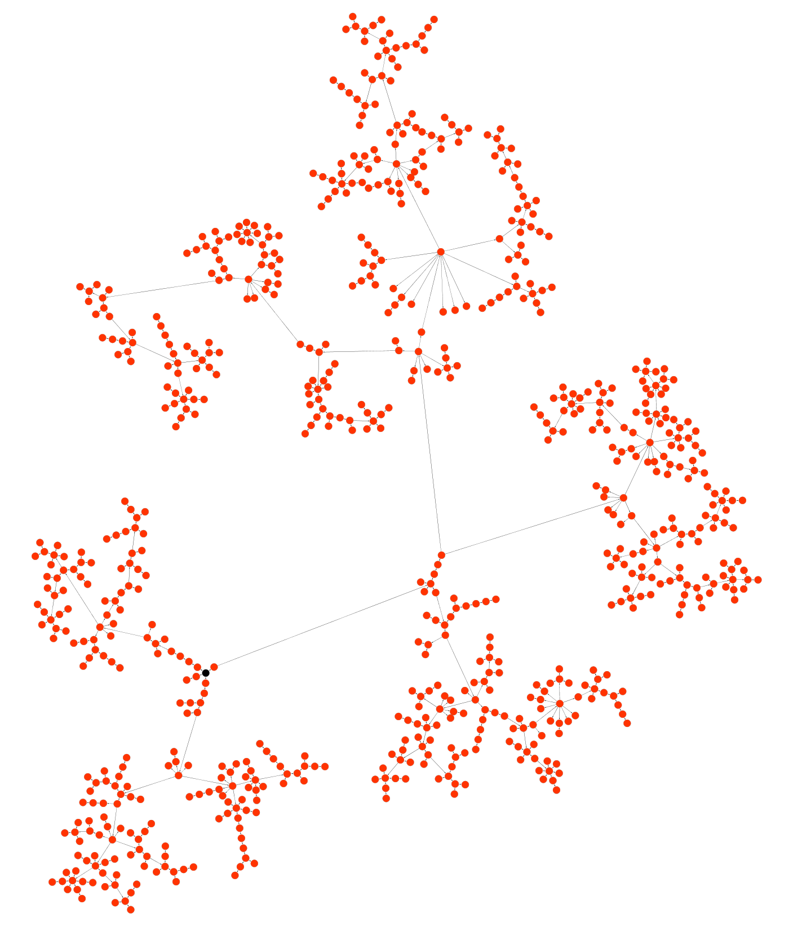
Individual SIR Model Outputs
Transmission Network (in Cytoscape)
Who infected Whom
Index case
(black)

Slide 21
Broadwick_with_IndividualNetworkModel.xml
Command:
(example_UK_cities.txt, example_UK_cities_links.txt must be in the same directory as the jar file)
java -jar BroadwickExamples-1.0-SNAPSHOT.one-jar.jar -c Broadwick_with_IndividualNetworkModel.xml
Expected results – also written to log file epic.sir.IndividualNetworkModel.log
[main] INFO Running broadwick Version 1.1 Build (SJLDELL - unknown : 2014-06-14 11:49)
[main] INFO Running broadwick for the following models [Broadwick Project]
[pool-1-thread-1] INFO Running Broadwick Project [epic.network.IndividualNetworkModel]
[pool-1-thread-1] INFO IndividualNetworkModel - init
[pool-1-thread-1] ERROR Could not find parameter susceptibility in configuration file.
[pool-1-thread-1] INFO Optional parameter susceptibility (=wanning immunity) is not set, but this is OK
[pool-1-thread-1] INFO Network Model locationsFile = example_UK_cities.csv
[pool-1-thread-1] INFO Network Model linksFile = example_UK_cities_links.csv
[pool-1-thread-1] INFO Network Model locationType = LATLONG
[pool-1-thread-1] INFO 170 locations read from file
[pool-1-thread-1] INFO 181 links read from file
[pool-1-thread-1] INFO Initialising infection from CN000111,Stoke-on-Trent,53.0,-2.13
[pool-1-thread-1] INFO Number of susceptibles in network = 106
[pool-1-thread-1] INFO Number of infecteds in network = 1
[pool-1-thread-1] INFO seed = 12349
[pool-1-thread-1] INFO maxTime = 1000000.0
[pool-1-thread-1] INFO tauStep = 0
[pool-1-thread-1] INFO N = 107
[pool-1-thread-1] INFO initI = 1
[pool-1-thread-1] INFO IndividualNetworkModel - run
[pool-1-thread-1] INFO IndividualNetworkModel - final simulation time = 152.54159155869897
[pool-1-thread-1] INFO IndividualNetworkModel - SUSCEPTIBLE:3 EXPOSED:0 INFECTED:0 RECOVERED:104
[main] INFO Simulation complete. 0:00:00.710

Slide 22
Individual Network Model Outputs
*modelState.txt, *allEvents.txt, *transmissions.txt
Same as in Individual SIR Model outputs
*locations.txt
The locations of the network nodes (one line = one vertex):
Name,Location,Latitude,Longitude
CN000144,Edinburgh,55.95,-3.35
CN000145,Glasgow,55.8667,-4.43333
CN000146,Inverness,57.5333,-4.05
*initialNetwork.net
The (undirected) links between the network nodes (one line = one edge):
Name,Location,Latitude,Longitude,Name,Location,Latitude,Longitude
CN000145,Glasgow,55.8667,-4.43333,CN000142,Campbeltown,55.4333,-5.6
*individualStates_initial.txt, *individualStates_final.txt, *individualStates_[number].txt
The infection state of each network node at each simulation step (one file per step), e.g:
Name,Location,Latitude,Longitude,State
CN000144,Edinburgh,55.95,-3.35,SUSCEPTIBLE

Slide 23
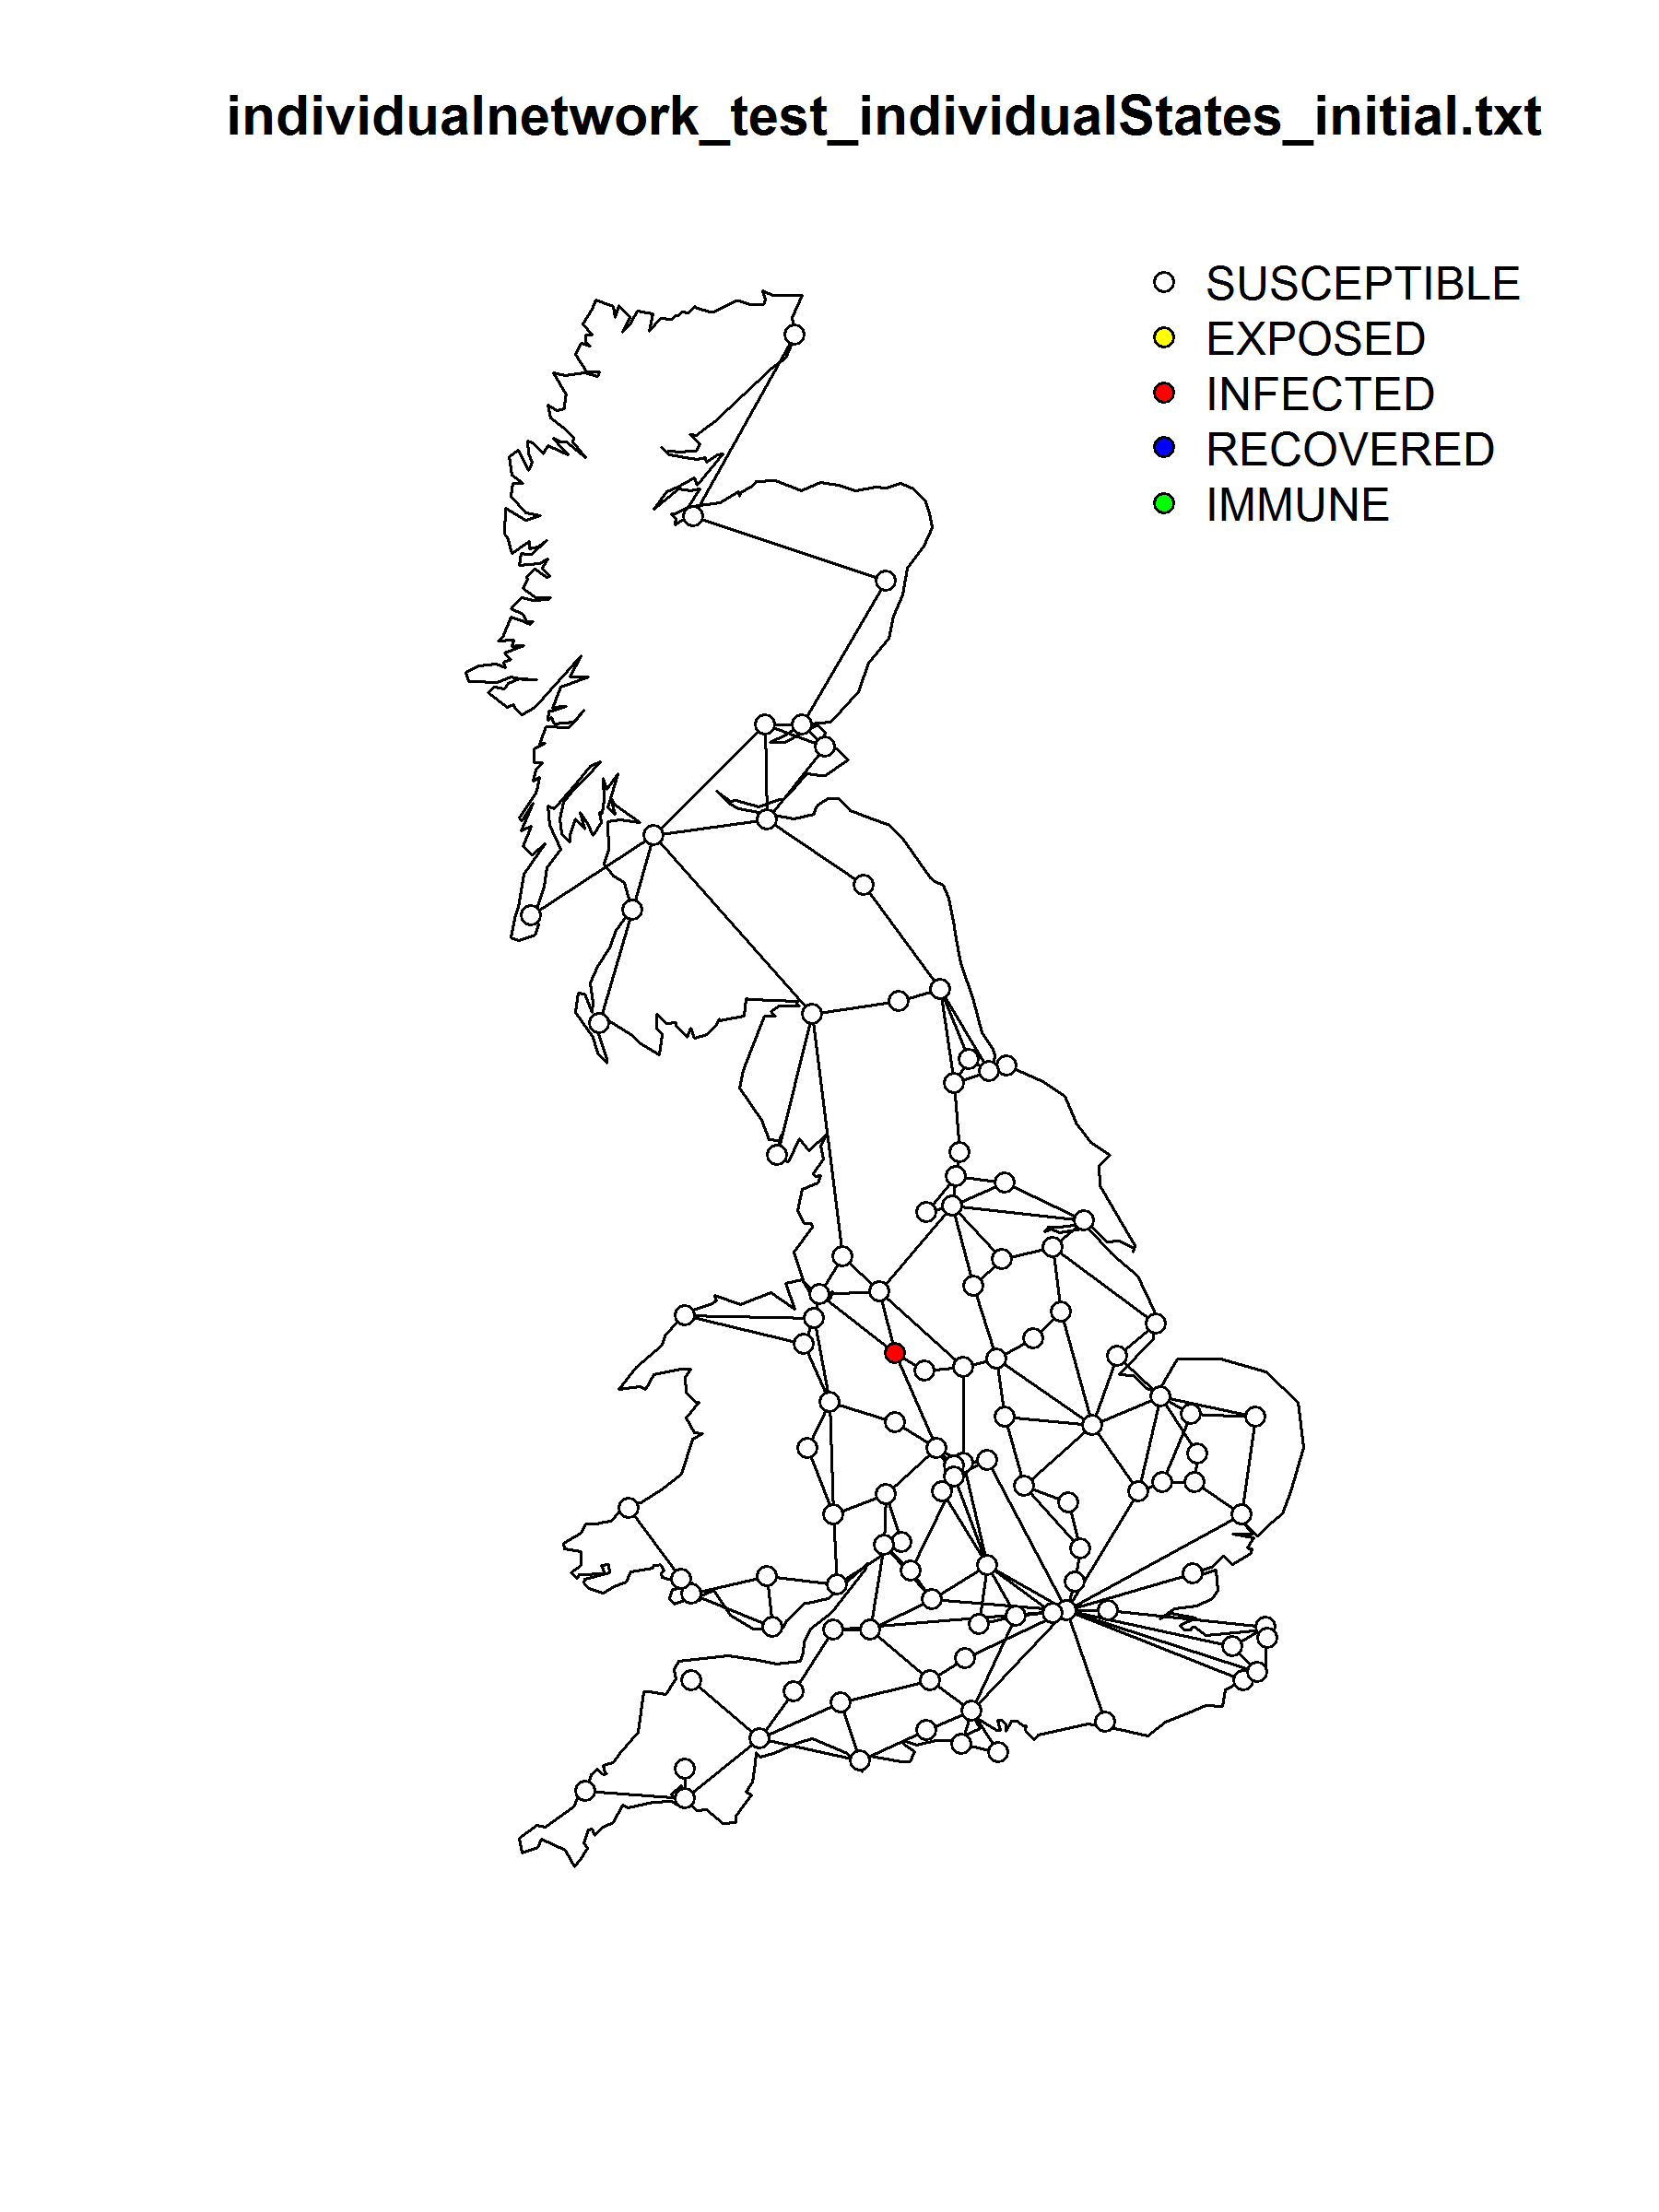
Plot individual states output using R script: plotGBDiseaseMap.R (one image per step)

Slide 24
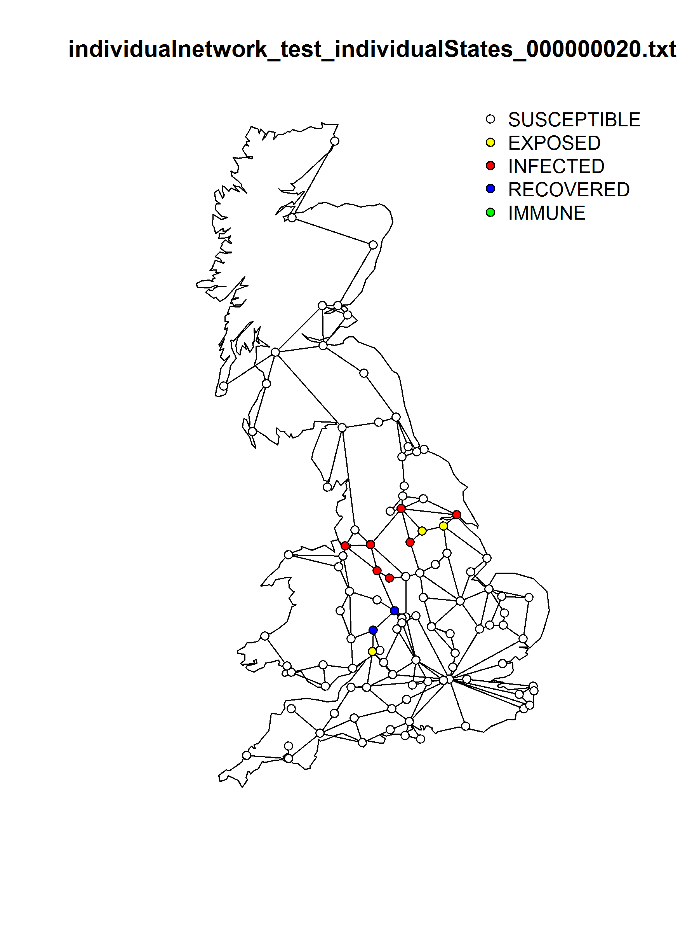

Slide 25
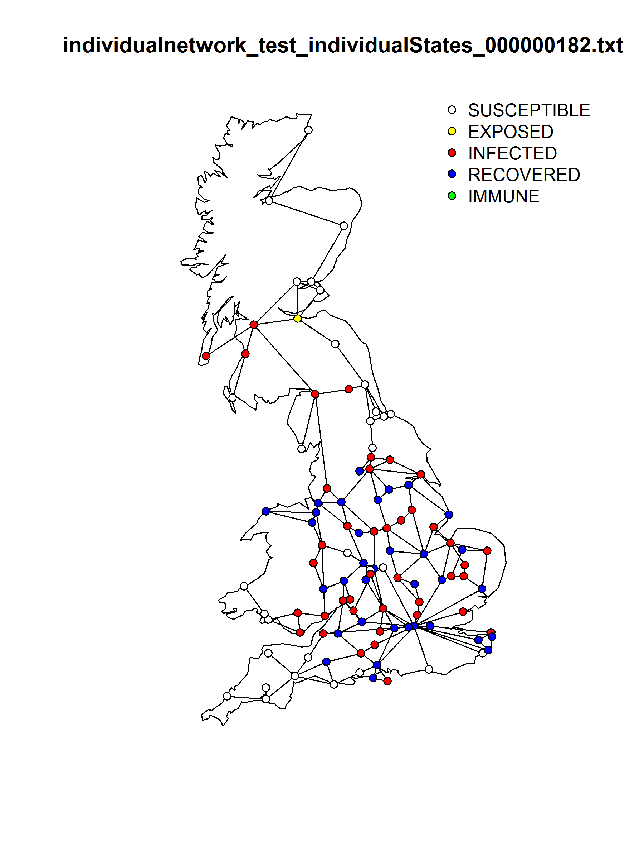

Slide 26
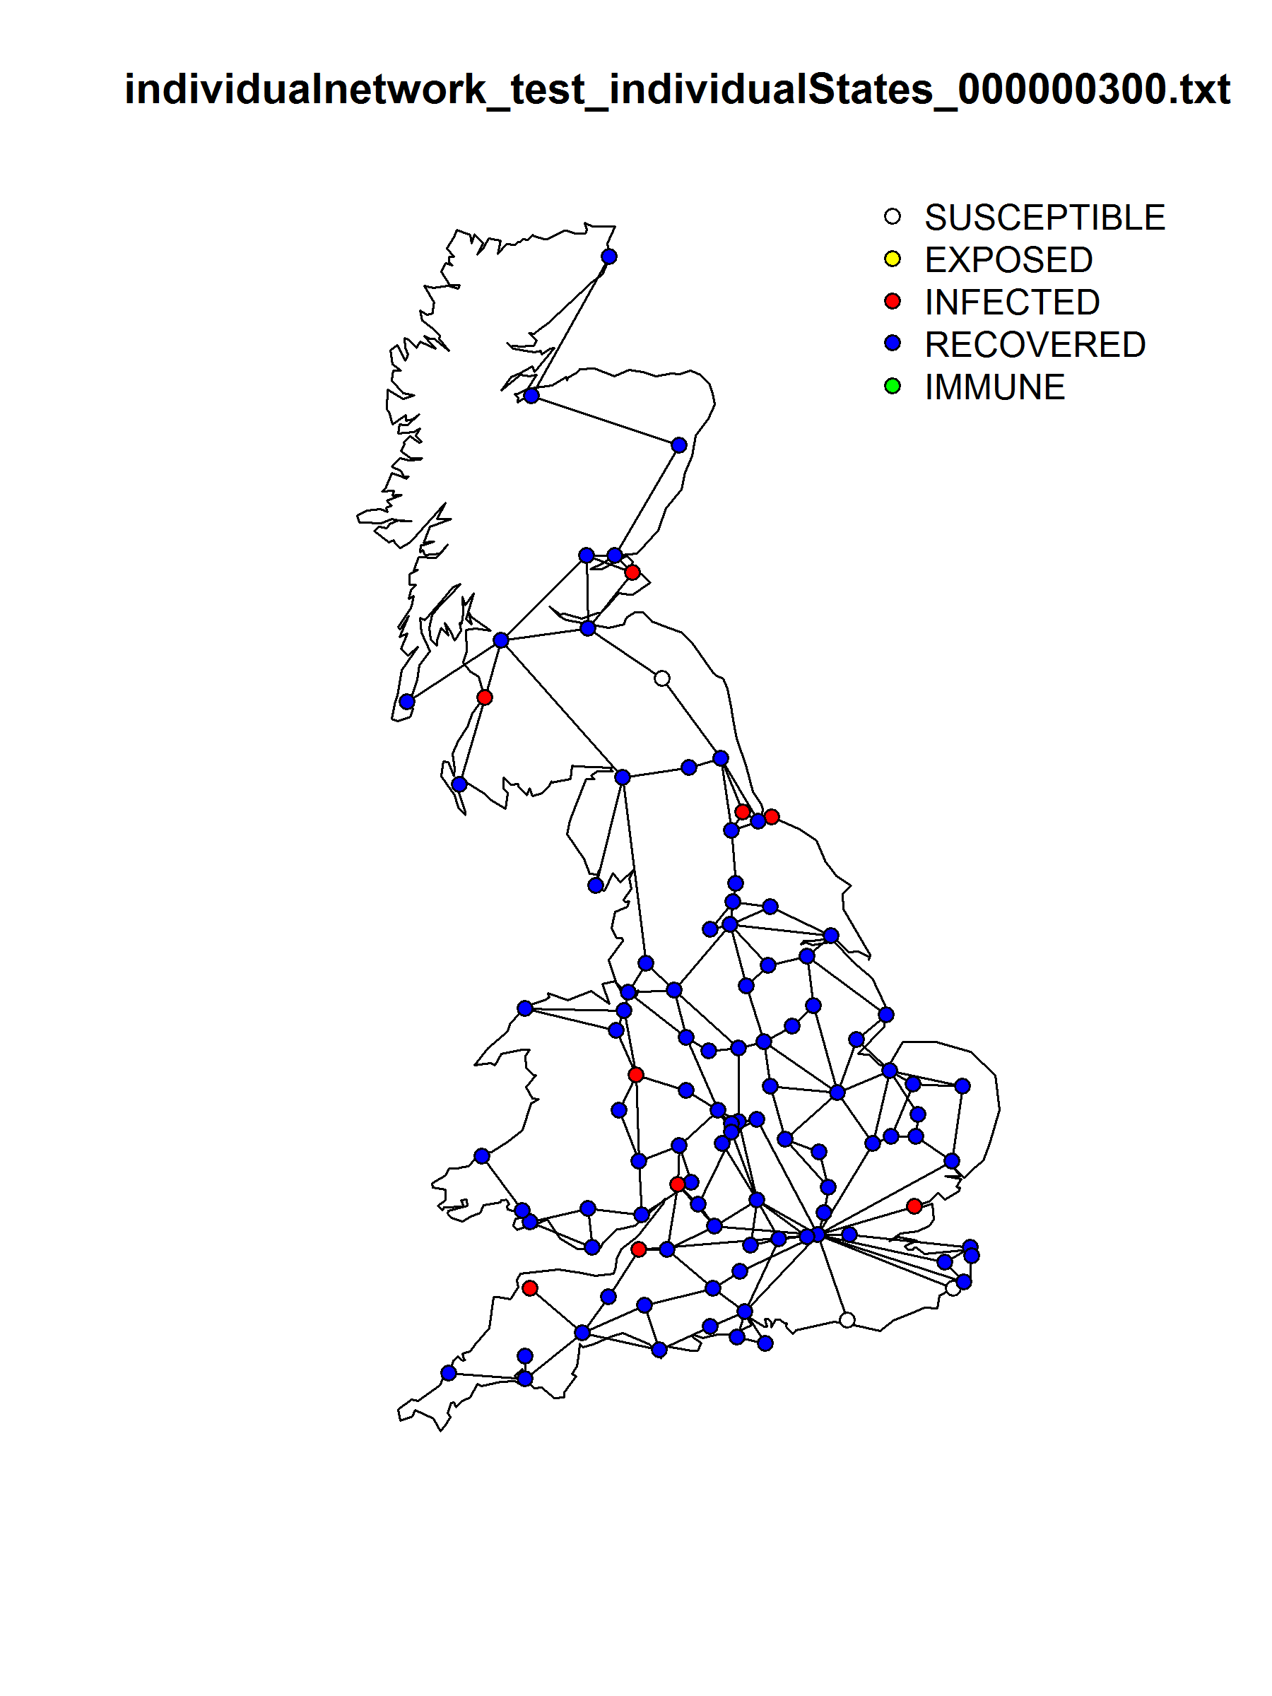

Slide 27
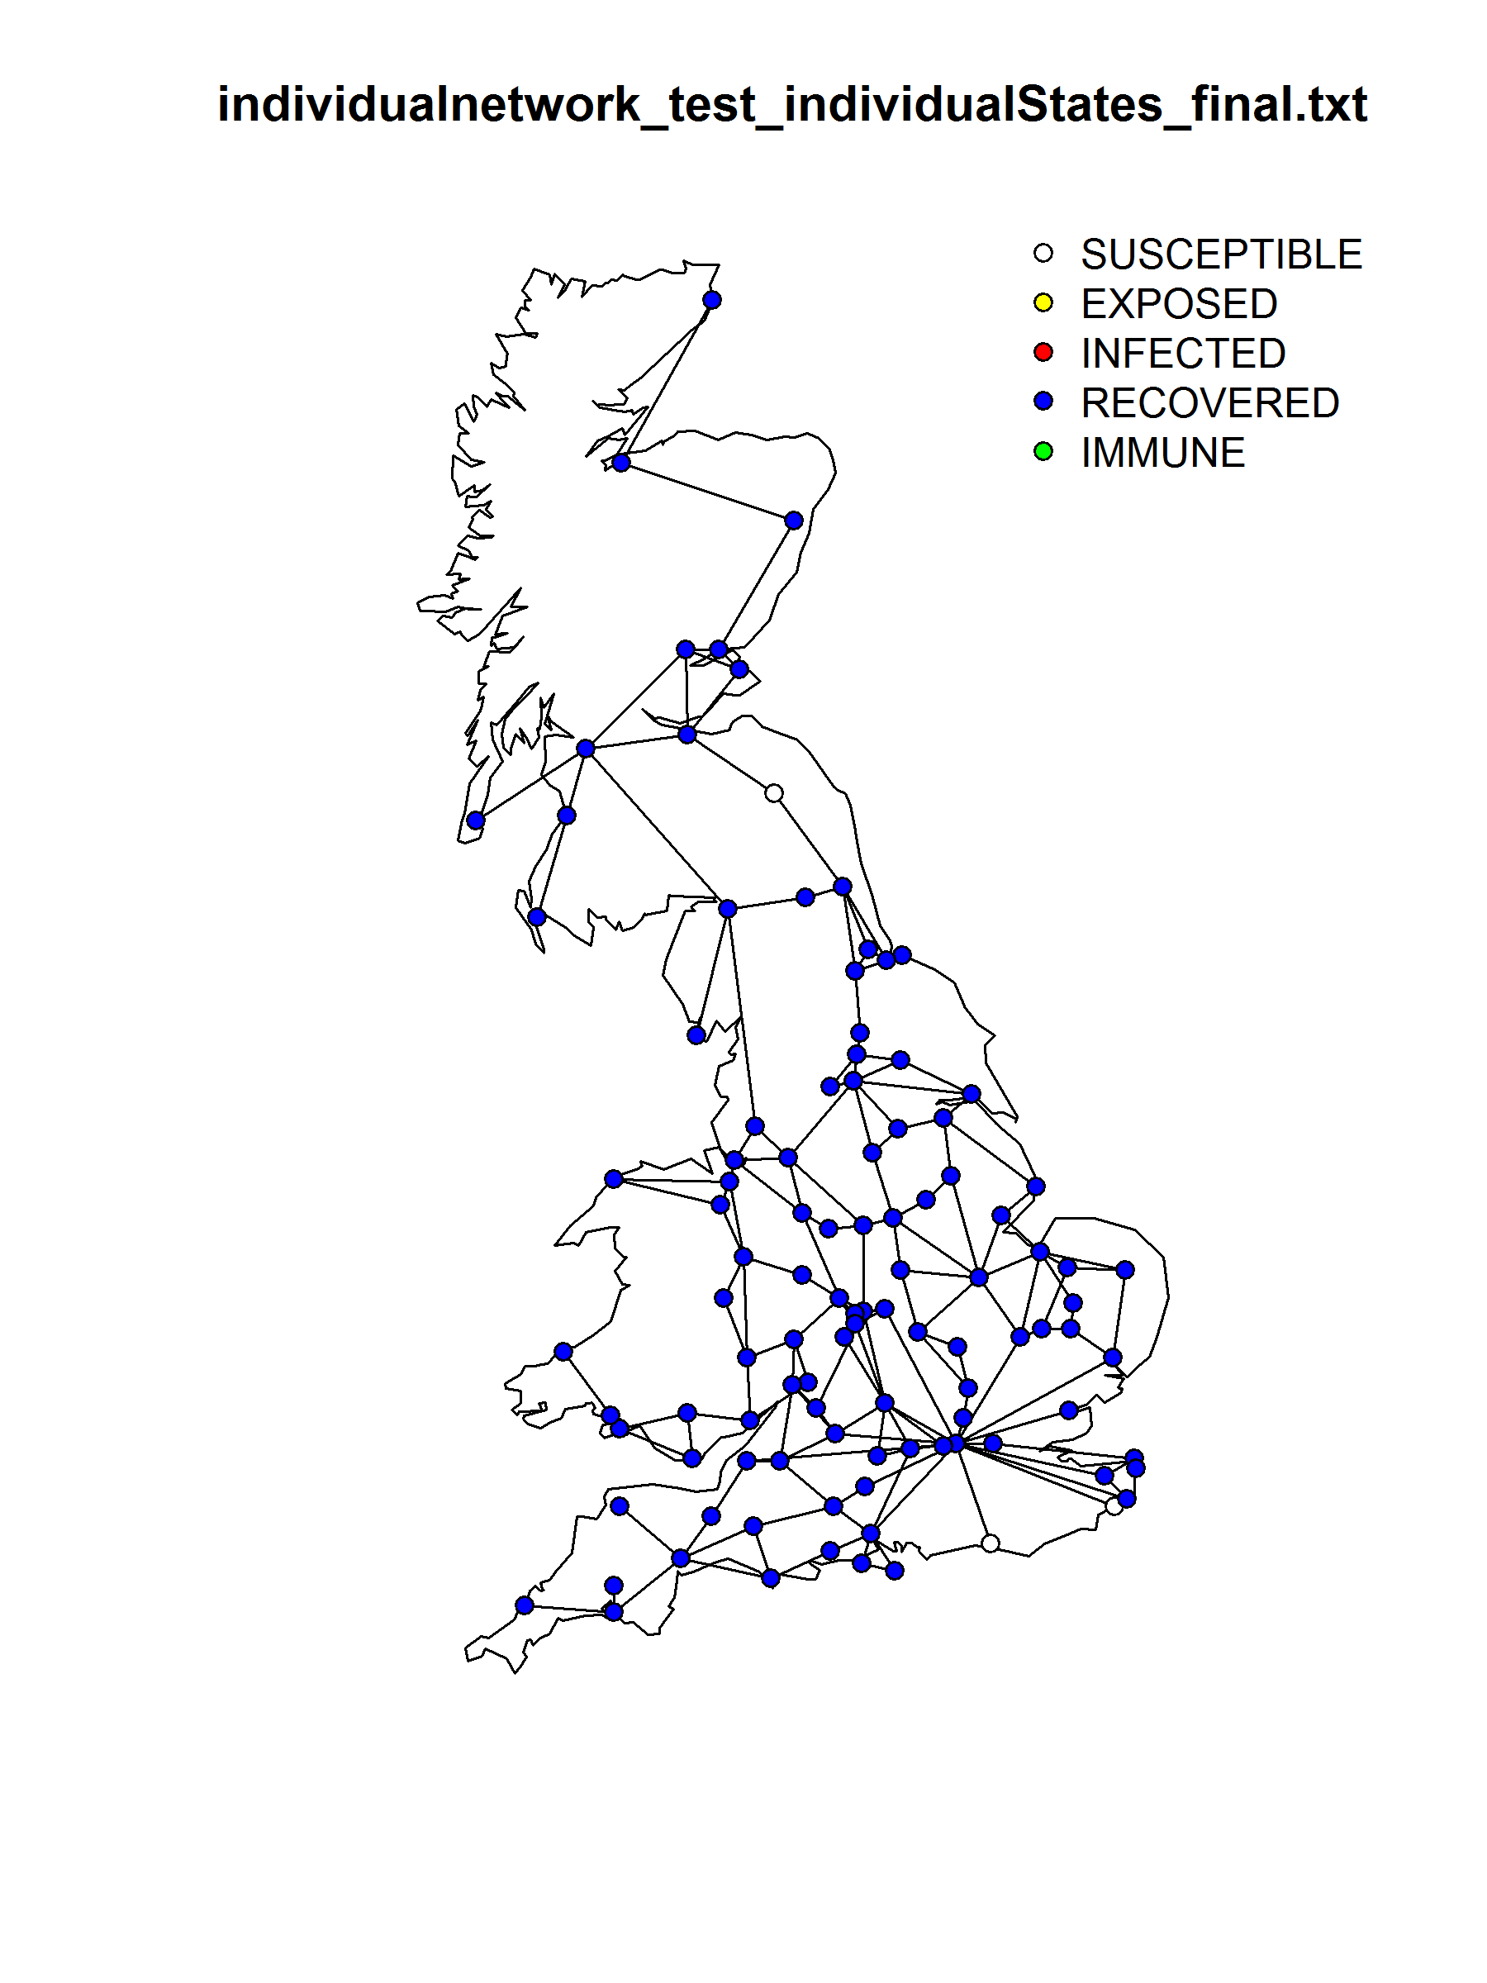

Slide 28
Next Steps
Broadwick Tutorial
How to write your own models
This afternoon

