Slide 1

Yahoo Users Travel Insights
Presented By,
Eldhose Paulose Kunnel

Slide 2
Traveler Journey Insights
Since the outbreak in 2020, there has been a steady rise of tourists once travel ban reduces; in the summer of 2021, about 20% of people travelled and during Christmas about 10%.
35 percent of travelers select London airports as their primary departure airport, with Manchester coming in second.
The majority of traveler's final destinations were diverse locations across Europe.
On the other hand, a large fall in travel occurred in 2022, with 10% of passengers choosing to go in the spring.

Slide 3
Most age groups prefer to book their travel around 100 days timeline
Travelers expect to stay in the destination place around 14 to 15 days
Five percent of passengers carried swimsuit during the summer since the primary destination has many beaches, and ten percent of travelers brought new bags after they began organising their trip.
The majority of passengers looked for the best hotels and flights to their destinations. Travel occurred after the pandemic, and everyone made sure to practice proper travel guidelines.

Slide 4
Traveler Query Insights
Each month, around 10% of male and female users searched for information related to travel
Users between the ages of 60 and 70 often browse various websites and make travel plans for upcoming travels
35% users logged through windows OS and almost 15 percentage for both android and mac OS users who search about travel related queries
This aids in determining how to build travel-related platforms that include all elements like booking and displaying suggested places to visit. top airlines, as well as travel-related merchandise

Slide 5
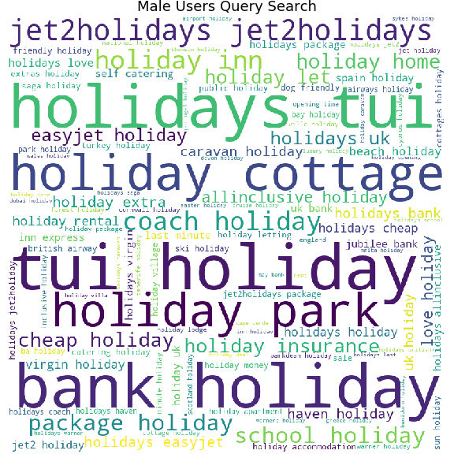
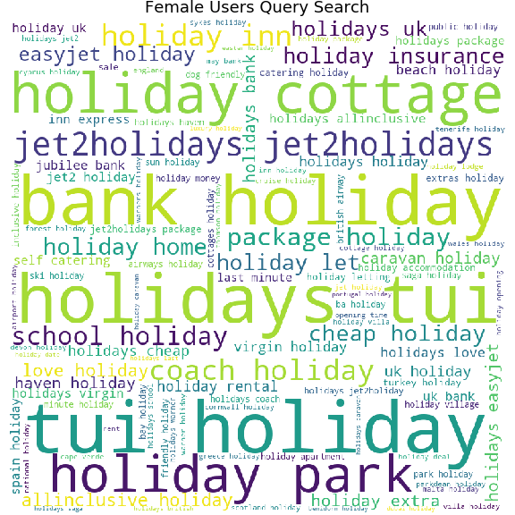
The website Tui, Jet2, which shows the best travel arrangements for each holiday and allows customers to book all of their necessary travel entitlements from a single platform, was being visited more frequently by male and female users.
Users searched for cheap vacations as well as cottages to stay in.

Slide 6
Key Insights
Travel during the year 2022 evidently shows the trend of decline from Q2 to Q4.
Users wishes to finalize their booking in an average period of 100 days before their travel.
Comparing 2021, The number of users traveled during 2022 March higher than 2021 so the travel forecast for year 2022 should depict increase in trend for Summer and Christmas 2022
15 to 20% users are searching various travel queries till June 2022, as they are mainly checking best places to visit during bank holidays, looking for best hotels and price of airlines.
This shows huge potential of increase in travel during Summer and Christmas of year 2022.
Based on age wise category search, we can offer the customers belter deals in terms of flight fares and whole stay packages based on their search preferences. This can leverage the customer market for the company.
Create a mobile application where users can search all their required travel details and notified with latest offers and travel deals.

Slide 7
Thank you

