Slide 1

Challenges faced by non-native English speaking students in computer science education due to linguistic barriers
Student urn: 6936865

Slide 2
Why language matters in computer science ?
Programming languages and materials are mostly in English
Non-native English speakers must learn both computing and English
Terminology, error messages, and documentation create extra barriers
Research shows English proficiency strongly affects CS1 success

Slide 3

Linguistic barriers in learning programming
1. Technical Vocabulary
Keywords like return, while, else don’t translate
Abbreviations and identifiers confuse NNES
2. Cognitive Overload
Students translate English → native language → code
Reduces available working memory
3. Communication Barriers
Students hesitate to ask questions
Fear of “wrong English” reduces engagement

Slide 4
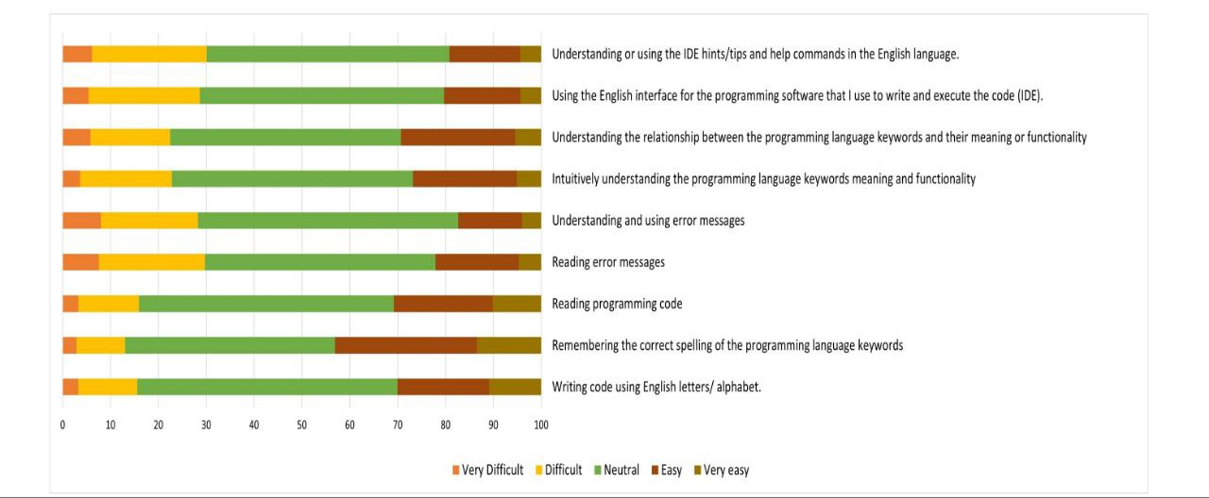
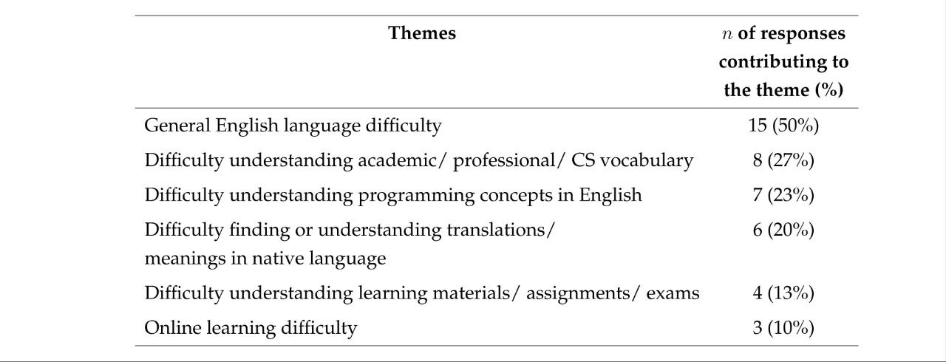
Evidence from a multi-case study
Study of 300+ CS1 students (China & Saudi Arabia)
English skills strongly linked to CS1 performance
Students struggled with reading, terminology, error messages
50% reported general English difficulty
27% struggled with CS vocabulary

Slide 5


Solutions for more inclusive CS education
Provide explicit teaching of CS terminology
Use bilingual glossaries and translated notes
Reduce cognitive load with visual or block programming
Allow small-group discussions in students’ native languages
Use inclusive, linguistically friendly teaching materials
Making computer Science linguistically accessible benefits all learners.

