Slide 1
Lab Meeting Thursday, May 8, 2025
Elizabeth Paillan

Slide 2
Content
Matrix-Interact
Persistence Project

Slide 3
Matrix-Interact Background
Sampling
Hilliard wheat compartments: Leaves, roots & rhizosphere
16S & ITS
3 growth stages – Seedling, heading, & jointing
7 sites
Metadata:
Plant weight, height, & yield
Leaf N, P, K, Ca, Mg, S, Fe, Mn, Zn, Cu, B, Na, Al
Soil pH, P, K, Ca, Mg, S, Mn, Zn, Cu, Na
Notes:
Currently working on a project on MATRIX analyzing
16S & ITS matrices of
Hilliard wheat compartments that was sampled at the same time
At three growth stages across 7 sites
I have metadata of plant weight, height, yield, and soil & leaf element composition

Slide 4
How do bacterial & fungal communities shift at different wheat phenological stages?
Do changes in the wheat microbiome across compartments correlate with transitions between phenological stages?
Can changes in microbiome compositions across developmental stages be modeled?
Are specific microbes associated with different stages of plant growth?
Are there stages in wheat growth correlated with shifts in its microbiome that can predict yield?
Notes:
As i’ve been working through this some questions i’ve been considering pursuing are these
I will be going through my hypotheses for these questions, proposed analysis,
and if you guys have any thoughts please chime in

Slide 5
Do changes in the wheat microbiome across compartments correlate with transitions between phenological stages?
H1: Microbiome composition in all compartments will show stage-specific shifts at phenological transition.
H2: A set of microbes will be associated with the same phenological stage across sits despite environmental differences
Proposed Analysis:
PERMANOVA
Differential Abundance

Slide 6
Can changes in microbiome compositions across developmental stages be modeled?
H1: Microbiome composition could follow a stage-dependent succession pattern that can be modeled
H1a: There would be a temporal decay in the accuracy of models
Proposed analysis:
Model inference
LASSO
Beta-diversity

Slide 7
Are specific microbes associated with different stages of plant growth?
H1: Enriched microbes at distinct stages create stage-dependent niches.
Proposed analysis:
Modelling method?
Differential Abundance
Compartment comparison

Slide 8
Are there stages in wheat growth correlated with shifts in its microbiome that can predict yield?
H1: Microbiome shifts towards later phenological stages will be more predictive of final yield.
Proposed analysis:
Differential Abundance
Indicator species analysis
Log-fold change between stages

Slide 9
Content
Matrix-Interact
Persistence Project

Slide 10
Plants influence their microbiome under stress
This influence can create legacy effects affecting other plants inhabiting the same soil
Legacy effects in soil microbiota can influence traits like root morphology and biomass production
However, most studies either focus on
Single plant species or the swapping of two or more plant species
Single acute or prolonged drought stress
Is there a “stress memory” in microbial communities?
Notes:
The experiment i’ve been designing i would be testing if theres a stress memory in microbial communities
We know plants can create legacy effects in shared soil
And that these effects can influence plant physiology traits
But a gap i’ve run into is that experiments looking into cross-plant microbiomes use
Single plant species, or multiple plant species being swapped across soils
Single instance of acute drought stress
Or prolonged drought stress

Slide 11
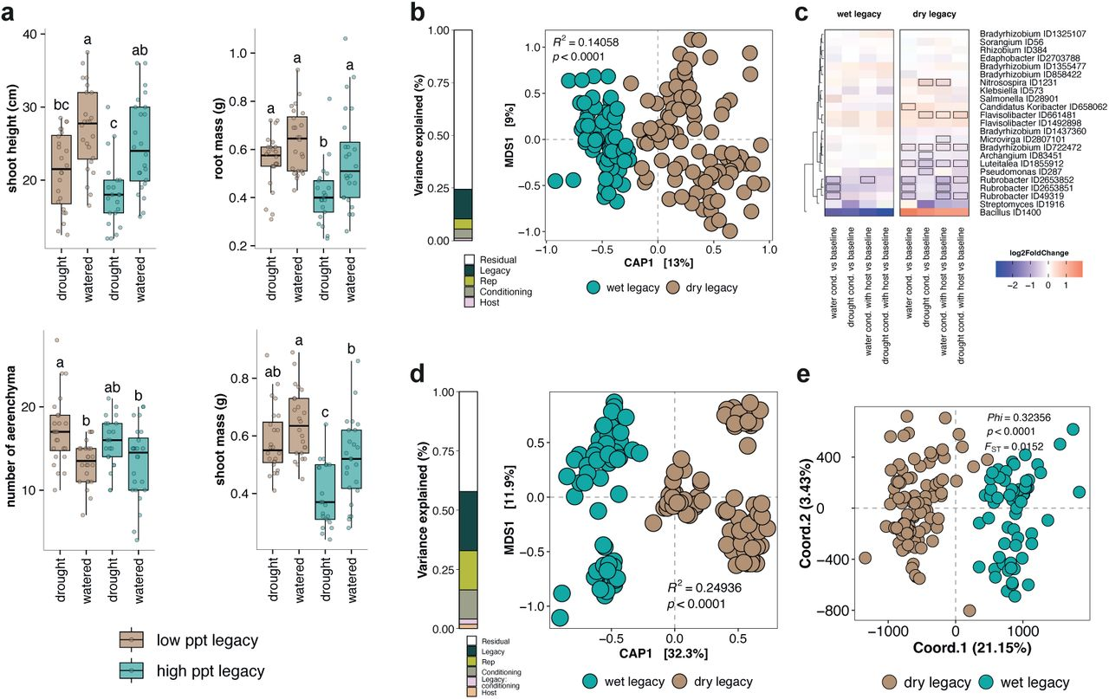
Soil Legacy Effects
Preprint Ginnan et al., 2024
Notes:
In a pre-print from Nicole Ginnan, they looked into
How microbial drought legacy effects manifests plant response to drought
While using gamagrass planted in soil from different drought histories
In C) , they identified enrichment patterns of the microbial inhabitants compared to the baselines
And in E) , they show that soil legacy does separate SNP variance of drought legacy markers
X- axis is explaining more variance and seperation: wet vs dry legacy

Slide 12
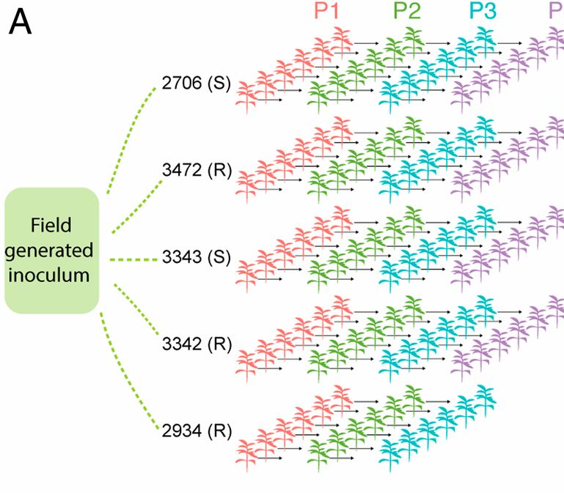
Succession Effects
Morella et al., 2020
Notes:
In a successive passaging experiment with inocula from the tomato phylosphere
They inoculated 5 tomato plant genotypes in 4 successive rounds

Slide 13
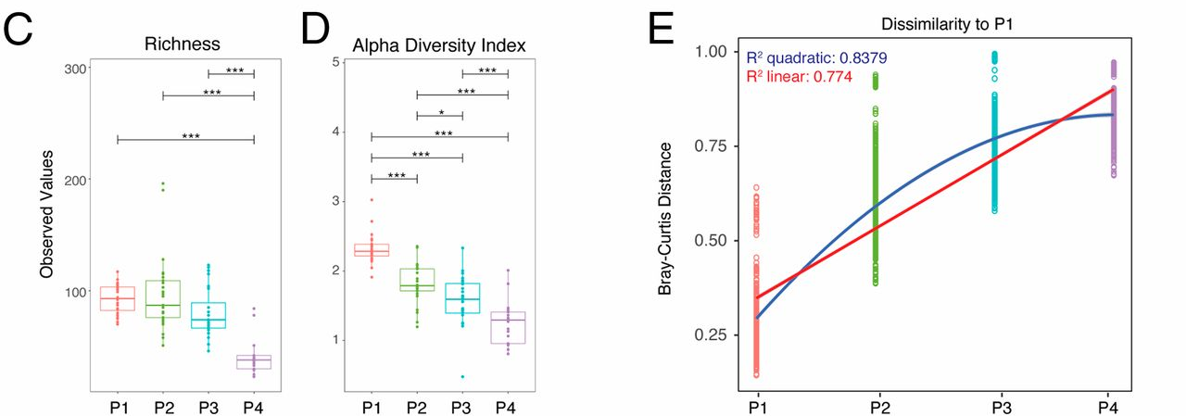
Succession Effects
Morella et al., 2020
Notes:
To find: Microbiome selection from a well-adapted host and environment can occur,
but that the host influence decreases overtime
C & D) Uses richness and shannon’s alpha diversity to display through progression
Richness decreases
Alpha-diversity decreases (variety within a species)
E) Composition is different from the first plant to the fourth!

Slide 14
Objective: Test whether drought-adapted plant-associated microbes are dominant through a rotation sequence
Crop Rotation Sequence:
Wheat > Cereal Rye > Wheat
Soil legacy differences
Soil A – “Drought-adapted” with a history of severe drought stress
Soil B – “Drought-naive” with a minimal/no drought history
Drought would be applied in each cycle
Harvest would occur at the end of each cycle
Notes:
The experiment I’m thinking of evaluates both of those effects in a crop-rotation context

Slide 15
Cycle 1:
Wheat
Initial Soil
Drought Treatment
No Drought Treatment Control
Wheat
Soil A
Wheat
Soil B
(Control)
Wheat
Soil A
(Control)
Wheat
Soil B
(Control)
Cereal rye
Soil A
(Control)
Cereal rye
Soil B
Wheat
Soil A
Wheat
Soil B
Drought stress
Applied
Harvest
Cycle 2:
Cereal Rye
Cereal rye
Previous
Soil A
Cereal rye
Previous
Soil B
(Control)
Wheat
Soil A
(Control)
Wheat
Soil B
Cereal rye
previous
Soil A
Cereal rye
previous
Soil B
Drought stress
Applied
Harvest
Wheat
Previous
Soil A
Wheat
Previous
Soil B
(Control)
Wheat
Soil A
(Control)
Wheat
Soil B
Wheat previous
Soil A
Wheat previous
Soil B
Cycle 3:
Return to wheat
Drought stress
Applied
Harvest

Slide 16
Can the microbiome composition formed from a stress event mitigate future plant stress responses?
Do future host stress benefits depend on the plant-soil system under selection?
Can soil history alter the effectiveness of the plant-soil system?
What plant-associated microbes are dominant through multiple rounds of acute drought stress?
Are those plant-associated microbes beneficial to different host identities?
Notes:
These are the questions i’m looking to pursue, and like before chime in with any like suggestions etc

Slide 17
Do future host stress benefits depend on the plant-soil system under selection?
H1: The magnitude of stress resilience after drought stress will depend on host identity.
Proposed analysis:
Mixed-effect models

Slide 18
Can soil history alter the effectiveness of the plant-soil system?
H1: Plants grown in drought-adapted soil will exhibit greater stress resilience through recurring drought events than plants in drought-naive soils.
Proposed analyses:
PERMANOVA
PCoA
Notes:
Read question
H1: Drought-adapted soil will exhibit greater stress relief through drought recurrence than drought-naive soils.
Permanova – tests if soil legacy explains microbiome composition variance
Using PCoA to visualize data points based on soil legacy

Slide 19
What plant-associated microbes are dominant through multiple rounds of acute drought stress?
H1: A group of drought-adapted microbes will dominate plant-associated microbiomes across multiple rounds of drought stress, independent of host identity.
Proposed analyses:
Rank-abundance curve
Differential Abundance
Notes:
Read question
H1: Set of drought-adapted microbes will dominate across the rounds of drought that are independent of host identity
Rank abundance curve
Differential abundance - find ASV enirched in drought vs controls

Slide 20
Are those plant-associated microbes beneficial to different host identities?
H1: The magnitude of benefit will depend on host-specific microbial interaction. However, drought-adapted microbes will continue to mitigate stress in both host species.
Proposed analyses:
ANOVA
Tukey’s HSD
Network analysis
Notes:
Read question
H1: Host-specific microbial interaction will carry the magnitude of drought mediation, but will still confer a level of stress in both.
ANOVA
Tukey HSD – would it still be valid if the sample sizes were inequal???
Network? – link microbes to plant traits?

