Slide 1
ReconOS Tutorial
Introduction to ReconOS
  The Idea: Multithreaded HW/SW
  Hardware threads
  Delegate threads
  System architecture
  Tool flow
ReconOS Walkthrough
  Setting up ReconOS
  Case study: sorting demo
    From source code to running system
    How to debug hardware threads
    Live demonstration
  Case study: webcam demo
    Live demonstration
Discussion
Andreas Agne, University of Paderborn

Slide 2

ReconOS:
Multithreaded Programming for Reconfigurable Systems on Chip
Andreas Agne
Computer Engineering Group
University of Paderborn
agne@upb.de

Slide 3
Overview
Introduction
The Idea: Multithreaded HW/SW
ReconOS basics
  Hardware threads
  OS synchronization FSM
  Delegate threads
  System architecture
  Tool flow
Andreas Agne, University of Paderborn

Slide 4
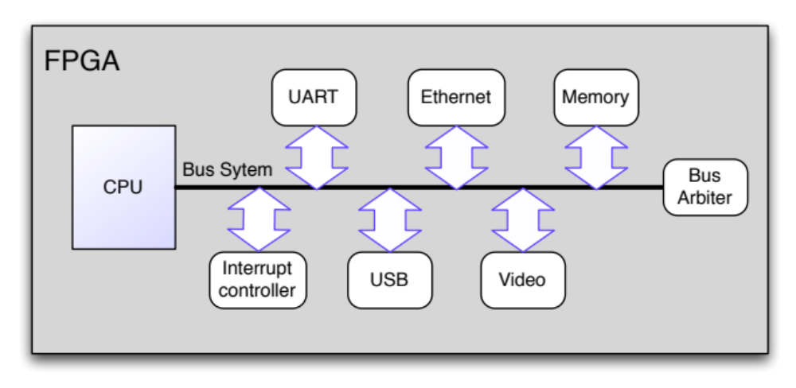
Reconfigurable System-On-Chip (rSoC)
rSoC: Implements digital components of a computer system in reconfigurable hardware
Modern FPGAs offer lots of reconfigurable logic resources
Enables integration of custom hardware accelerators
Andreas Agne, University of Paderborn

Slide 5
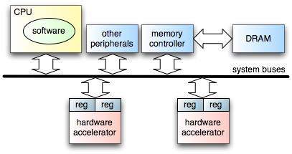
Reconfigurable System-On-Chip (rSoC)
Traditionally, hardware accelerators are integrated as coprocessors
  Software (CPU) explicitly communicates with hardware accelerator
  Memory-mapped registers, streaming interfaces
FPGA
int main() {
...
data = do_something();
io_out32(HW_ACCEL_DATA_REG, data);
io_out32(HW_ACCEL_CMD_REG, CMD_GO);
while (io_in32(HW_ACCEL_STATUS_REG) != DONE)
sleep();
result = io_in32(HW_ACCEL_RESULT_REG);
...
}
Andreas Agne, University of Paderborn

Slide 6
Reconfigurable System-On-Chip (rSoC)
Traditional approach has its limitations
Hardware accelerators are passive
Cannot use OS objects
Cannot call OS or library functions
Can be difficult to integrate into an existing system
Programmer has to take care of hw/sw communication
Idea: Extend multithreaded programming from software domain to reconfigurable hardware => Hardware Threads
software thread
software thread
monolithic software application
software thread
software thread
software thread
hardware thread
operating system
operating system
operating system
Andreas Agne, University of Paderborn

Slide 7
The ReconOS Project (DFG SPP 1148)
Provide the multithreaded programming model to reconfigurable hardware
  threads communicate and synchronize using programming model primitives,
  e.g., semaphores, mutexes, mailboxes, shared memory
  established model in software-based systems (e.g., POSIX pthreads)
Challenges in translating this model to hardware
  hardware is inherently parallel
  hardware has no notion of function calls or even blocking function calls
  thread synchronization and communication
  transparency of implementation: it should not matter to the rest of the system, whether a thread runs in hardware or software
  All threads have to live in the same (virtual) address space
Andreas Agne, University of Paderborn

Slide 8
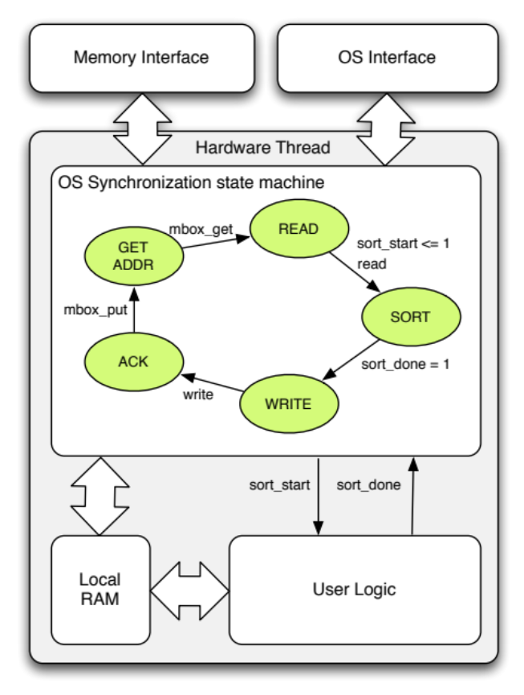
ReconOS Hardware Threads
A hardware thread consists of two parts
  An OS synchronization state machine
    Initiates memory accesses
    Synchronizes thread with operating system calls
    Serializes access to OS objects via the OS interface
    Can be blocked by the OS interface
  Parallel “user processes”
    Communicate with OS
    synchronization state machine
    Can directly access local
    memory blocks
    Are not necessarily blocked
    by the OS interface
Andreas Agne, University of Paderborn

Slide 9
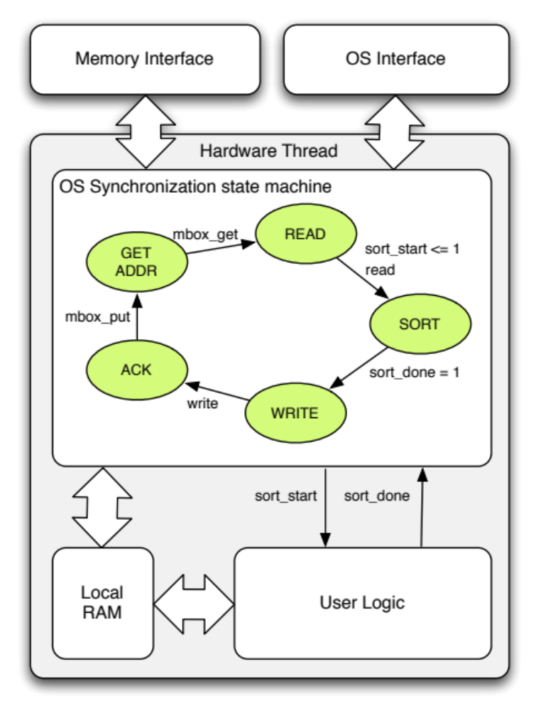
ReconOS API for Hardware Threads
reconos_fsm: process (i_osif.clk,rst,o_osif,o_memif,o_ram) is
variable done : boolean;
begin
if rst = '1' then
osif_reset(o_osif); memif_reset(o_memif); ram_reset(o_ram);
state <= STATE_GET_ADDR;
done := False;
sort_start <= '0';
elsif rising_edge(i_osif.clk) then
case state is
when STATE_GET_ADDR =>
osif_mbox_get(i_osif, o_osif, MBOX_RECV, addr, done);
if done then state <= STATE_READ; end if;
when STATE_READ =>
memif_read(i_ram,o_ram,i_memif,o_memif,
addr,X"00000000”,C_LEN,done);
if done then
sort_start <= '1';
state <= STATE_SORTING;
end if;
when STATE_SORT =>
sort_start <= '0’;
if sort_done = '1' then
state <= STATE_WRITE;
end if;
when STATE_WRITE =>
memif_write(i_ram,o_ram,i_memif,o_memif,
X"00000000",addr,C_LEN,done);
if done then state <= STATE_ACK; end if;
when STATE_ACK =>
osif_mbox_put(i_osif, o_osif, MBOX_SEND, addr, done);
if done then state <= STATE_GET_ADDR; end if;
end case;
end if;
end process;
  VHDL function library
  May only be used in the OS synchronization state machine
Andreas Agne, University of Paderborn

Slide 10
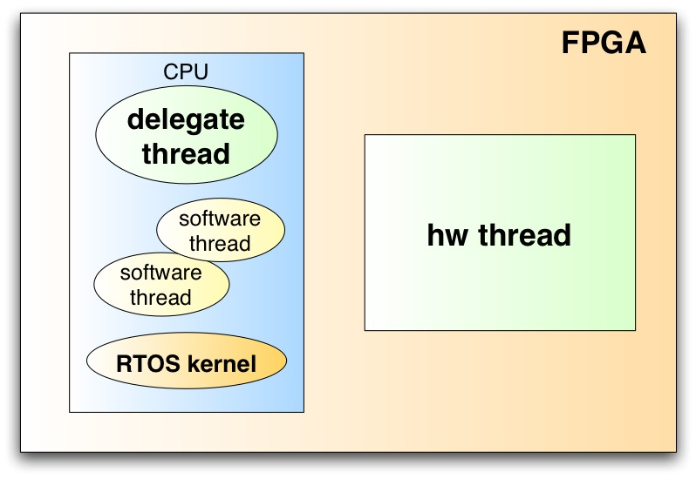
Delegate Threads
Basic mechanism
  A delegate thread in software is associated with every hardware thread
  The delegate thread calls OS functions on behalf of the hardware thread
  All return values are relayed back to the hardware thread
Advantages
  No modification of the kernel required
  Lightweight runtime environment
  Extremely flexible
  Transparent to kernel and
  other threads
Drawback
  Increased overhead due to
  interrupt processing and
  context switch
Andreas Agne, University of Paderborn

Slide 11
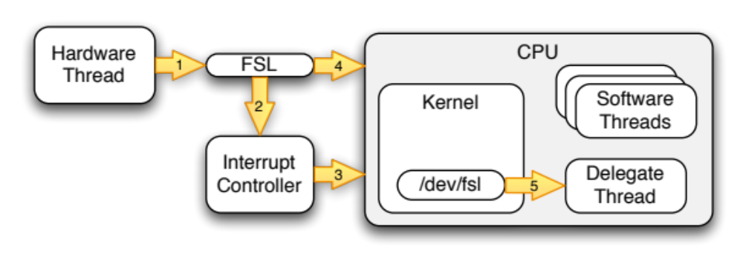
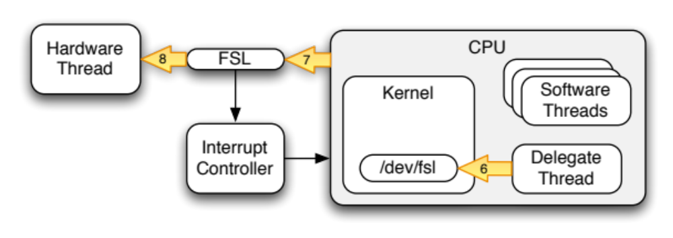
OS Call Sequence
  Hardware thread initiates request; interface raises interrupt
  Delegate is synchronized to interrupts through blocking filesystem accesses
  Delegate thread is woken up and retrieves OS call and parameters
  Delegate thread executes call for hardware thread
  Delegate thread writes result back to hardware thread
Andreas Agne, University of Paderborn

Slide 12
Supported OS Calls (Selection)
Semaphores (counting and binary)
  osif_sem_post()
  osif_sem_wait()
Mutexes
  osif_mutex_lock()
  osif_mutex_trylock()
  osif_mutex_unlock()
Condition Variables
  osif_cond_wait()
  osif_cond_signal()
  osif_cond_broadcast()
Mailboxes
  osif_mbox_get()
  osif_mbox_put()
ReconOS Queues
  osif_rq_send()
  osif_rq_receive()
Memory access
  memif_read()
  memif_write()
basic synchronization
primitives
synchronize access to
mutual exclusive operations
(critical sections)
handled in software
(via delegate thread)
allow waiting until arbitrary
conditions are satisfied
message passing primitives
handled in hardware
(via system bus / point-to-point links)
CPU-independent access
to the entire process address
space (memory and peripherals)
Andreas Agne, University of Paderborn
Notes:
- gute Auswahl an API-Funktionen
- zusätzlich unterstützt ReconOS noch einige (thread_exit())
- einige RTOS-Funktionen fehlen (z.B. Scheduling)

Slide 13
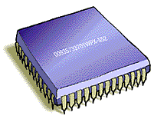
Tool Flow
delegate threads
CPU
buses
peri-pherals
libreconos
(static library)
root file system
and device drivers
reference design
compile & link
.c
.vhd
platform generation
software
threads
hardware
threads
.elf
via NFS
synthesis / place & route
linux
kernel image
.bit
FPGA
Andreas Agne, University of Paderborn

Slide 14
ReconOS Repository
demos:
  Demo applications that showcase individual features of ReconOS
  Tutorial applications: sort_demo and webcam
designs:
  reference designs
  Templates
linux:
  Device drivers
  ReconOS runtime library
  Utility scripts
pcores:
  Peripheral cores used to implement ReconOS with the Xilinx EDK tools
tools:
  ReconOS tool-chain
  Various utilities
Andreas Agne, University of Paderborn

Slide 15
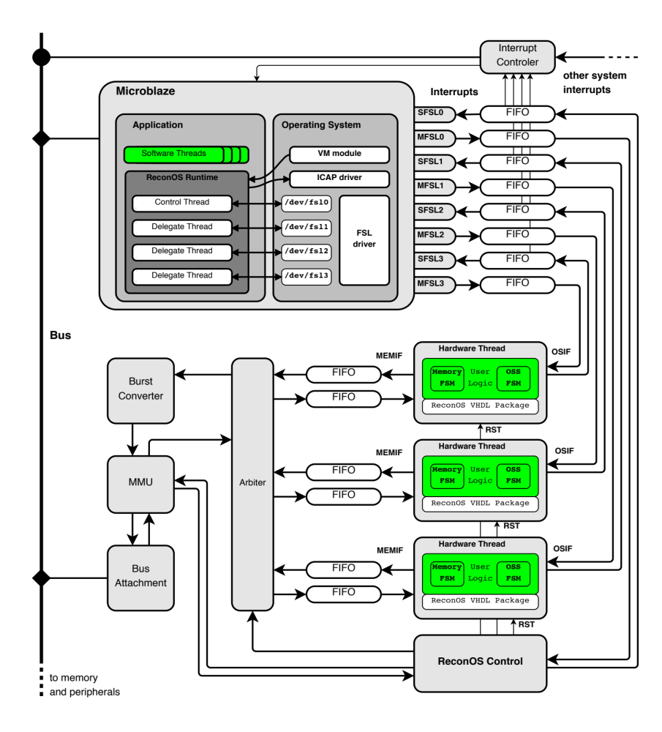

Slide 16
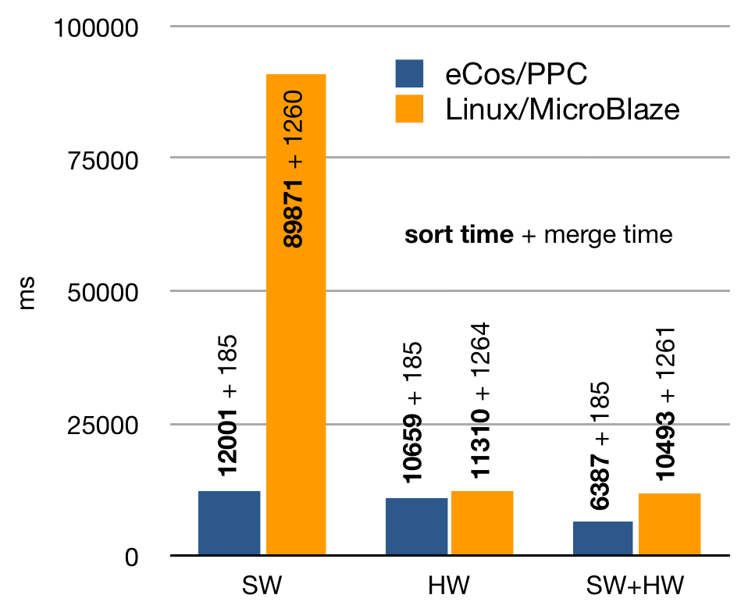
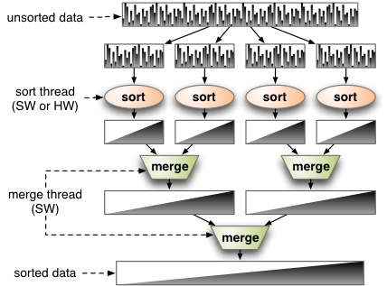
Sorting Case Study
sort thread
Application
  sorts an array of integers (1MB) using a combination of bubble sort and merge sort
  OS call overhead not a major factor in overall performance
Benchmarks available for:
  eCos/PPC: PowerPC405@300MHz, HW threads & bus @100MHz
  Linux-noMMU/MicroBlaze: MicroBlaze4.0@100Mhz, HW threads & bus @100MHz
How will the ML605/Linux-system compare to those?
Andreas Agne, University of Paderborn

Slide 17
Thank you for your attention

Slide 18
Publications
Ariane Keller, Bernhard Plattner, Enno Lübbers, Marco Platzner, and Christian Plessl. Reconfigurable Nodes for Future Networks. In Proceedings of the 3rd IEEE Globecom 2010 Workshop on Network of the Future (FutureNet III), IEEE. To appear.
Enno Lübbers, Marco Platzner, Christian Plessl, Ariane Keller and Bernhard Plattner. Towards Adaptive Networking for Embedded Devices based on Reconfigurable Hardware. In Proceedings of the 8th International Conference on Engineering of Reconfigurable Systems and Algorithms (ERSA), July 2010, CSREA Press.
Enno Lübbers. Multithreaded Programming and Execution Models for Reconfigurable Hardware. PhD thesis, Computer Science Department, University of Paderborn, ISBN: 978-3-8325-2463-0, 2010. Logos Verlag Berlin.
Enno Lübbers and Marco Platzner. ReconOS: An Operating System for Dynamically Reconfigurable Hardware. In Dynamically Reconfigurable Systems: Architectures, Design Methods and Applications, ISBN: 978-90-481-3484-7, 2010, Springer.
Markus Happe, Enno Lübbers and Marco Platzner. An Adaptive Sequential Monte Carlo Framework with Runtime HW/SW Repartitioning. In Proceedings of the 2009 International Conference on Field-Programmable Technology (FPT’09), December 2009, IEEE.
Enno Lübbers and Marco Platzner. ReconOS: Multithreaded Programming for Reconfigurable Computers. ACM Transactions on Embedded Computing Systems. Volume 9, Number 1, October 2009.
Enno Lübbers and Marco Platzner. Cooperative Multithreading in Dynamically Reconfigurable Systems. In Proceedings of the 19th IEEE International Conference on Field Programmable Logic and Applications (FPL’09), August 2009, IEEE.
Markus Happe, Enno Lübbers and Marco Platzner. A Multithreaded Framework for Sequential Monte Carlo Methods on CPU/FPGA Platforms. In Reconfigurable Computing: Architectures, Tools and Applications: 5th International Workshop (ARC 2009), March 2009, Springer.
Enno Lübbers and Marco Platzner. A Portable Abstraction Layer for Hardware Threads. In Proceedings of the 18th IEEE International Conference on Field Programmable Logic and Applications (FPL’08), September 2008, IEEE.
Enno Lübbers and Marco Platzner. Communication and Synchronization in Multithreaded Reconfigurable Computing Systems. In Proceedings of the 8th International Conference on Engineering of Reconfigurable Systems and Algorithms (ERSA), July 2008, CSREA Press.
Enno Lübbers and Marco Platzner. ReconOS: An RTOS supporting Hard- and Software Threads. In Proceedings of the 17th International Conference on Field Programmable Logic and Applications (FPL), August 2007, IEEE.
Andreas Agne, University of Paderborn

Slide 19
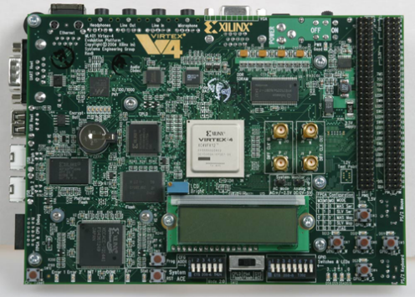
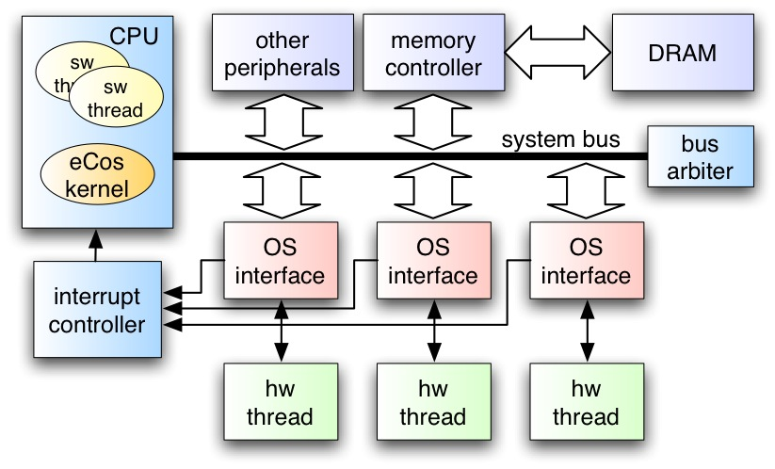
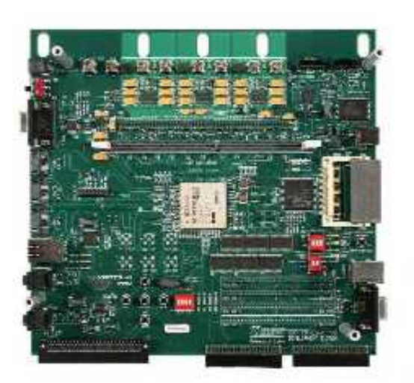
Operating Systems for Reconfigurable Computers
Support development of reconfigurable systems-on-chip by providing operating system services for hardware threads
Aspects
  multithreaded programming models for CPU/FPGA hybrids
  dynamic and partial reconfiguration, placement and scheduling techniques
  runtime verification based on "proof-carrying" hardware
  implementation based on eCos / Linux on μBlaze / PowerPC
Xilinx Virtex platforms
hybrid hw/sw thread architecture
M. Platzner, University of Paderborn

Slide 20
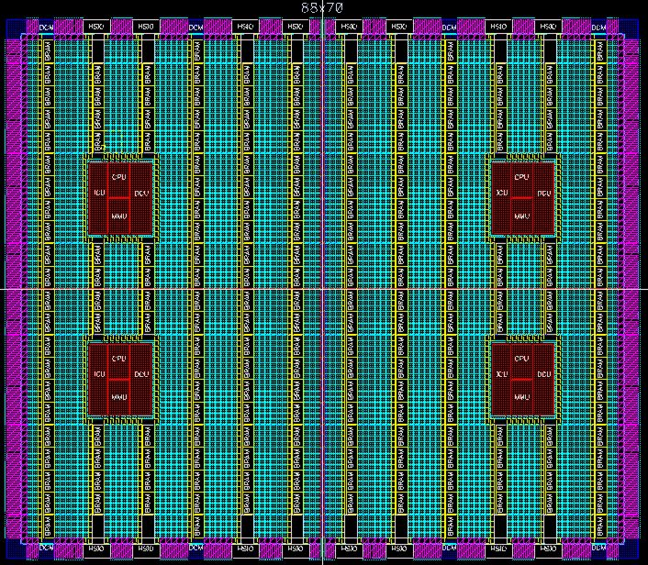
Features of Current FPGAs - Example Xilinx Virtex
Virtex family
  Virtex, Virtex-II, Virtex-IIPro, Virtex4 (90nm), Virtex5 (65nm), Virtex-6 (40nm)
  increasing densities, eg. XC6VHX565T: 354’240 6-LUTs, 708’480 Flip-Flops,
  864 DSP blocks, 32’821 KBit RAM
Embedded function blocks
  RAM, memory controllers
  dedicated multipliers, DSP blocks
  multi-Gigabit transceivers, Ethernet MACs,
  PCI Express
  hard CPU cores (PowerPC)
  soft CPU cores (eg. PicoBlaze, MicroBlaze)
Partial reconfiguration
  also from within the chip
  Virtex-II/Virtex-IIPro reconfigurable in chip-spanning vertical columns
  since Virtex-4 reconfigurable in rectangular regions
M. Platzner, University of Paderborn

Slide 21
Reconfigurable Hardware Operating System
Introduce a new layer of abstraction
  turn hardware accelerators into hardware tasks (threads)
  rely on an operating system to schedule, place, and execute these tasks
Motivation
  increase productivity and portability
  exploit partial reconfigurability
  use reconfigurable hardware for
  dynamic task sets
Projects
  XFORCES (SNF, 2000-2004)
  ReconOS (DFG, 2006-2010)
task 2
task 1
task N
services
operating system
CPU
FPGA
T₂
T_{N}
T₁
M. Platzner, University of Paderborn

Slide 22
System Architecture
Development platforms
  ML605 (Virtex-6LX), ML403 (Virtex-4FX)
  Avnet Virtex-4 PCIe Kit (XC4VFX100)
  Xilinx XUPV2P (Virtex-II Pro)
  Erlangen Slot Machine (XC2V6000)
  embedded PowerPC 405 CPU(s)
  CoreConnect bus architecture
  FPGAs support partial reconfiguration
Operating systems
  eCos on µBlaze and PowerPC
  eCos is a widely-used open source RTOS with modular, extensible design
  Linux on µBlaze and PowerPC
  supplemented with OS interface for hardware threads
M. Platzner, University of Paderborn

Slide 23
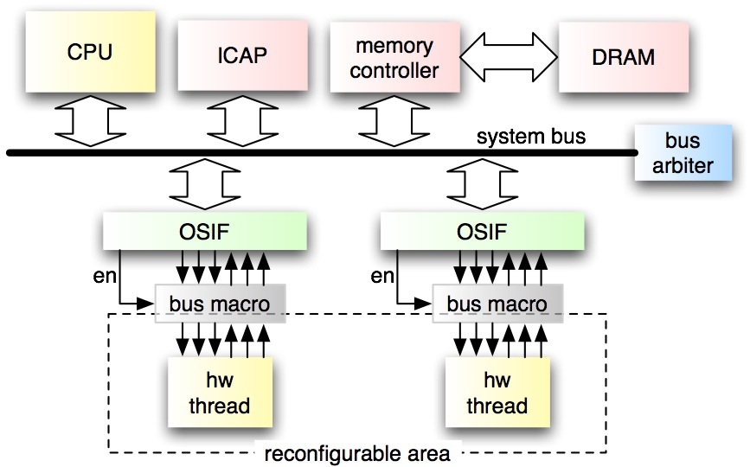

Partial Reconfiguration
Hardware threads can be partially reconfigured
  partial bitstreams are pre-generated at design time and placed in DRAM
Cooperative scheduling
  hardware threads cooperatively share computing resources by „yielding“
  their slots to other waiting threads
  scheduling decisions are handled globally by hardware scheduler
M. Platzner, University of Paderborn

Slide 24
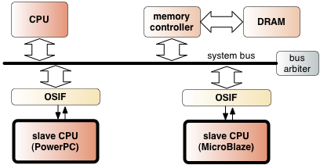
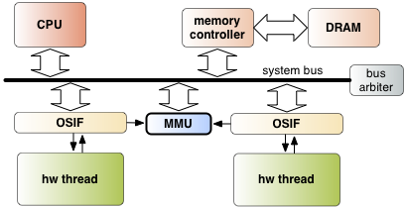
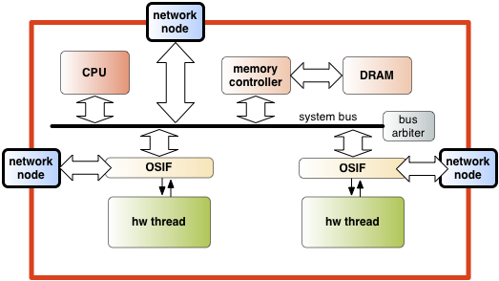
Ongoing & Future Research Based on ReconOS
Asymmetric multi-processor support
  support OS calls while avoiding cache coherency issues
Virtual memory for hardware threads
  provide shared memory support for
  ReconOS/Linux
  several hw threads can share one TLB
Token-ring on-chip network
  reduce bus-based thread-to-thread communication
M. Platzner, University of Paderborn
Notes:
- warum multi-processor? For SW threads that do not have a hardware implementation
- Achtung: VMem-Fragen von Prof. Koch
- network improves thread-level parallelism

Slide 25
Ongoing & Future Research Based on ReconOS
Reconfigurable hardware security
  ReconOS as infrastructure for “proof-carrying hardware”
  runtime verification of functional and non-functional properties of reconfigurable modules
Self-aware heterogeneous multi-cores
  node builds models of environment and “one self” to anticipate changes
  EU FP7 project EPiCS (with EADS, ETHZ, Imperial)
Temperature-driven thread mapping and shadowing
  shadow threads and compare signatures to detect core failures
  migration, also across the software-hardware boundary
  within DFG SPP 1500
M. Platzner, University of Paderborn
Notes:
- warum multi-processor? For SW threads that do not have a hardware implementation
- Achtung: VMem-Fragen von Prof. Koch
- network improves thread-level parallelism

Slide 26
Summary
Modern FPGAs
  have huge densities
  integrate reconfigurable logic cores with hard CPUs, soft CPUs, memories
  and embedded function blocks to reconfigurable systems on chip
  (some) allow for partial reconfiguration
Operating system layers for reconfigurable devices
  increase productivity and portability
  exploit partial reconfigurability
  allow for running dynamic task sets
ReconOS extends the multithreaded programming model
across the software/hardware boundary
M. Platzner, University of Paderborn

