Slide 1
Mini-Project Presentation
Mini-Project
Soundgates – Interactive Music Synthesis on FPGAs

Slide 2
Outline
Objectives
Ideas
Overview
Live demo
Prospect

Slide 3
Objectives
Objective of supervisors:
Get sound of out the PmodAMP3 Sound Module
Group objectives:
  Possibility to play different sounds controlled with hardware buttons
  Possibility to play well known sounds

Slide 4
Ideas for the implementation
Convert WAVE files to a ROM
Usage of the CORDIC algorithm to play sine and cosine waveforms
MIDI controlling of the CORDIC

Slide 5
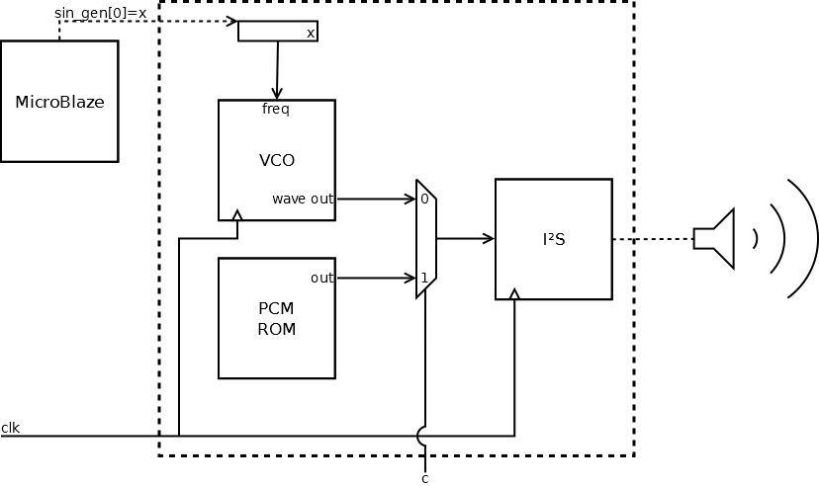
Circuit overview

Slide 6

Live demo

Slide 7
Prospect

