Slide 1
Projectplan

Slide 2
Outline
Introduction
Generative music
Soundgates
Technologies
Workplan
Notes:
Introduction: Our Goal and how we want to achieve it
Maybe related work
Technologies: ReconOS, XPS, GMF
Soundgates: 3 Parts: Editor, Simulator, COSMIC

Slide 3
Introduction

Slide 4
Music
Traditional:
Musicians perform and people perceive music
Trend:
Interact with music (even without knowledge)
  Cheering and shouting at a concert
  Guitar Hero, Rockband, DJ Hero, Singstar, …
Introduction
Notes:
Interact without musical knowledges or even talent.
We‘d like to combine these elements ...

Slide 5
2 Level of sound generation
Goal:
Generate music in Hardware on a FPGA
Level 1:
Musician connects components to generate sounds and melodies
Level 2:
User interacts with system at runtime to modify the output
  Motion Sensors
  3D depth camera (i.e. Kinect)
Introduction
Notes:
2 Level: Mobile devices: motion and position sensors
3D depth camera tracks movement of body. map frequency to altitude of the left arm (ie)

Slide 6
Generative music

Slide 7
Approaches to generative music
Creative / Procedural
Interactive / Behavioural
Generative Music

Slide 8
Approaches to generative music
Creative / Procedural
Interactive / Behavioural
Generative Music

Slide 9
Creative / Procedural
Goal:
Generate music from precomposed options
Musician writes song which consists of different parts
  parts are exchangeable and randomly played
  generates every time a new song
ie. “Mozarts Musical Dicegame“
  next played part was randomly chosen by rolling a dice
Generative Music

Slide 10
Approaches to generative music
Creative / Procedural
Interactive / Behavioural
Generative Music
Notes:
Before i define interactive behavioral music i have to make a short excourse to synthesized music

Slide 11
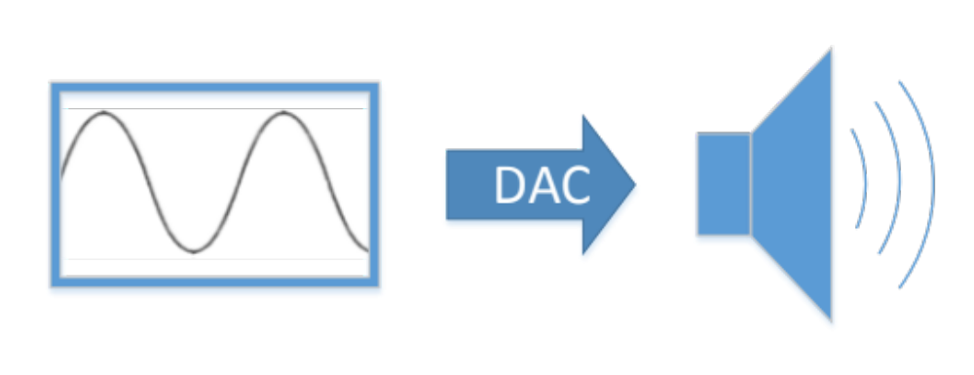
Generate Sound on a digital System
- Simple synthesizer
Generative Music
Notes:
signal generator generates waveform (ie. SINE wave)
Sampled values are fed into Digital-To-Analog Converter to convert them into analog signal
→not pleasing to listen to but artifical
→ Possible to change frequency to play different notes

Slide 12
Interactive / Behavioural
Results from processes without discernable musical inputs
  uses:
  synthesized music
Music generation fully controlled by user input and interaction
  combined and filtered synthesized waveforms
  input modified with sensors
Generative Music
Notes:
This is our approach!

Slide 13
Soundgates

Slide 14
Soundgates
Editor
Simulator
COSMIC
Soundgates

Slide 15
Soundgates
Editor
Simulator
COSMIC
Soundgates

Slide 16
Editor
Musician builds/loads a patch
  consists of sound-components and connections
Sound-components
  wave generators (sine, sawtooth, rectangular)
  arithmetic functions (i.e. addition, multiplication)
  filters (i.e. low pass)
  mixers
  composite sound components
Soundgates

Slide 17
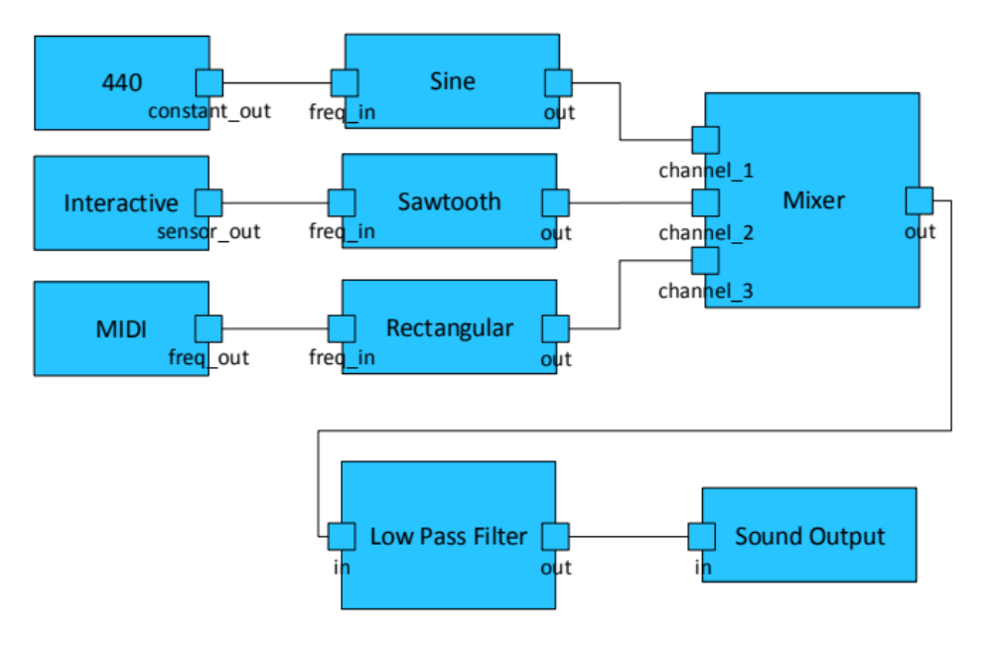
Example patch
Soundgates
Notes:
LP: where frequencies up to a specific threshold are passed through unmodfied whereas frequencies above that range are weakend or blocked

Slide 18
Editor functions
Make sound component public
  possible to modify at runtime with sensors
Export patch to VHDL code
Validate patch
  constraints
    i.e. every port has an input
Soundgates

Slide 19
Soundgates
Editor
Simulator
COSMIC
Soundgates
Notes:
take long - Bitstream

Slide 20
Simulator
Problem:
Testing the output is not possible until VHDL code is synthesized
Solution:
Test the developed system on PC
  Every component will be implemented in SW & HW
Soundgates

Slide 21
Soundgates
Editor
Simulator
COSMIC
Soundgates

Slide 22
COSMIC
Computer Scientists Making Music
The generated Bitstream is put on an FPGA
Performer maps sensors to interfaces
  starts session by pushing a button
Creates input values with sensors
  music will be generated / modified
Soundgates
Notes:
performer or musician

Slide 23
Technologies
Notes:
to build these parts we are going to use diff tech
----- Besprechungsnotizen (22.07.13 11:28) -----
k

Slide 24
Graphical Modeling Framework (GMF)
“Model Driven Software Development” approach for graphical editors
Specify Metamodel and generate software
  parts and rules which are needed to create valid patches
Used for:
Create graphical editor to build patches
Technologies
Notes:
, which would definetely an time consuming and error prone process
MM: so we define the parts and rules which are needed to create valid models → a Patch

Slide 25
ReconOS
Model applications using software and hardware threads on an FPGA
  Posix-like abstraction (mailboxes, semaphores, …)
  communication between threads abstracted by method calls
Used for:
Sensor input comes via IPC and is processed in software
  modifies parameters of HW
Technologies
Notes:
Sensor input via ethernet / wifi (sockets IPC)

Slide 26
Open Sound Control (OSC)
Message based communication protocol
  developed for communication between computer systems and sound synthesizers
OSC message modifies parameters
  i.e.
  /synthesizer1/oscillators/sine/freq “int32” 440
Independent of transport protocol
Used for:
Sensors will send OSC messages to FPGA system to modify parameters
Technologies
Notes:
it‘s possible with OSC to modify values of sound components
datatype

Slide 27
Workplan

Slide 28
Agile inspired development process
Split into Hardware- and Software Groups
  “Cross testing”
5 milestones
  each consists of a set of tasks
  approximately five to six weeks per milestone
“Github” for versioning and sharing of code
“Redmine” to represent milestones and tracking of tasks and bugs
Functional system at the end of every milestone
Workplan

Slide 29
Milestones
Prototyping infrastructure / environment
  fundamental infrastructure is prototyped
  no direct communication between them
Prototype of a digital synthesizer
  basic digital synthesizer can be modeled with the editor
  transform patch to HDL description
Workplan
Notes:
Open editor, place and connect dummy components; Simulate patch in simulator (proof of concept), HW: ReconOS environment + prototype I/o interface
basic components, constants, adders, delasy + rotary switches (on fpga)

Slide 30
Milestones
Polishing editing environment
  every planed component is implemented
  create Android application to stream sensor data to the COSMIC system
  additional audio processing components
System integration and benchmarking
  evaluate system limits
Workplan
Notes:
3. Low/High pass filters ie., mixers, amplifier

Slide 31
Milestones
Documentation, Testing, Presentation
  polishing phase
Workplan
Notes:
3. Low/High pass filters ie., mixers, amplifier

Slide 32
Thank you for your attention –
Any comments, hints, questions?
Thank you

Slide 33
Backup
Thank you

Slide 34
Open Sound Control (OSC) - Datatypes
int32
float32
OSCString
OSCTimetag
OSCBlob
Technologies

Slide 35
Open Sound Control (OSC)
Advantage:
  higher speed than midi
    larger datatypes and float values
  can be send via ethernet
  “Internet-Jam”
Disadvantage:
  namespace does not follow any standard
Technologies

