Slide 1
Midlleware and filters in ASP .Net Core MVC
Evgeniy Pilyaev

Slide 2
Middleware
Middleware is the term used for the components that are combined to form the request pipeline.
Content-Generating
Short-circuiting
Request-editing
Response-editing

Slide 3
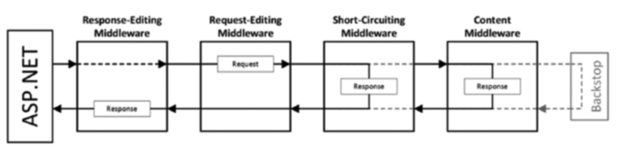
Middleware
@ Pro Asp .Net Core MVC 2

Slide 4
Middleware
To be a middleware component class must have:
Constructor that takes a RequestDelegate (nextDelegate)
Define Invoke method which takes HttpContext as and argument

Slide 5
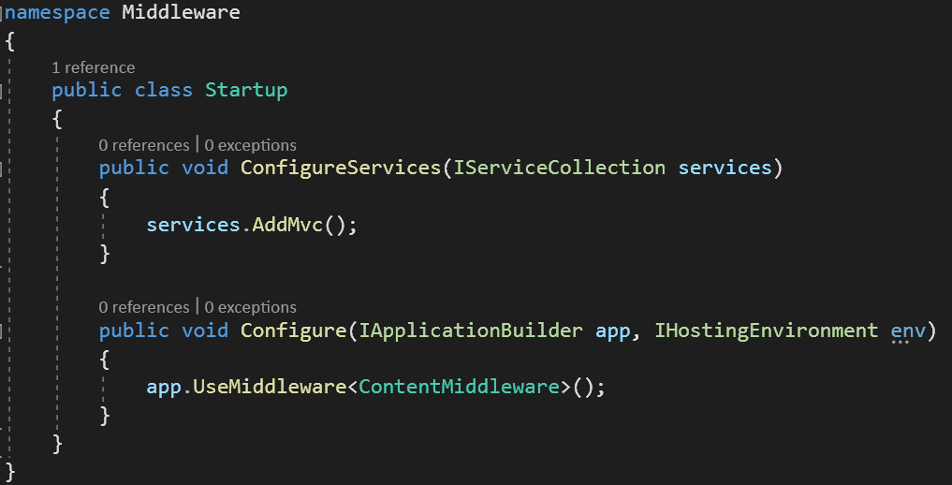
Content Middleware

Slide 6
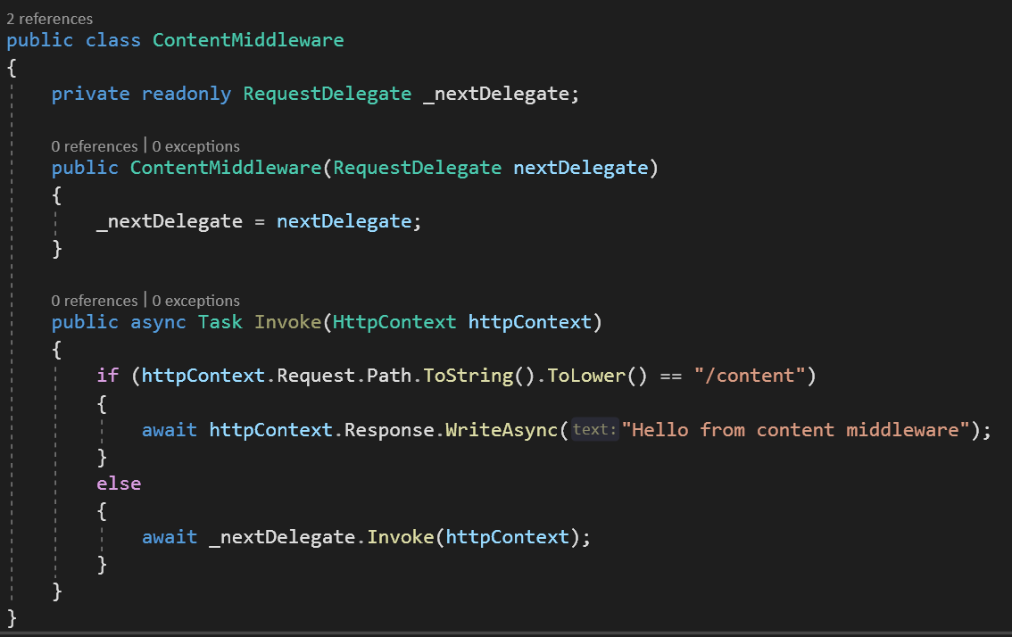
Content Middleware

Slide 7

Content Middleware

Slide 8
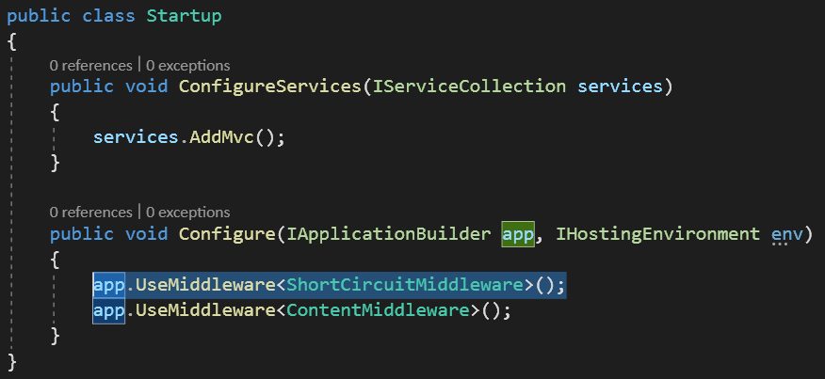
Short-Circuiting Middleware

Slide 9
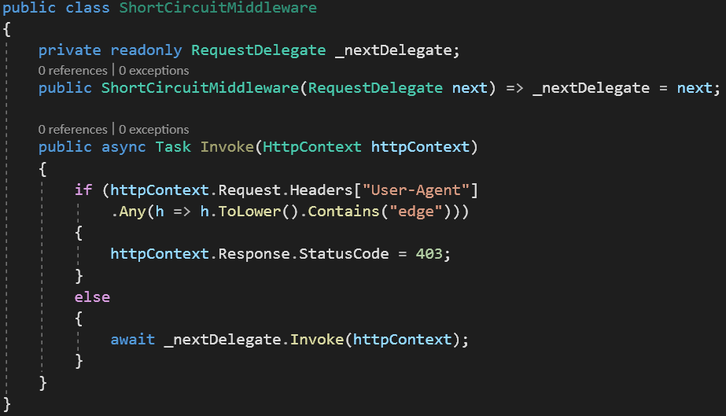
Short-Circuiting Middleware

Slide 10
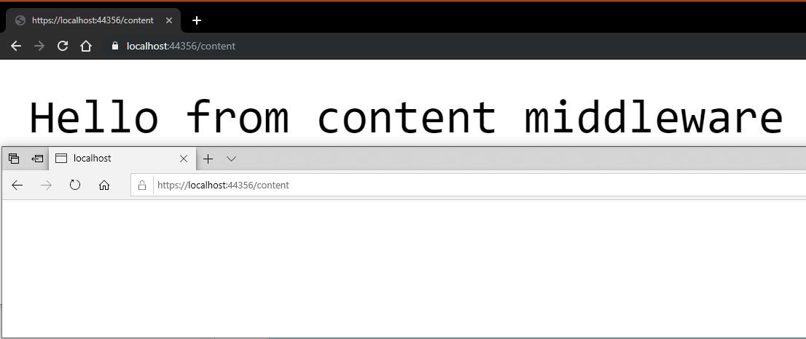
Short-Circuiting Middleware

Slide 11
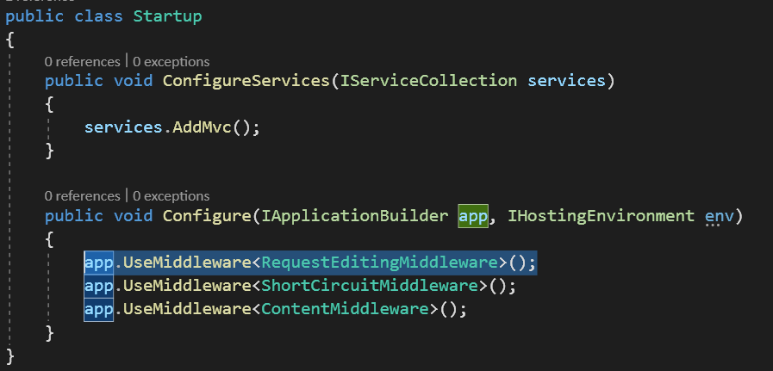
Request-editing Middleware

Slide 12
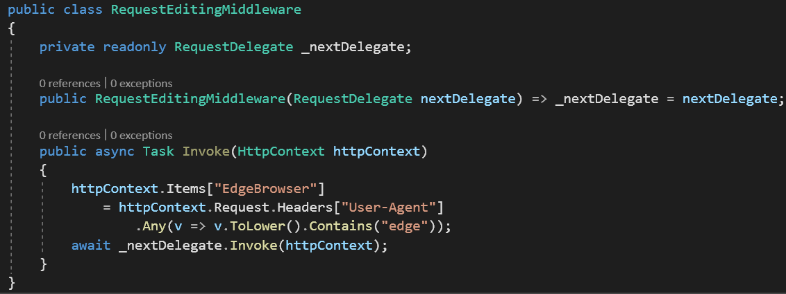
Request-editing Middleware

Slide 13
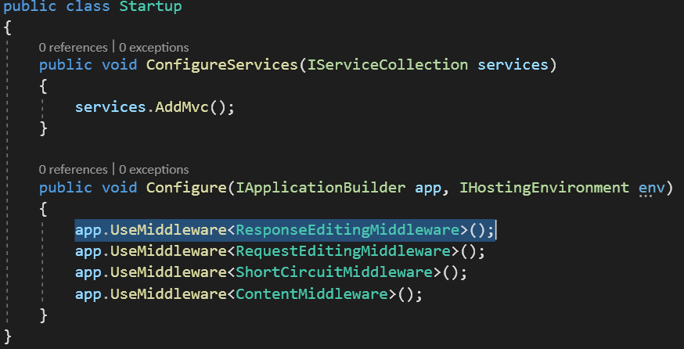
Response-editing Middleware

Slide 14
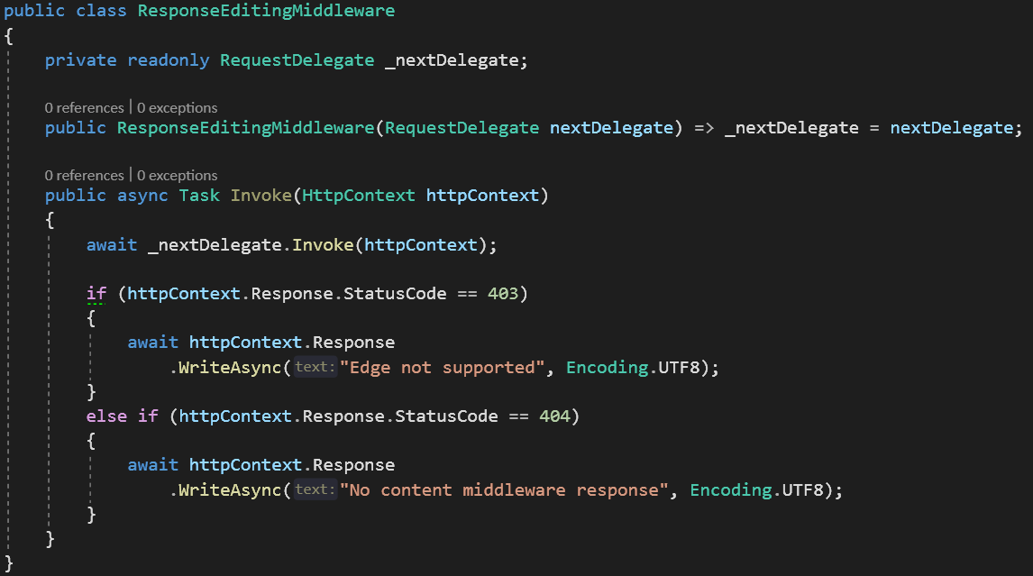
Response-editing Middleware

Slide 15
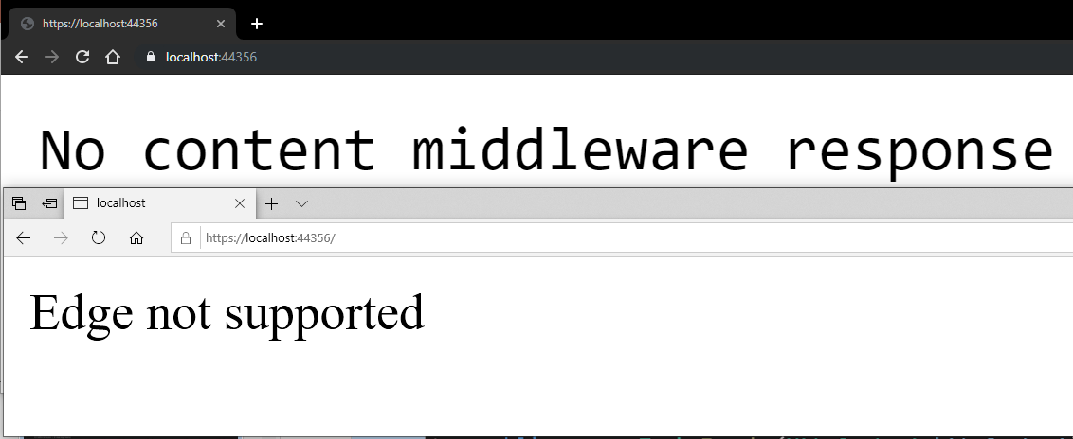
Response-editing Middleware

Slide 16
Filters
Implement IFilterMetadata:
namespace Microsoft.AspNetCore.Mvc.Filters {
public interface IFilterMetadata { }
}

Slide 17
Filters
Types and order of filters:
Authorization – I(Async)AuthorizationFilter
Action – I(Async)ActionFilter
Result – I(Async)ResultFilter
Exception – I(Async)ExceptionFilter

Slide 18
Authorization filters
namespace Microsoft.AspNetCore.Mvc.Filters {
public interface IAuthorizationFilter : IFilterMetadata {
void OnAuthorization(AuthorizationFilterContext context);
}
}

Slide 19
Async authorization filters
namespace Microsoft.AspNetCore.Mvc.Filters {
public interface IAsyncAuthorizationFilter : IFilterMetadata {
Task OnAuthorizationAsync(AuthorizationFilterContext context);
}
}

Slide 20
Authorization Filters
IActionResult AuthorizationFilterContext.Result property:
If this property is set, MVC renders the IActionResult instead of invoking the action method

Slide 21
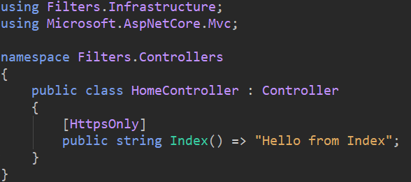
Authorization filter example

Slide 22
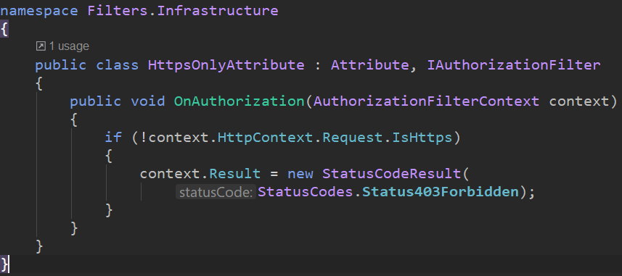
Authorization filter example

Slide 23
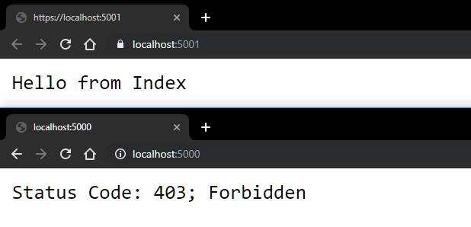
Authorization filter example

Slide 24
Action Filters
namespace Microsoft.AspNetCore.Mvc.Filters {
public interface IActionFilter : IFilterMetadata {
void OnActionExecuting(ActionExecutingContext context);
void OnActionExecuted(ActionExecutedContext context);
}
}
Notes:
OnActionExecuting – before the action method is invoked
OnActionExecuted – after

Slide 25
Action Filters
ActionExecutingContext properties:
Controller
ActionArguments – dictionary of arguments
IActionResult Result – if set, short-circuits the request and returns

Slide 26
Action Filters
ActionExecutedContext properties:
Controller
Canceled – true if another filter has set Result
Exception
ExceptionDispatchInfo – stack trace
ExceptionHandled – if set to true – suppresses exception
IActionResult Result – can change or replace result

Slide 27
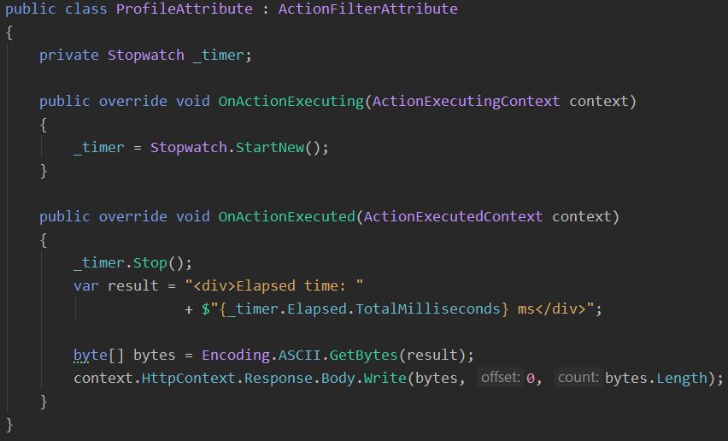
Action Filter example

Slide 28
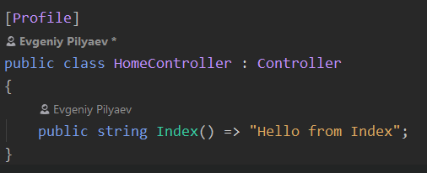
Action Filter example

Slide 29
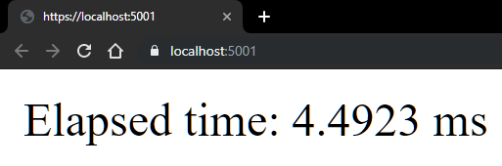
Action Filter example

Slide 30
Asynchronous Action Filter
public interface IAsyncActionFilter : IFilterMetadata {
Task OnActionExecutionAsync(ActionExecutingContext context,
ActionExecutionDelegate next);
}

Slide 31
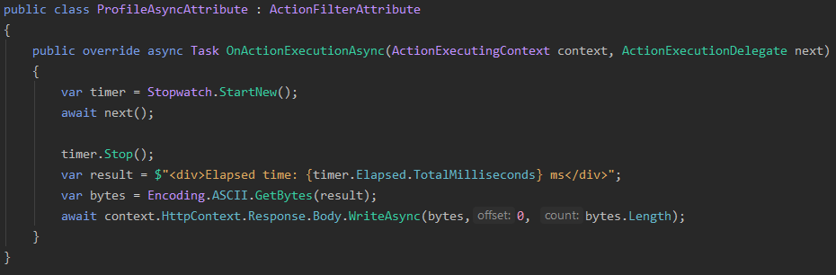
Asynchronous Action Filter

Slide 32
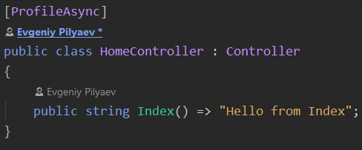

Asynchronous Action Filter

Slide 33
Result Filters
public interface IResultFilter : IFilterMetadata {
void OnResultExecuting(ResultExecutingContext context);
void OnResultExecuted(ResultExecutedContext context);
}

Slide 34
Result Filters
ResultExecutingContext properties:
Controller
bool Cancel - if true, will stop the action result from being processed
IActionResult Result – result object returned by the action method

Slide 35
Result Filters
ResultExecutedContext properties:
Controller
bool Canceled – whether the request was cancelled
Exception
ExceptionDispatchInfo – stack trace
bool ExceptionHandled – if set to true – suppresses exception
IActionResult Result – result object that was used to generate response

Slide 36
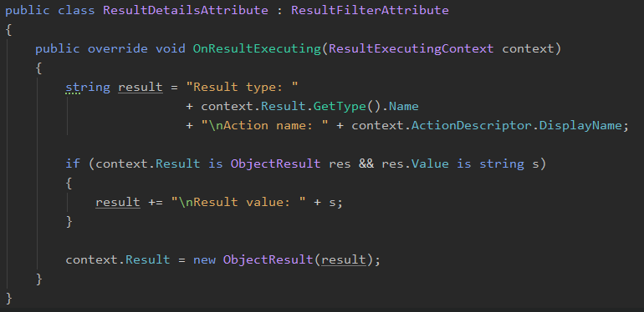
Result Filter example

Slide 37
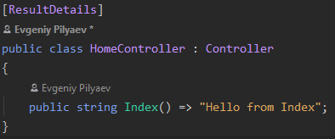
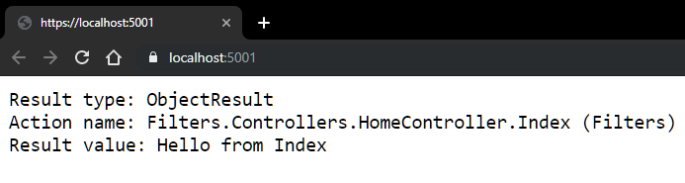
Result Filter example

Slide 38
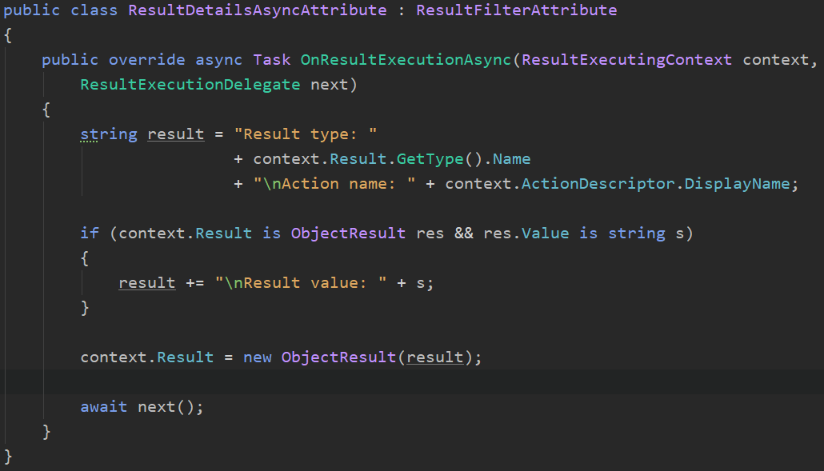
Async Result Filter example
Notes:
Next must be invoked to complete request processing pipeline and render result. If not called – it won’t be rendered

Slide 39
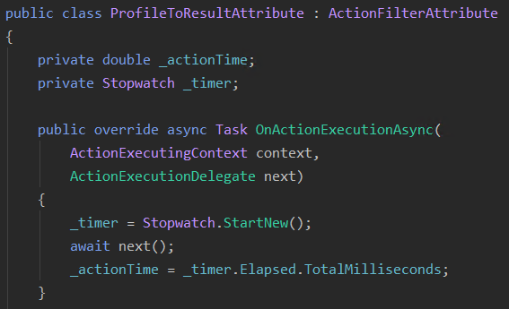
Hybrid Action\Result filter

Slide 40
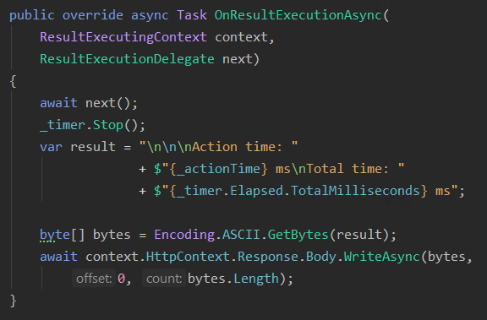
Hybrid Action\Result filter

Slide 41
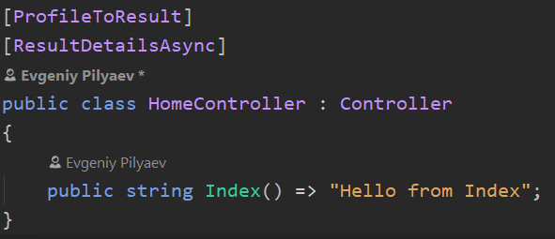
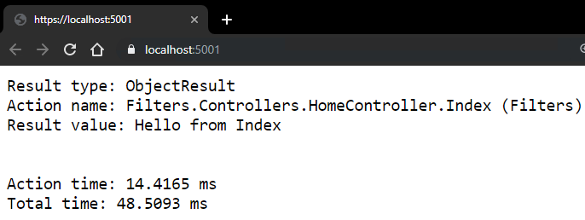
Hybrid Action\Result filter
Notes:
The output is after because it is written in the post-processed stage of the result filter.
In this case attribute order doesn’t matter.

Slide 42
Exception filters
public interface IExceptionFilter : IFilterMetadata {
void OnException(ExceptionContext context);
}
public interface IAsyncExceptionFilter : IFilterMetadata {
Task OnExceptionAsync(ExceptionContext context);
}

Slide 43
Exception filters
Exception context properties:
Exception
ExceptionDispatchInfo – stack trace details
bool ExceptionHandled
IActionResult Result – used to generate response

Slide 44
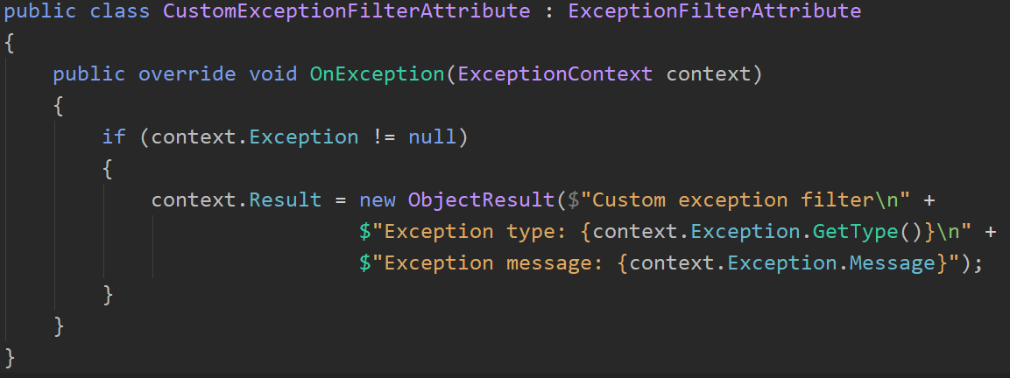
Exception filter example

Slide 45
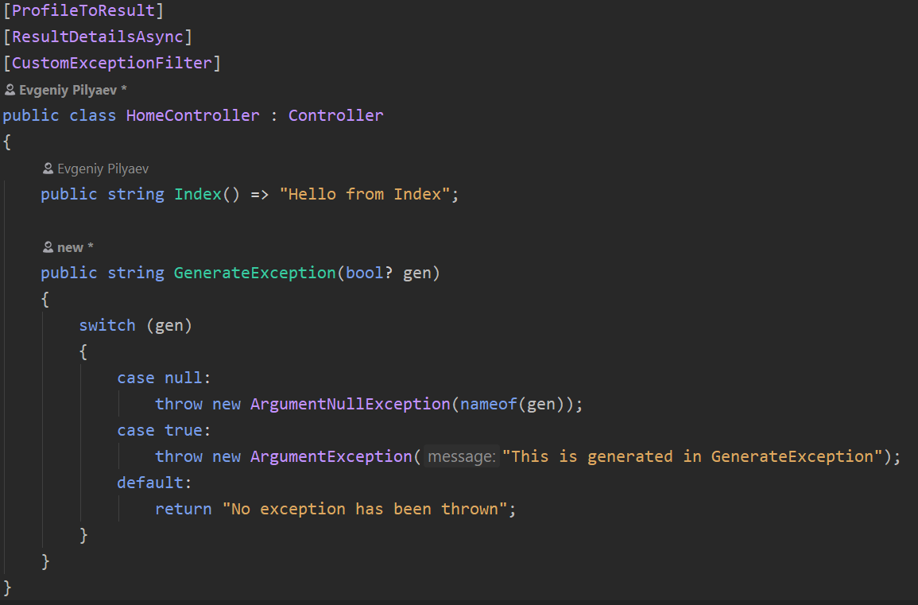
Exception filter example

Slide 46
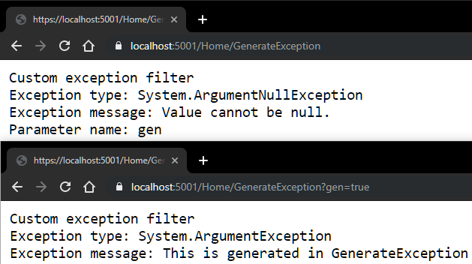
Exception filter example

Slide 47
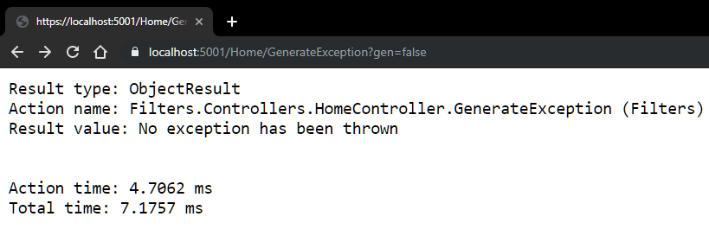
Exception filter example

Slide 48
Dependency injection for filters
Type filter attribute - Inject data inside the filter
Service filter attribute – Create a filter object using service provider

Slide 49
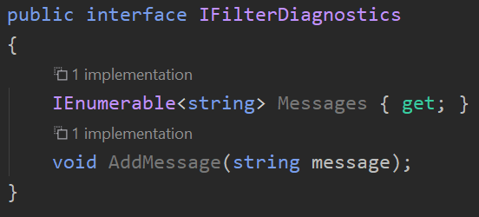
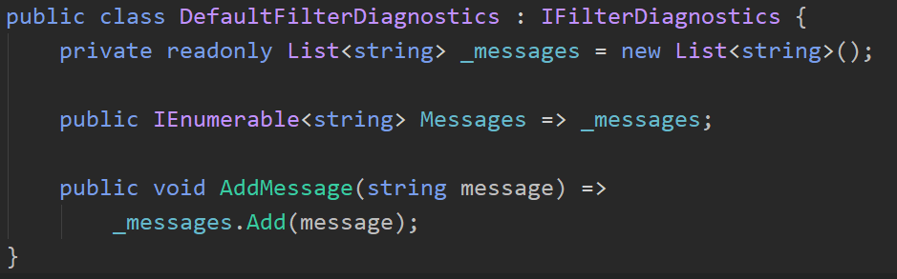
Type filter attribute (FilterDiagnostics)

Slide 50
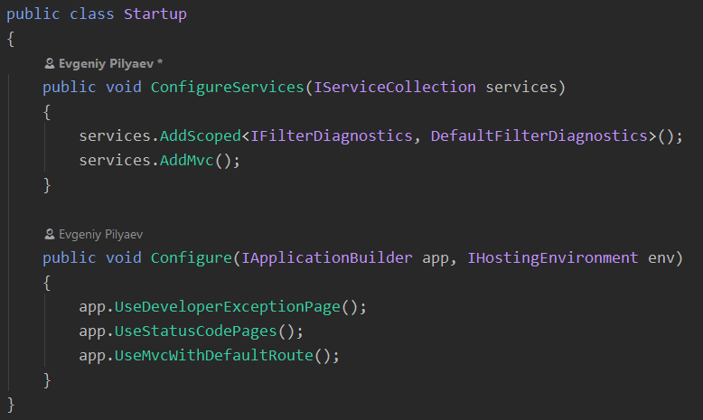
Type filter attribute (Startup)

Slide 51
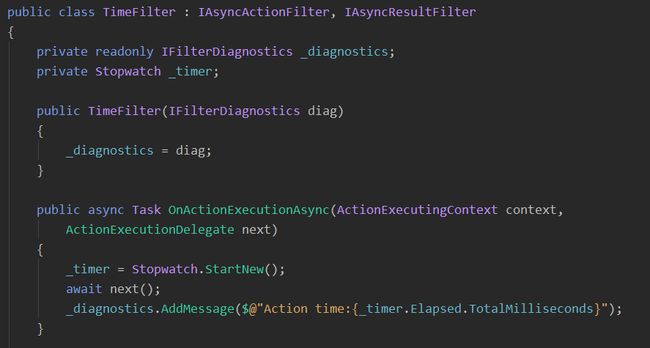
Type filter attribute (TimeFilter)

Slide 52
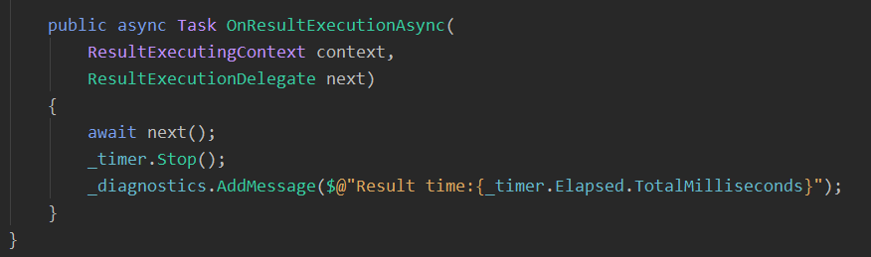
Type filter attribute (TimeFilter)

Slide 53
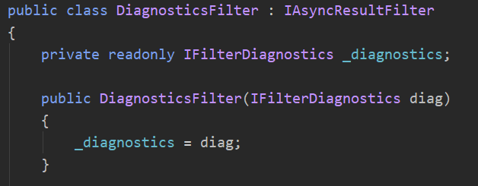
Type filter attribute (DiagnosticsFilter)

Slide 54
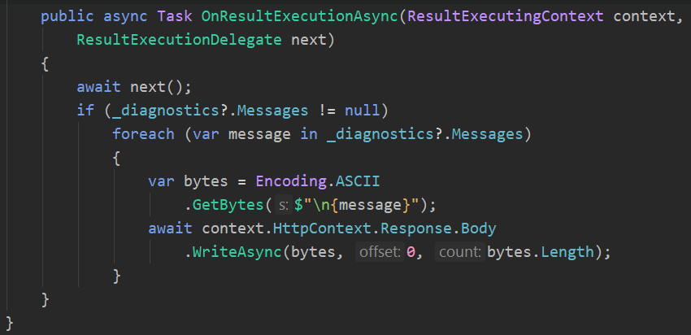
Type filter attribute (DiagnosticsFilter)

Slide 55
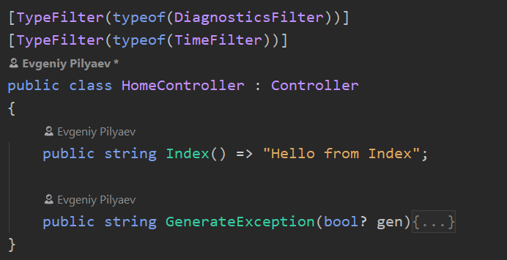
Type filter attribute (HomeController)

Slide 56
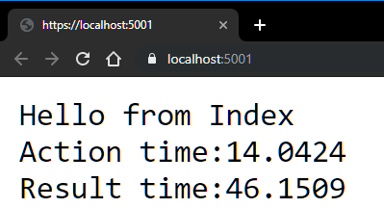
Type filter attribute (Demo)

Slide 57
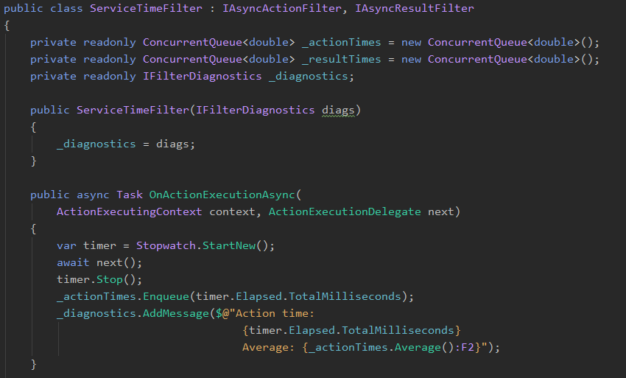
Service filter attribute (ServiceTimeFilter)

Slide 58
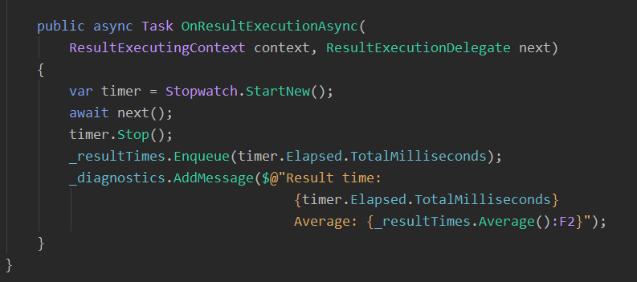
Service filter attribute (ServiceTimeFilter)

Slide 59
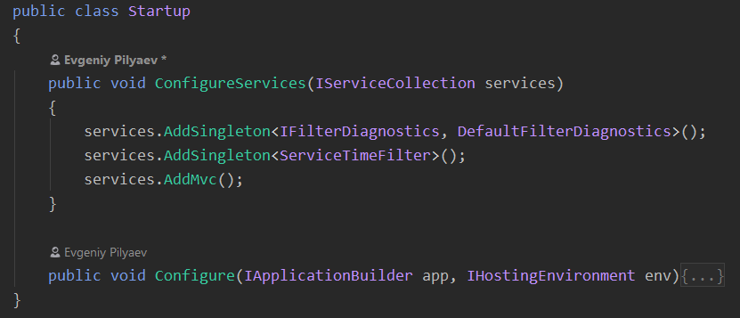
Service filter attribute (Startup)

Slide 60
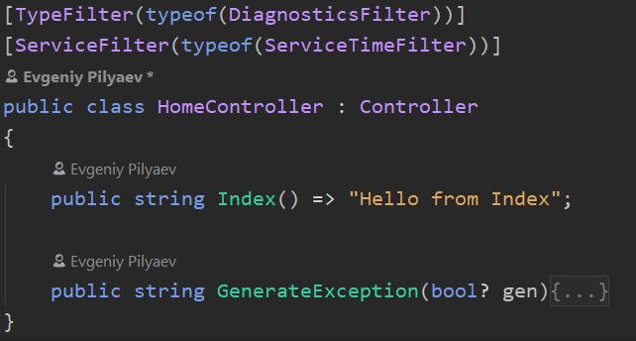
Service filter attribute (HomeController)

Slide 61

Service filter attribute (Demo)

Slide 62
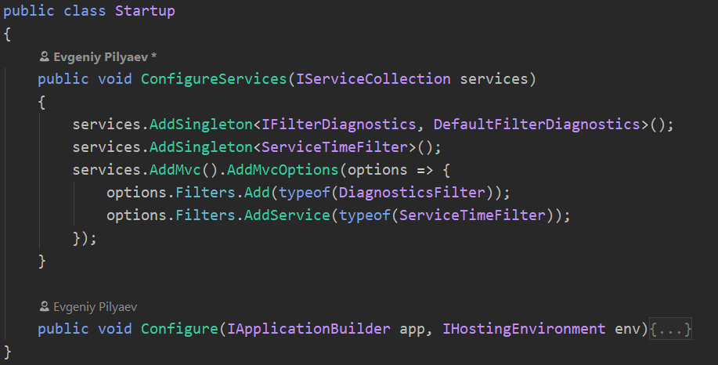
Global filters
Notes:
Аналог type и Service фильтров

Slide 63
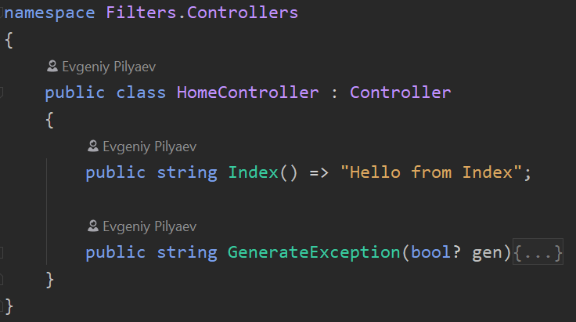
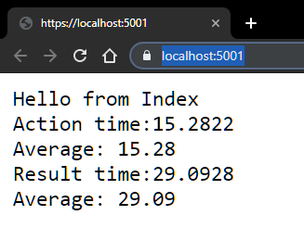
Global filters
Notes:
No filters

Slide 64
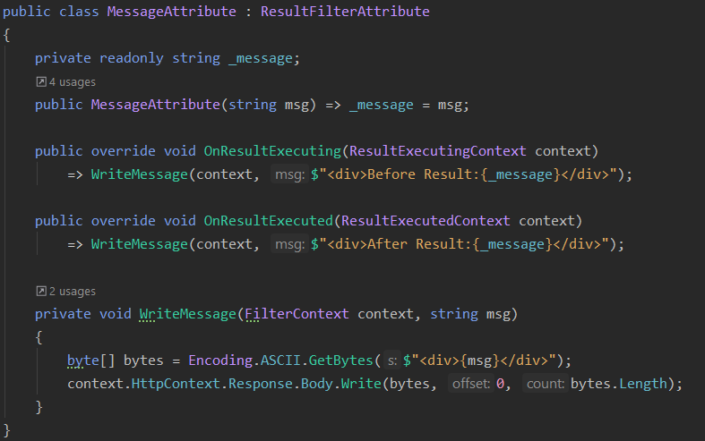
Filter order

Slide 65
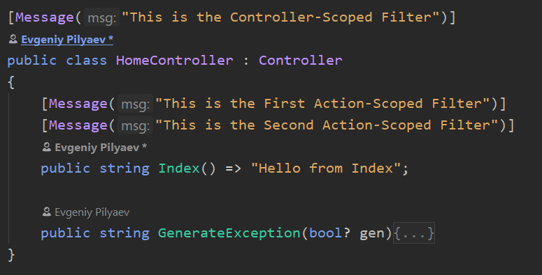
Filter order

Slide 66
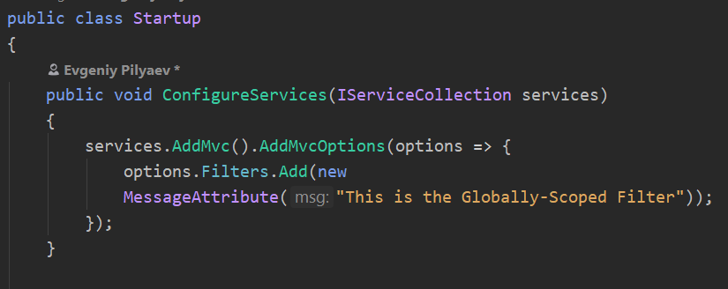
Filter order

Slide 67

Filter order

Slide 68
Changing filter order
namespace Microsoft.AspNetCore.Mvc.Filters {
public interface IOrderedFilter : IFilterMetadata
{
int Order { get; }
}
}

Slide 69

Changing filter order

Slide 70

Changing filter order

Slide 71
Thanks for attention Evgeniy Pilyaev https://github.com/EPilyaev/ASPNetCoreMVC (Middleware&Filters presentation)

