Slide 1
Host, Startup, DI in ASP .Net Core 3.0
Evgeniy Pilyaev

Slide 2
Host
A host is an object that encapsulates an app's resources, such as:
Dependency injection (DI)
Logging
Configuration
IHostedService implementations

Slide 3
Host
Provides lifetime management.
Startup:
Calls IHostedService.StartAsync on each implementation of IHostedService. In a web app – starts an HTTP server implementation.
Graceful shutdown.

Slide 4
Host
Generic Host – recommended.
Web Host – not recommended, backward compatibility. Used for HTTP workloads before .Net Core 3.0.

Slide 5
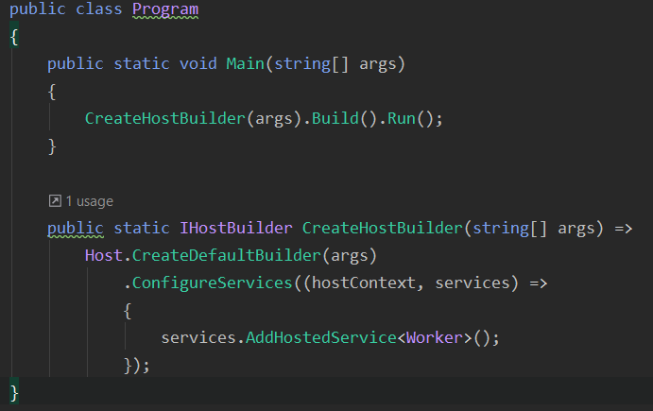
Generic Host (non-http workload)
Notes:
Program class, main method
Program.cs code for a non-HTTP workload, with a single IHostedService implementation added to the DI container.

Slide 6
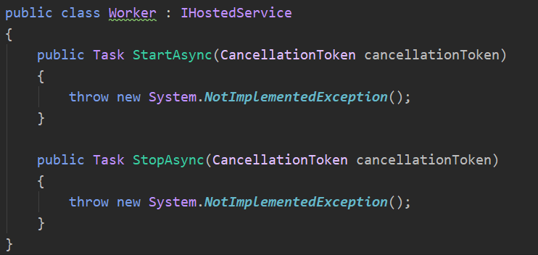
IHostedService implementation

Slide 7
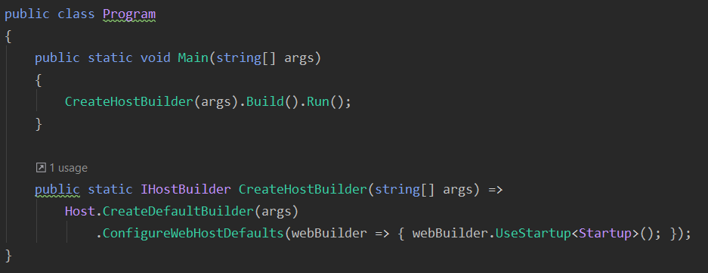
Generic Host (web)
Notes:
If the app uses Entity Framework Core, don't change the name or signature of the CreateHostBuilder method. The Entity Framework Core tools expect to find a CreateHostBuilder method that configures the host without running the app.

Slide 8
(Create)DefaultBuilder settings:
Content root = GetCurrentDirectory()
Loads host configuration from:
Environment variables prefixed with "DOTNET_".
Command-line arguments.
Loads app configuration from:
appsettings.json.
appsettings.{Environment}.json.
Secret Manager when the app runs in the Development environment.
Environment variables.
Command-line arguments.

Slide 9
(Create)DefaultBuilder settings:
Adds following logging providers:
Console
Debug
EventSource
EventLog (Windows)
Enables scope validation and dependency validation when the environment is Development.
Notes:
Scope validation:
When the app is running in the Development environment, the default service provider performs checks to verify that:
Scoped services aren't directly or indirectly resolved from the root service provider.
Scoped services aren't directly or indirectly injected into singletons.

Slide 10
ConfigureWebHostsDefault:
Loads host configuration from environment variables prefixed with "ASPNETCORE_".
Sets Kestrel server as the web server and configures it using the app's hosting configuration providers.
Adds Host Filtering middleware.
Adds Forwarded Headers middleware if ASPNETCORE_FORWARDEDHEADERS_ENABLED=true.
Enables IIS integration.
Notes:
Forwarded headers
By convention, proxies forward information in HTTP headers.

Slide 11
Framework-provided services
Services that are registered automatically include the following:
IHostApplicationLifetime
IHostLifetime
IHostEnvironment / IWebHostEnvironment

Slide 12
IHostApplicationLifetime
CancellationToken Properties:
ApplicationStarted – fully started
ApplicationStopped
ApplicationStopping
StopApplication() method
- Graceful shutdown, blocks
Notes:
handle post-startup and graceful shutdown tasks
ApplicationStarted
Triggered when the application host has fully started.
ApplicationStopped
Triggered when the application host is performing a graceful shutdown. Shutdown will block until this event completes.
ApplicationStopping
Triggered when the application host is performing a graceful shutdown. Shutdown will block until this event completes.
StopApplication()
Requests termination of the current application.

Slide 13
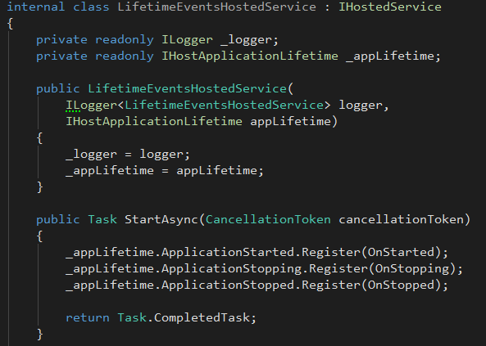
IHostApplicationLifetime usage

Slide 14
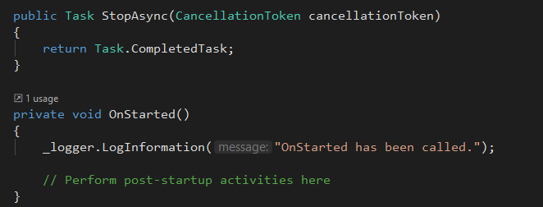
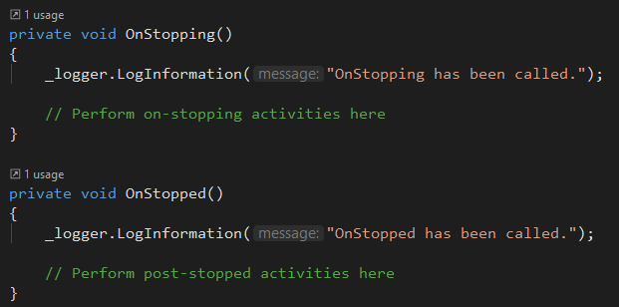
IHostApplicationLifetime usage

Slide 15
IHostLifetime
Сontrols when the host starts and when it stops.
The last implementation registered is used.
ConsoleLifetime is the default IHostLifetime implementation.
Listens for Ctrl+C/SIGINT or SIGTERM and calls StopApplication to start the shutdown process.
Unblocks extensions such as RunAsync and WaitForShutdownAsync.

Slide 16
IHostEnvironment
Provides information about:
ApplicationName
EnvironmentName
ContentRootPath
Web apps implement the IWebHostEnvironment interface, which inherits IHostEnvironment and adds:
WebRootPath

Slide 17
Header
text

Slide 18
Header
text

Slide 19
Header
text

Slide 20
Thanks for attention Evgeniy Pilyaev https://github.com/EPilyaev/ASPNetCoreMVC (Host&Startup&Di presentation)

