Slide 1
Host, Startup in ASP .Net Core 3.0
Evgeniy Pilyaev

Slide 2
Host
A host is an object that encapsulates an app's resources, such as:
Dependency injection (DI)
Logging
Configuration
IHostedService implementations

Slide 3
Host
Provides lifetime management.
Startup:
Calls IHostedService.StartAsync on each implementation of IHostedService. In a web app – starts an HTTP server implementation.
Graceful shutdown.

Slide 4
Host
Generic Host – recommended.
Web Host – not recommended, backward compatibility. Used for HTTP workloads before .Net Core 3.0.

Slide 5
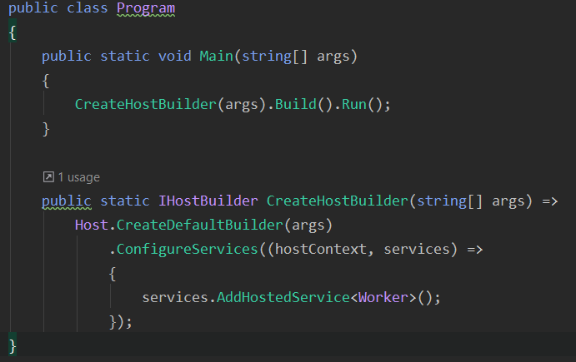
Generic Host (non-http workload)
Notes:
Program class, main method
Program.cs code for a non-HTTP workload, with a single IHostedService implementation added to the DI container.

Slide 6
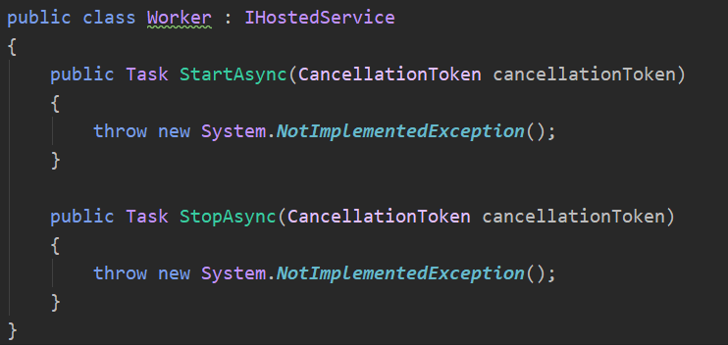
IHostedService implementation

Slide 7
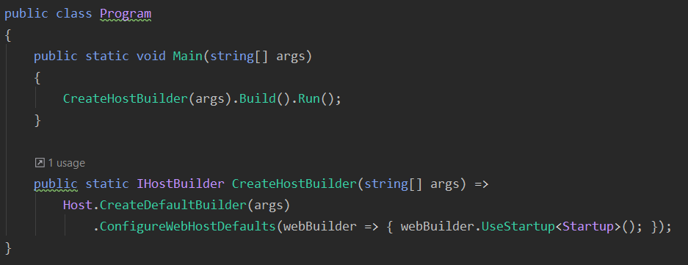
Generic Host (web)
Notes:
If the app uses Entity Framework Core, don't change the name or signature of the CreateHostBuilder method. The Entity Framework Core tools expect to find a CreateHostBuilder method that configures the host without running the app.

Slide 8
(Create)DefaultBuilder settings:
Content root = GetCurrentDirectory()
Loads host configuration from:
Environment variables prefixed with "DOTNET_".
Command-line arguments.
Loads app configuration from:
appsettings.json.
appsettings.{Environment}.json.
Secret Manager when the app runs in the Development environment.
Environment variables.
Command-line arguments.

Slide 9
(Create)DefaultBuilder settings:
Adds following logging providers:
Console
Debug
EventSource
EventLog (Windows)
Enables scope validation and dependency validation when the environment is Development.
Notes:
Scope validation:
When the app is running in the Development environment, the default service provider performs checks to verify that:
Scoped services aren't directly or indirectly resolved from the root service provider.
Scoped services aren't directly or indirectly injected into singletons.

Slide 10
ConfigureWebHostsDefault:
Loads host configuration from environment variables prefixed with "ASPNETCORE_".
Sets Kestrel server as the web server and configures it using the app's hosting configuration providers.
Adds Host Filtering middleware.
Adds Forwarded Headers middleware if ASPNETCORE_FORWARDEDHEADERS_ENABLED=true.
Enables IIS integration.
Notes:
Forwarded headers
By convention, proxies forward information in HTTP headers.

Slide 11
Framework-provided services
Services that are registered automatically include the following:
IHostApplicationLifetime
IHostLifetime
IHostEnvironment / IWebHostEnvironment

Slide 12
IHostApplicationLifetime
CancellationToken Properties:
ApplicationStarted – fully started
ApplicationStopped
ApplicationStopping
StopApplication() method
- Graceful shutdown, blocks
Notes:
handle post-startup and graceful shutdown tasks
ApplicationStarted
Triggered when the application host has fully started.
ApplicationStopped
Triggered when the application host is performing a graceful shutdown. Shutdown will block until this event completes.
ApplicationStopping
Triggered when the application host is performing a graceful shutdown. Shutdown will block until this event completes.
StopApplication()
Requests termination of the current application.

Slide 13
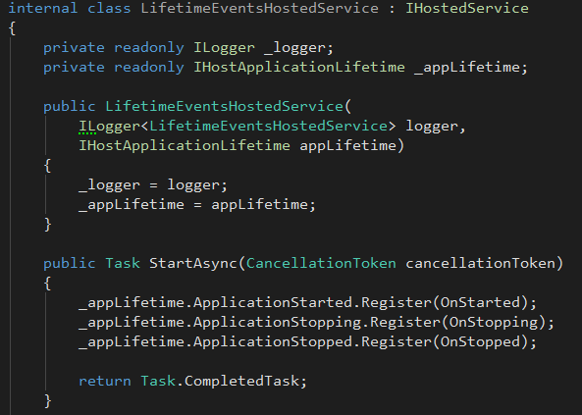
IHostApplicationLifetime usage

Slide 14
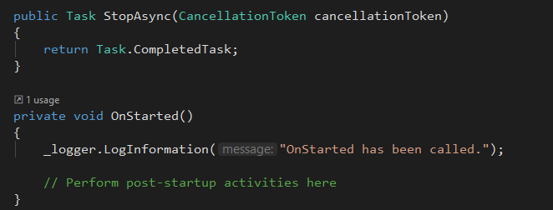
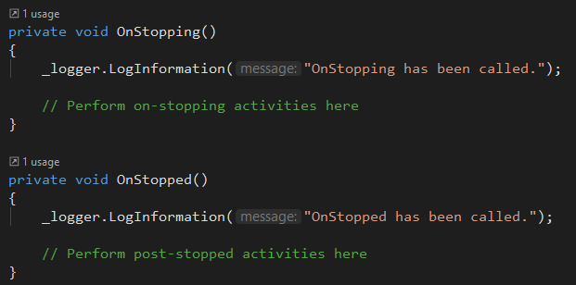
IHostApplicationLifetime usage

Slide 15
IHostLifetime
Сontrols when the host starts and when it stops.
The last implementation registered is used.
ConsoleLifetime is the default IHostLifetime implementation.
Listens for Ctrl+C/SIGINT or SIGTERM and calls StopApplication to start the shutdown process.
Unblocks extensions such as RunAsync and WaitForShutdownAsync.

Slide 16
IHostEnvironment
Provides information about:
ApplicationName
EnvironmentName
ContentRootPath
Web apps implement the IWebHostEnvironment interface, which inherits IHostEnvironment and adds:
WebRootPath

Slide 17
Host configuration
Used for the properties of the IHostEnvironment implementation
Available from HostBuilderContext.Configuration inside ConfigureAppConfiguration
To add host configuration, call ConfigureHostConfiguration on IHostBuilder
(Can be called multiple times for additive results, last option value on a key is used)

Slide 18
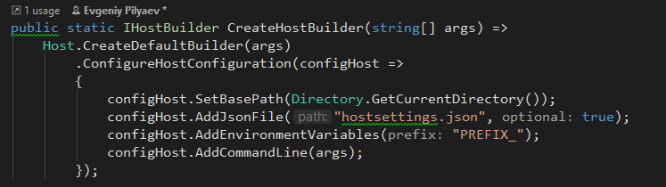
Host configuration example:

Slide 19
App configuration
Created by calling ConfigureAppConfiguration on IHostBuilder
(Can be called multiple times with additive results, last option value on a key is used)
Available at HostBuilderContext.Configuration for subsequent operations and as a service from DI.
Host configuration is also added to app configuration.

Slide 20
Settings for all app types
ApplicationName
Environment variable: <PREFIX_>APPLICATIONNAME
ContentRootPath
Environment variable: <PREFIX_>CONTENTROOT
Or call UseContentRoot on IHostBuilder.
EnvironmentName (Development/Staging/Production)
Case-insensitive.
Default: Production.
Environment variable: <PREFIX_>ENVIRONMENT.
Or call UseEnvironment on IHostBuilder.
Notes:
By default, environment variables used to configure these settings can have a DOTNET_ or ASPNETCORE_ prefix

Slide 21
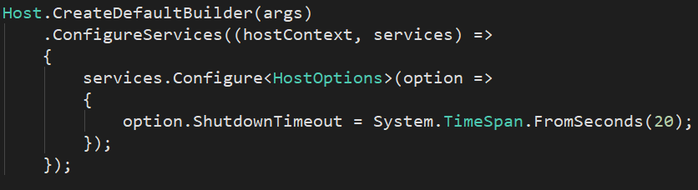
Settings for all app types
ShutdownTimeout (time to wait for hosted services to stop)
Default: 5 seconds.
Environment variable: <PREFIX_>SHUTDOWNTIMEOUTSECONDS.
Or configure HostOptions.

Slide 22
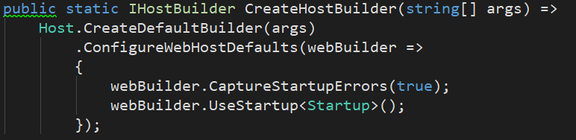
Web apps settings
Extension methods on IWebHostBuilder are available for these settings:
Notes:
By default, environment variables used to configure these settings can have a DOTNET_ or ASPNETCORE_ prefix

Slide 23
Web apps settings
CaptureStartupErrors
False – errors during startup result in host exiting.
True – host captures exceptions during startup and attempts to start the server.
Default: false / true when Kestrel behind IIS.
Environment variable: <PREFIX_>CAPTURESTARTUPERRORS.
Use configuration or call CaptureStartupErrors:
webBuilder.CaptureStartupErrors(true);

Slide 24
Web apps settings
DetailedErrors
True or environment=“Development” – app captures detailed errors.
Default: false.
Environment variable: <PREFIX_>_DETAILEDERRORS.
Use configuration or call UseSetting:
webBuilder.UseSetting(WebHostDefaults.DetailedErrorsKey, "true");

Slide 25
Web apps settings
HostingStartupAssemblies
A semicolon-delimited string of hosting startup assemblies to load on startup.
Default: Empty string.
Environment variable: <PREFIX_>_HOSTINGSTARTUPASSEMBLIES.
Use configuration or call UseSetting:
webBuilder.UseSetting(WebHostDefaults.HostingStartupAssembliesKey, "assembly1;assembly2");

Slide 26
Web apps settings
HostingStartupExcludeAssemblies
A semicolon-delimited string of hosting startup assemblies to exclude on startup.
Default: Empty string.
Environment variable: <PREFIX_>_HOSTINGSTARTUPEXCLUDEASSEMBLIES.
Use configuration or call UseSetting:
webBuilder.UseSetting(WebHostDefaults. HostingStartupExcludeAssembliesKey, "assembly1;assembly2");

Slide 27
Web apps settings
HTTPS_Port
The HTTPS redirect port.
Default: value isn’t set.
Environment variable: <PREFIX_>HTTPS_PORT.
Use configuration or call UseSetting:
webBuilder.UseSetting("https_port", "8080");

Slide 28
Web apps settings
PreferHostingUrls
Indicates whether the host should listen on the URLs configured with the IWebHostBuilder instead of those configured with the IServer implementation.
Default: true.
Environment variable: <PREFIX_>_PREFERHOSTINGURLS.
Use the environment variable or call PreferHostingUrls:
webBuilder.PreferHostingUrls(false);

Slide 29
Web apps settings
PreventHostingStartup
Prevents the automatic loading of hosting startup assemblies, including hosting startup assemblies configured by the app's assembly.
Default: false.
Environment variable: <PREFIX_>_PREVENTHOSTINGSTARTUP.
Use the environment variable or call UseSetting:
webBuilder.UseSetting(WebHostDefaults.PreventHostingStartupKey, "true");

Slide 30
Web apps settings
StartupAssembly
The assembly to search for the Startup class.
Default: the app’s assembly.
Environment variable: <PREFIX_>STARTUPASSEMBLY.
Use the environment variable or call UseStartup:
webBuilder.UseStartup("StartupAssemblyName");
webBuilder.UseStartup<Startup>();
Notes:
If multiple UseStartup methods are called, the last one takes precedence.

Slide 31
Web apps settings
URLs
A semicolon-delimited list of IP addresses or host addresses with ports and protocols that the server should listen on for requests.
Default: http://localhost:5000 and https://localhost:5001.
Environment variable: <PREFIX_>URLS.
Use the environment variable or call UseUrls:
webBuilder.UseUrls("http://*:5000;http://localhost:5001;https://hostname:5002");

Slide 32
Web apps settings
WebRoot
The relative path to the app's static assets.
Default: “wwwroot”.
Environment variable: <PREFIX_>WEBROOT.
Use the environment variable or call UseWebRoot:
webBuilder.UseWebRoot("public");

Slide 33
Manage the host lifetime
Run
Runs the app and blocks the calling thread until the host is shut down.
RunAsync
Runs the app and returns a Task that completes when the cancellation token or shutdown is triggered.
RunConsoleAsync
Enables console support, builds and starts the host, and waits for Ctrl+C/SIGINT or SIGTERM to shut down.
Notes:
Call methods on the built IHost implementation to start and stop the app. These methods affect all IHostedService implementations that are registered in the service container.

Slide 34
Manage the host lifetime
Start
Starts the host synchronously.
StartAsync
Starts the host and returns a Task that completes when the cancellation token or shutdown is triggered.
WaitForStartAsync
Is called at the start of StartAsync, which waits until it's complete before continuing. This can be used to delay startup until signaled by an external event.

Slide 35
Manage the host lifetime
StopAsync
Attempts to stop the host within the provided timeout.
WaitForShutdown
Blocks the calling thread until shutdown is triggered by the IHostLifetime, such as via Ctrl+C/SIGINT or SIGTERM.
WaitForShutdownAsync
Returns a Task that completes when shutdown is triggered via the given token and calls StopAsync.

Slide 36
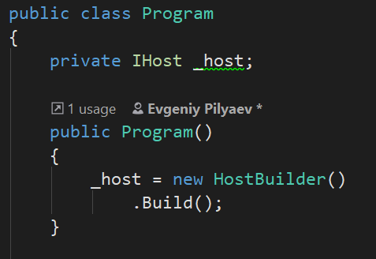
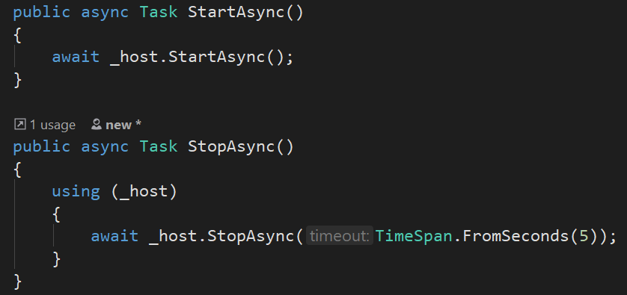
External control
Notes:
Direct control of the host lifetime can be achieved using methods that can be called externally:

Slide 37
Startup
Methods (are called by ASP.Net Core runtime when app starts):
Configure services – optional
Configures app’s services (reusable component that provides app functionality).
Services are consumed by DI or ApplicationServices.
Configure
Defines app’s request processing pipeline
Notes:
The Startup class configures services and the app's request pipeline.

Slide 38
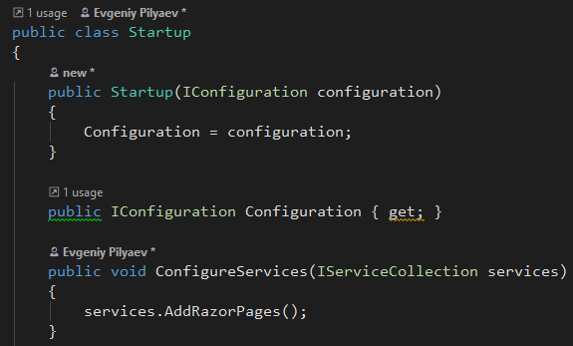
Startup example
Notes:
The Startup class configures services and the app's request pipeline.

Slide 39
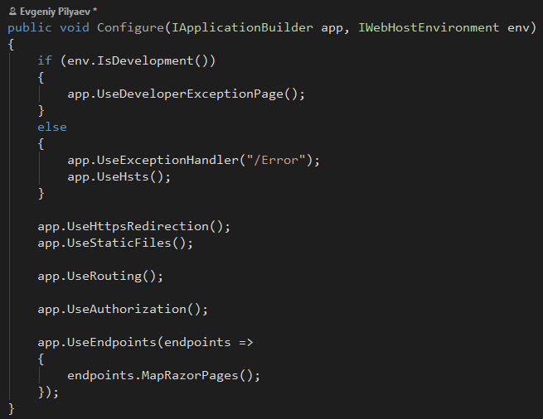
Startup example
Notes:
The Startup class configures services and the app's request pipeline.

Slide 40
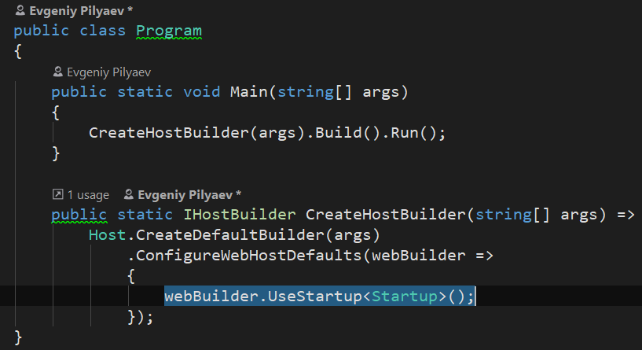
Specifying Startup
Notes:
The Startup class is specified when the app's host is built. The Startup class is typically specified by calling the WebHostBuilderExtensions.UseStartup<TStartup> method on the host builder:

Slide 41
Startup
Only the following service types can be injected into the Startup constructor when using the Generic Host (IHostBuilder):
IWebHostEnvironment
IHostEnvironment
Iconfiguration
Most services are not available until the Configure method is called.

Slide 42
Multiple Startup
A naming scheme “Startup{Environment}” can be used to automatically pick a Startup class for current environment:
Startup
StartupDevelopment
StartupStaging
StartupProduction
The class whose name suffix matches the current environment is prioritized.

Slide 43
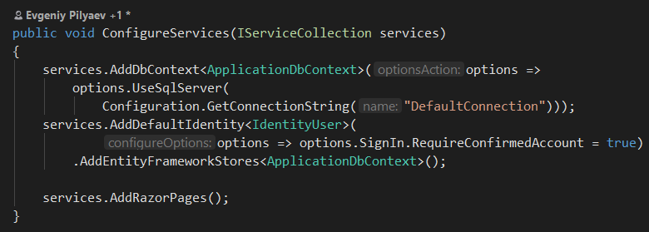
ConfigureServices
Optional.
Called by the host before the Configure method to configure the app's services.
Where configuration options are set by convention.
Notes:
Adding services to the service container makes them available within the app and in the Configure method. The services are resolved via dependency injection or from ApplicationServices.

Slide 44

Configure
Used to specify how the app responds to HTTP requests
Pipeline is configured by adding middleware components to IApplicationBuilder instance

Slide 45
Configure
IApplicationBuilder is available to the Configure method, but it isn't registered in the service container.
Hosting creates an IApplicationBuilder and passes it directly to Configure.
Each Use extension method adds one or more middleware components to the request pipeline

Slide 46
Configure
IApplicationBuilder is available to the Configure method, but it isn't registered in the service container.
Hosting creates an IApplicationBuilder and passes it directly to Configure.
Each Use extension method adds one or more middleware components to the request pipeline
Middleware can invoke next component or short-circuit the chain

Slide 47
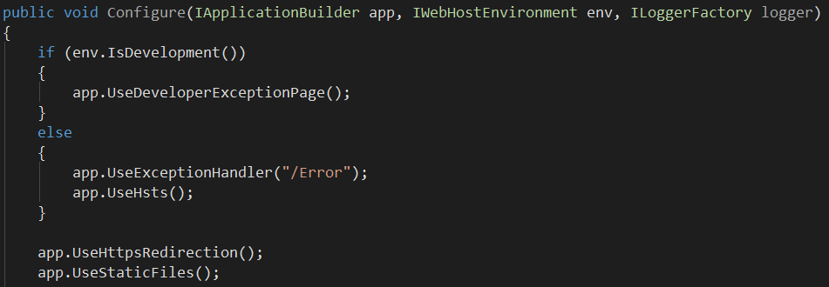
Configure
Additional services (IWebHostEnvironment, IloggerFactory, etc.) can be specified in Configure method signature. They are injected if available:

Slide 48
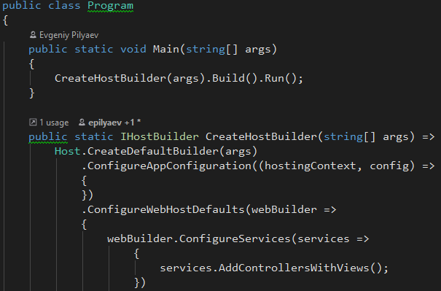
Configure services without startup
Multiple calls to ConfigureServices append to one another
Only last Configure call is used

Slide 49
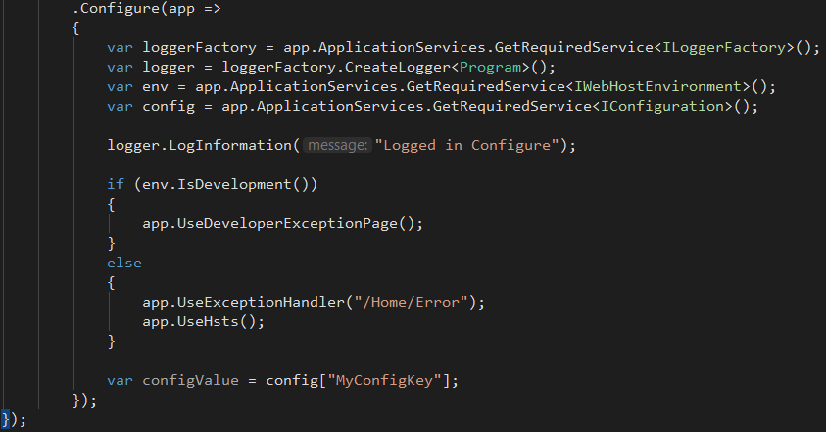
Configure services without startup

Slide 50
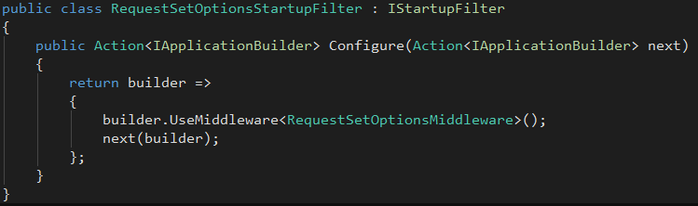
Startup filters
Configure middleware at the beginning or end of Configure pipeline without explicit call to Use{Middleware}
Create pipeline of Configure methods

Slide 51
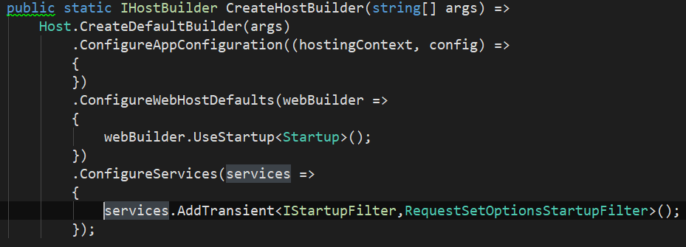
Startup filters
Registered in the service container in ConfigureServices:
Notes:
Order does matter.
Order IStartupFilter service registrations to match the order that their middlewares should run.
Libraries may add middleware with one or more IStartupFilter implementations that run before or after other app middleware registered with IStartupFilter. To invoke an IStartupFilter middleware before a middleware added by a library's IStartupFilter:
Position the service registration before the library is added to the service container.
To invoke afterward, position the service registration after the library is added.

Slide 52
Thanks for attention Evgeniy Pilyaev https://github.com/EPilyaev/ASPNetCoreMVC (Host&Startup presentation)

