Slide 1
ASP .Net Core MVC
Evgeniy Pilyaev

Slide 2
Routing

Slide 3
Middleware
Middleware is the term used for the components that are combined to form the request pipeline.
Content-Generating
Short-circuiting
Request-editing
Response-editing

Slide 4
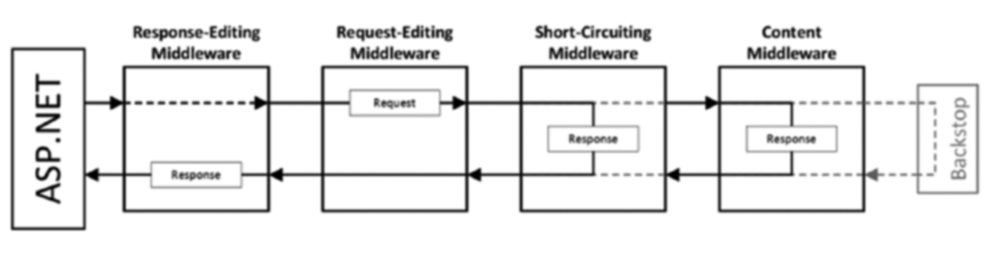
Middleware
@ Pro Asp .Net Core MVC 2

Slide 5
Middleware
To be a middleware component class must have:
Constructor that takes a RequestDelegate (nextDelegate)
Define Invoke method which takes HttpContext as and argument

Slide 6
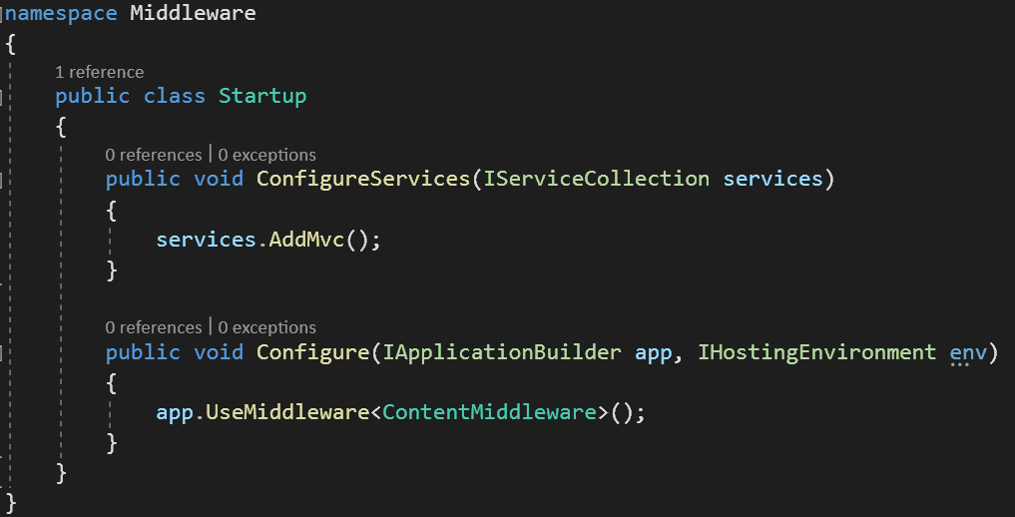
Content Middleware

Slide 7
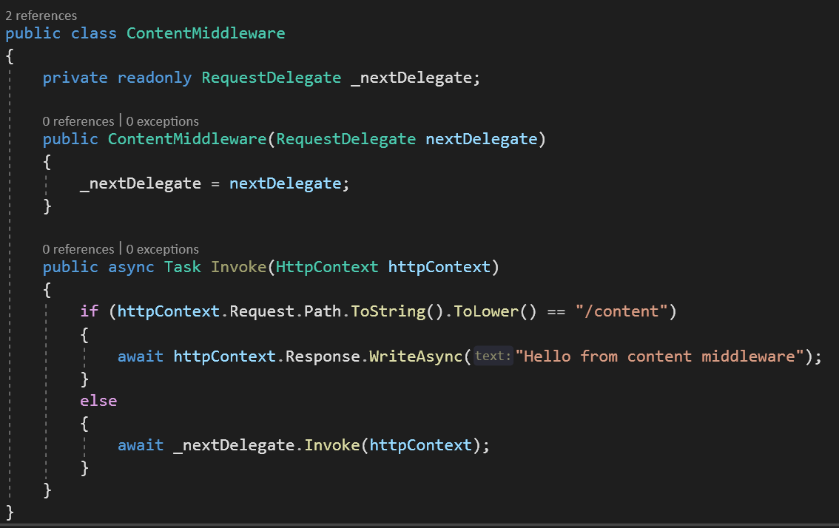
Content Middleware

Slide 8

Content Middleware

Slide 9
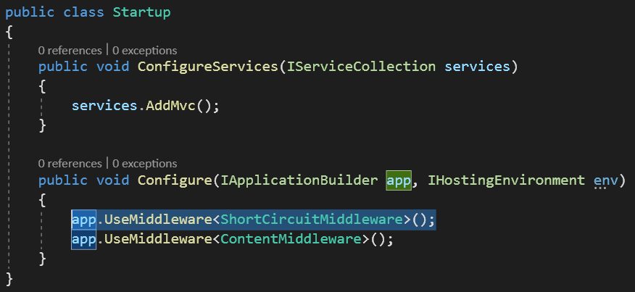
Short-Circuiting Middleware

Slide 10
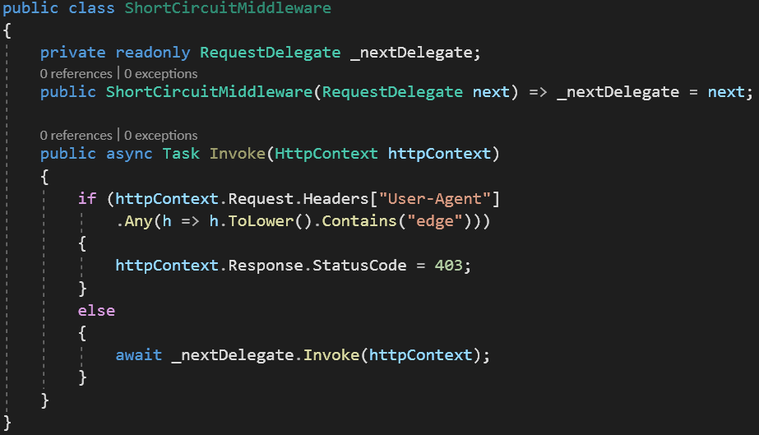
Short-Circuiting Middleware

Slide 11
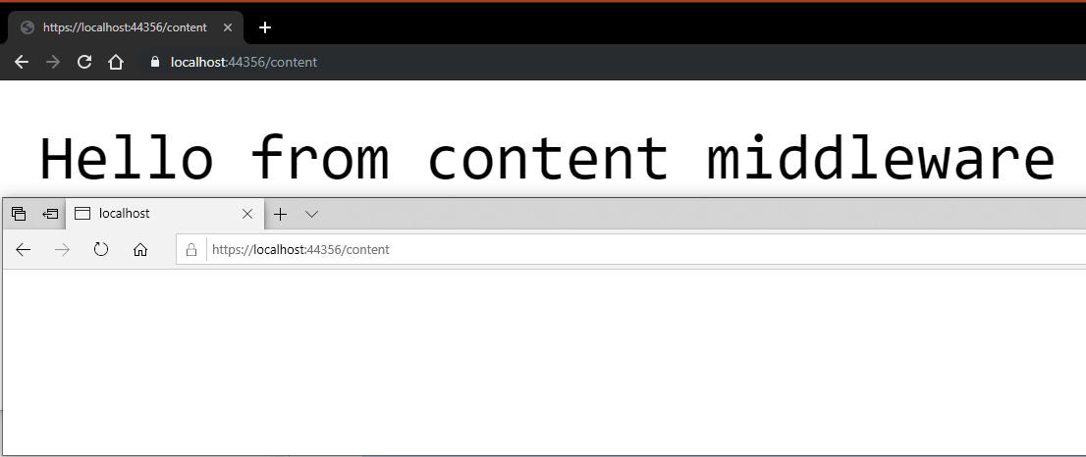
Short-Circuiting Middleware

Slide 12
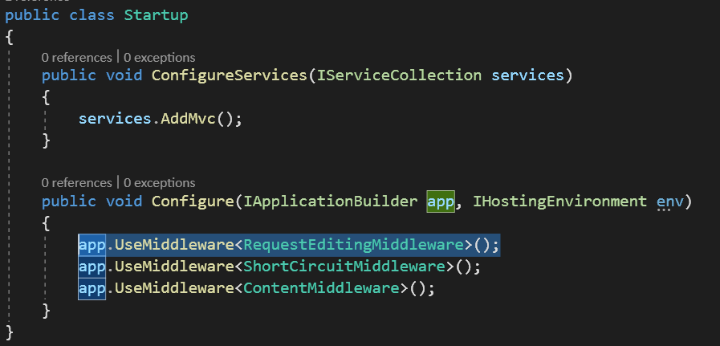
Request-editing Middleware

Slide 13
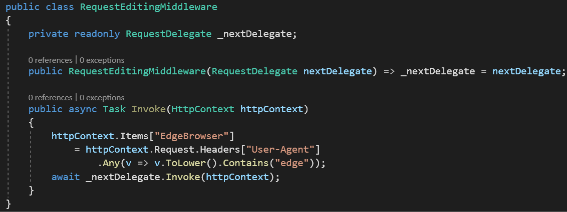
Request-editing Middleware

Slide 14
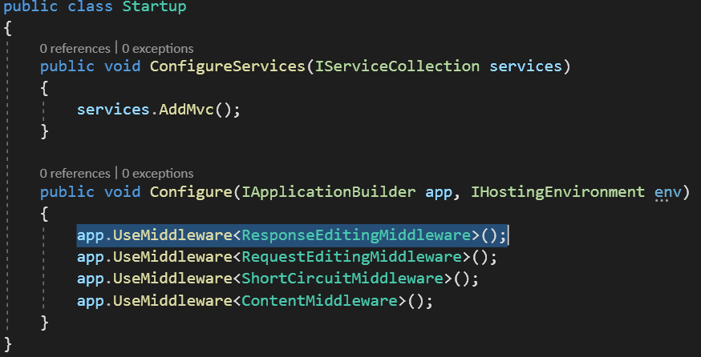
Response-editing Middleware

Slide 15
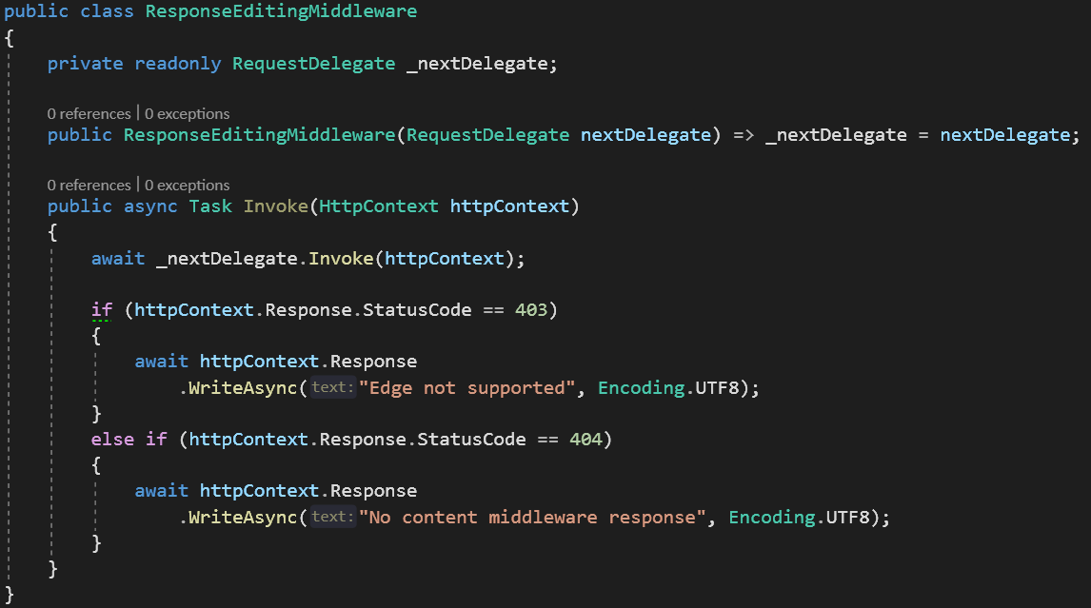
Response-editing Middleware

Slide 16

Response-editing Middleware

Slide 17
Filters
Implement IFilterMetadata:
namespace Microsoft.AspNetCore.Mvc.Filters {
public interface IFilterMetadata { }
}

Slide 18
Filters
Types and order of filters:
Authorization – I(Async)AuthorizationFilter
Action – I(Async)ActionFilter
Result – I(Async)ResultFilter
Exception – I(Async)ExceptionFilter

Slide 19
Authorization filters
namespace Microsoft.AspNetCore.Mvc.Filters {
public interface IAuthorizationFilter : IFilterMetadata {
void OnAuthorization(AuthorizationFilterContext context);
}
}

Slide 20
Async authorization filters
namespace Microsoft.AspNetCore.Mvc.Filters {
public interface IAsyncAuthorizationFilter : IFilterMetadata {
Task OnAuthorizationAsync(AuthorizationFilterContext context);
}
}

Slide 21
Authorization Filters
IActionResult AuthorizationFilterContext.Result property:
If this property is set, MVC renders the IActionResult instead of invoking the action method

Slide 22
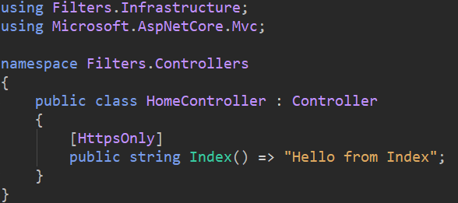
Authorization filters example

Slide 23
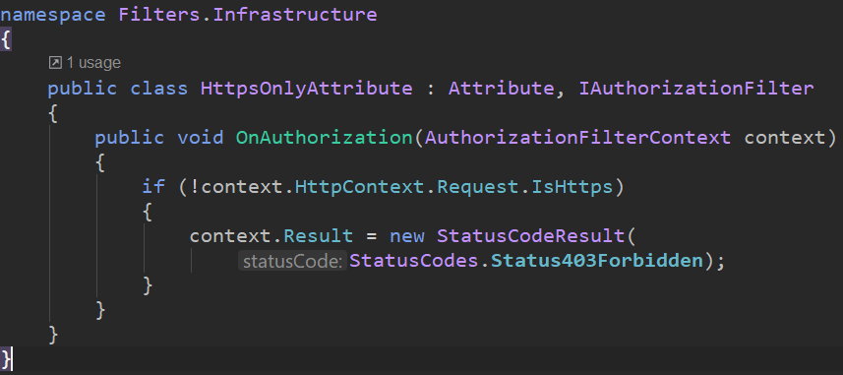
Authorization filters example

Slide 24
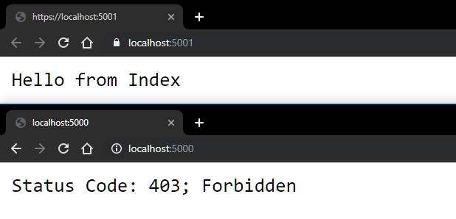
Authorization filters example

