Slide 1
Host, Startup, DI in ASP .Net Core 3.0
Evgeniy Pilyaev

Slide 2
Host
A host is an object that encapsulates an app's resources, such as:
Dependency injection (DI)
Logging
Configuration
IHostedService implementations

Slide 3
Host
Provides lifetime management.
Startup:
Calls IHostedService.StartAsync on each implementation of IHostedService. In a web app – starts an HTTP server implementation.
Graceful shutdown.

Slide 4
Host
Generic Host – recommended.
Web Host – not recommended, backward compatibility. Used for HTTP workloads before .Net Core 3.0.

Slide 5
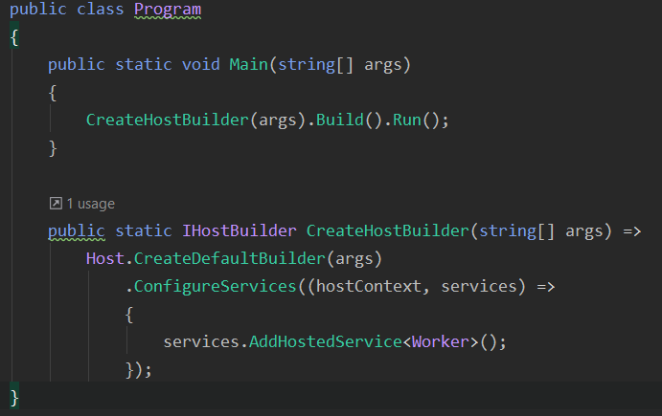
Generic Host (non-http workload)
Notes:
Program class, main method
Program.cs code for a non-HTTP workload, with a single IHostedService implementation added to the DI container.

Slide 6
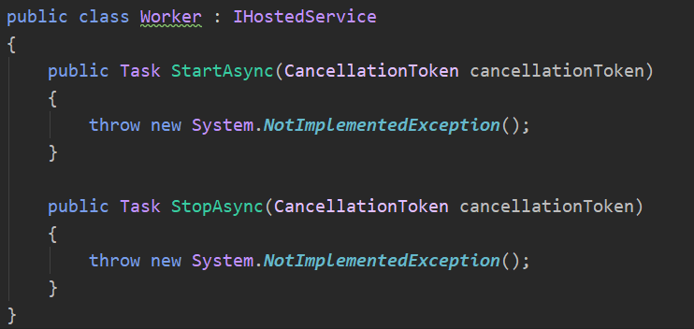
IHostedService implementation

Slide 7
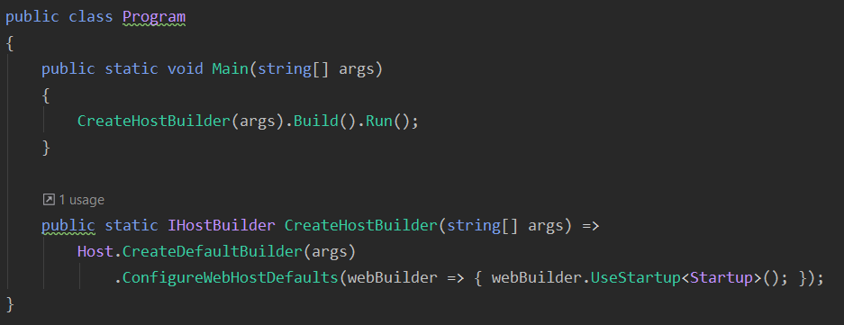
Generic Host (web)
Notes:
If the app uses Entity Framework Core, don't change the name or signature of the CreateHostBuilder method. The Entity Framework Core tools expect to find a CreateHostBuilder method that configures the host without running the app.

Slide 8
(Create)DefaultBuilder settings:
Content root = GetCurrentDirectory()
Loads host configuration from:
Environment variables prefixed with "DOTNET_".
Command-line arguments.
Loads app configuration from:
appsettings.json.
appsettings.{Environment}.json.
Secret Manager when the app runs in the Development environment.
Environment variables.
Command-line arguments.

Slide 9
(Create)DefaultBuilder settings:
Adds following logging providers:
Console
Debug
EventSource
EventLog (Windows)
Enables scope validation and dependency validation when the environment is Development.
Notes:
Scope validation:
When the app is running in the Development environment, the default service provider performs checks to verify that:
Scoped services aren't directly or indirectly resolved from the root service provider.
Scoped services aren't directly or indirectly injected into singletons.

Slide 10
ConfigureWebHostsDefault:
Loads host configuration from environment variables prefixed with "ASPNETCORE_".
Sets Kestrel server as the web server and configures it using the app's hosting configuration providers.
Adds Host Filtering middleware.
Adds Forwarded Headers middleware if ASPNETCORE_FORWARDEDHEADERS_ENABLED=true.
Enables IIS integration.
Notes:
Forwarded headers
By convention, proxies forward information in HTTP headers.

Slide 11
Thanks for attention Evgeniy Pilyaev https://github.com/EPilyaev/ASPNetCoreMVC (Host&Startup&Di presentation)

