Slide 1
RabbitMQ in .Net Core
Evgeniy Pilyaev
.Net developer

Slide 2
What is RabbitMq?
Open-source message broker software
(sometimes called as message-oriented middleware)
Originally implemented AMQP
Supports also STOMP, MQTT and other protocols
Written in the Erlang programming language
Built on the Open Telecom Platform framework for clustering and failover.
Notes:
AMQP (Advanced message queuing protocol)
Streaming Text Oriented Messaging Protocol (STOMP)
Message Queuing Telemetry Transport (MQTT)
Client libraries to interface with the broker are available for all major programming languages.

Slide 3
Terms
Producing – sending
Queue – large message buffer
  (bound by host’s memory and disk limits)
  Many producers can send messages that many consumers can receive
Consuming - receiving

Slide 4
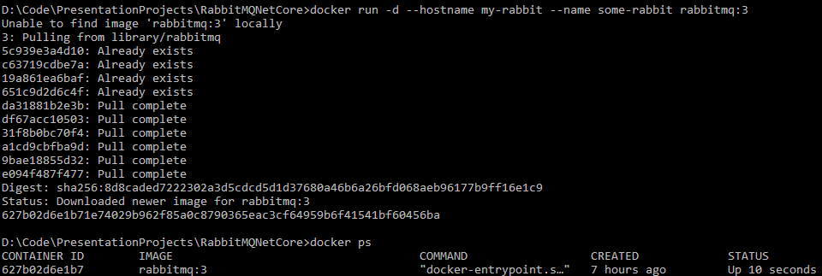

How to install?
$ docker run -d --hostname my-rabbit --name some-rabbit rabbitmq:3

Slide 5
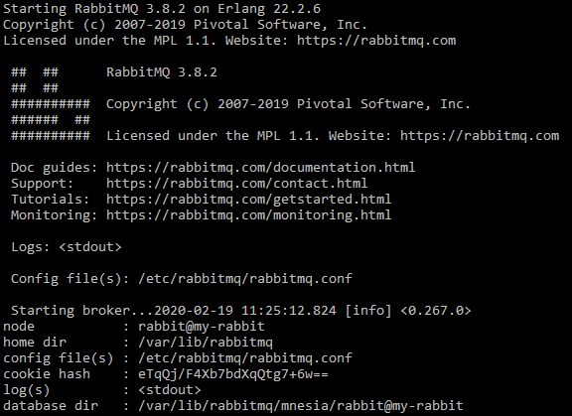
How to install?
Part of docker container logs:
$ docker logs some-rabbit
Notes:
Database dir: node name is appended

Slide 6
Hello world
Producer sends messages
Queue accumulates them
Consumer receives messages
Prerequisites:
RabbitMQ running in Docker container
Two console projects for sender and receiver respectively
Installed RabbitMQ.Client NuGet package

Slide 7
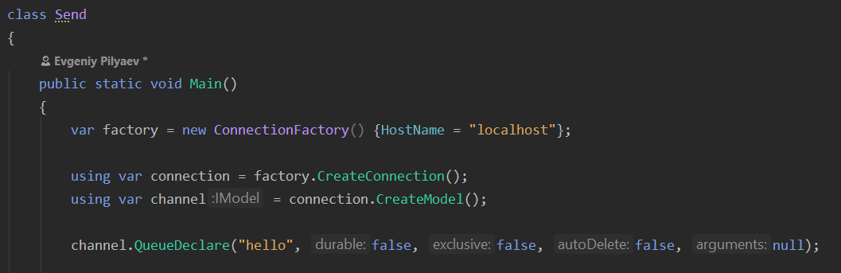
Sending
Create channel and declare queue to send to:
Notes:
The connection abstracts the socket connection, and takes care of protocol version negotiation and authentication and so on for us.
Next we create a channel, which is where most of the API for getting things done resides.
Declaring a queue is idempotent - it will only be created if it doesn't exist already.

Slide 8
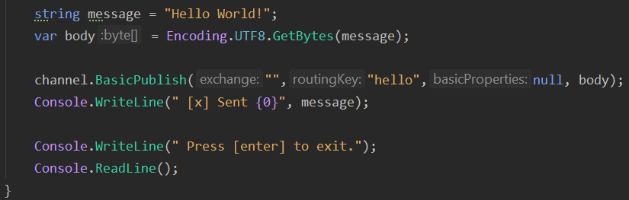
Sending
Publish a message to the queue:
Notes:
The message content is a byte array, so you can encode whatever you like there.
When the code above finishes running, the channel and the connection will be disposed. That's it for our publisher.

Slide 9
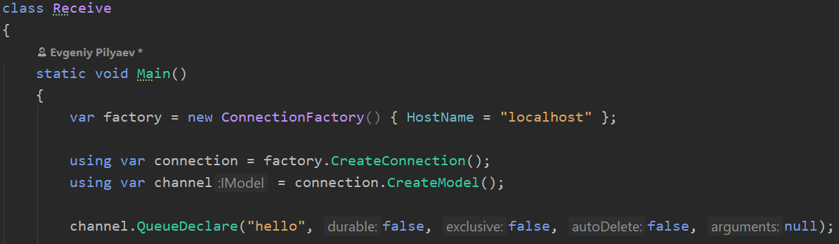
Receiving
Setup connection, channel and queue:
Notes:
As for the consumer, it is listening for messages from RabbitMQ. So unlike the publisher which publishes a single message, we'll keep the consumer running continuously to listen for messages and print them out.
Setting up is the same as the publisher; we open a connection and a channel, and declare the queue from which we're going to consume. Note this matches up with the queue that Send publishes to.

Slide 10
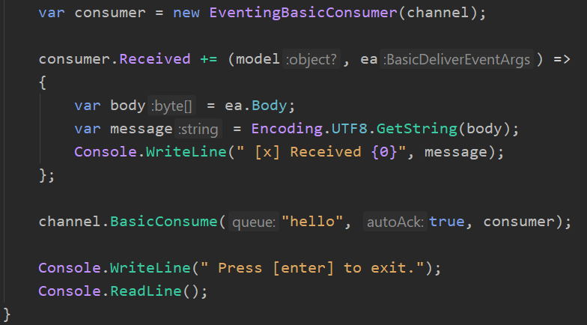
Receiving
Create consumer, consume:
Notes:
Since it will push us messages asynchronously, we provide a callback. That is what EventingBasicConsumer.Received event handler does.

Slide 11
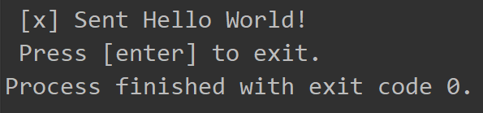
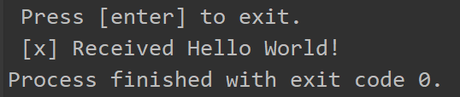
Resulting output
Send program output:
Receive program output:

Slide 12
Work queues idea
Avoid doing resource-intensive task immediately.
Encapsulate task as a message.
Send it to queue.
Worker process pops task and executes job.
Tasks can be shared between many workers.
Notes:
This concept is especially useful in web applications where it's impossible to handle a complex task during a short HTTP request window.

Slide 13
Work queues
Sample application:
Send string “tasks”
Emulate work using Thread.Sleep()
Number of dots = complexity (every dot is a second of “work”)
e.g. “Hello…” => Emulate task that runs 3 seconds

Slide 14
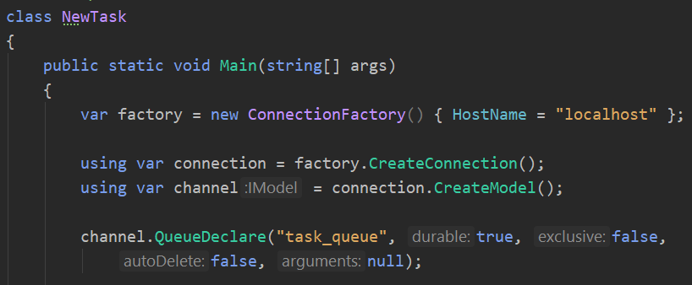
Work queues - NewTask
Create connection and channel, declare queue:

Slide 15
Message durability
Save message if something goes wrong.
Mark Queue and Message as durable:
Set “durable” argument in QueueDeclare as true
(queue will be saved)
Mark the message as persistent by setting IBasicProperties.SetPersistent to true.
(saves message to the disk)
Notes:
RabbitMQ doesn't allow you to redefine an existing queue with different parameters and will return an error to any program that tries to do that. Workaround – declare a queue with a different name.
SetPersistent does not fully guarantee that message won’t be lost – short time window between command accepted and message saved. Also particular message may be saved to cache.

Slide 16
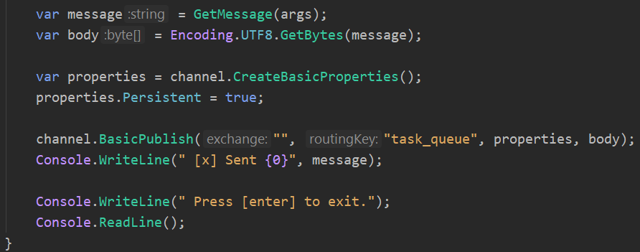
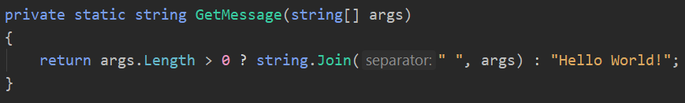
Work queues - NewTask

Slide 17
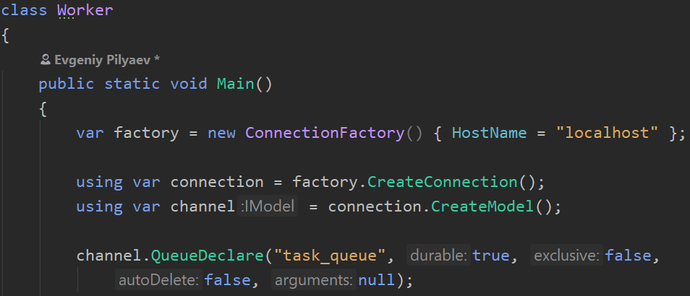
Work queues - Worker
Create connection, channel and declare queue:

Slide 18
Work queues - Dispatching
Round-robin dispatching:
Send each message to the next worker, in sequence.
Disadvantage: uneven load distribution between workers.
Fair dispatch:
channel.BasicQos(prefetchSize: 0, prefetchCount: 1, global: false);
Notify RMQ not to give more than one message to the worker at a time.
“Don’t dispatch until previous task is processed and acknowledged -> dispatch task to the next not busy worker”
Notes:
Task queue allows easily parallelize work
Qos – quality of service
PrefetchSize – size of the message that can be sent in advance
Global – applied separately to each new consumer \ shared across all consumers

Slide 19
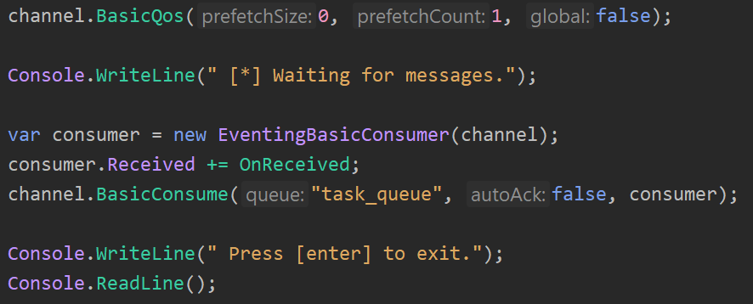
Work queues - Worker

Slide 20
Message acknowledgement
AutoAck
When message is delivered by RabbitMQ it is automatically marked for deletion.
Worker dies -> message is lost.
Manual ack
When work is done – call BasikAck to allow RMQ to delete message.
If worker dies – the message will be redelivered.
Notes:
Acknowledgement must be sent on the same channel that received the delivery. Attempts to acknowledge using a different channel will result in a channel-level protocol exception.
If ManualAck isn’t called – message will be redelivered after worker quits.

Slide 21
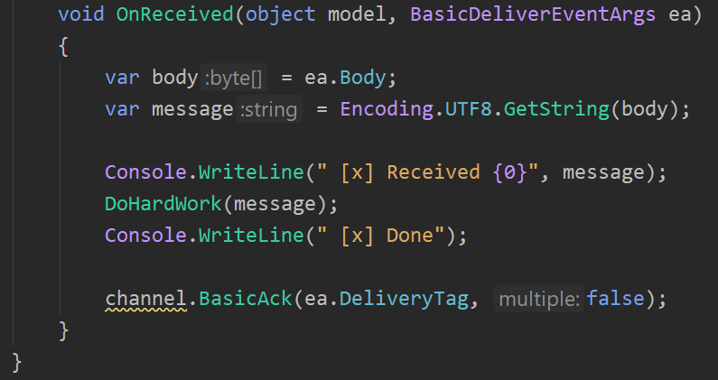
Work queues - Worker

Slide 22
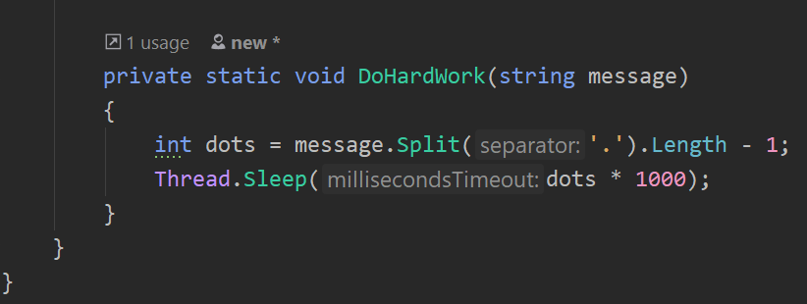
Work queues - Worker

Slide 23
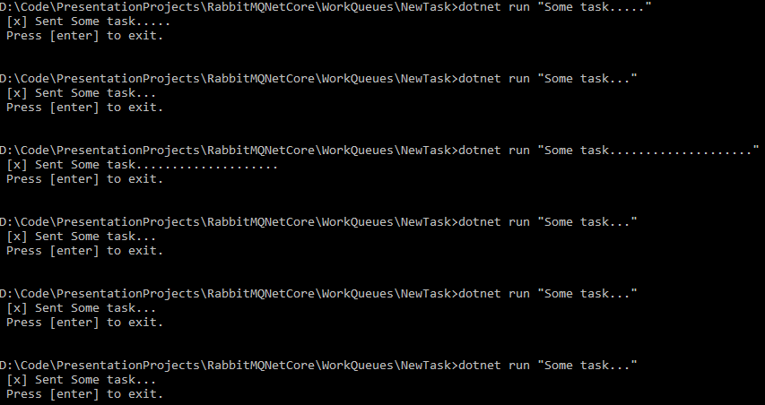
Work queues - Tasks

Slide 24
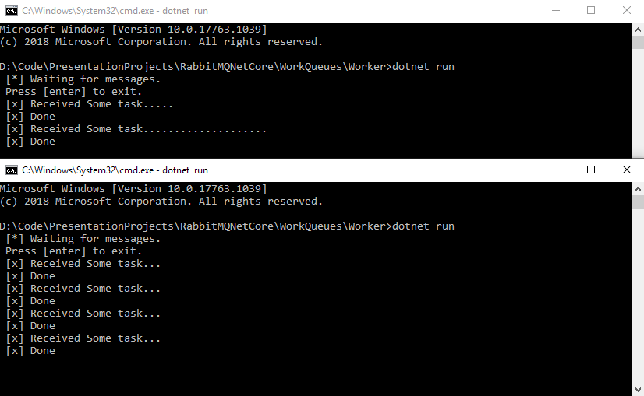
Work queues - Workers
Notes:
If all the workers are busy, queue can fill up. You will want to keep an eye on that, and maybe add more workers, or have some other strategy.
Mention fair dispatch

Slide 25
Publish/Subscribe
Logging system.
2 applications:
First – emits logging messages.
Second – receives and prints them.
Every receiver instance gets a message.
(e.g. one receiver writes to disk, another – displays log on the screen)

Slide 26
Exchanges
Producer pushes message to exchange
Exchange is responsible in pushing messages to queues
How message is routed by exchange depends on exchange type
Exchange types: direct, topic, headers, fanout.
Fanout broadcasts all received messages to all queues it knows.
Notes:
Default exchange is identified by empty string and is used when no exchange is specified
Default exchange type is direct

Slide 27
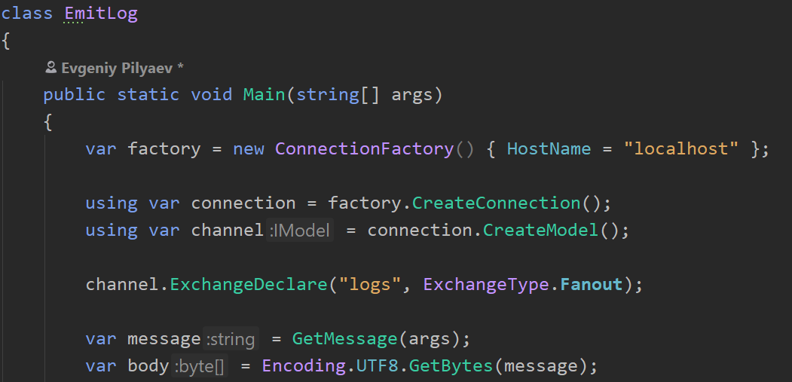
Emit log

Slide 28
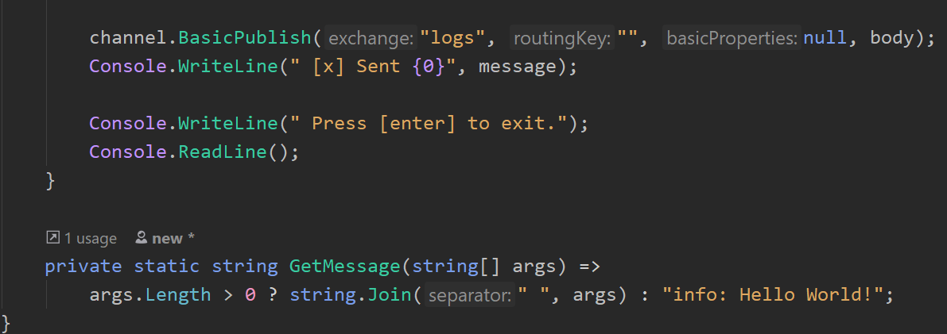
Emit log

Slide 29
Temporary queues
Aim:
Hear about all log messages, not just subset of them.
Get only currently flowing messages, not the old ones.
Implementation:
Get a fresh, empty queue whenever connect to Rabbit.
(let server choose a random queue name)
Auto-delete queue when consumer is disconnected.
var queueName = channel.QueueDeclare().QueueName;
Notes:
In the .NET client, when we supply no parameters to QueueDeclare() we create a non-durable, exclusive, autodelete queue with a generated name
An exclusive queue can only be used by its declaring connection. An attempt to use an exclusive queue from a different connection will result in a channel-level exception

Slide 30
Bindings
Tell exchange to send messages to the queue = binding
channel.QueueBind(queue:queueName, exchange:"logs", routingKey:"");

Slide 31
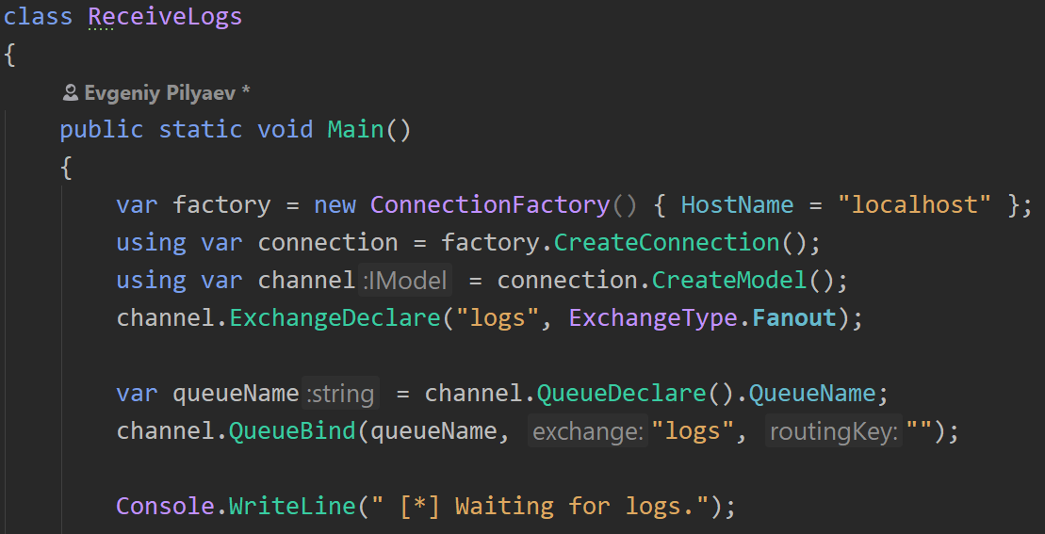
Receive logs
Notes:
Random queue name

Slide 32
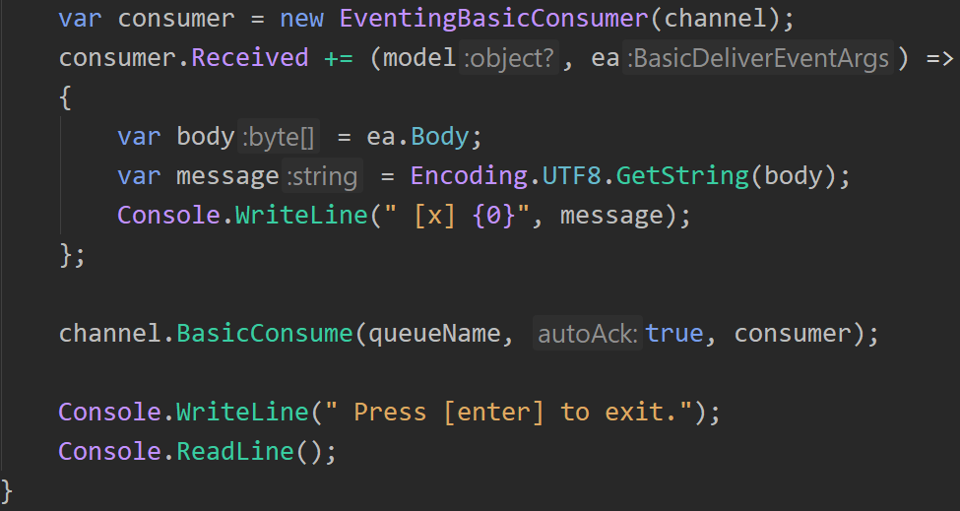
Receive logs

Slide 33
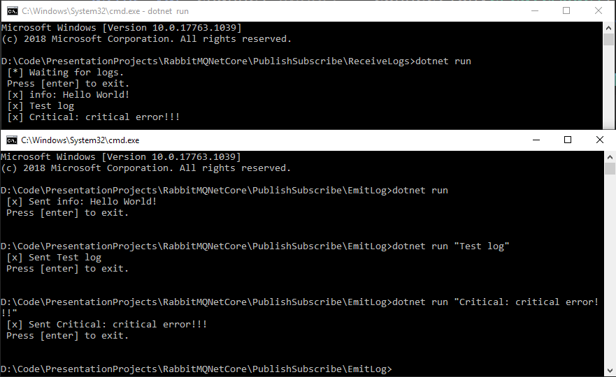
Publish/Subscribe demo

Slide 34
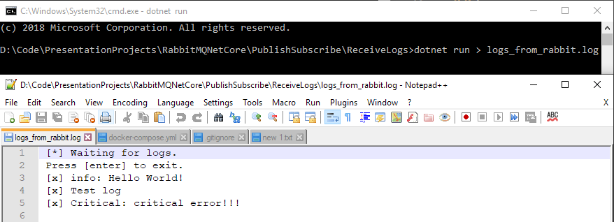
Publish/Subscribe demo

Slide 35
New aim
Subscribe only to a subset of messages
e.g.
Direct only critical errors to log file to save disk space
Print all log messages on the console

Slide 36
Routing
Bindings can take extra routingKey parameter:
channel.QueueBind(queue: queueName, exchange: "direct_logs", routingKey: "black");
Meaning of this key depends on exchange type.
Fanout exchanges simply ignore its value.

Slide 37
Direct exchange
A message goes to the queues whose binding key matches routing key of the message
Notes:
Message with routing key “orange” goes to Q1
Message with routing key “black” or “green” goes to Q2
Other messages are discarded

Slide 38
Multiple bindings
Perfectly legal:
In this case direct exchange behaves like fanout
Message will be transmitted to both Q1 and Q2

Slide 39
Logging system

Slide 40
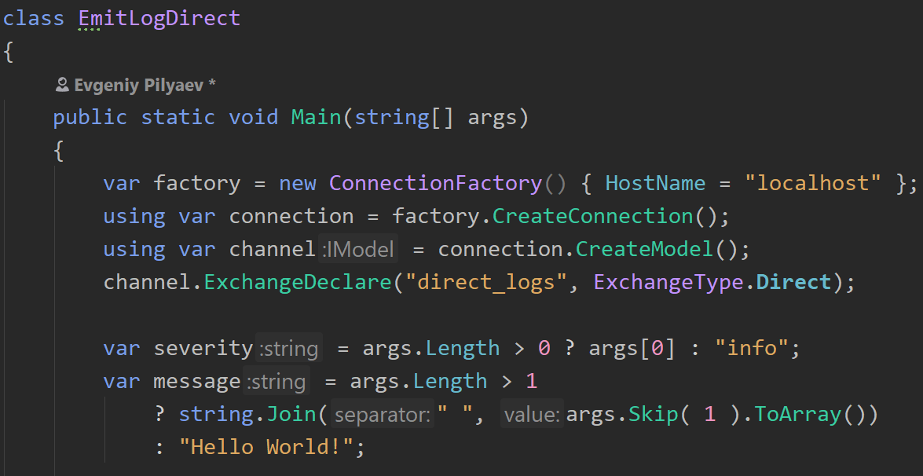
Emit Log Direct

Slide 41
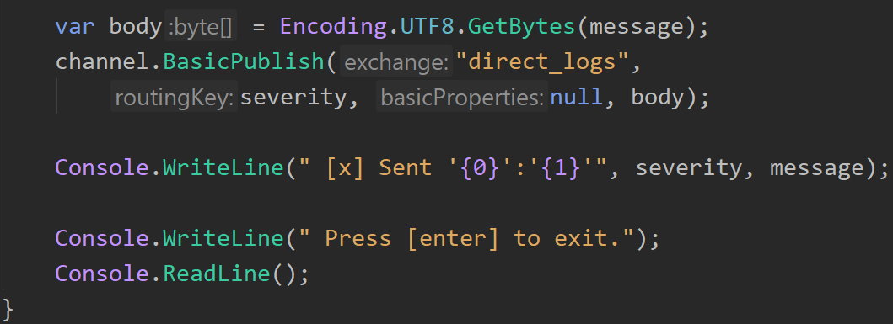
Emit Log Direct

Slide 42
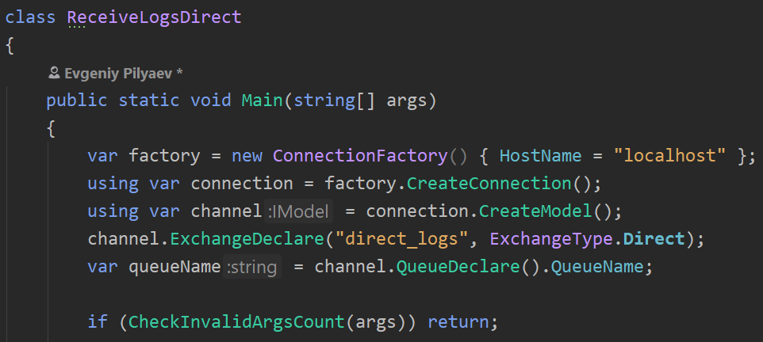
Receive logs direct

Slide 43
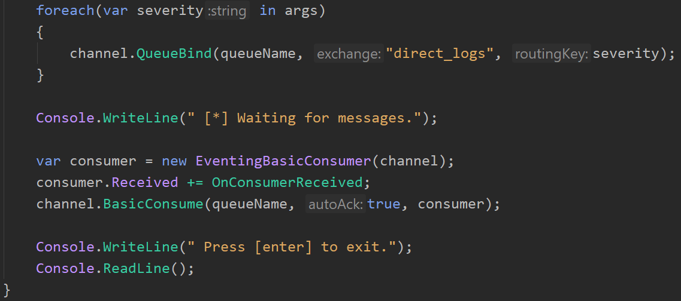
Receive logs direct

Slide 44
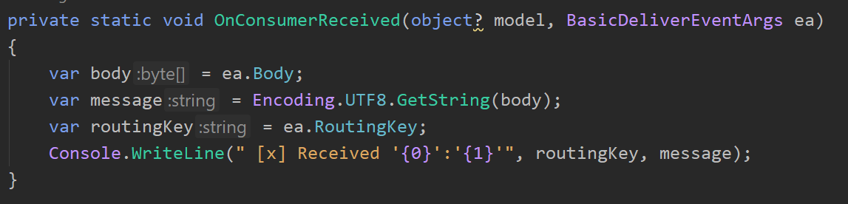
Receive logs direct

Slide 45
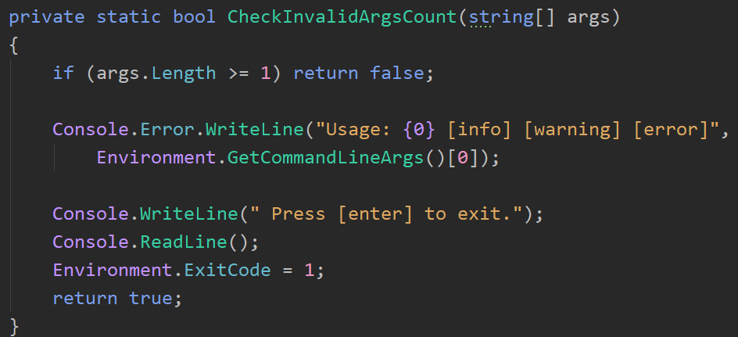
Receive logs direct

Slide 46
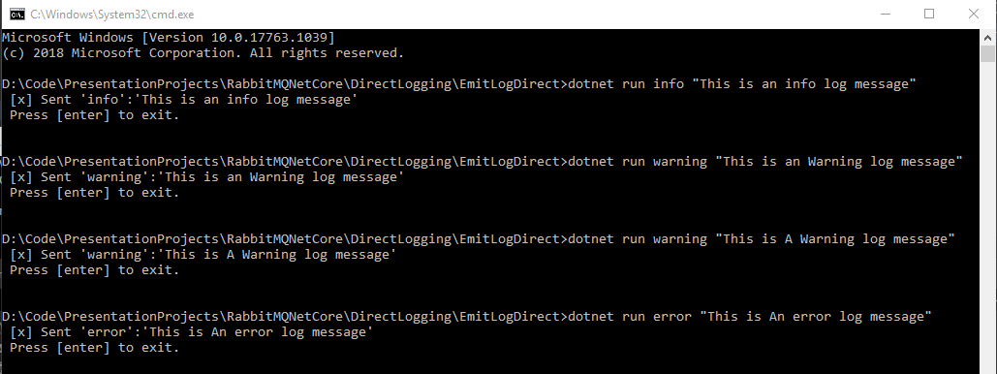
Send logs direct demo

Slide 47
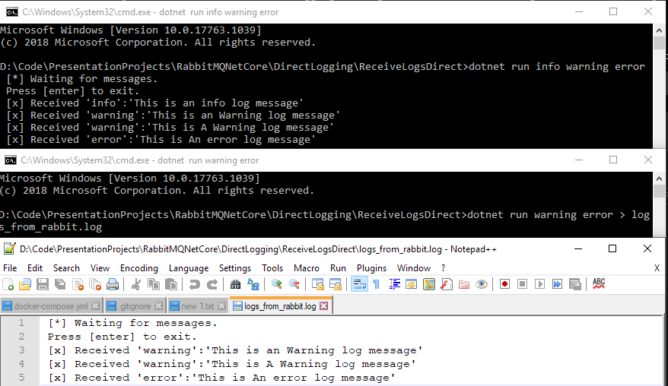
Receive logs direct demo

Slide 48
Topics
Listen to logs not only based on severity but also based on source.
Topic exchange:
Messages sent to Topic exchange can’t have arbitrary routing_key.
It must be a list of words delimited by dots:
“slow.red.bicycle”, “horror.movie”, “big.white.rabbit”
Limit – 255 bytes.

Slide 49
Topics
Special cases:
* (star) – can substitute for exactly one word
# (hash) – can substitute for zero or more words
<speed>.<color>.<vehicle>
Notes:
Q1 – for all red vehicles
Q2 – everything about bicycles and everything about slow vehicles

Slide 50
Topic exchange
When a queue is bound with “#” (hash) key:
- It receives all messages, works like fanout exchange
When special characters (“*” and “#”) aren’t used in bindings:
- Topic exchange will behave like direct exchange

Slide 51
Thanks for attention https://github.com/EPilyaev/RabbitMQNetCore.git
Evgeniy Pilyaev

