Slide 1
RabbitMQ in .Net Core
Evgeniy Pilyaev

Slide 2
What is RabbitMq?
Open-source message broker software
(sometimes called as message-oriented middleware)
Originally implemented AMQP
Supports also STOMP, MQTT and other protocols
Written in the Erlang programming language
Built on the Open Telecom Platform framework for clustering and failover.
Notes:
AMQP (Advanced message queuing protocol)
Streaming Text Oriented Messaging Protocol (STOMP)
Message Queuing Telemetry Transport (MQTT)
Client libraries to interface with the broker are available for all major programming languages.

Slide 3
Terms
Producing – sending
Queue – large message buffer
(bound by host’s memory and disk limits)
Many producers can send messages that many consumers can receive
Consuming - receiving

Slide 4
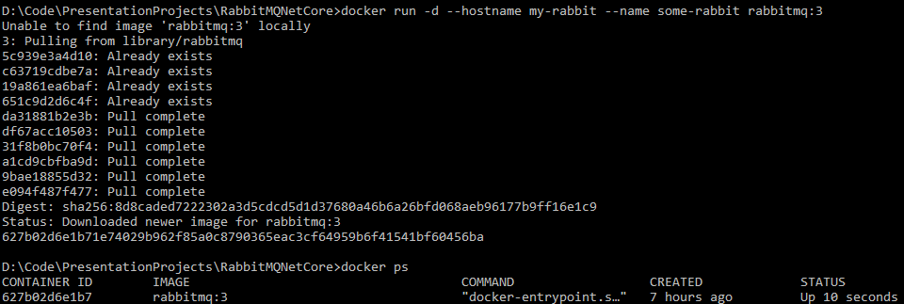

How to install?
$ docker run -d --hostname my-rabbit --name some-rabbit rabbitmq:3

Slide 5
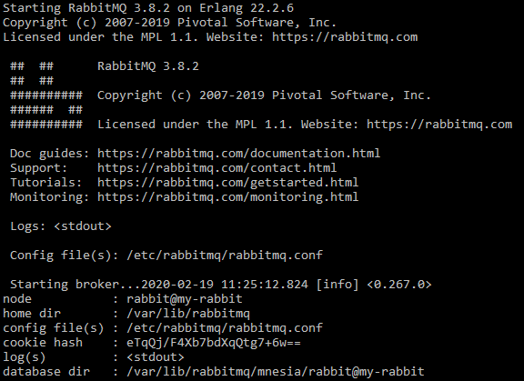
How to install?
Part of docker container logs:
$ docker logs some-rabbit
Notes:
Database dir: node name is appended

Slide 8
Thanks for attention Evgeniy Pilyaev https://github.com/EPilyaev/RabbitMQNetCore.git

