Slide 1
Facebook Stock History
Raphael Enriquez
Kuncha Chennika Wangmai
Prerna Amarnani
Priyadharshni E

Slide 2

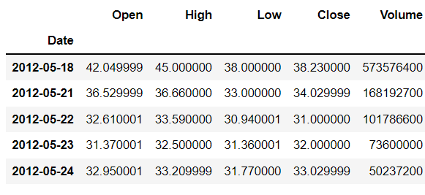
About the data

Slide 3

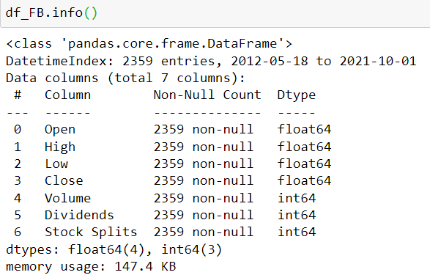
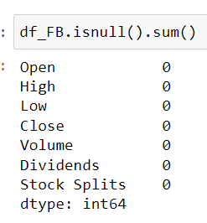


Data Cleaning and sorting
Fig 3
Fig 1
Fig 4
The data had no duplicates and no null values.
The datatypes of the values in the columns were apt.
Fig 2
Fig 5

Slide 4
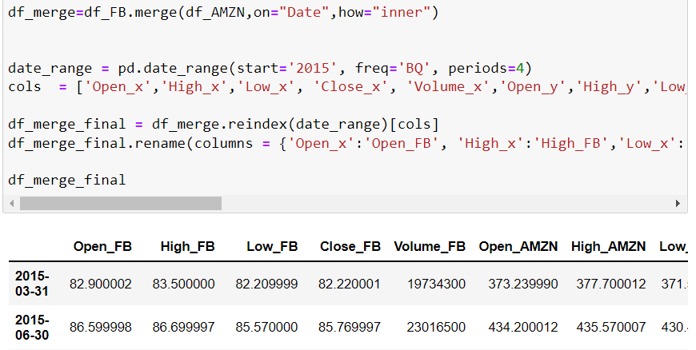
Merging
Amazon and Facebook stock data have been merged based on date.
For any particular day in the df_merge_final dataframe, Open, High, Close and Volume for Facebook and amazon data can be found.

Slide 5
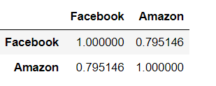
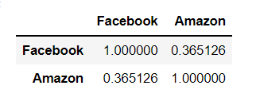
Correlation
Fig 1 Close prices
The close prices of facebook and amazon are slightly correlated. When the facebook close price raises, we can expect that the amazon close price has also raised.
Fig 2 Open prices

Slide 6
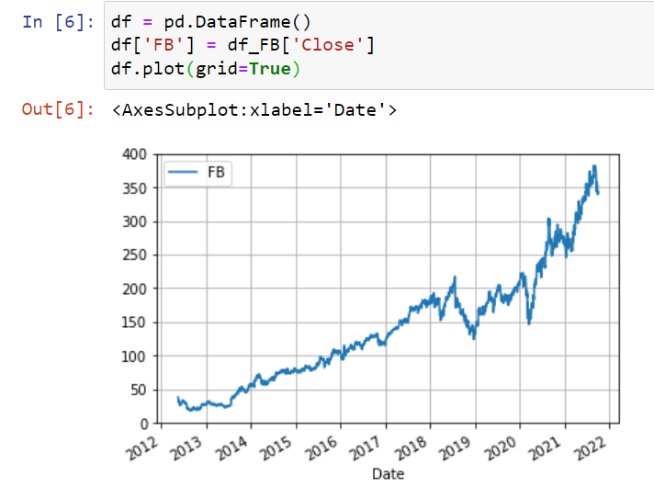
Data Visualization
History of FB Stock Closing Price (2012-2021)
“On May 18, 2012, Facebook held its initial public offering and, at that time, it was the largest technology IPO in U.S. history” (Share price: $38)
“Facebook's stock closed at an all-time high on Sept. 10, 2021, reaching a price of $378.69”
Reference:
https://www.investopedia.com/ask/answers/111015/when-did-facebook-go-public.asp

Slide 7
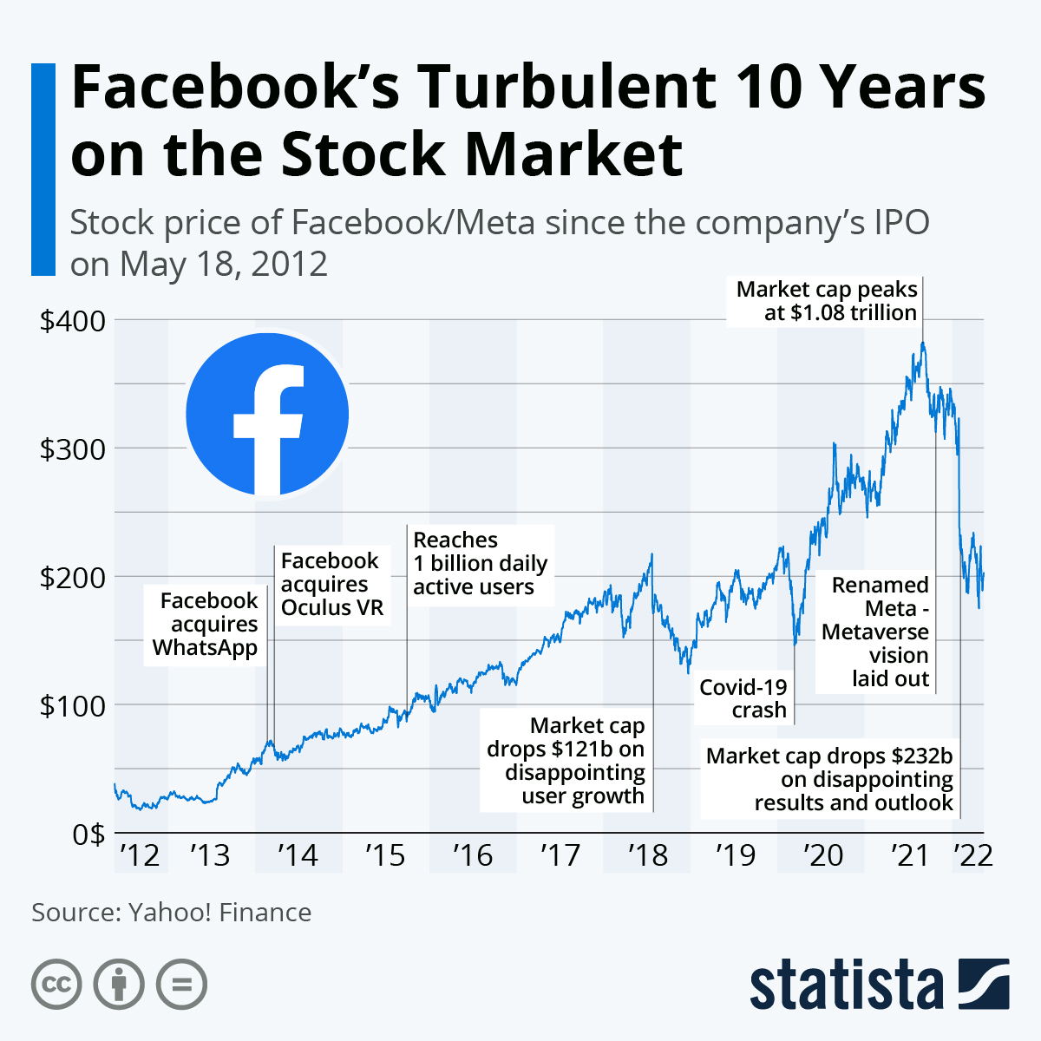
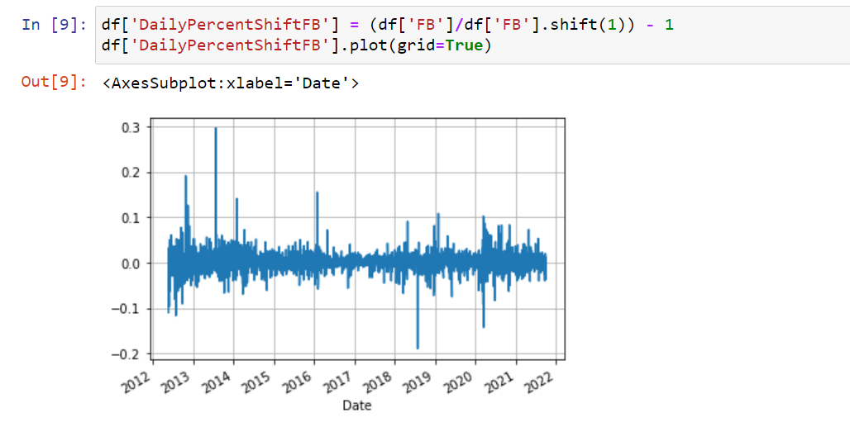
Data Visualization
History of FB Stock Closing Price (2012-2022)
Daily Percent Shift of FB Stock Closing Price (2012-2021)
Reference:
https://www.statista.com/chart/27473/facebook-stock-price-since-its-ipo/
Notes:
Priya

Slide 8
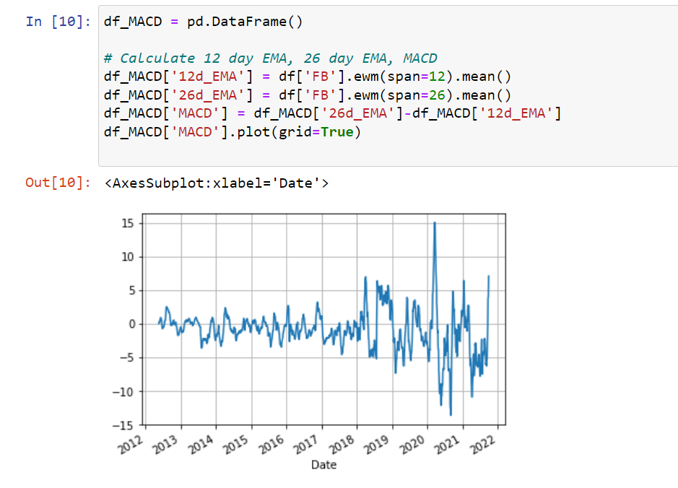
Data Visualization
Moving average convergence divergence (MACD) of FB Stock (2012-2021)
The MACD is a trend following momentum indicator that shows the relationship between two moving averages of prices.
Reference:
https://www.investopedia.com/terms/m/macd.asp
Notes:
Raphael
Moving average convergence divergence (MACD)
Exponential moving average (EMA)
The MACD ("Moving Average Convergence/Divergence") is a trend following momentum indicator that shows the relationship between two moving averages of prices

Slide 9
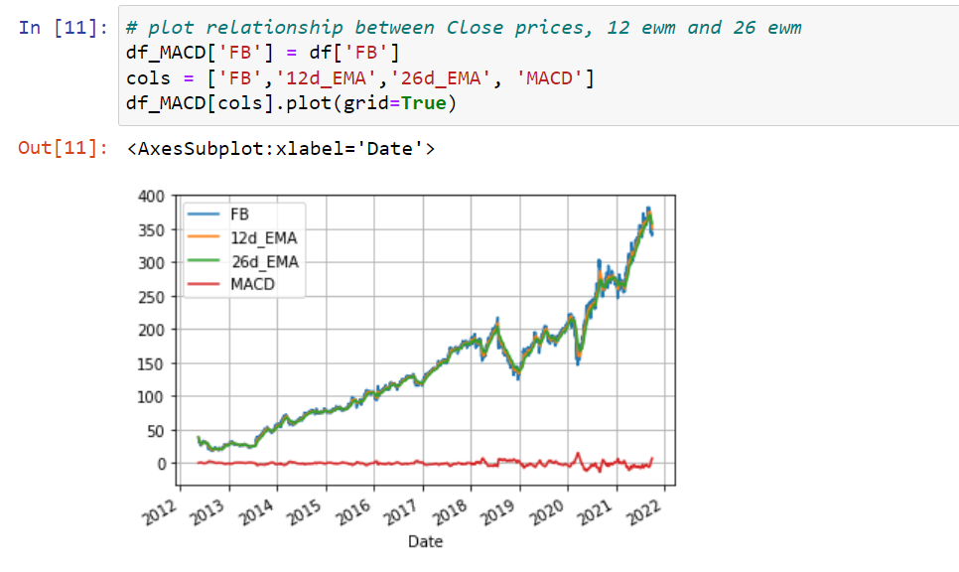
Data Visualization
Relationship between MACD, Close prices, 12 ewm and 26 ewm of FB Stock (2012-2021)
Notes:
Raphael

Slide 10
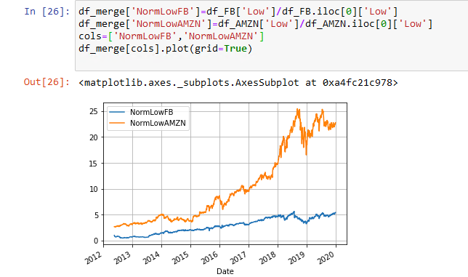
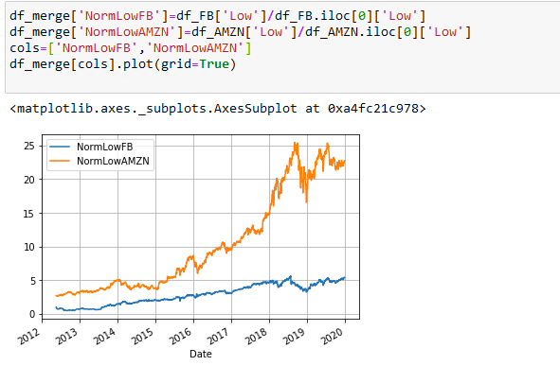
Normalized High ,Low Prices

Slide 11
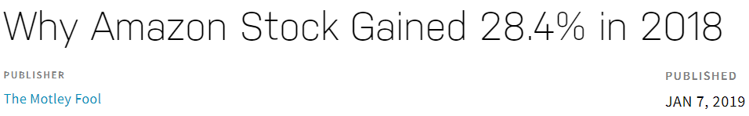
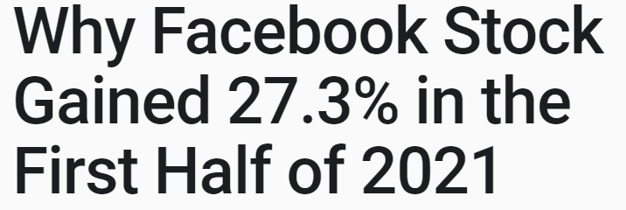
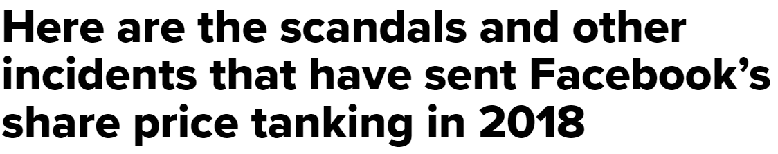
Trends Observed

Slide 12


