Slide 1

PowerSquad: Online
Training , Real Results
Welcome to the future of fitness. Our app offers personalized training, expert guidance, and measurable results. All from the comfort of your home.

Slide 2
Our Training Programs: From Beginner to Advanced
Beginner
Intermediate
Advanced
Start with the basics. Learn fundamental exercises. Build a solid foundation for fitness.
Increase intensity and complexity. Challenge your body. See noticeable improvements.
Push your limits with elite training. Achieve peak performance. Dominate your goals.

Slide 3
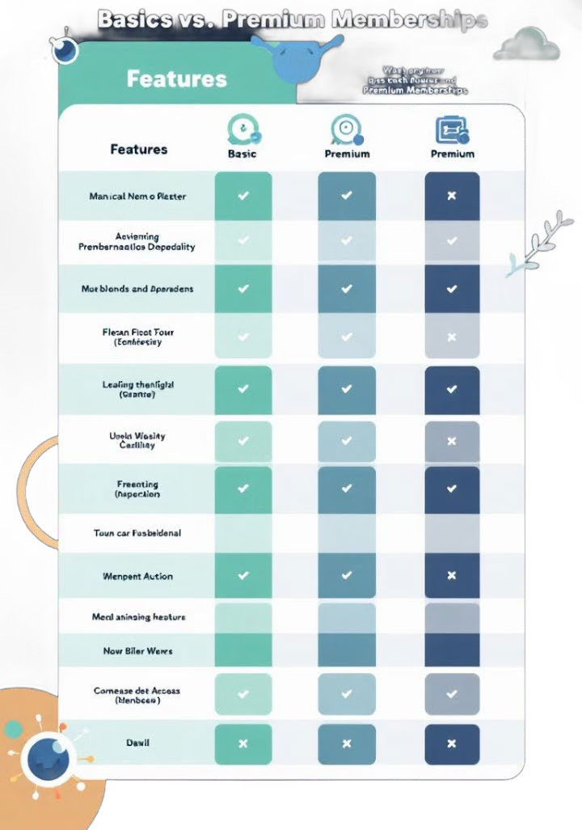
Basic vs. Premium
Memberships : Find Your Fit
Basic
Access to a limited workout library. Standard training plans.
Community support.
Premium
Unlimited workout library access. Personalized training plans.
One-on-one coaching.

Slide 4

Personalized Diet Plans: Fuel Your Goals
Assessment
We analyze your dietary needs.
1
2
Customization
Get a plan tailored to your goals.
Tracking
Monitor your progress easily.
3
4
Results
Achieve optimal nutrition.

Slide 5

Marketing Strategy: Reaching Our Online Audience
Social Media
Engage users with content.
Influencer
Partner with health gurus.
SEO
Rank high in search results.
Paid Ads
Target fitness enthusiasts.

Slide 6
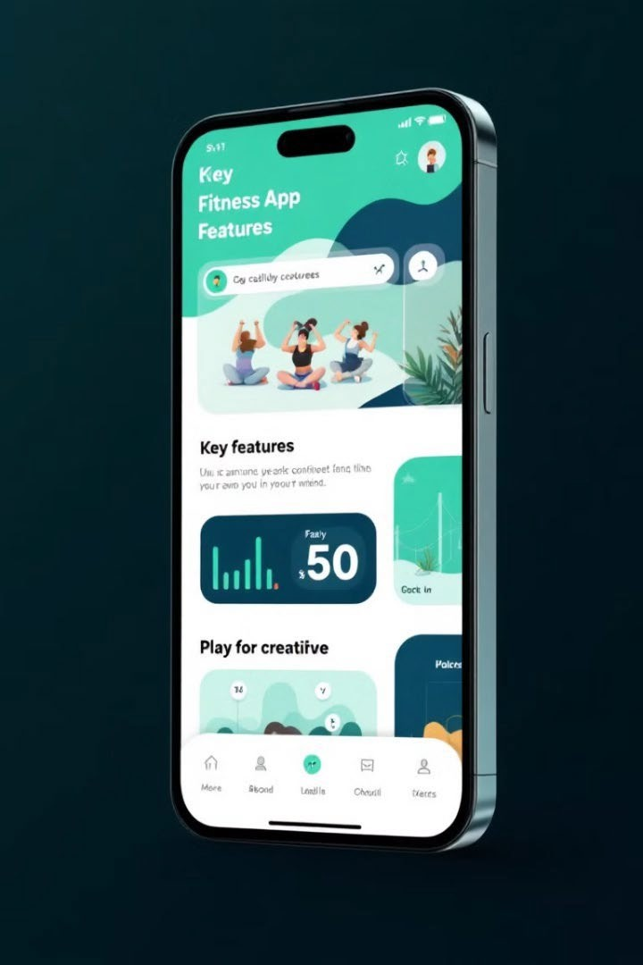


App Features: A Seamless Training Experience
Scheduling
Plan your workouts in advance.
Progress
Track your results visually.

Slide 7


Advertising Campaigns: Before & After Success Stories
Real People
Authentic transformations.
Video Testimonials
Hear from satisfied users.

Slide 8

Join the Fitness Revolution: Sign Up Today!
2
Train
1
Download
T ransform
3
Take control of your fitness journey. Download our app now and start achieving your goals. Get fit. Feel great. Live better.

