Slide 1


Does English help or hurt?
ECO 491
By Eli Quintanilla

Slide 2
Research Question:
How does English fluency impact earnings?
Economic Immigrants come to host countries to find better opportunities.
English is skill that opens doors for higher economic returns
Higher levels of education and more time spent in country help impact English fluency
(Lingua Franca) “Bridge Language”
Hypothesis:
- Having a good English fluency will lead to higher earnings.

Slide 3

The Data
The Data :
ACS 1-Year Estimate 1-Year – Public use Microdata Sample (2019)
MDAT. (2022). Retrieved 9 April 2022, from https://data.census.gov/mdat/#/search?ds=ACSPUMS1Y2019&vv=NOC,AGEP,%2aWAGP&cv=RACBLK,RACAIAN,RACWHT,MAR,SEX,ENG&rv=NATIVITY,HISP,SCHL&nv=YOEP&wt=PWGTP
Variables Used:
English Fluency
Highest Education Attainment
Age
Sex
Years Since Migration
Marital Status
Country of Origin
Race
Sample Pool
Foreign Born individuals that also who spoke a different language other than English
18 years or older
Reported an income
Observations: 1139

Slide 4
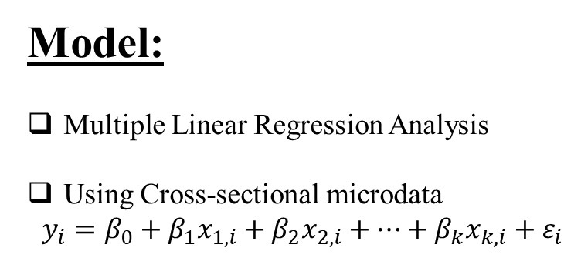
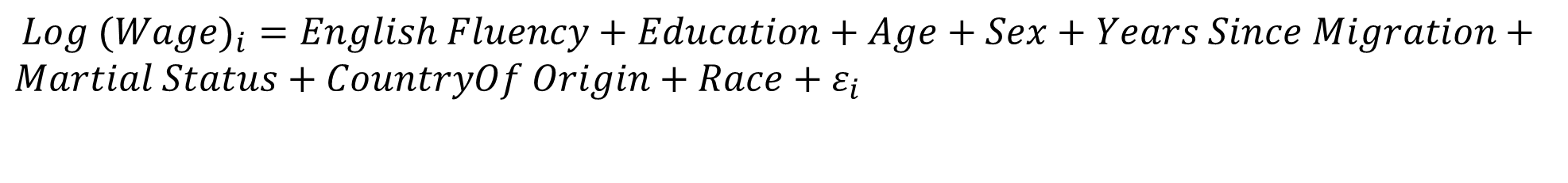
The Model
Model:
Multiple Linear Regression Analysis
Using Cross-sectional microdata
$y_{i}=β_{0}+β_{1}x_{1,i}+β_{2}x_{2,i}+…+β_{k}x_{k,i}+ε_{i}$
${Log (Wage)}_{i}=English Fluency+Education+Age+Sex+Years Since Migration+Martial Status+CountryOf Origin+Race+ε_{i}$

Slide 5
Regression Results
Coefficients: | Estimate | Std. Error | t value | Pr(>|t|)
(Intercept) | 7.711718 | 0.666001 | 11.579 | < 2e-16 ***
ENGLISH FLUENCY | 0.035428 | 0.114160 | 0.723 | 0.75636
HIGH SCHOOL | -0.082016 | 0.156505 | 0.310 | 0.60035
SOME COLLEGE | 0.147104 | 0.171962 | 0.855 | 0.39249
BACHELORS | 0.780404 | 0.153494 | 5.084 | 4.32e-07 ***
GRAD SCHOOL | 1.239150 | 0.167627 | 5.725 | 2.82e-13 ***
MALE | 0.477207 | 0.083350 | 5.684 | 1.32e-08 ***
AGE | 0.026155 | 0.004249 | 6.156 | 1.04e-09 ***
MARRIED | 0.289821 | 0.096082 | 3.016 | 0.00262 **
NOT HISPANIC | 0.324483 | 0.145240 | 2.234 | 0.02567 *
BLACK | -0.205678 | 0.242477 | -0.848 | 0.39649
ASIAN | -0.447252 | 0.625580 | -0.715 | 0.47479
WHITE | 0.021840 | 0.106968 | 0.204 | 0.83825
Europe | -0.214555 | 0.627765 | -0.342 | 0.73258
Africa | -0.458937 | 0.664013 | -0.691 | 0.48961
North America | -0.221245 | 0.636846 | -0.347 | 0.72835
South America | -0.362462 | 0.634057 | -0.572 | 0.56767
Asia | -0.510777 | 0.623416 | -0.819 | 0.41278
Years Since Migration | 0.009815 | 0.005227 | 1.878 | 0.06066
R-Squared: 0.2612, Adjusted R-Squared: 0.2493
P-value: < 2.2e-16, 1120 DF

