Slide 1

DATABASES &
INTRODUCTION TO SQL
LESSON 2
NANODEGREE 🡪 FOUNDATION MODULE
Notes:
1] Welcome students onto the course and introduce CFG! Our mission, why we do what we do and encourage them to share their experience on the course with others.

Slide 2

AGENDA
01 Database design and management
02 Constraints on a table
03 Primary and Foreign keys
04 Normalisation
05 SQL Coding
06 Data Modification Techniques
07 Data Retrieval Techniques (SELECT statements)

Slide 3
There are many ways that enable us to constrain the number of results returned by our query
DISTINCT Qualifier
It is the keyword, which means that in our query we are asking for a unique set of results
In other words we want non-repeating values in the result columns to be returned
SELECT DISTINCT

Slide 4


# EXAMPLE
SYNTAX
What are the fist names of people in my class?
Table name Alias
SELECT DISTINCT
<alias>.<column_name>,
FROM <table_name> <alias>;
first_name
Julie
Mary
Mary
Joanna
Julie
first_name
Julie
Mary
Joanna
SELECT
p.first_name,
FROM person p;
SELECT DISTINCT
p.first_name,
FROM person p;

Slide 5
The WHERE clause is a constraint that can be applied to the result set
The WHERE clause describes the conditions to match for rows to qualify for result set
It comes after the FROM statement
It contains Boolean expressions
Only rows that match a condition are selected for the result set
WHERE

Slide 6
SYNTAX
# EXAMPLE
What is the surname of all my classmates who are called Mary?
SELECT
<alias>.<column_name>,
FROM <table_name> <alias>;
SELECT
p.surname
FROM person p
WHERE p.name = ‘Mary’
🡨 SELECT clause
FROM clause
🡨 WHERE clause

Slide 7

PRACTICE
Create a new database called PARTS
(use a script supplied parts_database.sql and run it in your Workbench)
WRITE THE FOLLOWING QUERIES
Using the table ‘parts’, return all unique part names. What happens if we want to return all unique parts and their id number? Why?
Refer to the table ‘projects’ and return all projects that are run in London.
Notes:
1. Navigate

Slide 8
The idea behind normalisation is to organise a database into tables in such way that a table is created about one specific topic only.
The main reasons to normalise a database are:
to minimise duplicate data,
to minimize or avoid data modification issues
to simplify queries
There are three common forms of database normalization:
1st, 2nd, and 3rd normal form or
1NF, 2NF, and 3NF respectively
NB please read about 3 forms of normalisation:
https://www.complexsql.com/database-normalization/
DATABASE NORMALISATION

Slide 9
We want to design our DB that it can answer as many ‘questions’ as possible including the ones we may ask in the future. Design it in a way that we can always add more data to it and easily modify existing data if necessary.
Table 1 – NO normalisation applied
Employee No | Employee Name | Department
1 | Mary | FINANCE,TAX
2 | Edith | HR
3 | Anna | ADMIN
NORMALISATION EXAMPLE 1
Table 2.1 – normalised
Table 2.2 – normalised
Employee No | Employee Name
1 | Mary
2 | Edith
3 | Anna
Employee No | Department
1 | FINANCE
1 | TAX
2 | HR
3 | ADMIN

Slide 10
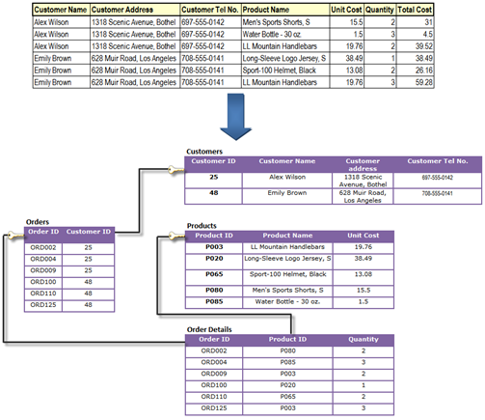
NORMALISATION EXAMPLE 2
source: http://salinaitmind.blogspot.com/2012/10/data-warehouse-data-normalization.html

Slide 11
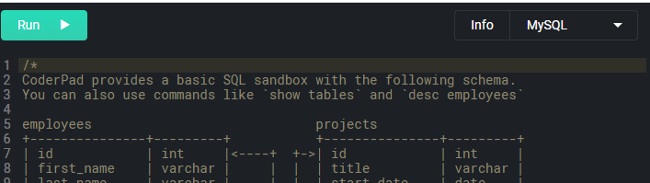
PRACTICE
LET’S REVIEW THE DB DESIGN IN OUR SANDBOX
https://coderpad.io/sandbox
Notes:
1. Navigate

Slide 12
Constraints are the rules that we can apply on the type of data in a table.
In other words, we can specify the limit on the type of data that can be stored in a particular column in a table. Using constraints ensures the accuracy and reliability of the data in the table.
If there is a mismatch or any violation between the constraint we set and the data, then the action that we are trying to perform would be aborted.
SQL
CONSTRAINT TYPES
NOT NULL
UNIQUE
CHECK
PRIMARY KEY
FOREIGN KEY
DEFAULT
NB please read about constraints: https://www.studytonight.com/dbms/sql-constraints.php

Slide 13
Primary Key is a single field or combination of fields that uniquely defines a record
ONLY ONE PRIMARY KEY IN A TABLE
Must be NOT NULL
Can be a multiple columns (compound key)
Can be defined in either a CREATE TABLE statement or an ALTER TABLE statement
PRIMARY KEY
NULL | NOT NULL
Default for a column definition | Must be specified on column definitions
It means that we are allowed to insert NULL values | It means we are not allowed to insert NULL values. Inserting a NULL would raise an error!

Slide 14
SYNTAX
# EXAMPLE
CREATE TABLE <table_name>
(col1 Type KEY DEFINITION,
col2 Type,
col3 Type);
CREATE TABLE customers
(customer_id INTEGER PRIMARY KEY,
name VARCHAR(50),
surname VARCHAR(50) NOT NULL,
telephone INTEGER);
CREATE TABLE + TABLE NAME
PRIMARY KEY
COLUMNS

Slide 15
SYNTAX
# EXAMPLE
CREATE TABLE <table_name>
(col1 Type,
col2 Type,
col3 Type,
CONTRAINT
<constraint_name>
<constraint_type>
(<col_that_it_applies_to>)
);
CREATE TABLE customers
(customer_id INTEGER,
name VARCHAR(50),
surname VARCHAR(50) NOT NULL,
telephone INTEGER,
CONSTRAINT
pk_ customer _id
PRIMARY KEY
(customer _id)
);
CREATE TABLE + TABLE NAME
CONSTRAINT

Slide 16
Unique PK
Table Customers
Unique Column
customer_id | name | surname | telephone
001 | Mary | Jones | 123-4567
002 | Julie | Smith | 789-4561
Unique column acts as FK in Orders
FOREIGN KEY
Unique PK
FK
Table Orders
order_no | customer_id | date | item
147A | 002 | 20-08-2019 | pizza
258B | 001 | 14-06-2019 | salad
NB please read about Foreign Key: http://www.mysqltutorial.org/mysql-foreign-key/
Notes:
A foreign key is a field in a table that matches another field of another table. A foreign key places constraints on data in the related tables.
A foreign key can be a column or a set of columns. The columns in the child table often refer to the primary key columns in the parent table.
A table may have more than one foreign key, and each foreign key in the child table may refer to a different parent table.

Slide 17
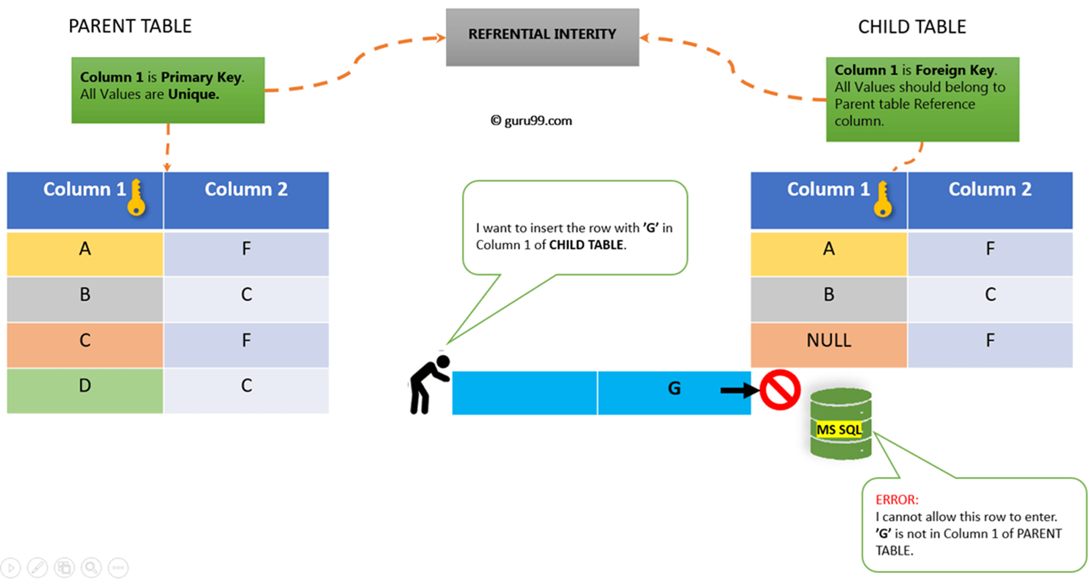
DATA INTEGRITY
DB
source: guru99.com

Slide 18
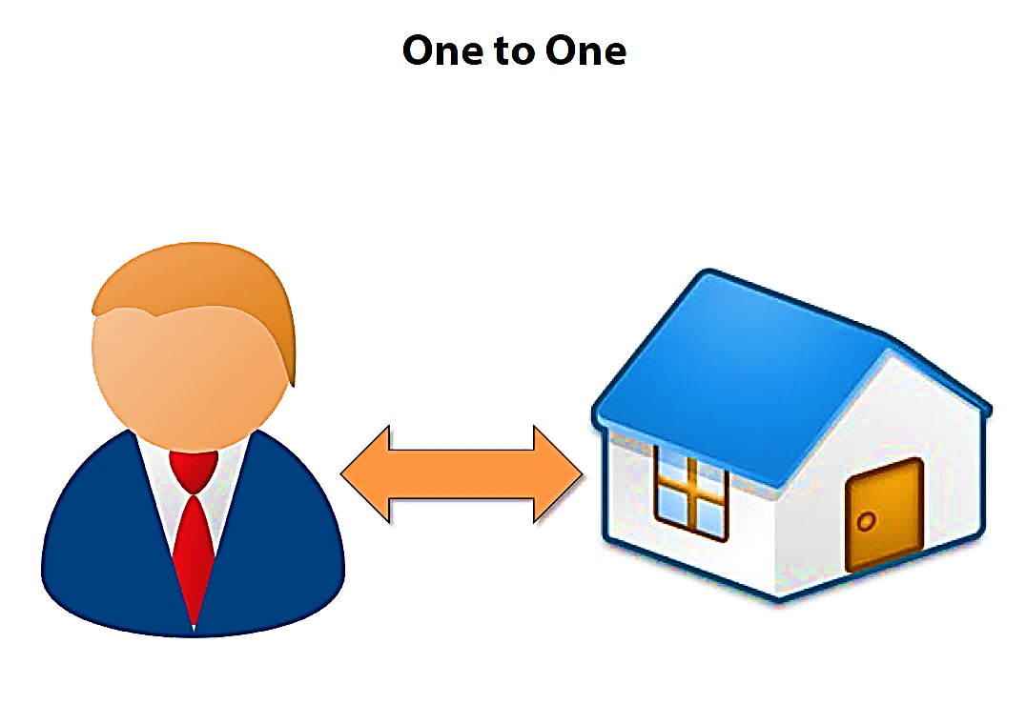
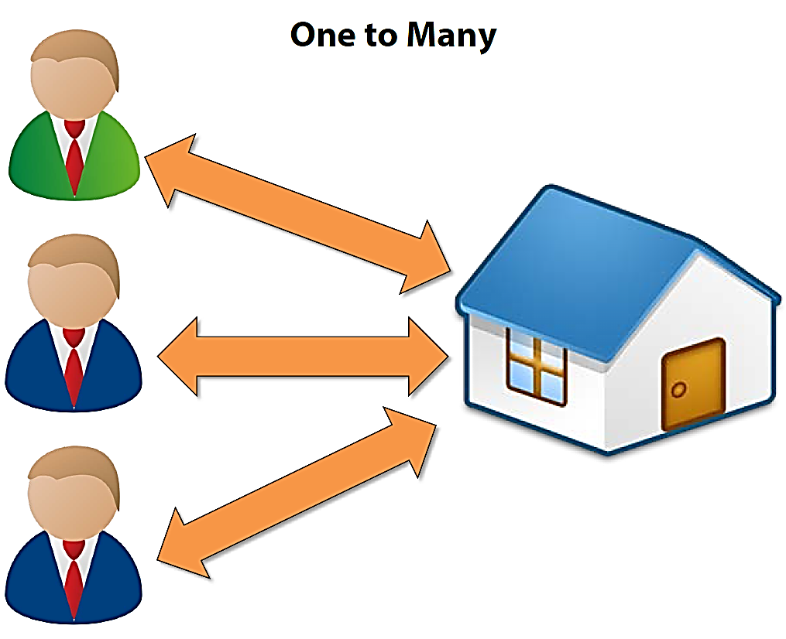
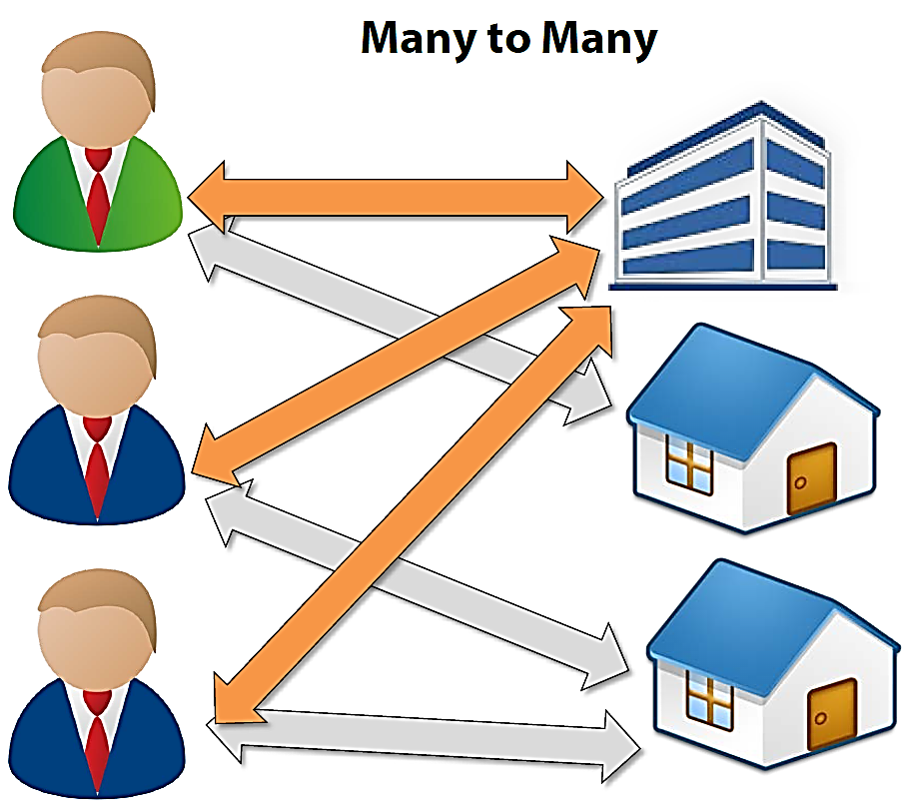
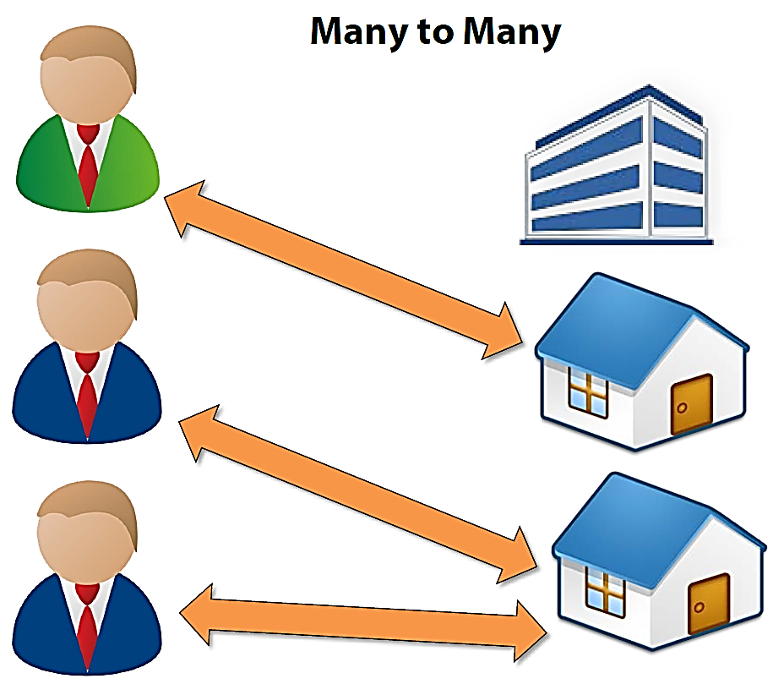
DATABASE RELATIONSHIPS
Notes:
When creating a database, common sense dictates that we use separate tables for different types of entities.
Some examples are: customers, orders, items and so on. But we also need to have relationships between these tables. For instance, customers make orders, and orders contain items.
There are several types of database relationships:
One to One Relationships
One to Many
Many to One Relationships
Many to Many Relationships

Slide 19
PRACTICE
Today we are going to be pizza makers, bakers and small restaurant owners! We accept orders online or by telephone and deliver pizza to our customers.
We need to create a database to hold information about our customers, so we can keep records of their names, addresses , phone numbers, email addresses and any other useful information like placed orders.
TASKS
Design and create a relational normalised database called customers.
Set reasonable primary keys to the tables.
Set NOT NULL constraints on the columns that you think must have values.
Let’s do it together!
Notes:
NOTE: manage the time and if necessary share parts of the code with students via files or a message widow (zoom) depending on the session delivery.
The main purpose of this exercise is to practice adding constraints to the tables rather than creating them from scratch.

Slide 20
DDL stands for "Data Definition Language“.
It is a subset of SQL statements that change the structure of the database schema.
Typically structural changes of the database schema refer to creating, deleting, or modifying schema objects such as databases or tables.
CORE COMMANDS
DDL
SELECT (read)
INSERT (create)
UPDATE
DELETE

Slide 21
Modifies column(s) in a single table
WHERE clause dictates which rows
SET keyword follows table name
UPDATE

Slide 22
SYNTAX
# EXAMPLE
UPDATE table_name
SET
table_name.col1 = new_value
WHERE
table_name.col2 = value;
UPDATE contacts
SET
contacts.mobile = 123456789
WHERE
contacts.surname = ‘Andrews’
UPDATE COMMAND
TABLE NAME
SET KEYWORD
VALUES
WHERE CLAUSE

Slide 23
DELETES one or more rows in a table
Permanent!
DELETE FROM is actual full command
WHERE clause is critical!
DELETE

Slide 24
SYNTAX
# EXAMPLE
DELETE FROM table_name;
DELETE FROM table_name
WHERE
table_name.col = value;
DELETE FROM customers;
DELETE FROM customers
WHERE
customers.id = 007;
DELETE COMMAND
BAD PRACTICE ☹
DELETE COMMAND
WHERE CLAUSE
GOOD PRACTICE ☺

Slide 25
Used to change an existing table
Add/remove column
Change column data type
Change column constraints
Must conform with current data
ALTER
TABLE

Slide 26
SYNTAX
# EXAMPLE
ALTER TABLE <table_name>
ADD CONTRAINT
<constraint_name>
<constraint_type>
(<col_that_it_applies_to>)
REFERENCES
<table_name2>
(<col2_that_it_applies_to>)
);
ALTER TABLE orders
ADD CONSTRAINT
fk_customer_id
FOREIGN KEY
(customer_id)
REFERENCES
customers
(customer_id);
CREATE TABLE + TABLE NAME
CONSTRAINT

Slide 27
Removes table and all data from database
BE CAREFUL!
Error if table is a foreign key to another table
DROP
TABLE

Slide 28
SYNTAX
# EXAMPLE
DROP TABLE <table_name>;
DROP TABLE customers;

Slide 29
PRACTICE
We have our pizzeria customers database. Let’s modify some tables in the database, so we add Foreign Keys to tables and define relationships between our tables.
TASKS
Add some data to the tables in the customers database
Alter tables email_address and phone_number in the customers database by adding Foreign keys that reference Primary keys from relevant tables.
Remove the table called orders from our database.
Notes:
1. Navigate

Slide 30

INDEPENDENT PRACTICE
Revise the slides to re-cap all materials from Module2
Read about Normalisation: https://www.complexsql.com/database-normalization/
Read about DDL: https://www.w3schools.in/mysql/ddl-dml-dcl/
Read about Foreign Key: http://www.mysqltutorial.org/mysql-foreign-key/
Read about Constraints: https://www.studytonight.com/dbms/sql-constraints.php

Slide 31
THANK YOU

Slide 32



REFERENCE
MATERIALS

Slide 33
A foreign key is a field in a table that matches another field of another table. A foreign key places constraints on data in the related tables
A foreign key can be a column or a set of columns. The columns in the child table often refer to the primary key columns in the parent table
A table may have more than one foreign key, and each foreign key in the child table may refer to a different parent table
FOREIGN KEY
NB please read about Foreign Key: http://www.mysqltutorial.org/mysql-foreign-key/
Notes:
A foreign key is a field in a table that matches another field of another table. A foreign key places constraints on data in the related tables.
A foreign key can be a column or a set of columns. The columns in the child table often refer to the primary key columns in the parent table.
A table may have more than one foreign key, and each foreign key in the child table may refer to a different parent table.

Slide 34
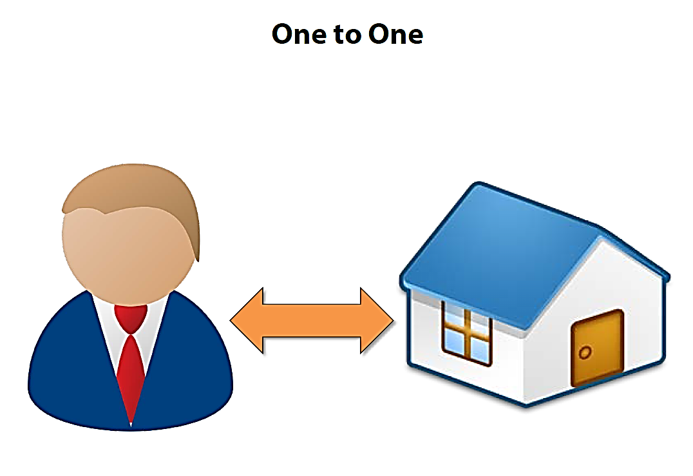
When creating a database, common sense dictates that we use separate tables for different types of entities.
Some examples are: customers, orders, items and so on. But we also need to have relationships between these tables. For instance, customers make orders, and orders contain items.
There are several types of database relationships:
One to One Relationships
One to Many
Many to One Relationships
Many to Many Relationships
DATABASE RELATIONSHIPS
Notes:
When creating a database, common sense dictates that we use separate tables for different types of entities.
Some examples are: customers, orders, items and so on. But we also need to have relationships between these tables. For instance, customers make orders, and orders contain items.
There are several types of database relationships:
One to One Relationships
One to Many
Many to One Relationships
Many to Many Relationships

Slide 35

PRACTICE
PRIMARY KEY
Unique identifier of row
One per table
Does not allow NULL
Single or multiple columns (composite columns)
FOREIGN KEY
Columns in a table that refer to a Primary Key of another table
Enforces referential integrity
Foreign key reinforces relationships between tables:
One-to-one
One-to-many
Many-to-many

