Slide 1

REGULAR EXPRESSIONS &
LAMBDA FUNCTIONS
LESSON 15
NANODEGREE → FOUNDATION MODULE
Notes:
[Opening slide]

Slide 2

AGENDA
01 Introduction to Lambda Functions
02 Practice with Lambda Functions
03 Introduction to Regex (Regular Expressions)
04 Practice with Regex

Slide 3

Lambda Functions (Expressions)
DEFINITION AND USE
Lambda functions (also called Lambda Expressions) are a way to quickly create anonymous functions in Python.
An anonymous function is like a one time use function that doesn’t have a name.
The anonymous functions are useful when we need to use them once.
A lambda function typically contains one or more arguments, but it can have only one expression.
Python Lambdas are often used with with Map, Filter, and Reduce functions from the core library.
Lambda Function Syntax
lambda parameters: expression
Function Syntax Equivalent
def anonymous(parameters):
return expression

Slide 4
Simplify the function
def plus_two(num):
return num + 2
Turn it into one line function
def plus_two(num): return num + 2
Remove ‘def’, ‘name’ and ‘return’ keywords
num: num + 2
Add the ‘lambda’ keyword and assign to a variable
plus_two = lambda num: num + 2
plus_two(5)
* result is 7
Lambda Functions
EXAMPLE
def plus_two(num):
result = num + 2
return result
plus_two(5)
* result is 7
-------------------------------------------------
This is a regular function, let’s convert it to an anonymous lambda function step by step.
Notes:
A Lambda Function is simply a shorthand version of a regular Python function.
So to better understand how to make a lambda function in Python, we can convert a regular function to a lambda function

Slide 5
Lambda Functions
EXAMPLE
Using a lambda function with map()
The first argument to the map() function is always a function itself. It is referred to as a transformation function. Use lambda for map().
Using a lambda function with filter()
The filter() function creates a list of elements for which a function returns true. It is often used with lambda expressions.
Using a lambda function with reduce()
The reduce() function applies a rolling computation to sequential pairs of values in a list. It is a common practice to use lambdas here.
The Python core library has three methods called map, reduce, and filter.
These methods are some of the best reasons to use lambda functions.
Let’s practice!
Notes:
Please start using Pycharm to go through a number of practical examples with the group. (see the coding script)

Slide 6
Regular Expressions (REGEX)
INTRODUCTION
‘Regex’ is short for Regular Expressions
Regex is about capturing a group of text in an input string and processing it as required.
In order to capture a group of text, we need to use patterns (digits, alpha characters, punctuation etc. )
Regex provides such patterns for us.
Regex attempts to check whether a specified pattern exists within an input string and perform some operations when it exists.
Python has a dedicated library called ‘re’, which provides lots of useful functionality to process regular expressions
import re
Notes:
REGULAR EXPRESSIONS
Are extremely useful for:
Pattern matching
Data science projects
Software systems that need to find or identify specific items
Any text analytics and processing
<Instructors!> -- perhaps you can remind student about pattern matching that we learn during the SQL classes. (% and _ characters with the ‘LIKE’ keyword’)

Slide 7
Regular Expressions (REGEX)
BASIC SYNTAX
EXAMPLE:
Let’s review the following Regex patterns to see what matches they would return
More patterns and character classes:
https://www.rexegg.com/regex-quickstart.html#classes
c | Matches the character ‘c’
cfg | Matches ‘cfg’
[cfg] | Matches ‘c’, ‘f’ OR ‘g’
[^cfg] | Matches ANY char EXCEPT for ‘c’, ‘f’ or ‘g’
cfg|xyz | matches ‘cfg’ OR ‘xyz’

Slide 8
Regular Expressions (REGEX)
CHARACTER MATCHING
EXAMPLE:
As well as characters matching, Regex also supports more flexible matching by defining different character sets that we can use to match.
More character matching patterns:
https://www.rexegg.com/regex-quickstart.html#chars
https://www.rexegg.com/regex-quickstart.html#morechars
\d | Matches any digit
\D | Matches any non-digit
\w | Matches any alphanumeric character
\s | Matches any whitespace
. | Matches ANY character

Slide 9
Regular Expressions (REGEX)
QUANTIFIERS
EXAMPLE:
Regex also defines some quantifiers that we can place beside a character set to indicate how many of that set we want to capture.
More quantifier matching patterns:
https://www.rexegg.com/regex-quickstart.html#quantifiers
https://www.rexegg.com/regex-quickstart.html#quantifiers
* | Matches 0 or more times
+ | Matches 1 or more times
? | Matches 0 or 1 time
{2} | Matches exactly 2 times
{2,7} | Matches 2 to 7 times

Slide 10

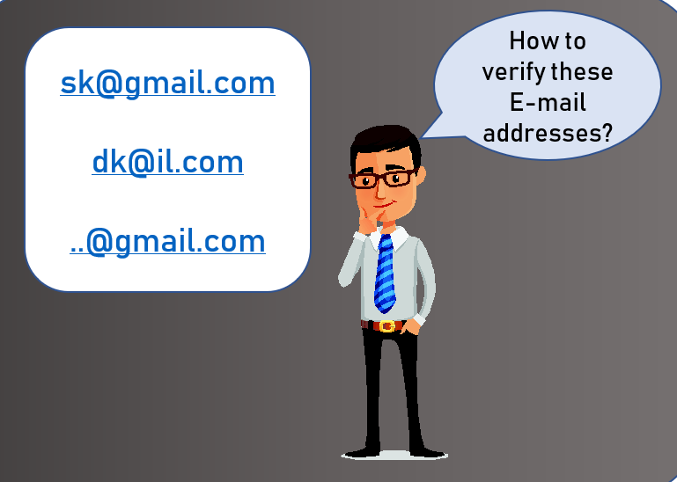
Regular Expressions (REGEX)
MOST COMMON FUNCTIONS
re.match(<regex>, s): finds and returns the first match of the regular expression <regex> starting from the beginning of the input string s
re.search(<regex>, s): finds and returns the first match of the regular expression <regex> in the input string s
re.finditer(<regex>, s): finds and returns an iterator consisting of all matches of the regular expression <regex> in the input string s
re.findall(<regex>, s): finds and returns a list of all matches of the regular expression <regex> in the input string s
re.sub(<regex>, new_text, s): finds and substitutes all matches of the regular expression <regex> in the input string s with new_text
REGEX use case example

Slide 11
Regular Expressions (REGEX)
GROUPING
Regex allows us to capture not just the entire regex pattern, but only capture a portion (or group) of it.
With Regex a simple way of doing this is by using the parenthesis (). (We can define a group we want to capture by surrounding it with ())
Parentheses create numbered Capturing Groups
We also have an option to name our groups, not just give them a number
A group may be excluded from the pattern by adding ?: in the beginning (it is called Non-capturing groups)
EXAMPLE:
In the following pattern, we only want to capture a group, which gives us a year.
“1986-05-20”

Slide 12
Regular Expressions (REGEX)
RAW STRING
If we are trying to escape a backslash \ char within an input string, the best way is to use the raw string r
The raw string r allows us to skip the Python interpreter background processes when matching a pattern
If we do not use the raw string r and still are trying to escape a \ character, then we would need to use 4 ! (yes four backslashes)
EXAMPLE:
regex = “\\\\[\d]+”
OR
regex = r“\\[\d]+”
pattern = ‘\123’
Notes:
RE: 4 backslashes to escape the \ character:
This is because when doing regular expressions, the pattern first gets passed to the Python string interpreter,
which interprets the first two \\ as \ ,
and then gets passed to the regex parser, which views the \ as an escape character for whatever is after.

Slide 13
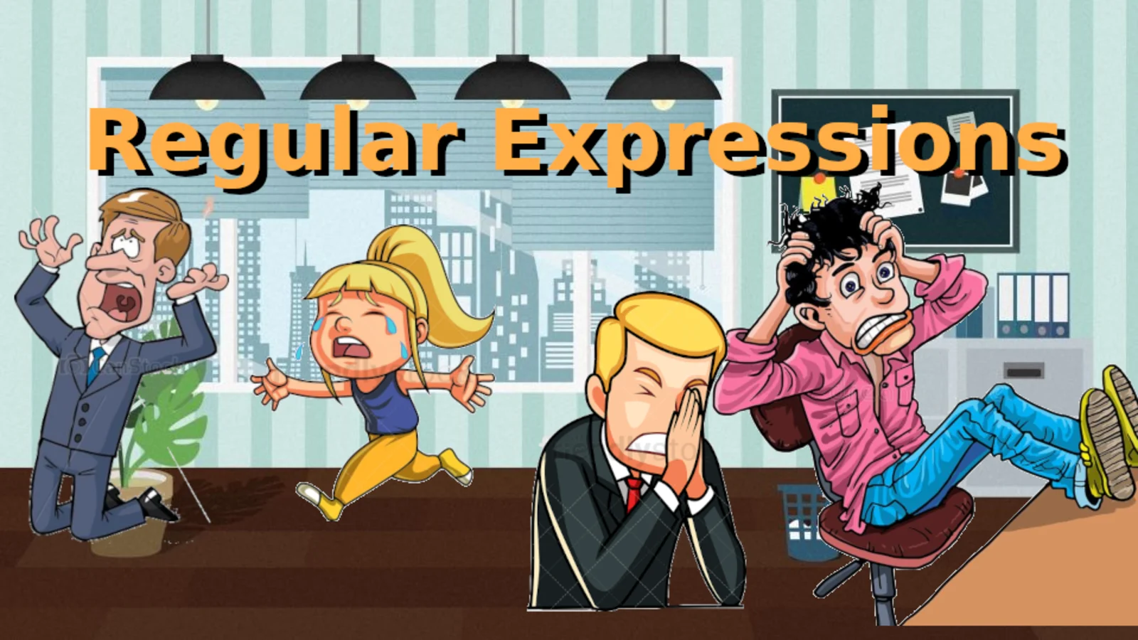
Regular Expressions (REGEX)
PRACTICE
Let’s practice Regex! It is tricky to start with, but it gets better with time. Regex is VERY USEFUL!
Notes:
<instructors>
Please switch to PyCharm to complete Regex exercises

Slide 14
Regular Expressions (REGEX)
SUMMARY
Useful online tool to test Regex: https://regex101.com/
Learning regex can be known as a lifetime investment. It has endless use cases.
Regex is often featured in interviews. It can help you to solve tasks that require to find some words or characters and many more patterns.
Remember that Regex patterns are their own specific language, (not python) it takes a while to learn it.
Regex matching can be used in any language for pattern matching (Python, Java etc.) Each language would have a specific library(ies) to work with regular expressions. For example, in Python a very common library is ‘re’, but there are more!

Slide 15
THANK YOU!

